Slide 1
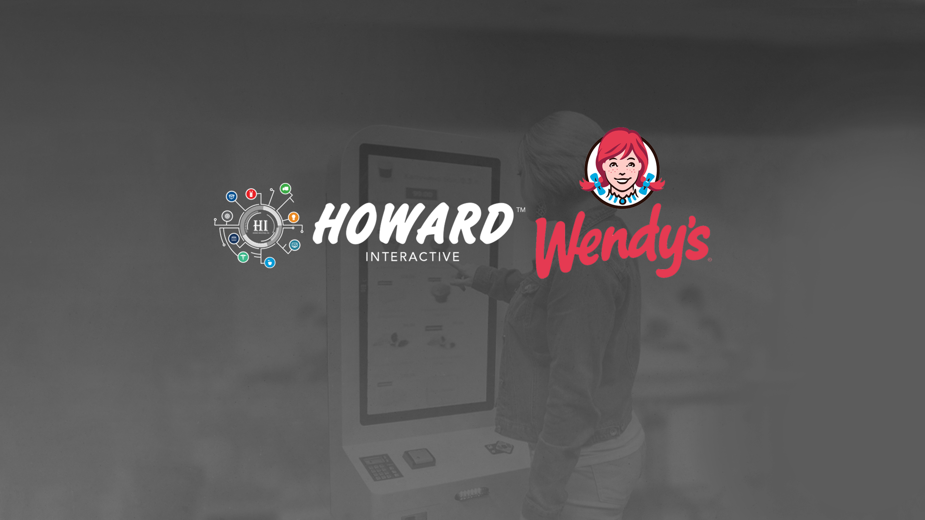
QSR Kiosk Solutions | 2020
January 22, 2020

Slide 2
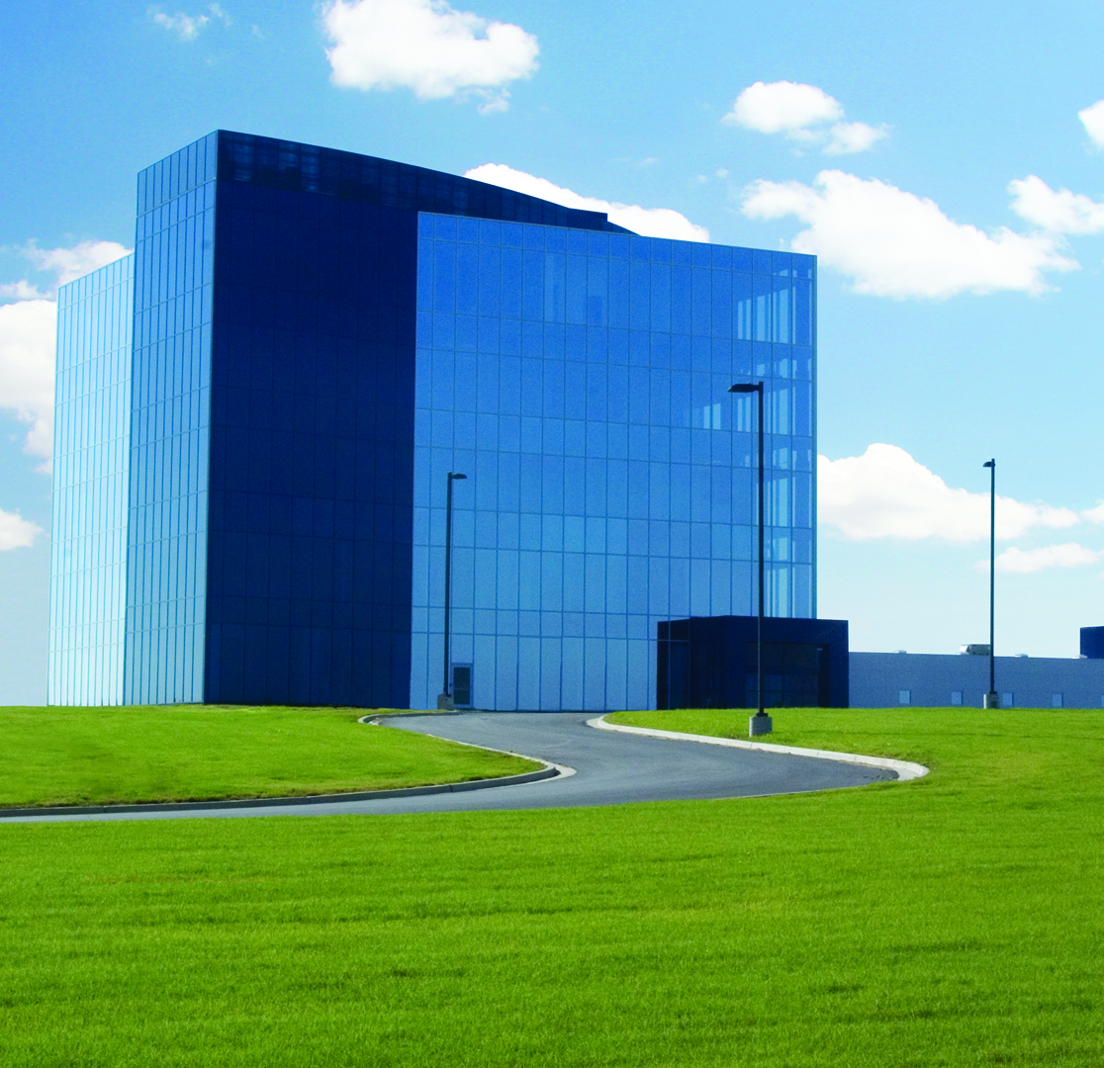
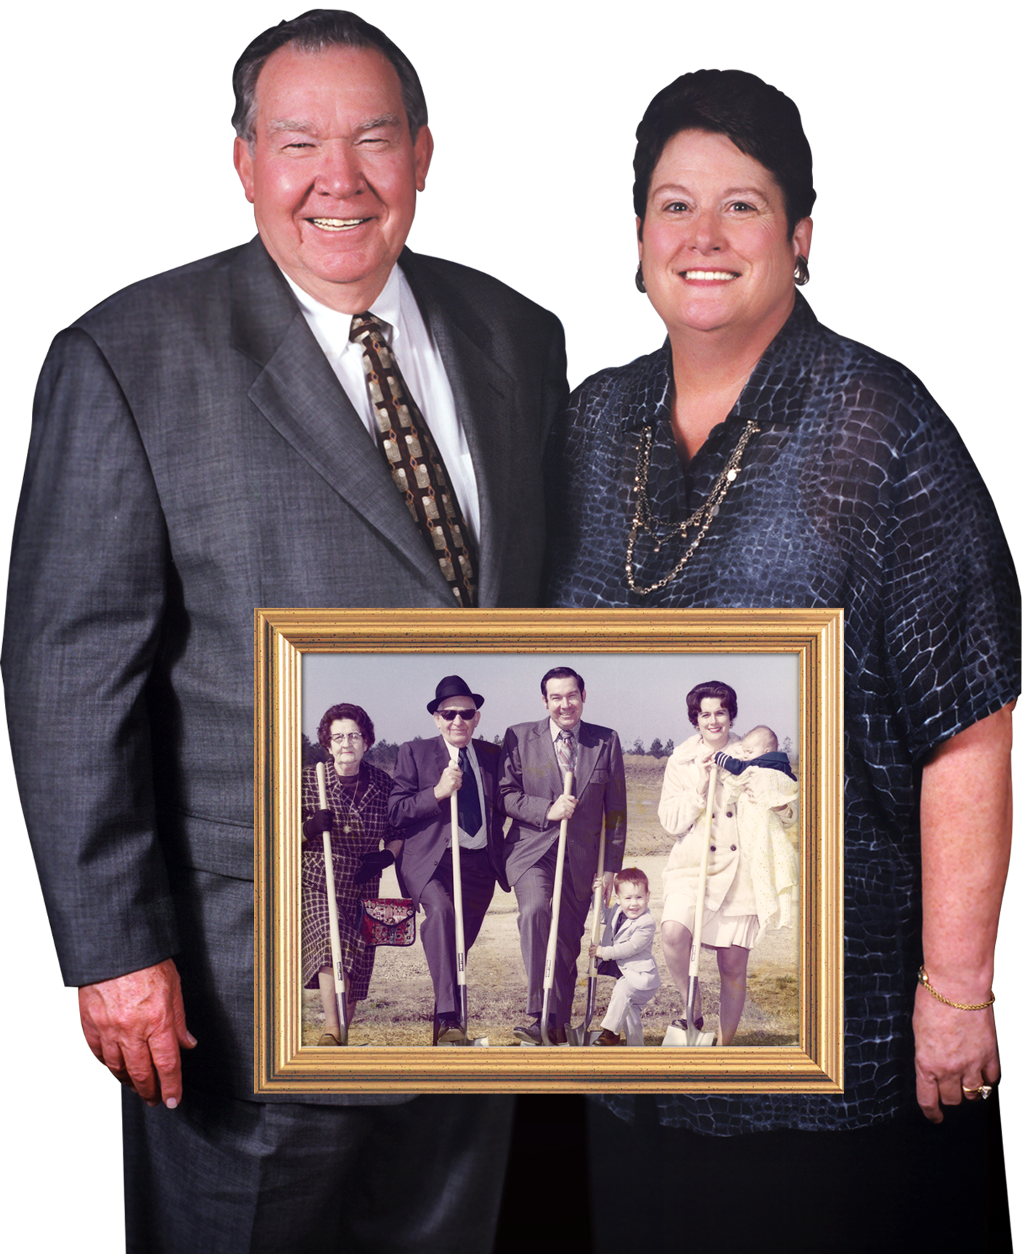
Howard Industries
1968 Howard Industries is established and grown by Billy W. Howard and Linda Howard
A billion dollar company that is family owned
Corporate headquarters located in south Mississippi

Slide 3
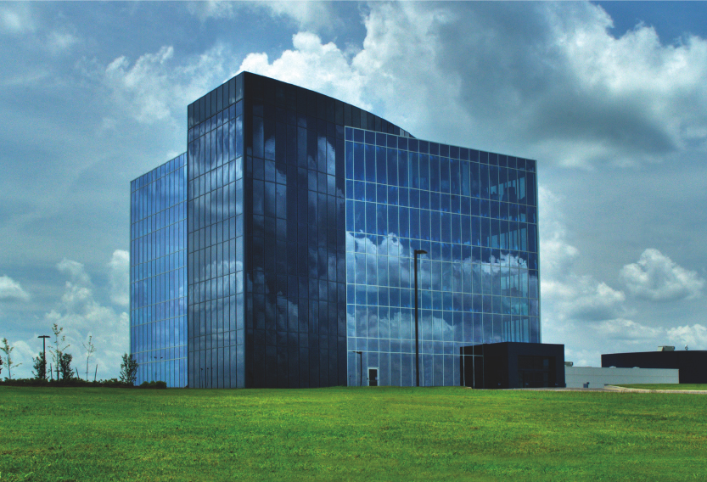
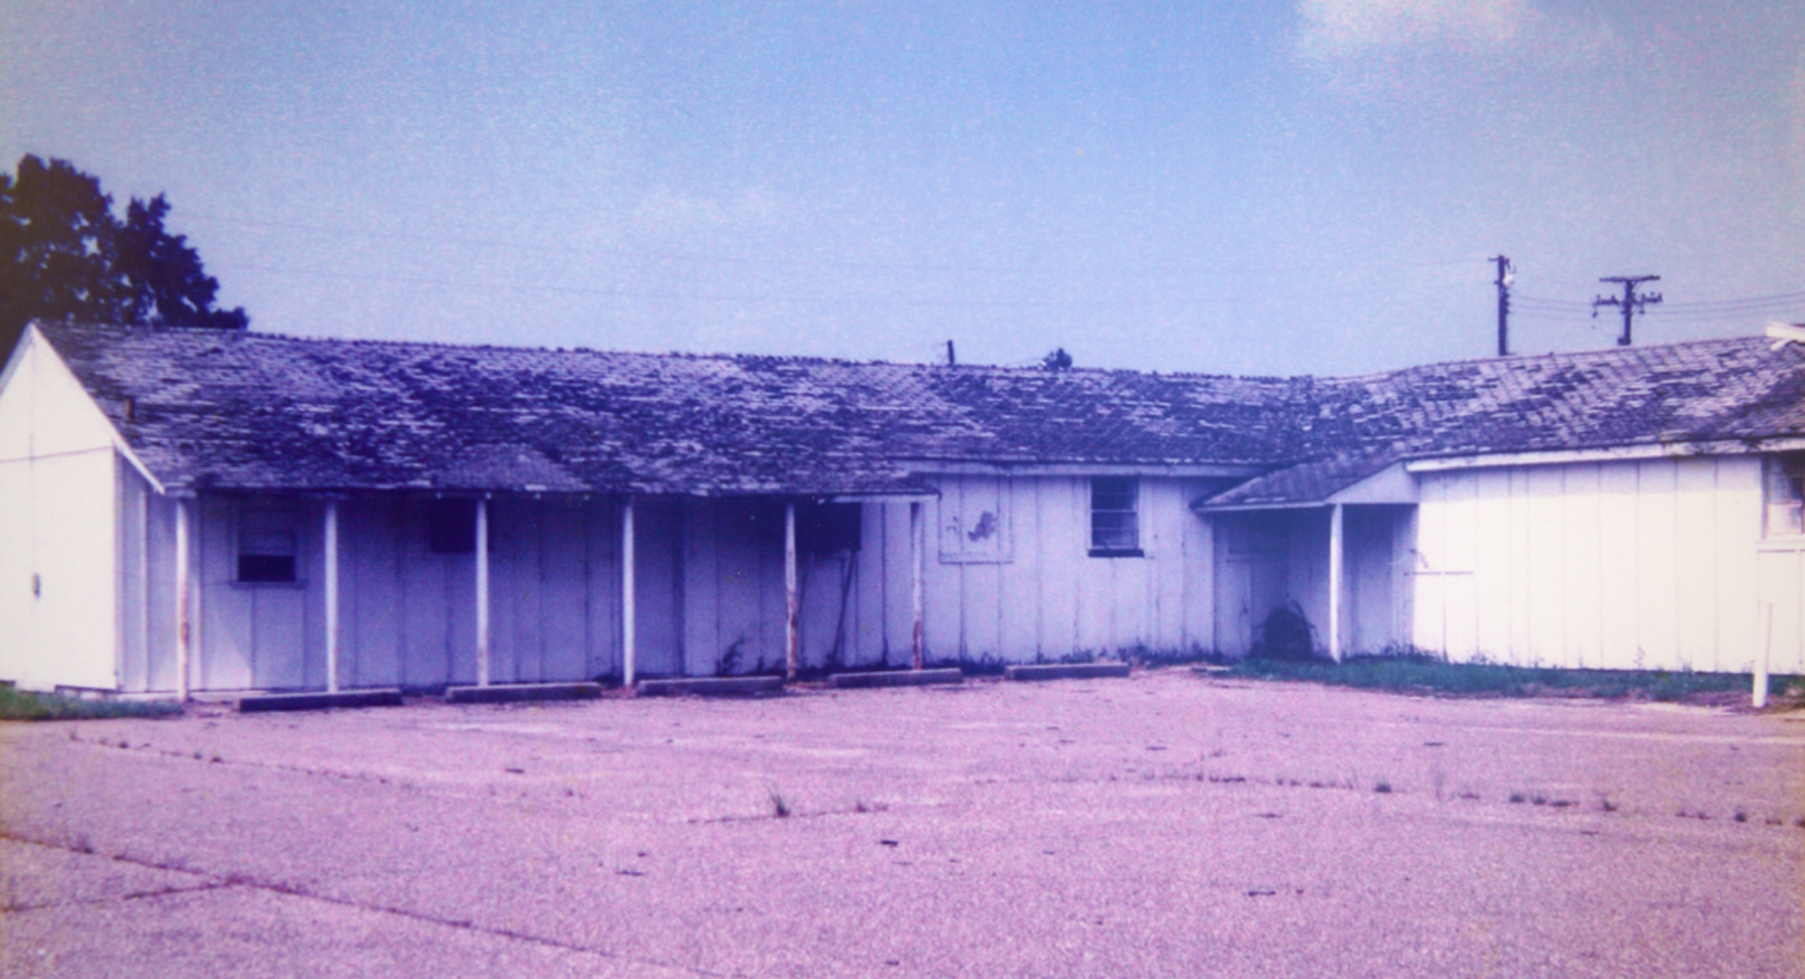
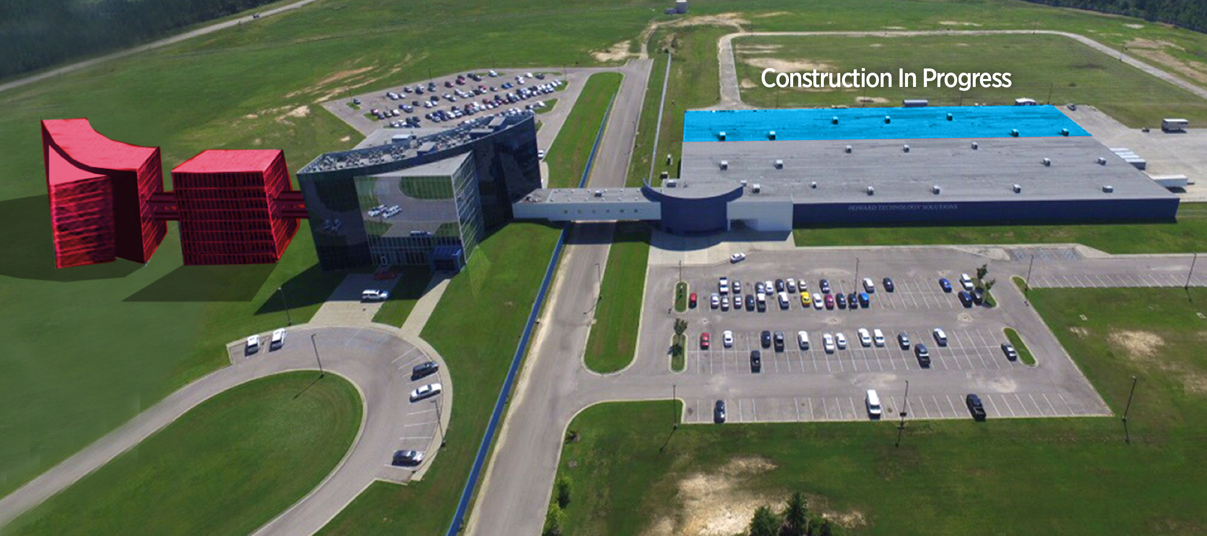
Howard – Then, Now, and the Future
The first Howard building in
an old army barracks
Current corporate headquarters & production facilities
Plans for future growth
& expansion

Slide 4
Howard Industries
Over 2-Million Square Feet
More Than
500 Engineers
6 Different Facilities
Six different facilities including corporate headquarters, manufacturing facilities, and a transportation facility
Over 2 million square feet of manufacturing space – Transformers, Lighting, Kiosks, Medical Equipment, Computers, & more…
Over five hundred mechanical & electrical engineers with thousands of combined years of experience

Slide 5
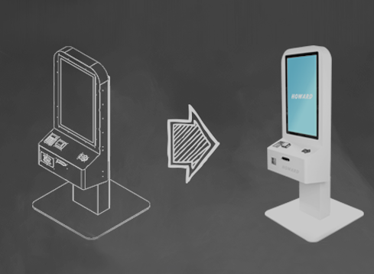
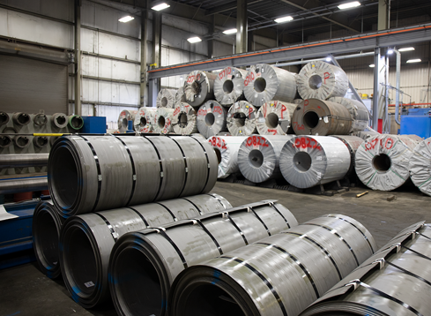
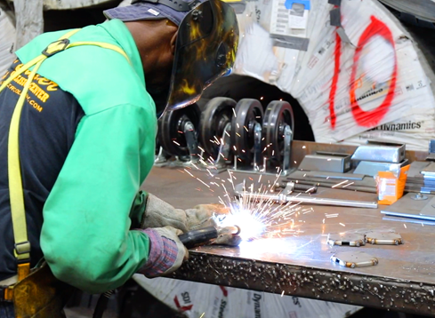

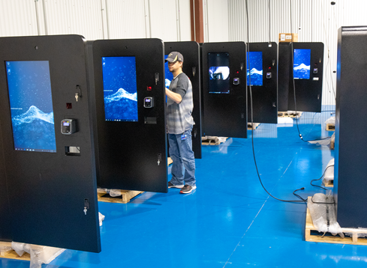
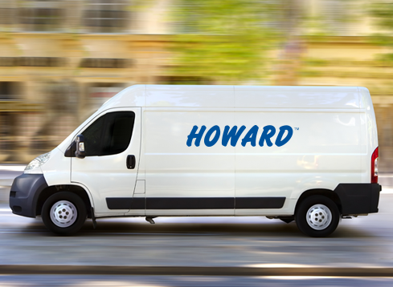

Kiosk Capabilities
Concept to Completion
Made in the USA with American Steel
50 Years of Manufacturing Expertise
Pre-Configured and Inspected
Coast-to-Coast Delivery
Full-Service Break Fix Solution

Slide 6




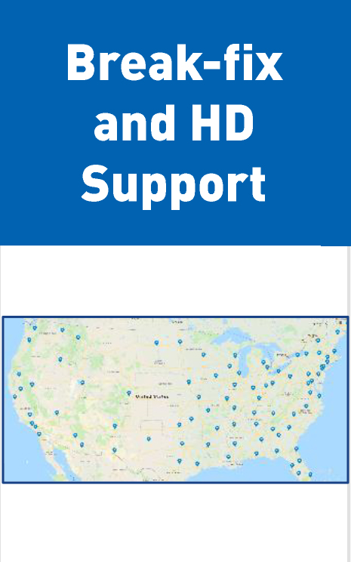
Software Solution
25,000+ Kiosk faces deployed to date
Kiosk/Self Order
Mobile Ordering
Menu Boards
Order Ready Board

Slide 7
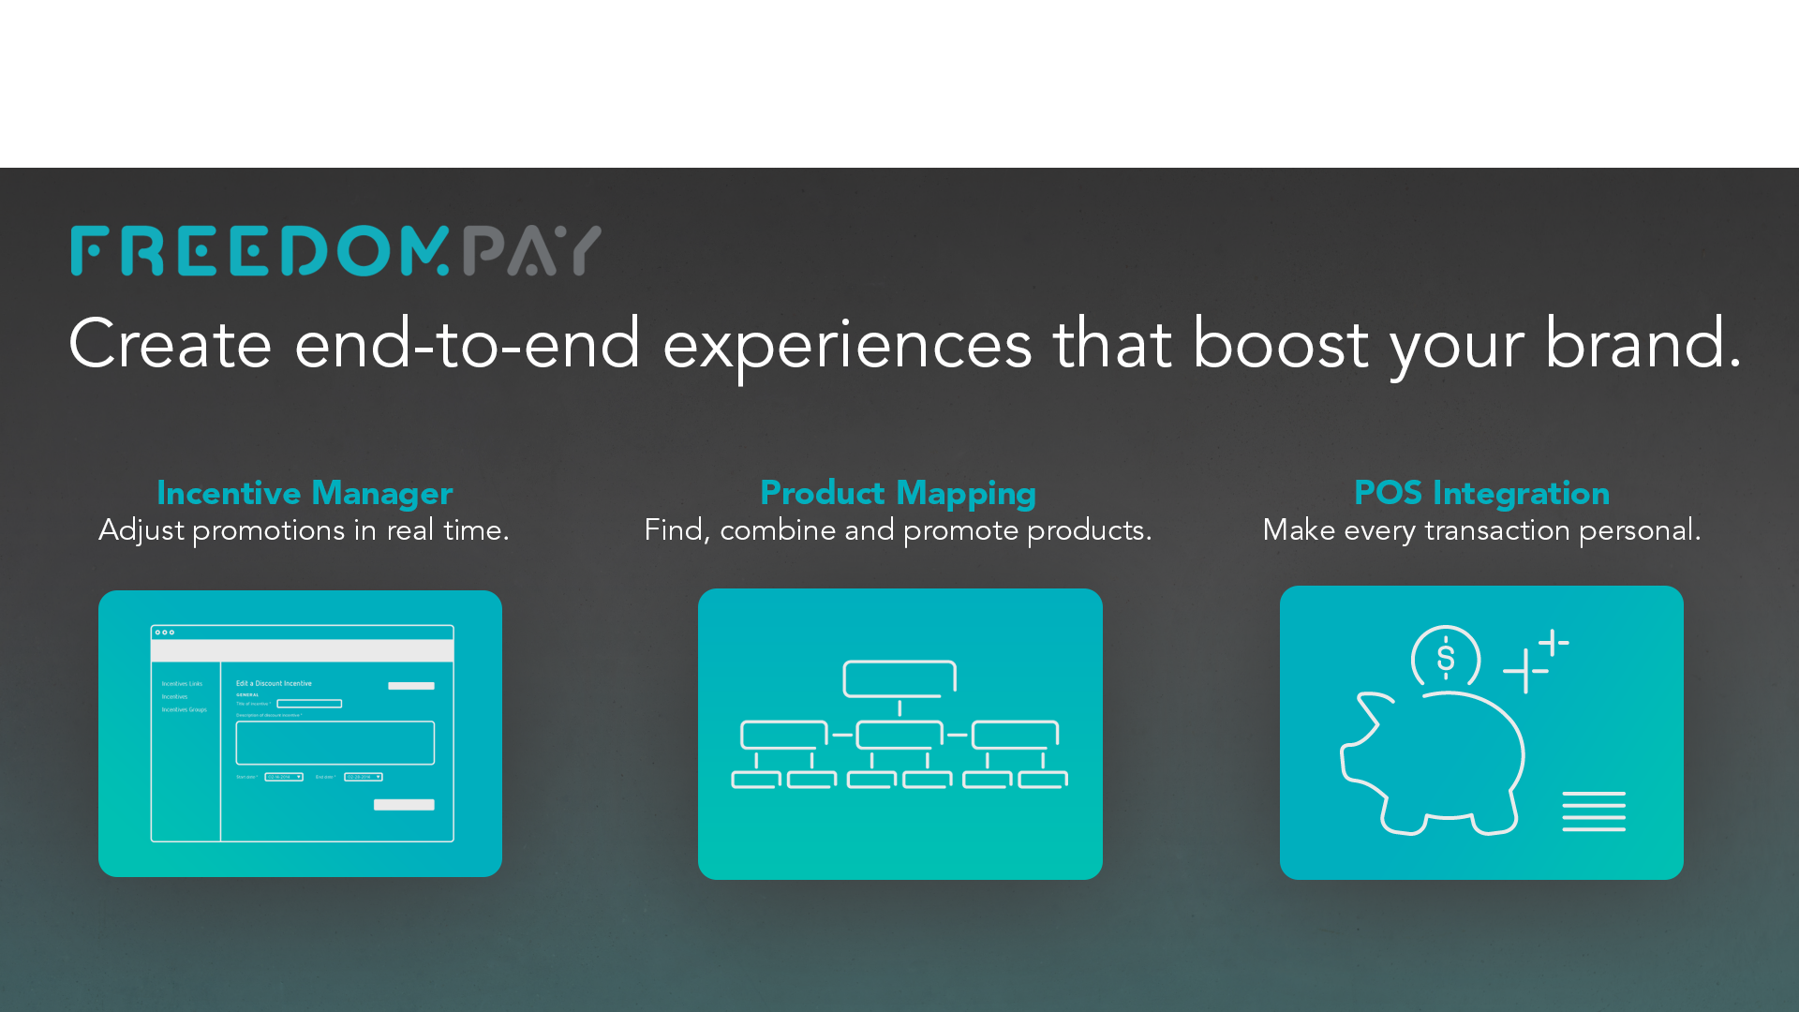

Slide 8
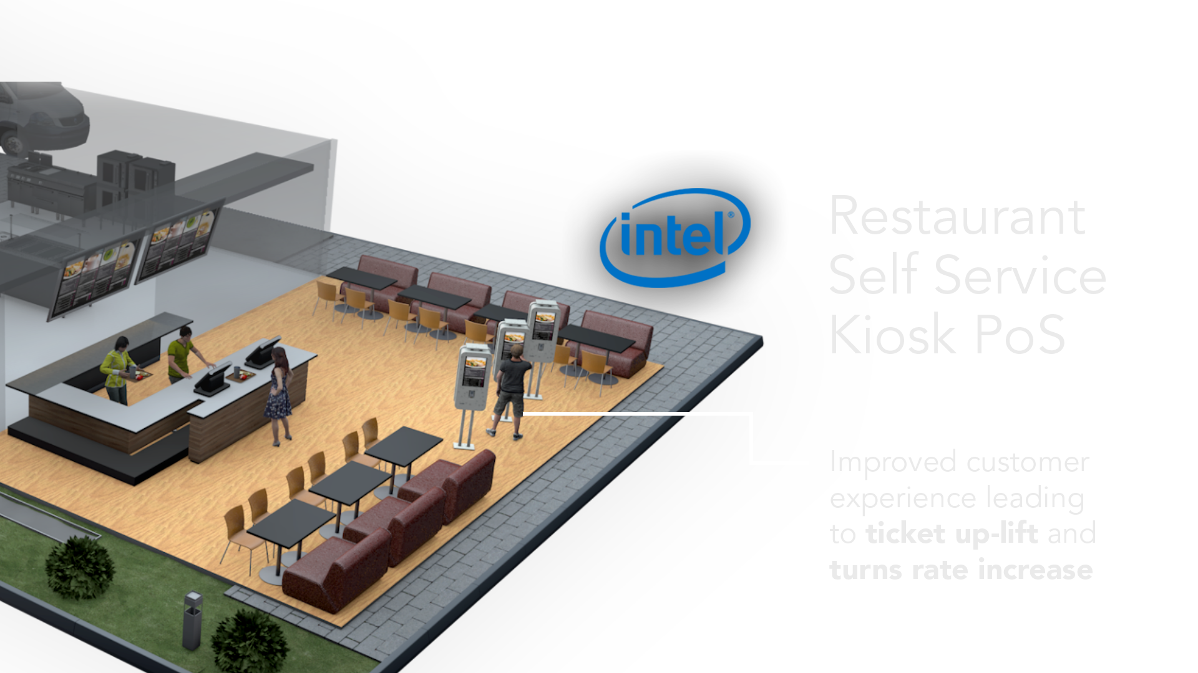
Technology & Integration Partner

Slide 9
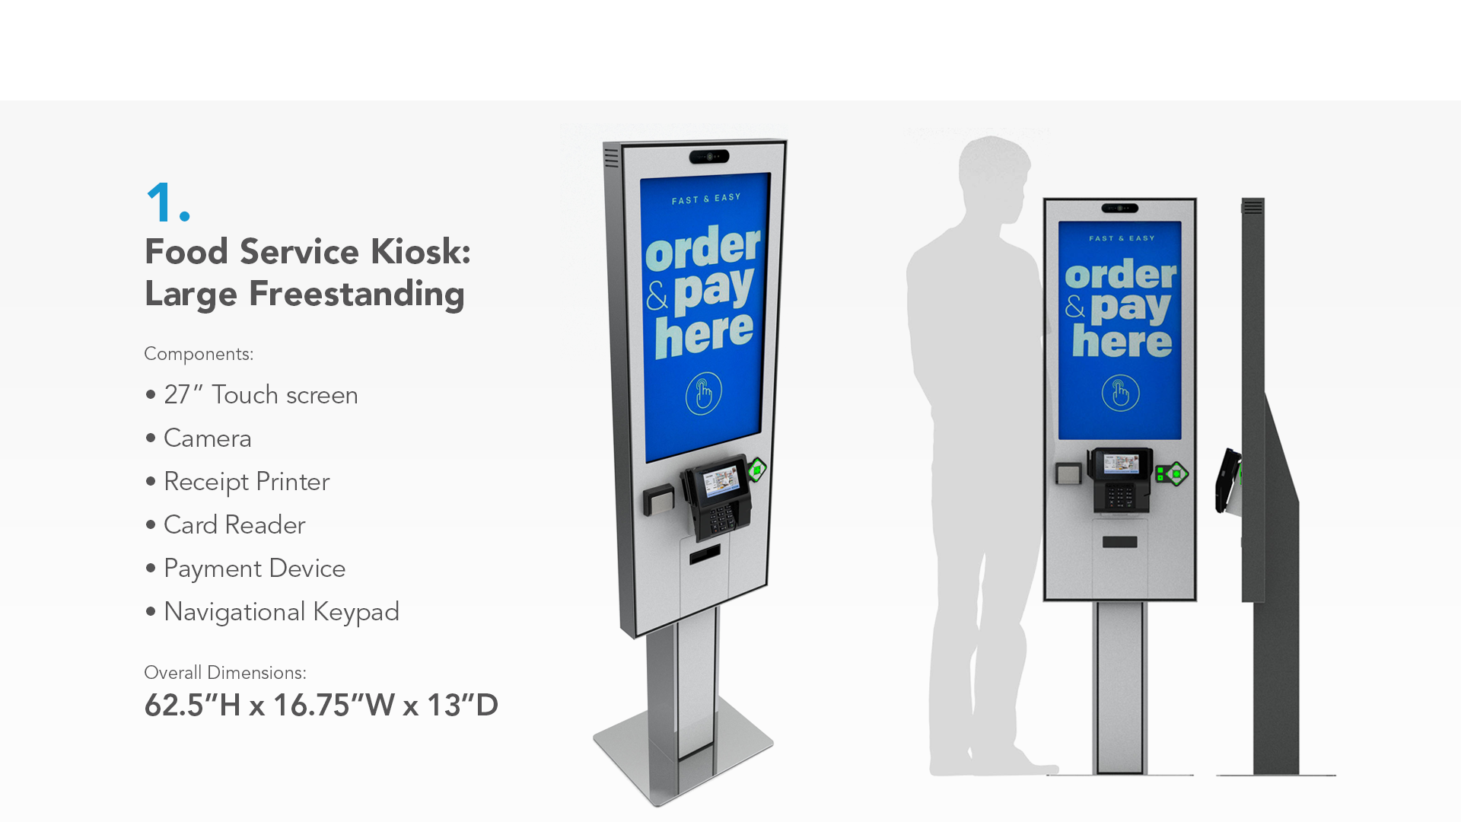

Slide 10
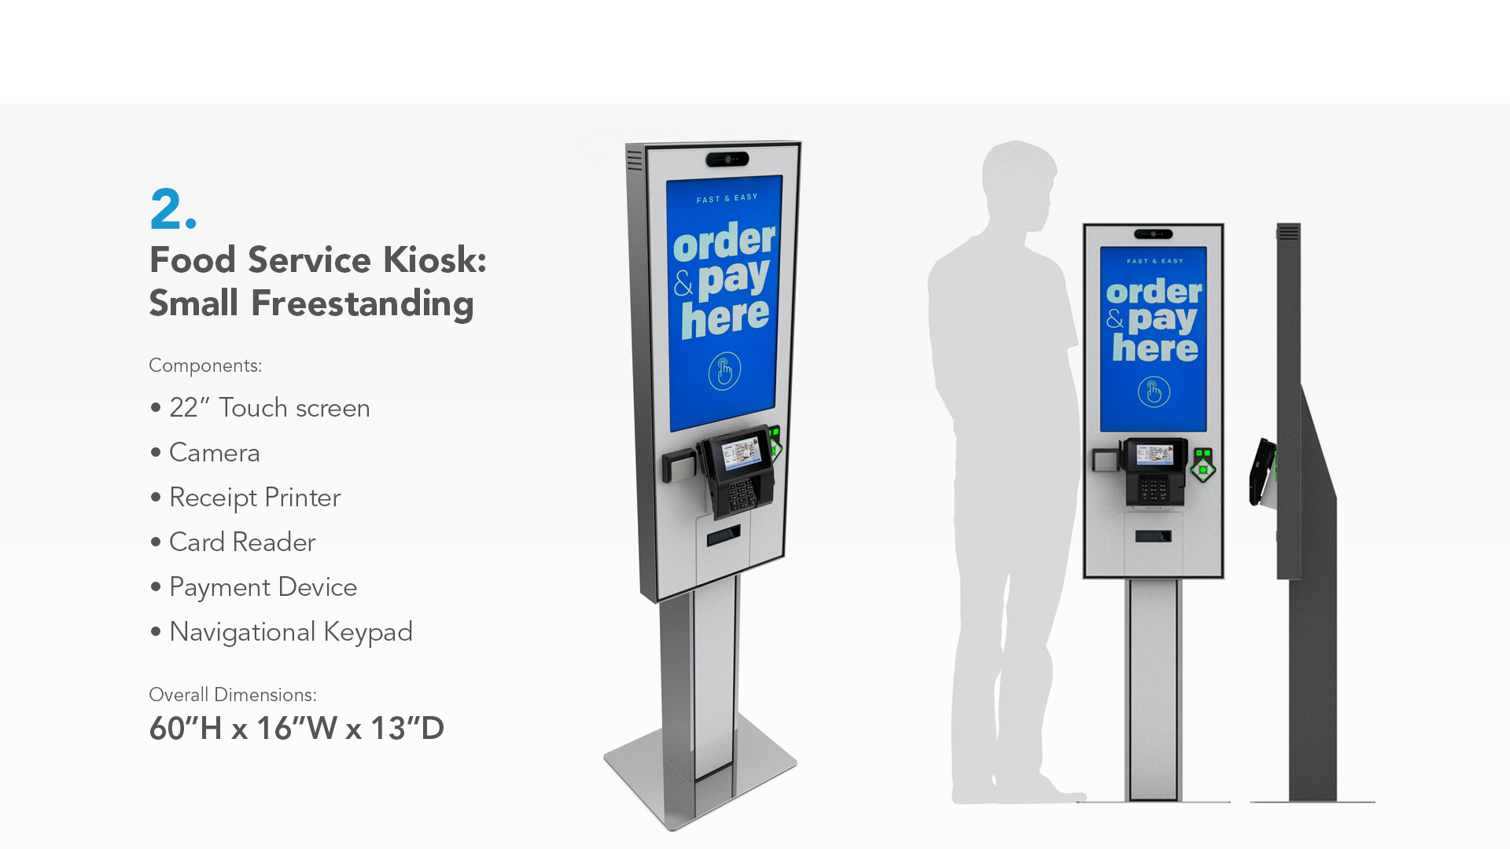

Slide 11
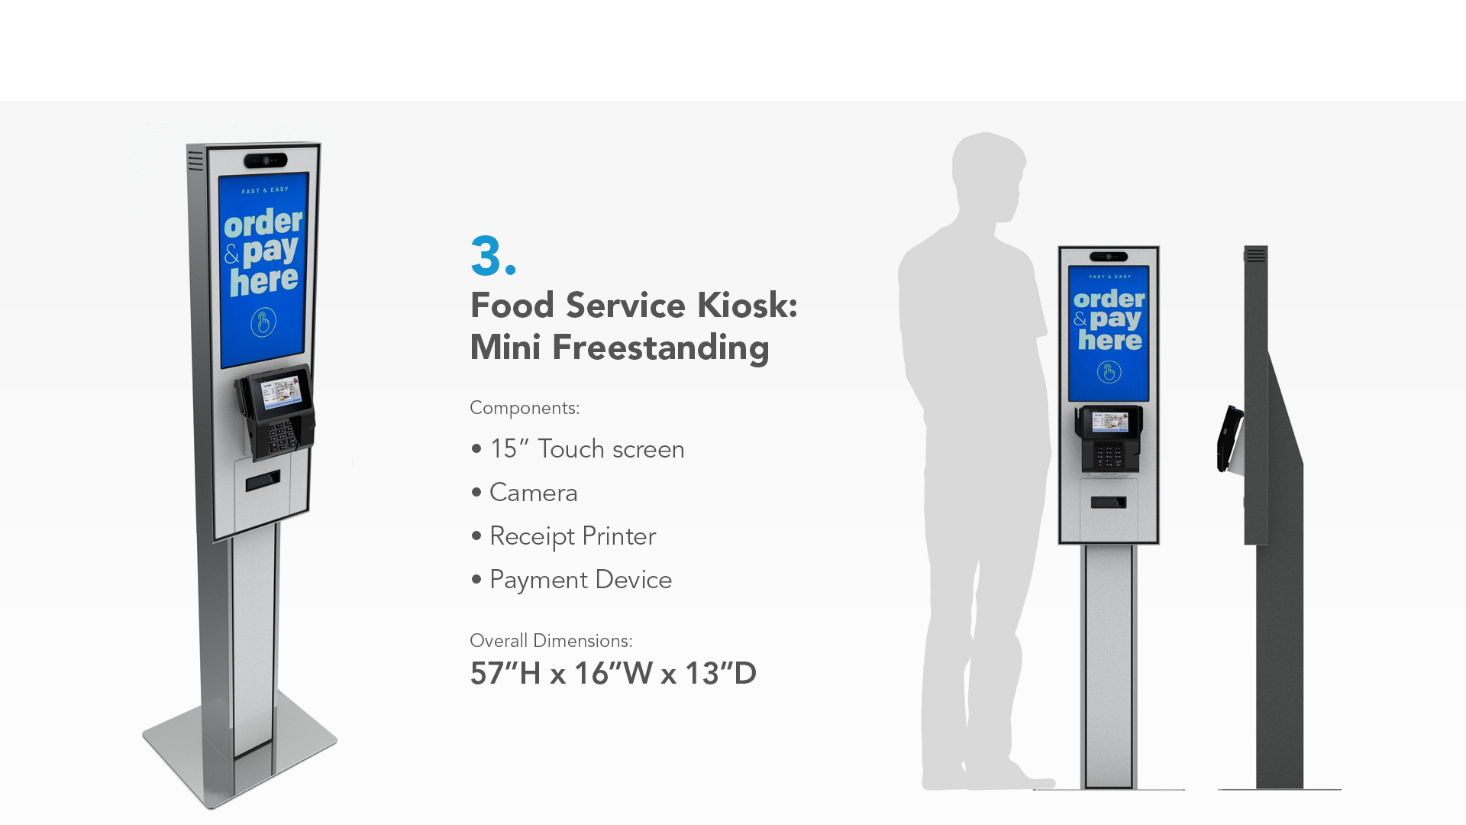

Slide 12
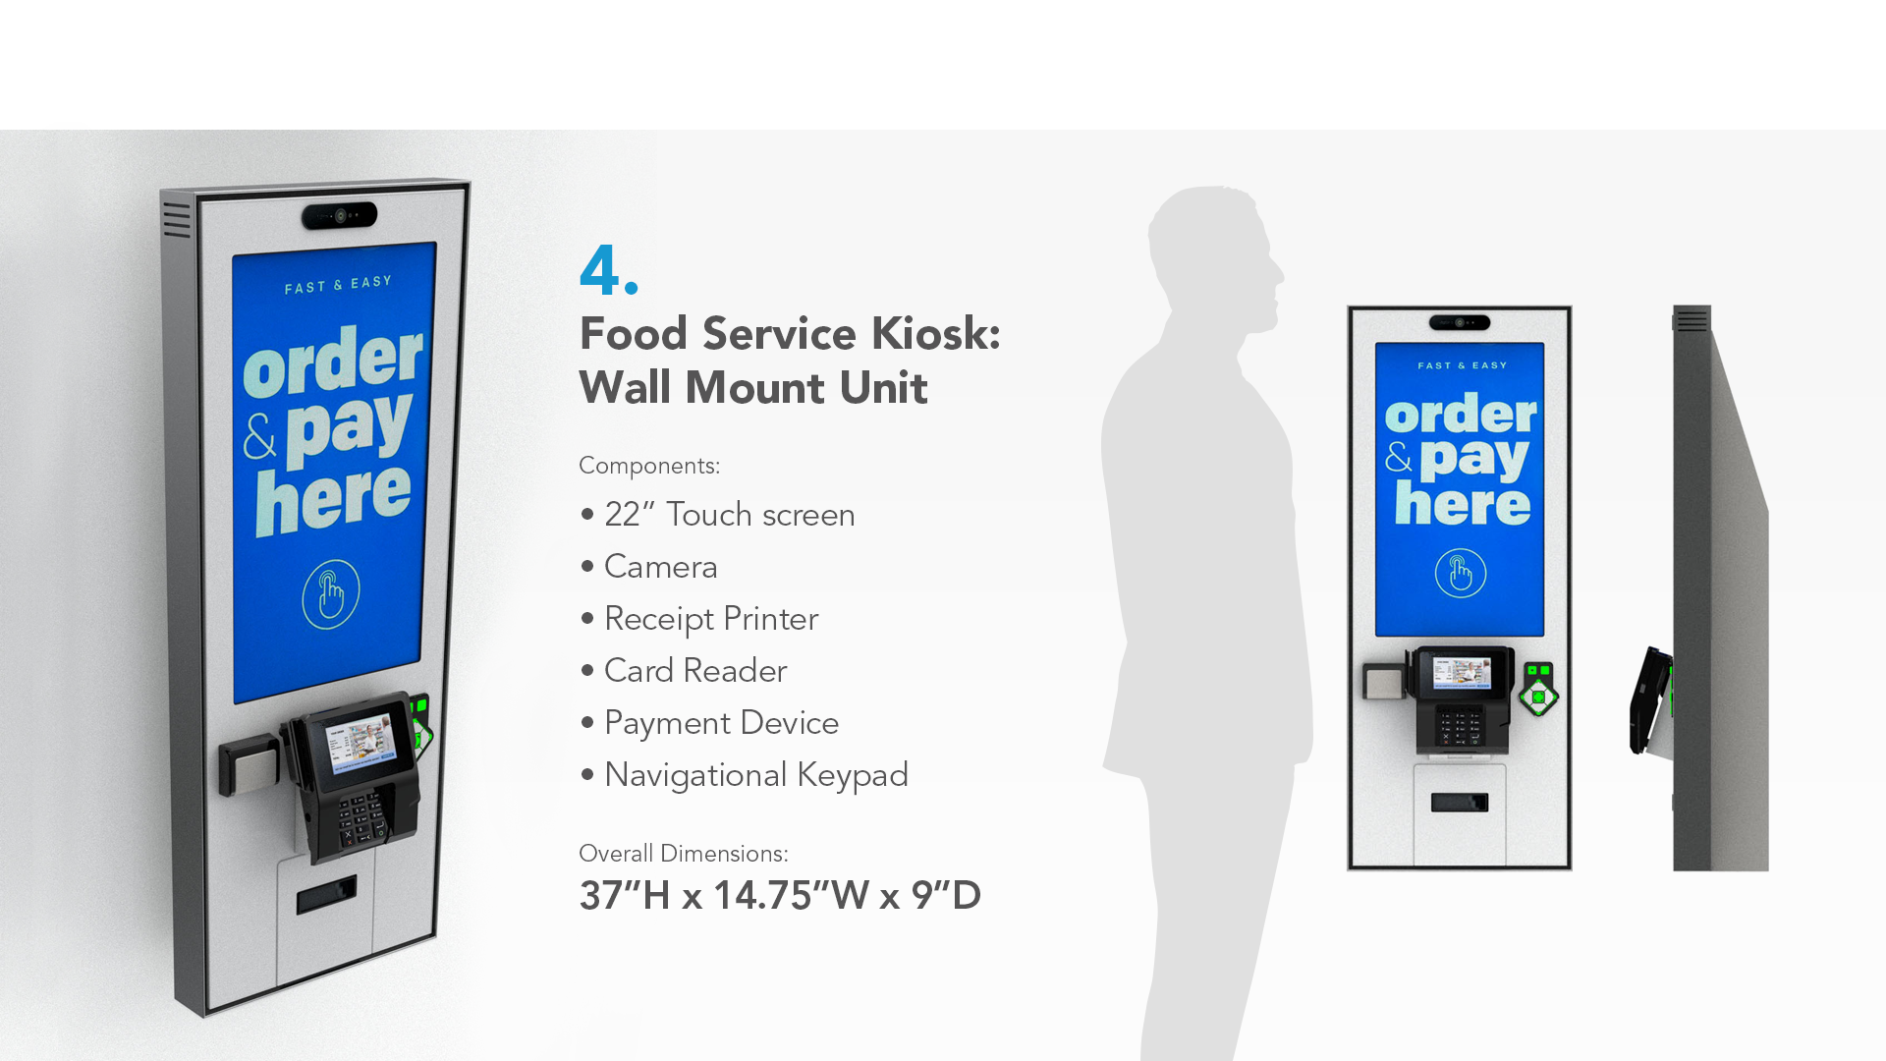

Slide 13
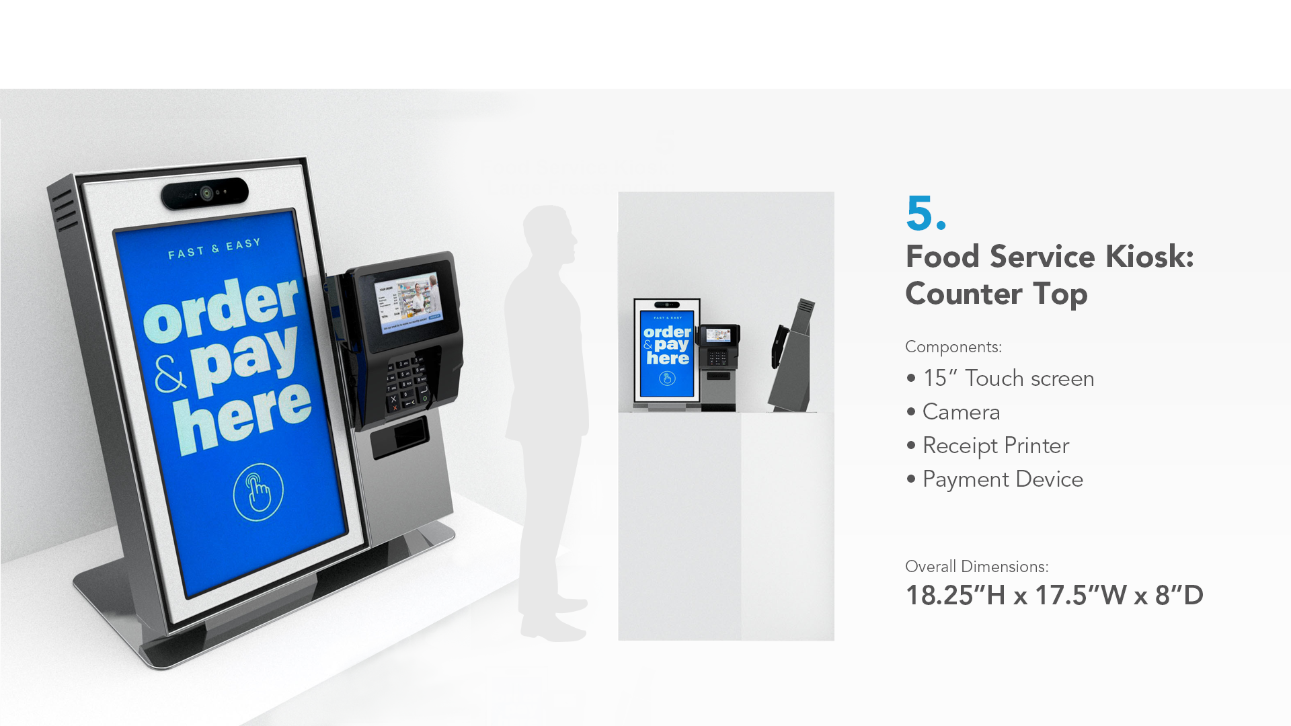

Slide 14
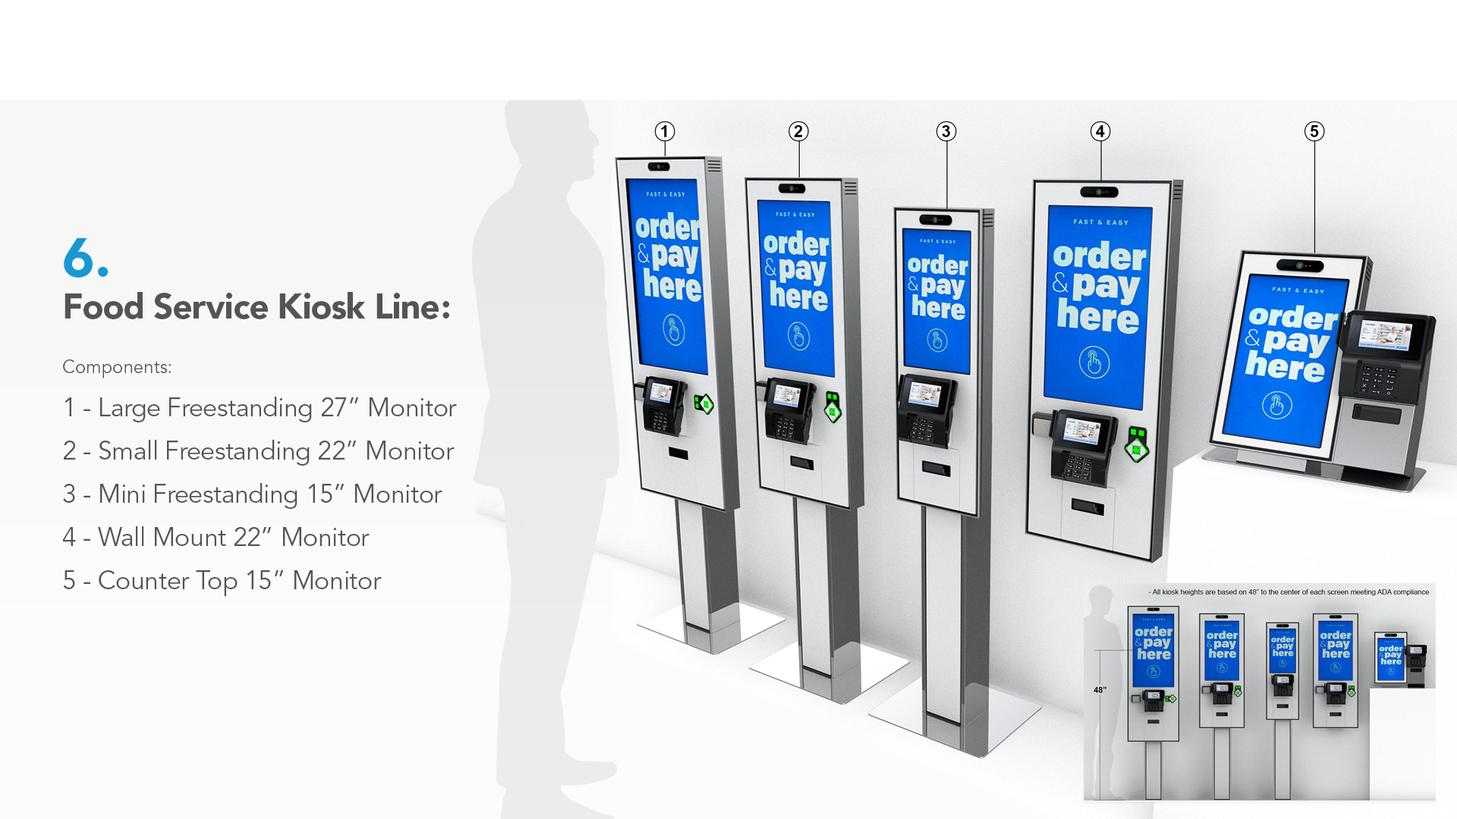

Slide 15
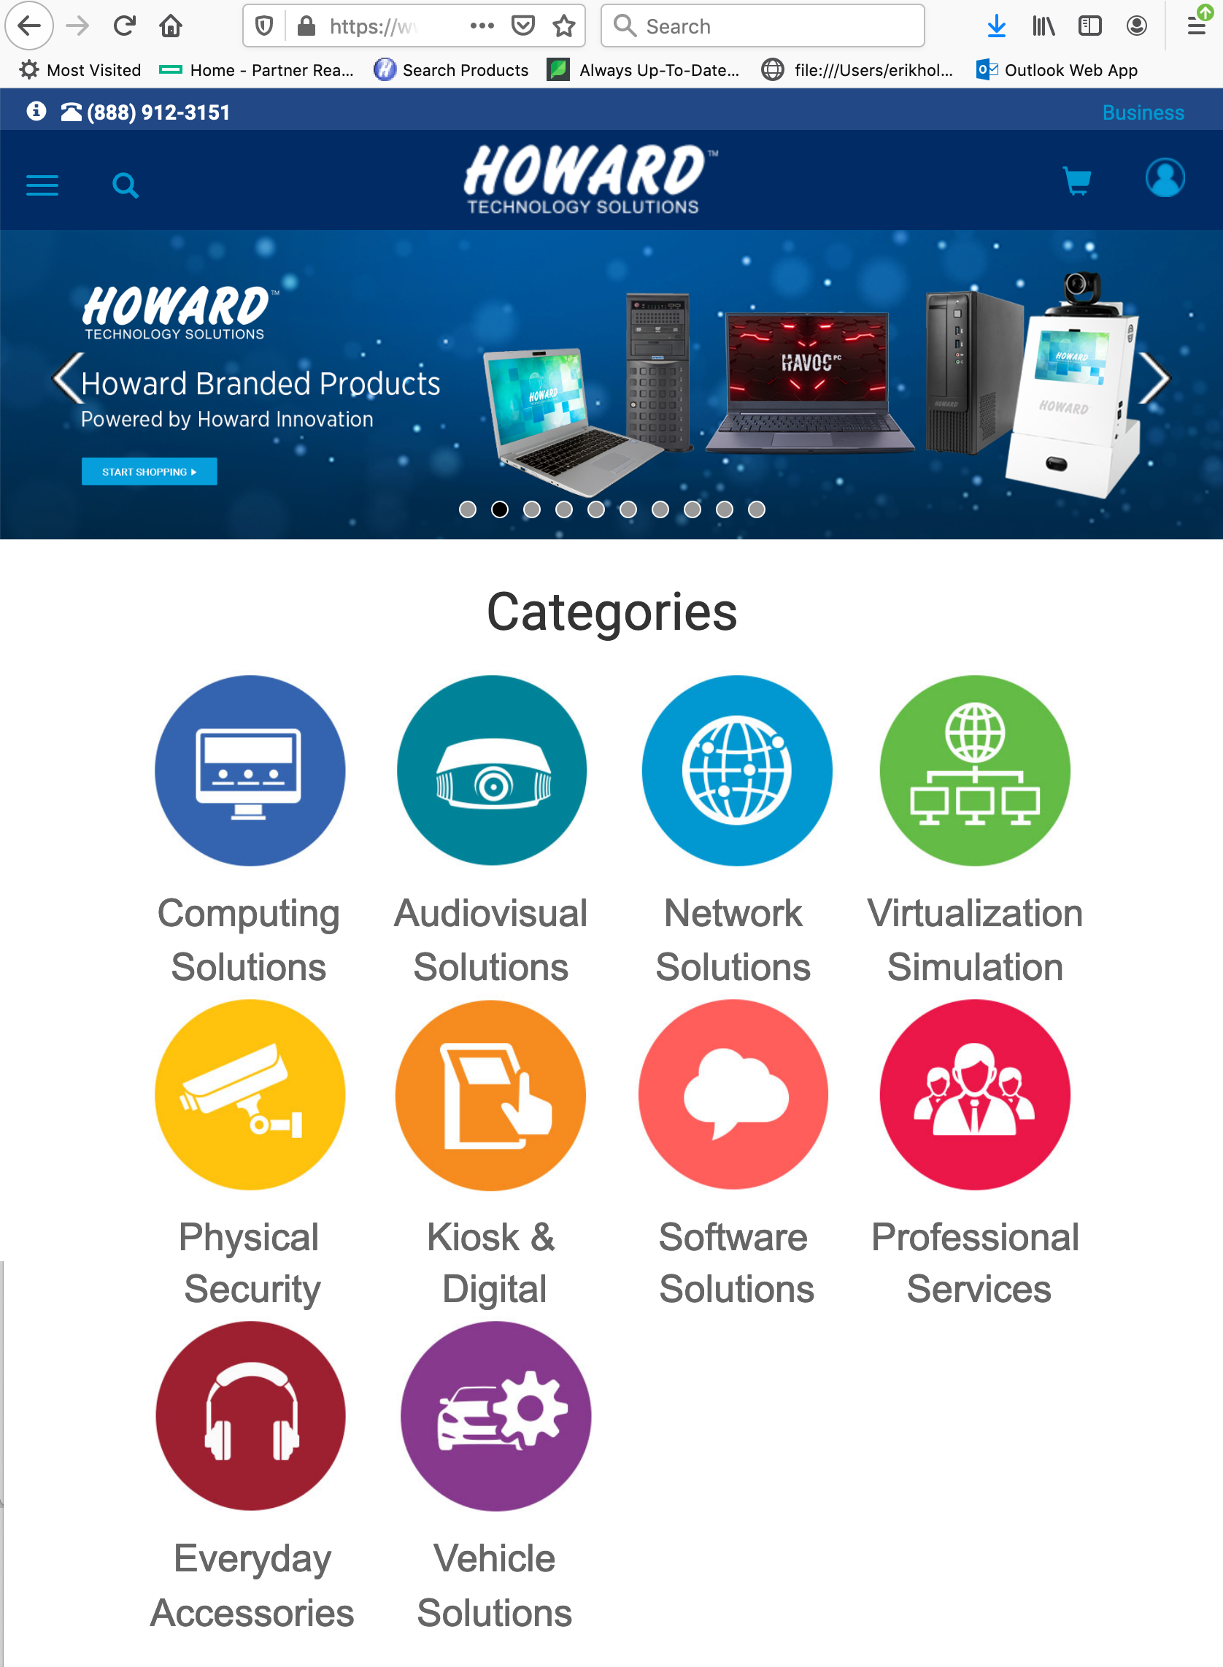
Thank You
Want to view more of Howard Interactive’s solutions?
Scan the QR code below to view our website.
^{Web:}
^{www.howard-medical.com}
Live chat available M-F, 8-5 CST
^{Customer & Technical Support:}
^{Toll Free: 1.888.323.3151}
^{24/7 (excluding US holidays)}
^{General Information:}
^{Toll Free: 1.888.912.3151}
Website:
www.howard.com
Customer & Technical Support:
Toll Free: 1.888.323.3151
24/7 (excluding US holidays)
General Information:
Toll Free: 1.888.912.3151

