Slide 1



WELCOME
Presented by

Slide 2
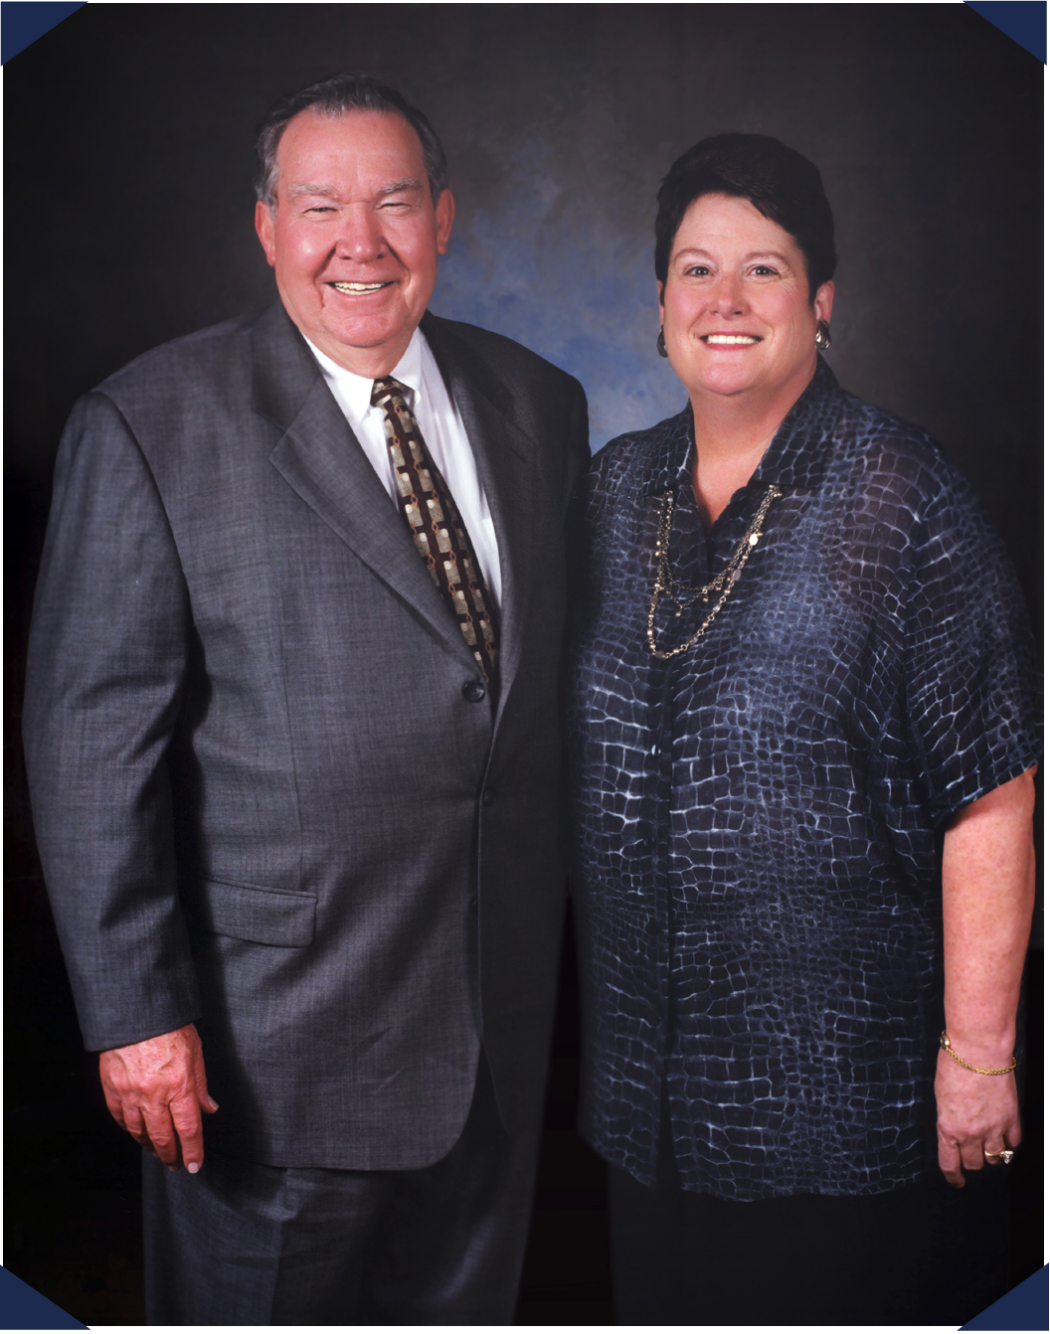
HI
CORPORATE HISTORY
In 1968, a young Billy W. Howard Sr. left his successful career at General Electric to return to his native Mississippi and create his own company –
Howard Industries.
Over the next five decades and with the assistance of his wife, Linda, Howard Industries has grown to become a billion dollar company consisting of four separate divisions and a wholly-owned subsidiary, Howard Transportation.

Slide 3
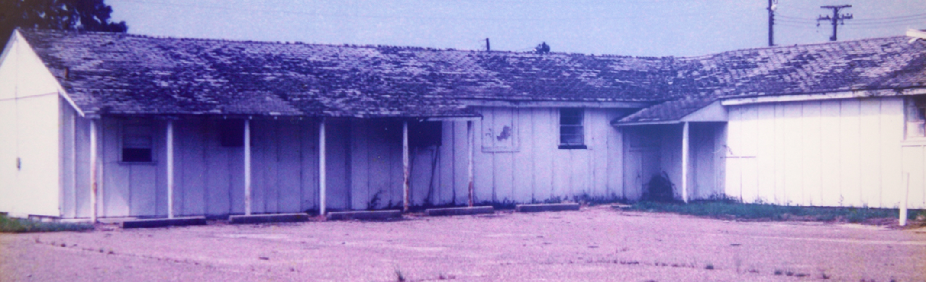
HI
THE FIRST HOWARD BUILDING
Established 1968 | Located in Laurel, Mississippi

Slide 4
HI
HOWARD INDUSTRIES
Over 5-Million Square Feet
More Than
150 Engineers
9 Different Facilities
Nine different facilities including corporate headquarters, manufacturing facilities, and a transportation facility.
Over 5 million square feet of manufacturing space for Howard products – transformers, lighting, kiosks, medical equipment, computers, & more.
Over 150 mechanical, industrial,
and electrical engineers with
thousands of years of combined
experience.

Slide 5
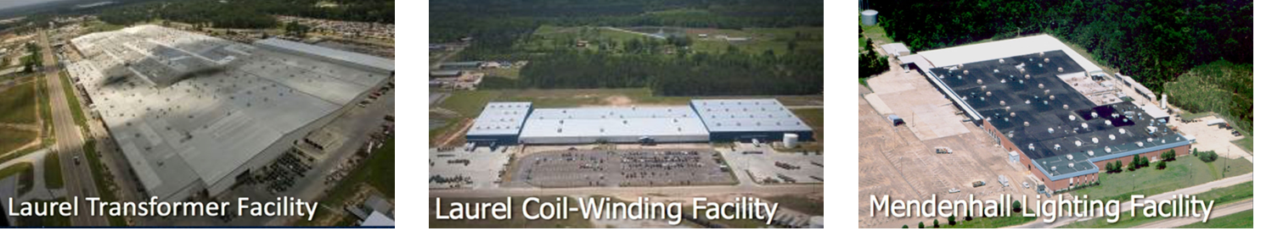
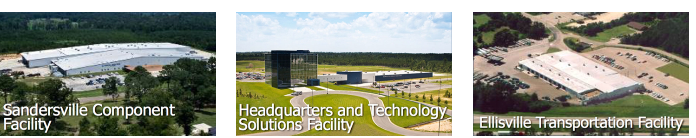
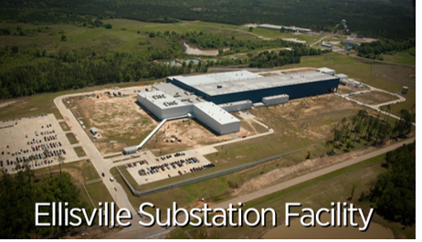
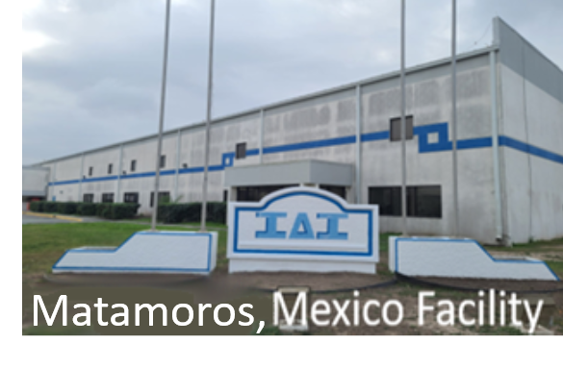
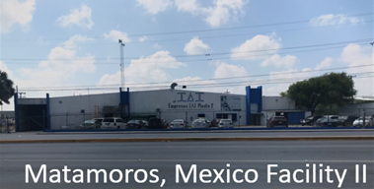
HI
CORPORATE FACILITIES
Over 4,300 employees
Largest employer among privately-held companies in the state of MS

Slide 6
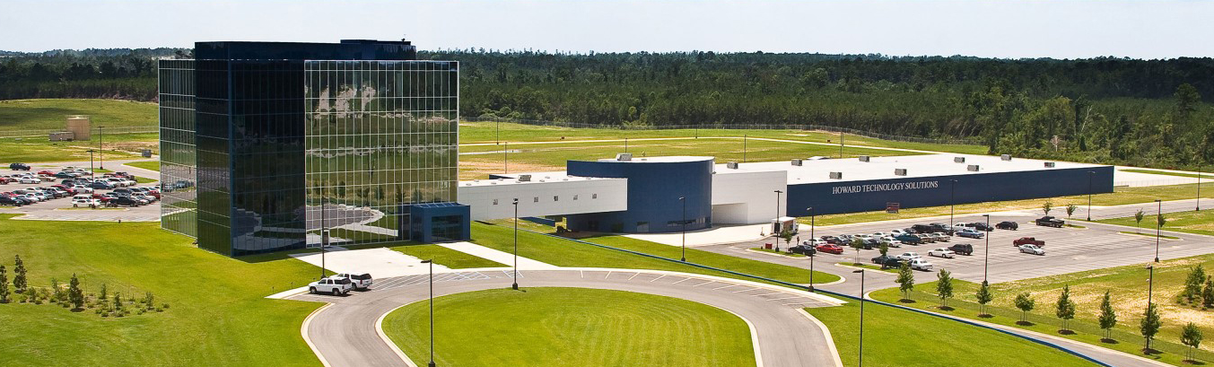
HI
CORPORATE HEADQUARTERS
Our Corporate Headquarters, in Ellisville
Mississippi, is a 5-Story structure wrapped
in two tones of blue glass which includes:
60,000 ft² of office space
72,000 ft² manufacturing plant
for technology products

Slide 7

OUR IMPACT ON MISSISSIPPI
Our employees’ annual payroll is over $177 million.
Between Howard Industries and our employees, we pay over
$56 million in taxes every year.
HI has invested over $460 million in Mississippi and purchase approximately $86 million of materials from Mississippi
companies annually.
According to the Mississippi Economic Authority, our total impact on
our state is $500 million each year.

Slide 8




ONE OF MISSISSIPPI’S LARGEST EMPLOYERS

Slide 9
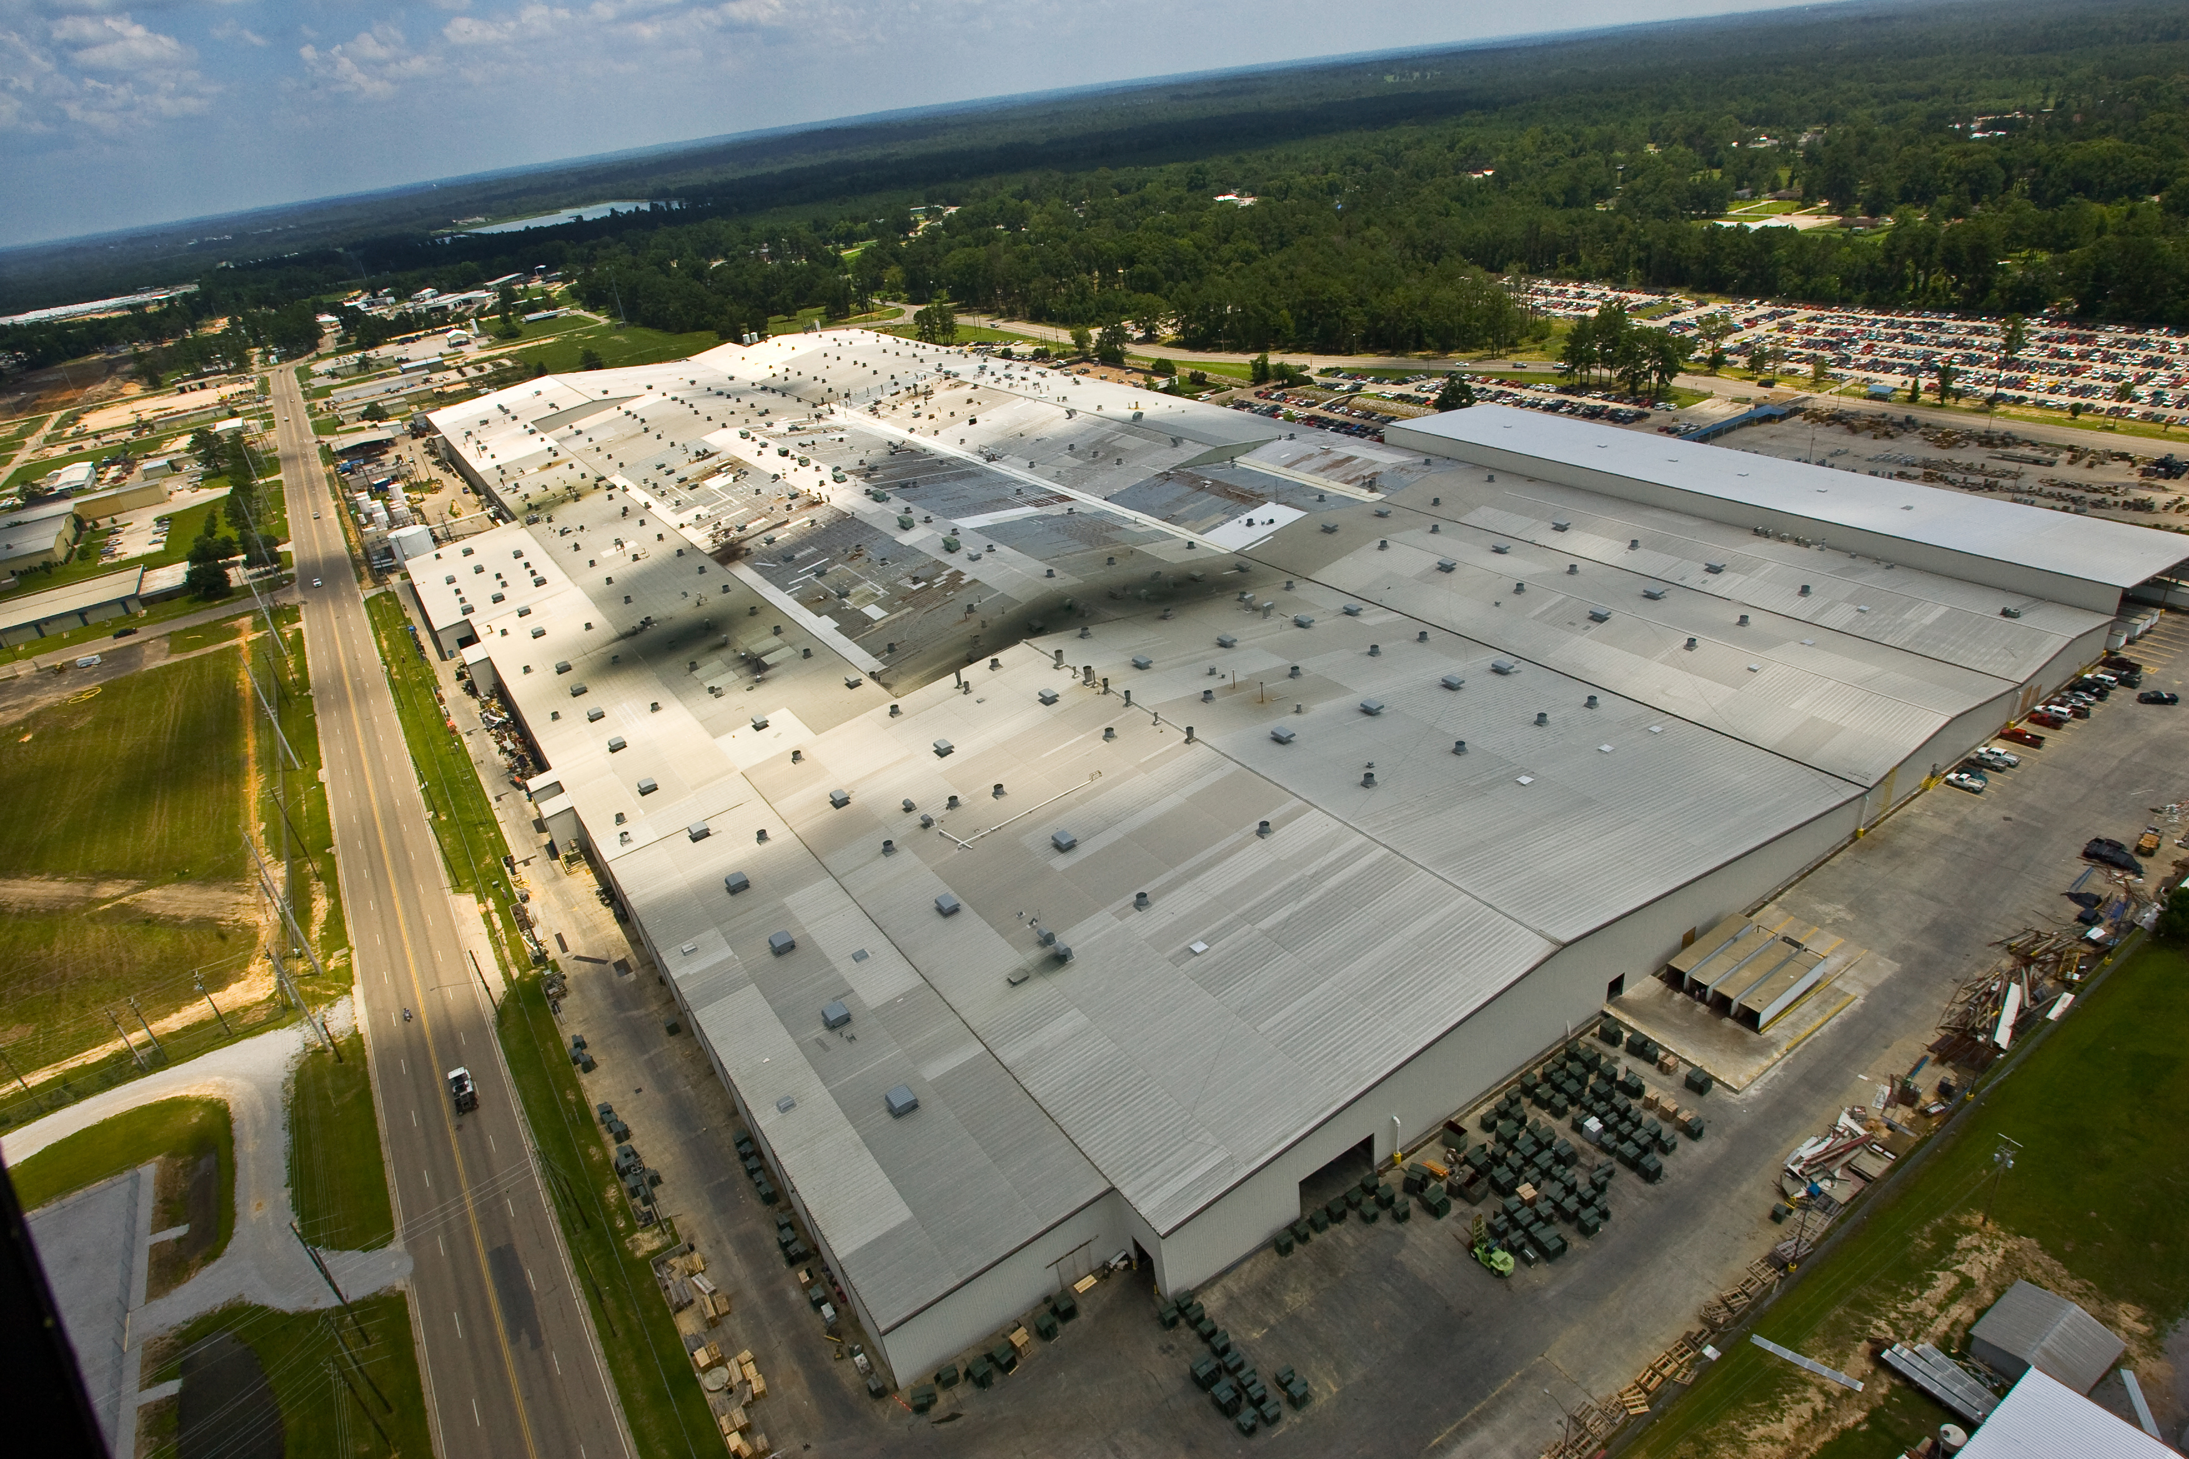
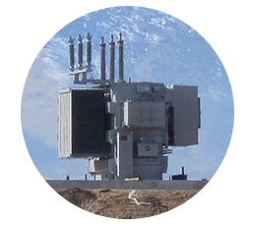
HI
HOWARD POWER SOLUTIONS
Established 1969
Located in Laurel, Mississippi
Largest single transformer manufacturing facility in the world over 2 million ft² (2,500,000 sq. ft.)
Transformer division is the #1 producer of oil-filled distribution transformers in the United States.
Manufacturer of Distribution, Small Power and Medium Power Transformers; Voltage Regulators, Components and Metal Enclosures

Slide 10
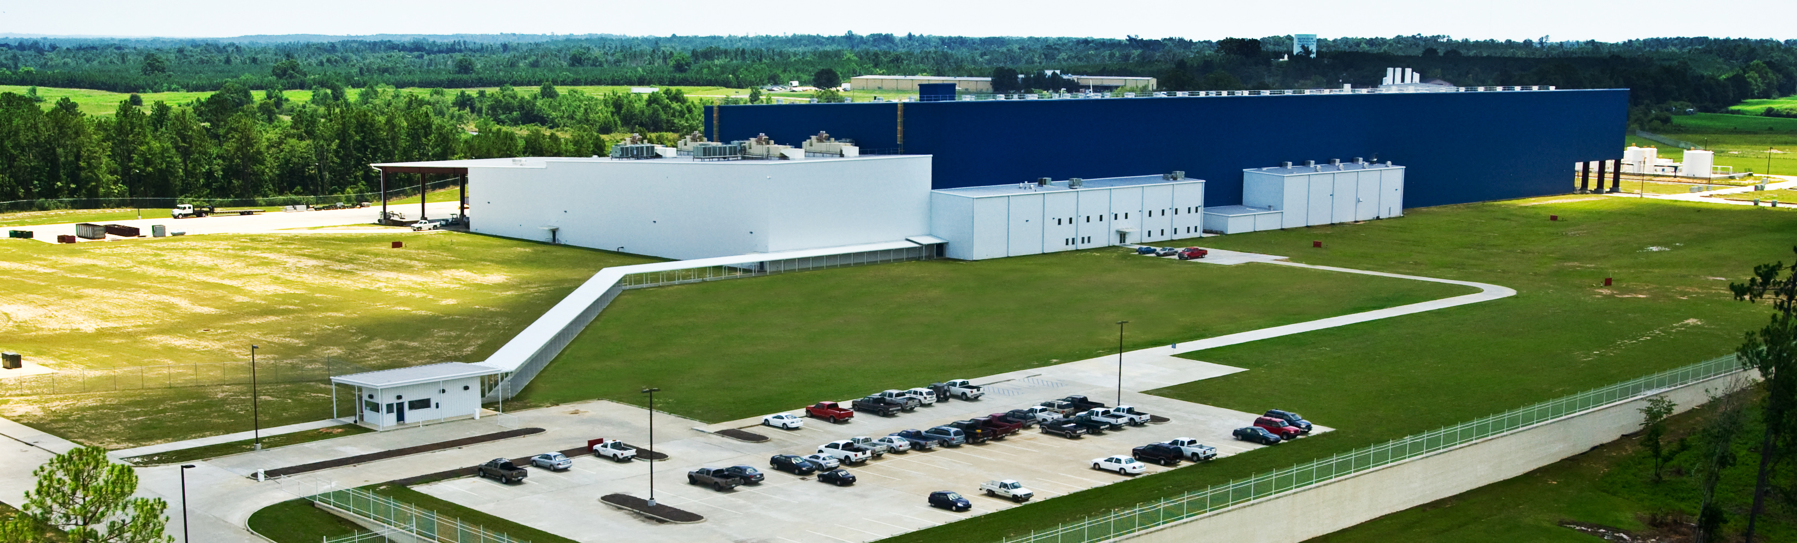
HI
HOWARD SUBSTATION
Established 2005 | Located in Ellisville, Mississippi

Slide 11
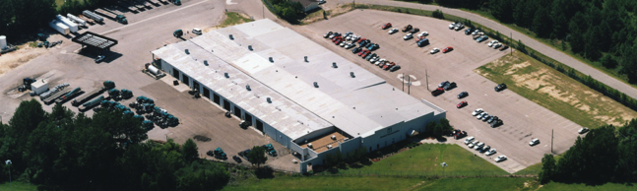


HOWARD TRANSPORTATION
Established 1983 | Located in Ellisville, Mississippi
Howard Transportation operates a full-load, long haul, flatbed common carrier truck line and brokerage operation with over 200 trucks, transporting commodities and industrial goods throughout the continental United States.

Slide 12
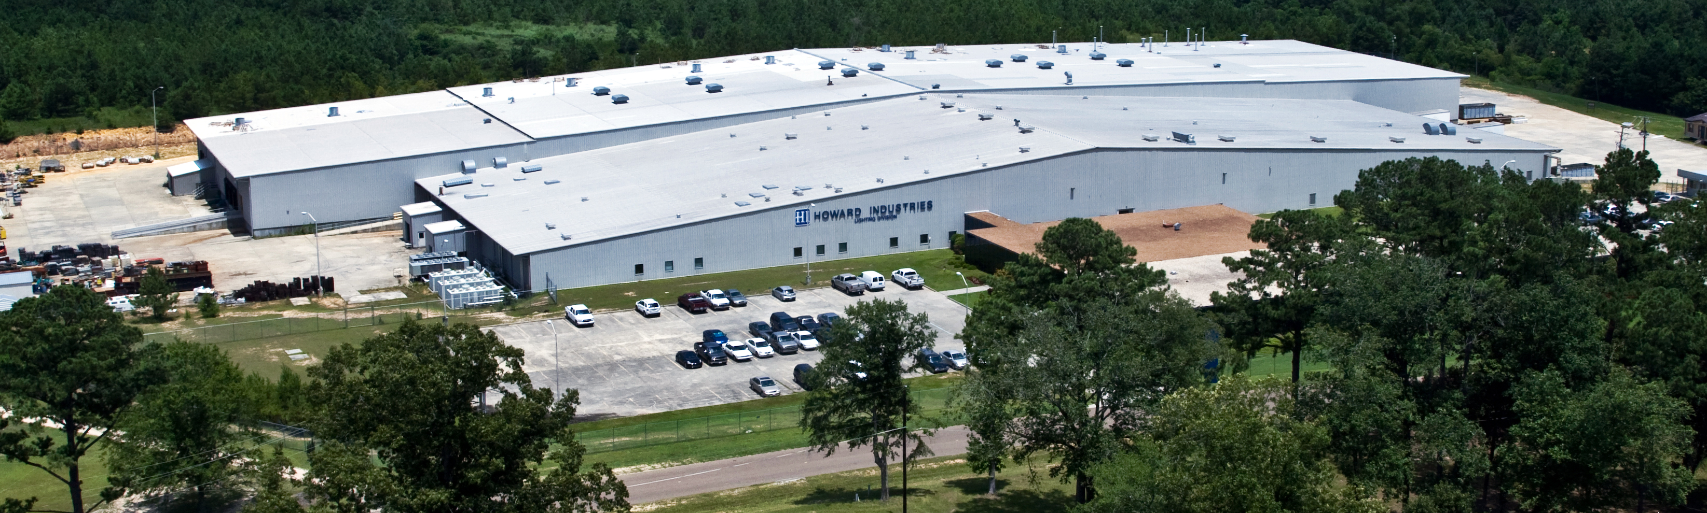

HI
HOWARD LIGHTING
Established 1994 | Located in Sandersville, Mississippi
Howard Lighting designs and manufactures safe, energy efficient lighting that includes a full line of high-quality, fluorescent and HID ballasts, fixtures, and lamps. Howard is committed to a brighter future.

Slide 13









HI
CORPORATE DIVISIONS
POWER SOLUTIONS
TECHNOLOGY SOLUTIONS
LIGHTING PRODUCTS
TRANSPORTATION
The nation’s leading
manufacturer of
transformers
Your one-stop-shop for
over 400,000
technology products
Your source for LED lamps,
fixtures, & many other
lighting solutions
Feet of 150+ trucks
that transport goods
throughout the U.S.

Slide 14












THE ONE-STOP-SHOP
Computing Solutions
Audiovisual Solutions
Network
Solutions
Physical
Security
Kiosks and
Digital Signage
Software Solutions
Professional
Services
Everyday
Accessories
eSPORTS
Solutions
Point-of-Care
Solutions
Telehealth
Solutions
Infection
Control

Slide 15
Did you know? HOWARD offers:
Computing Solutions
• Accessories • Antivirus • Asset Management • Desktops • MDM
• Mobile Presentation and Charging Stations • Notebooks • Printers (2D & 3D) • Refurbs • Tablets • VR
Audiovisual Solutions
• Audio Solutions • Broadcasting and Streaming • Cables • Control Systems • Document Cameras • Furniture
• Interactive Classroom Solutions • Interactive Displays • Intercoms, Bells and Paging Systems
• Lecture Capture • Mixers and Microphones • Monitors and Displays • Mounts • Projectors
• Projector Screens • Speakers and Amps • Video Cameras • Video Conferencing • Webcasting
• Wireless Interactive Pads
Network Solutions
• Backup and Replication • Bandwidth Management Solutions • Content Filtering • Continuity Solutions
• Cooling, LAN Storage and Power Protection • Disaster Recovery Products • Email Archiving Solutions
• Hyperconverged • Network Access Control • Network Infrastructure • Security Solutions • Servers • Storage
• VOIP • Wireless

Slide 16
Did you know? HOWARD offers:
Physical Security
• Access Control • Active Shooter • Behavior Management • Body Protection • Cloud • Displays
• Emergency Alert Notification • Encoders • Guard Services Equipment • Intercoms • Lighting
• Mobile Security • Mounting • Perimeter Security • Storage • Supporting Infrastructure • Video Management
• Video Surveillance • Visitor Management
Kiosks and Digital Signage
• Content Management Software • Digital Outdoor Signs and Scoreboards • Indoor Kiosks
• Large Format Displays • Media Players • Mounts and Mounting Brackets • Outdoor Kiosks
• Self-Serve Pickup Lockers • Tabletop Kiosks • Telemedicine Kiosks • Through-the-Wall Kiosks
• Wayfinding Kiosks
Software Solutions
• Antivirus • Backup, Recovery and Utility • Chromebook-Enabling Software • Content Creation
• Creativity, Design and Page Layout • Data Analytics • IT and Network Management • Network Security
• Print Management • Programming and Web Development • Virtualization and Storage

Slide 17
Did you know? HOWARD offers:
Professional Services
• Consulting • Installation and Design Services • Managed Services
• Physical Security and Video Surveillance Services • Professional Development/Training
• Programming Services • Support Services
Everyday Accessories
• Bags and Cases • Hardware • Headphones and Headsets • Networking • Office Supplies
• Printing Consumables
eSPORTS Solutions
• Gaming Desktops • Gaming Furniture • Gaming Headsets • Gaming Keyboards • Gaming Laptops
• Gaming Mice • Gaming Monitors • Graphic Cards

Slide 18
Did you know? HOWARD offers:
Point-of-Care Solutions and Technology
• All-in-One Computers • Authentication Devices • Barcode Scanners • Carts • Document Scanners
• Medical-Grade LCD • Signature Pads • Small Form Factor Computers • Software Solutions
• Specialty Printers • Standard LCD • Thin Clients • Wall-Mounted Arms and Cabinets
• Washable Keyboards and Mice
Telehealth Solutions
• Software • Telehealth Carts • Telehealth Kiosk • Device Technology • Wall-Mounted Cabinets
• Telehealth Technology • Telemedicine Kits
Infection Control
• Cleaning Supplies and PPE Equipment • Custom Protective Acrylic Shields
• Electrostatic Disinfectant Sprayers • Hand Sanitizer Stations • Sanitizable Technology
• Temperature Sensing Kiosks • UVC Sanitizing Solutions

Slide 19

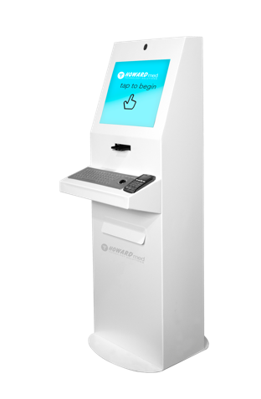
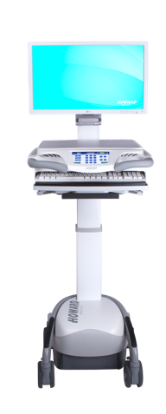
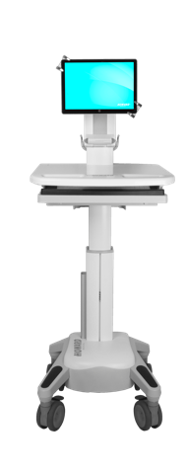
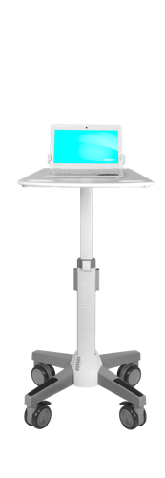
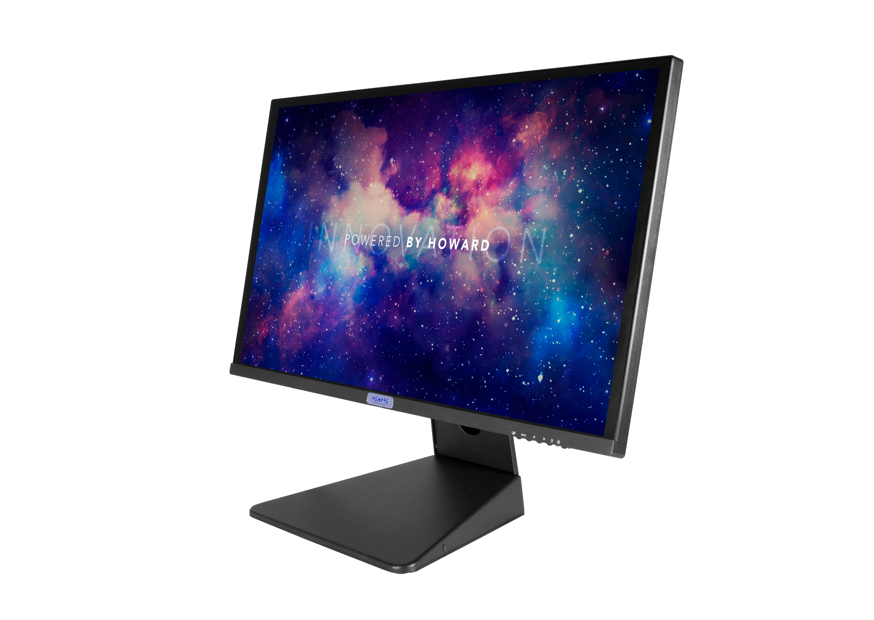
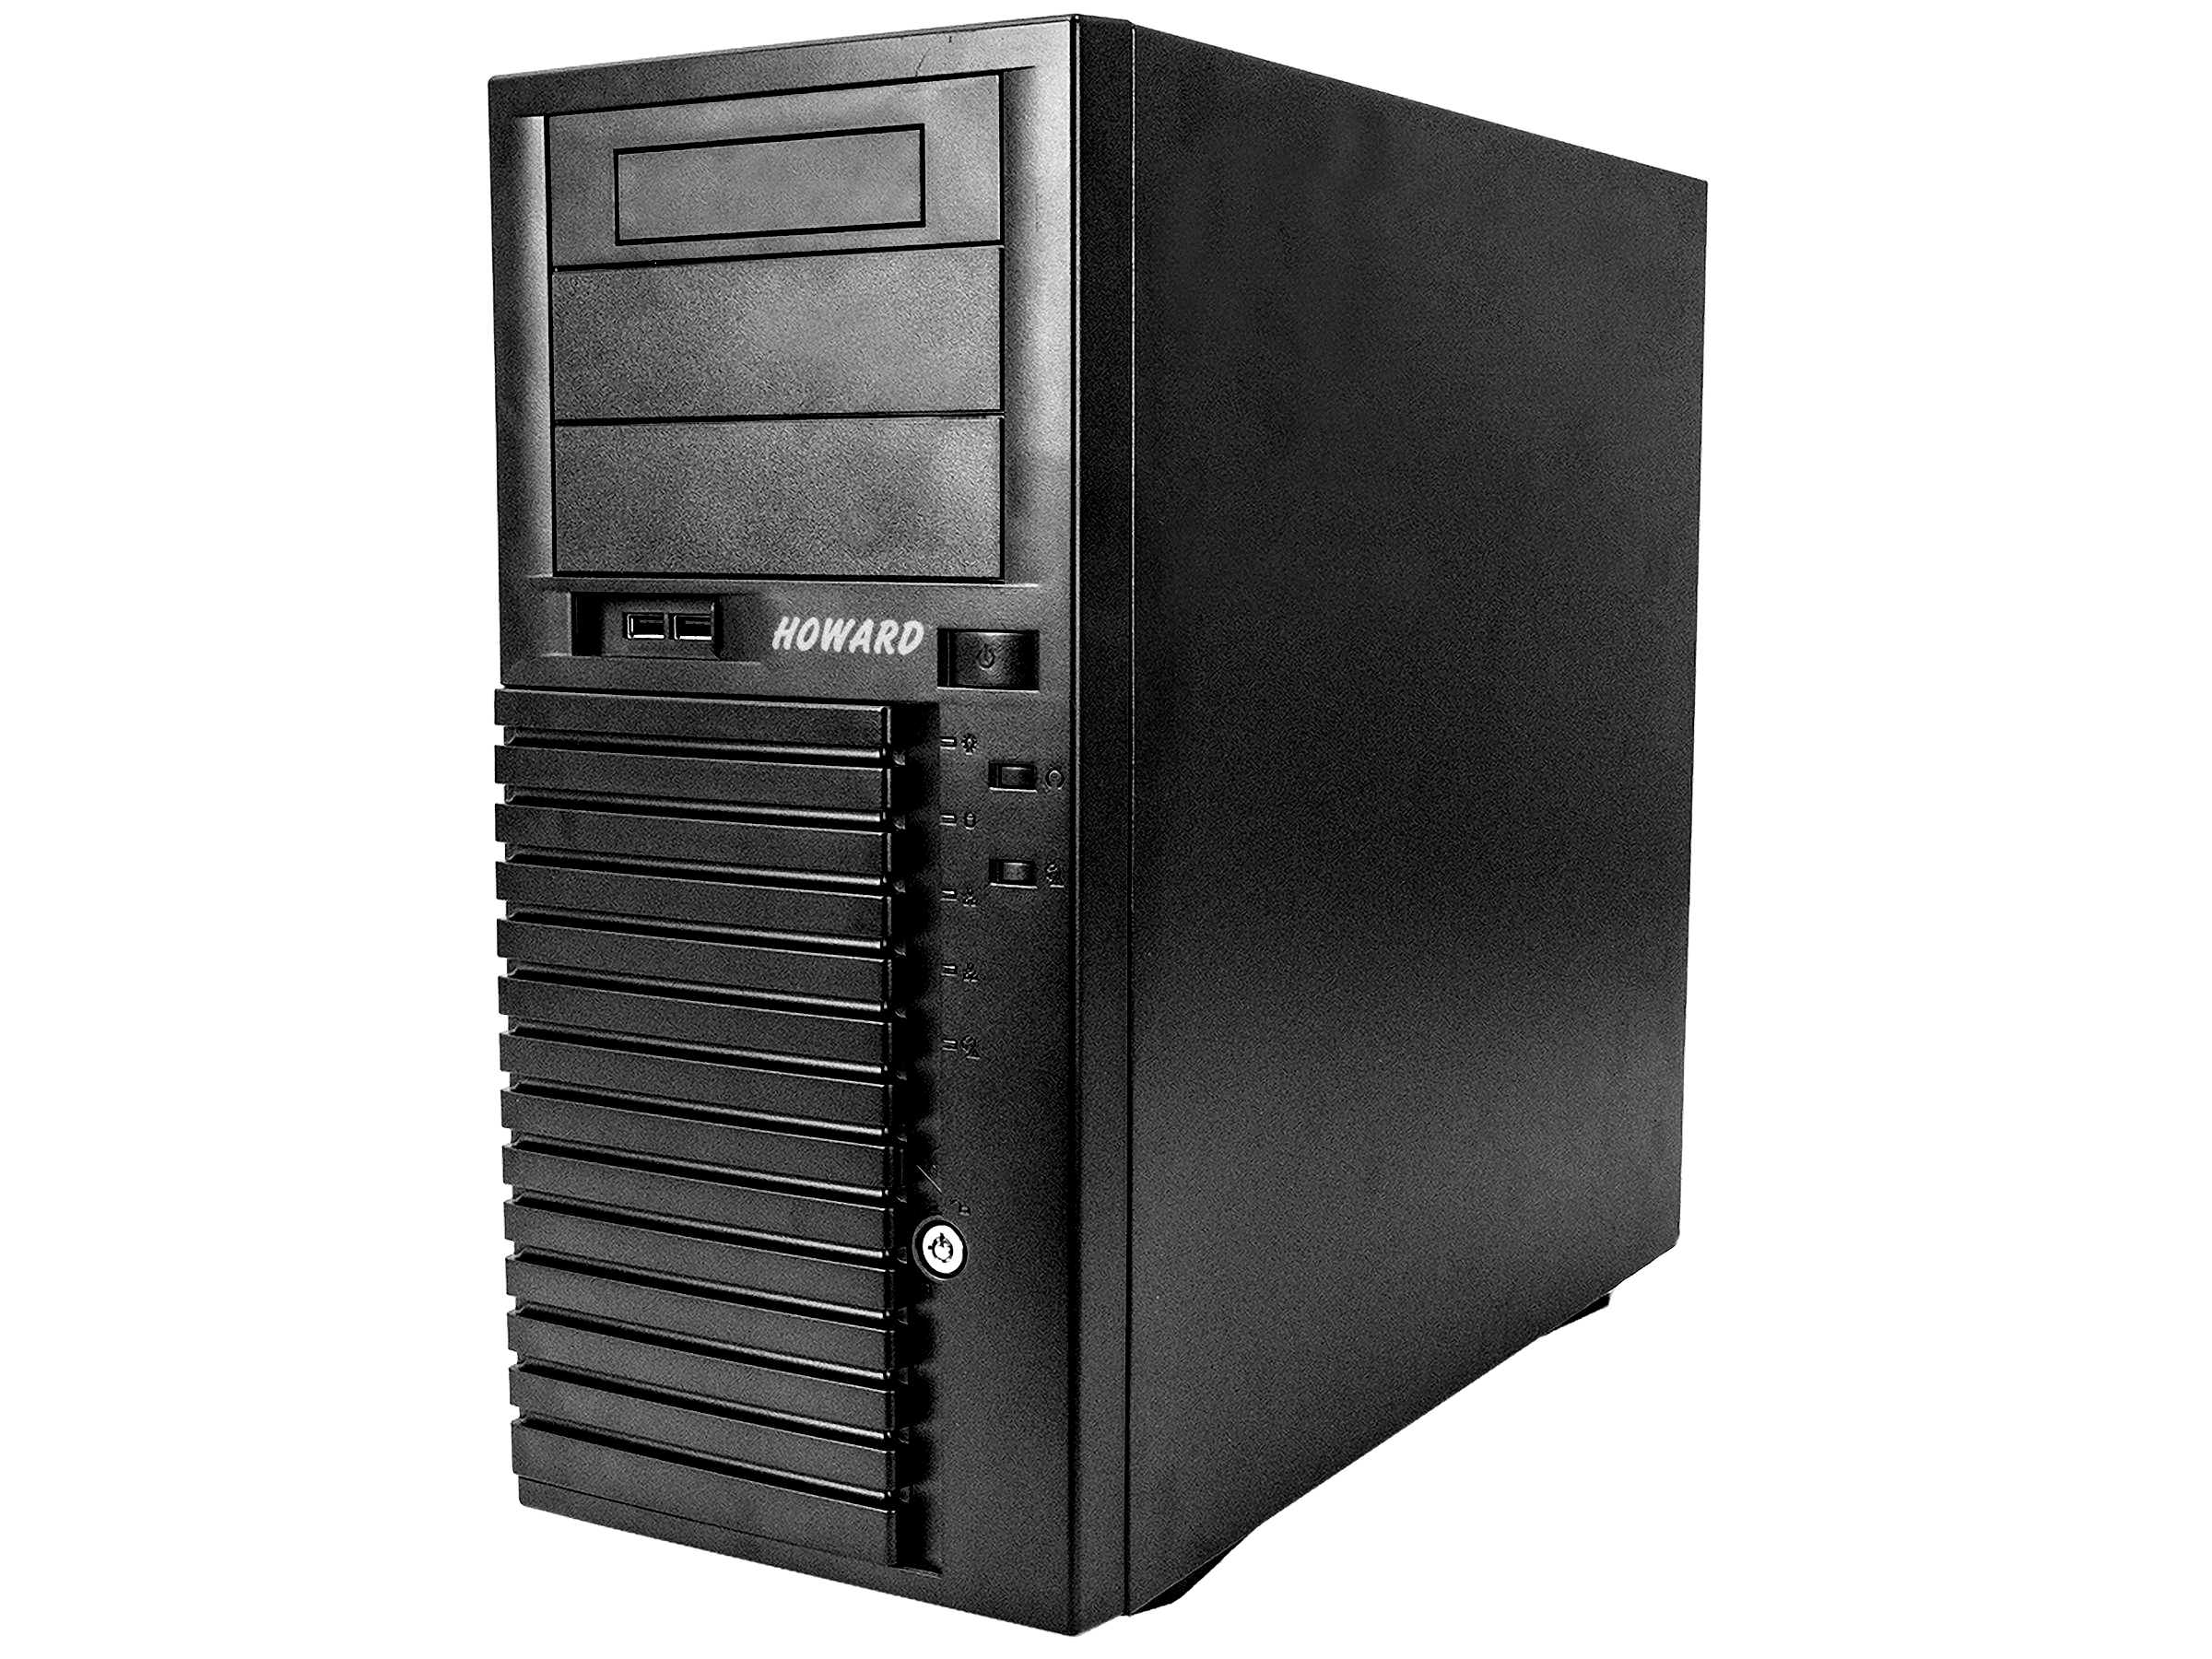
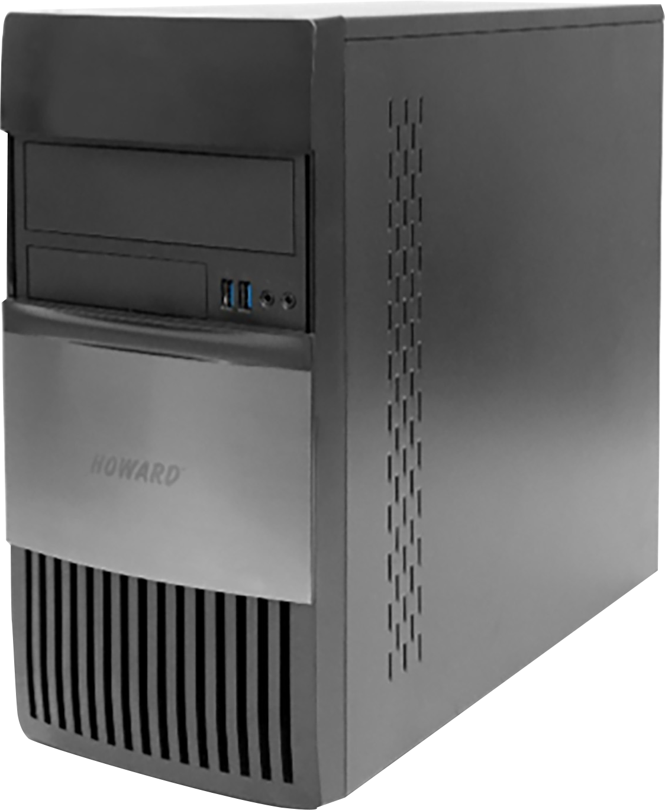

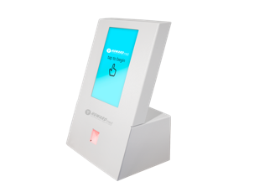
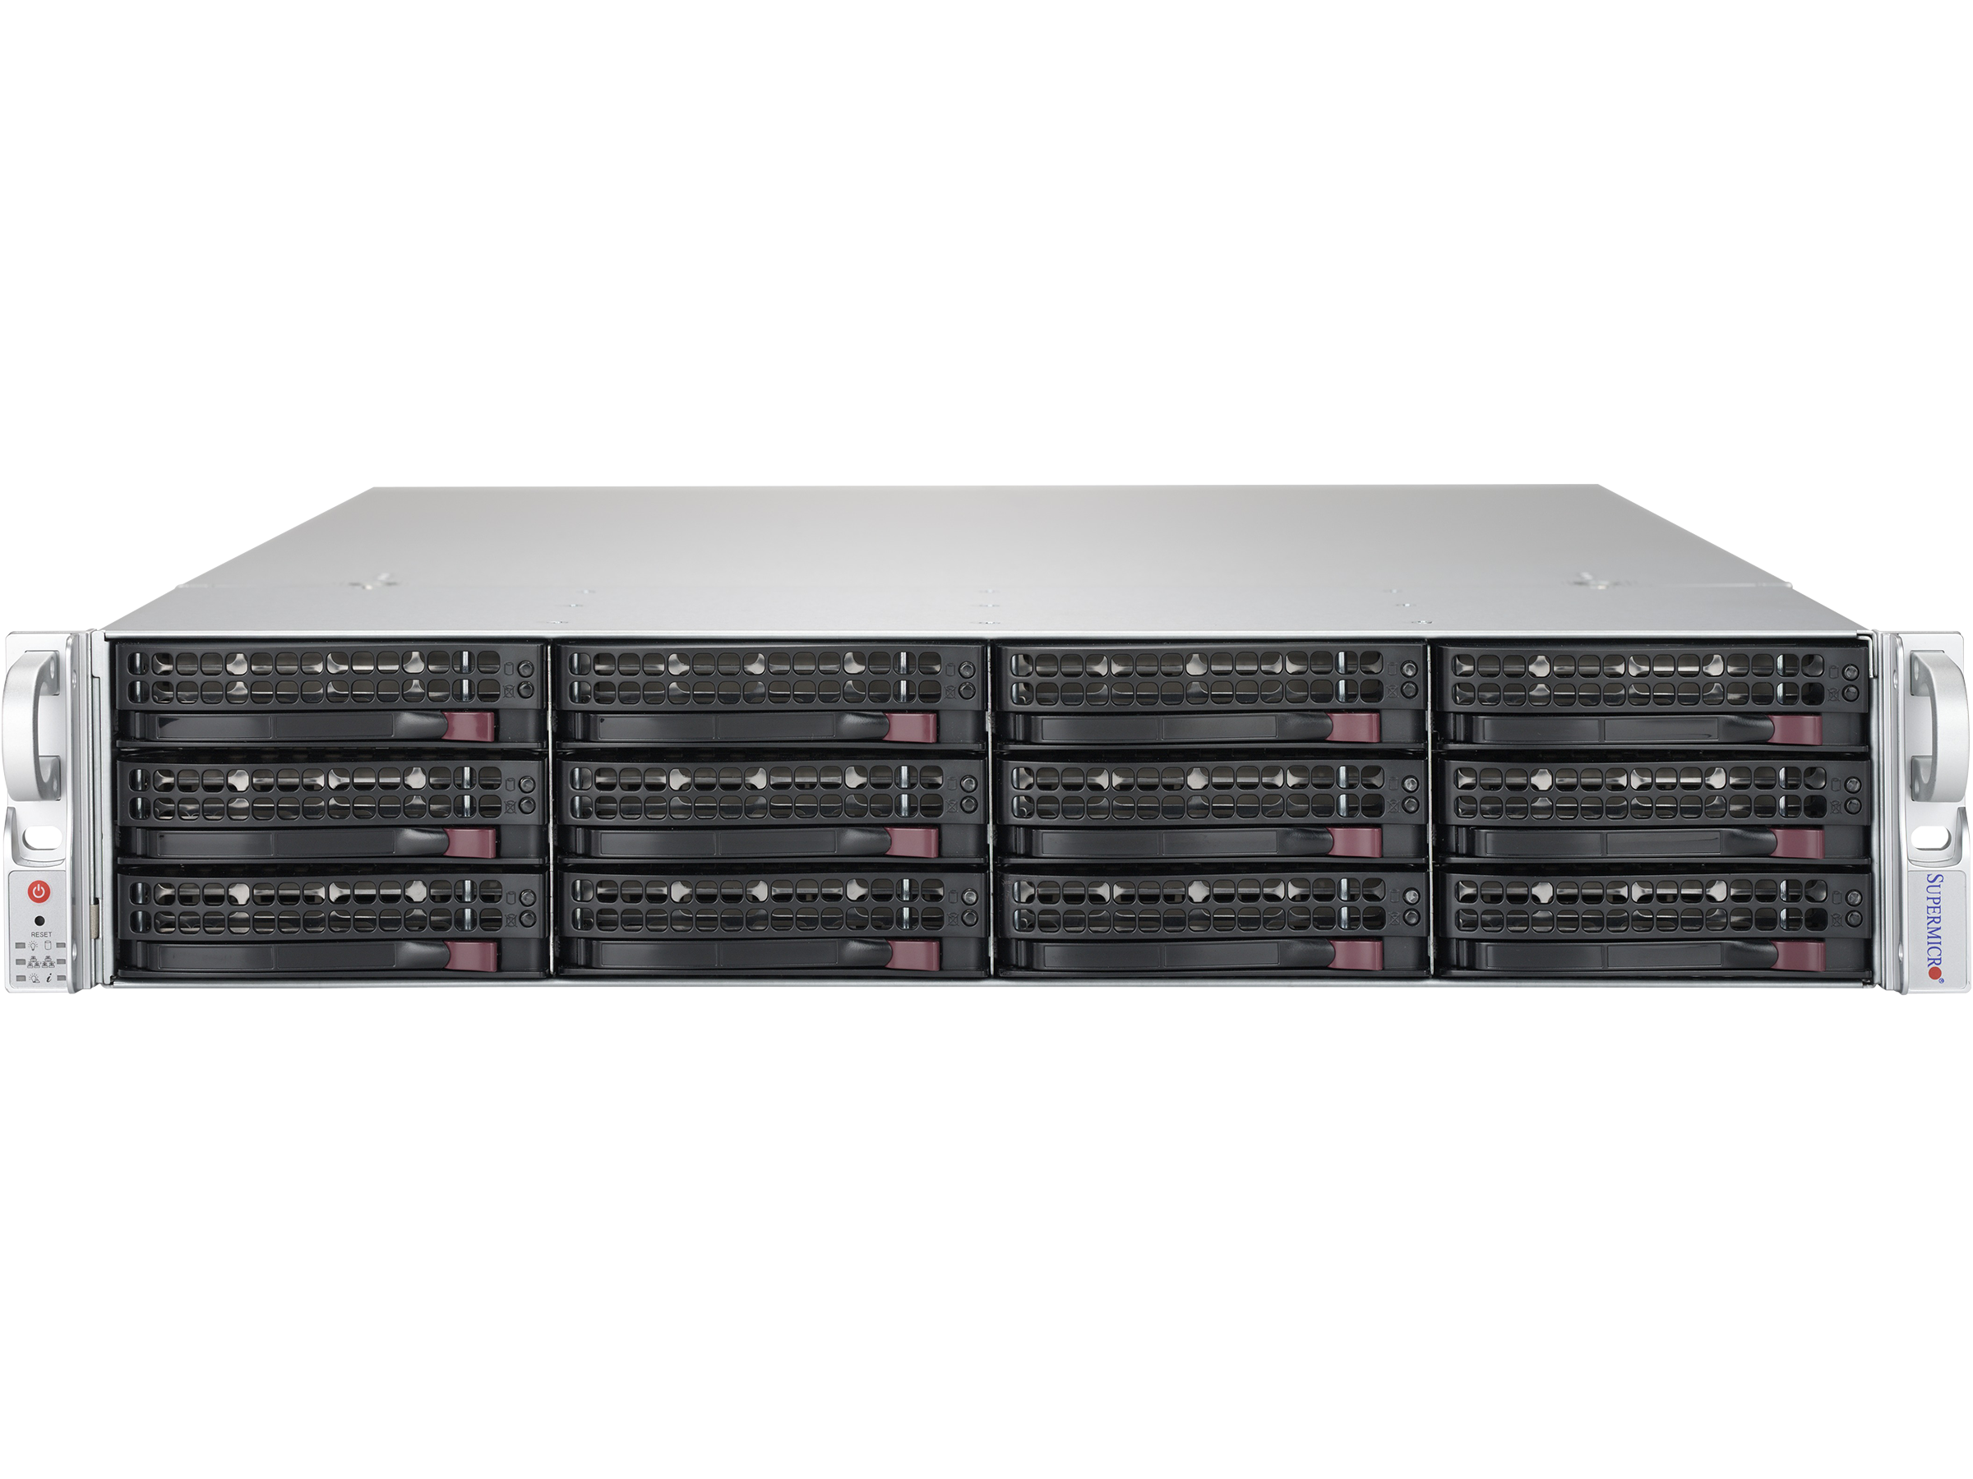
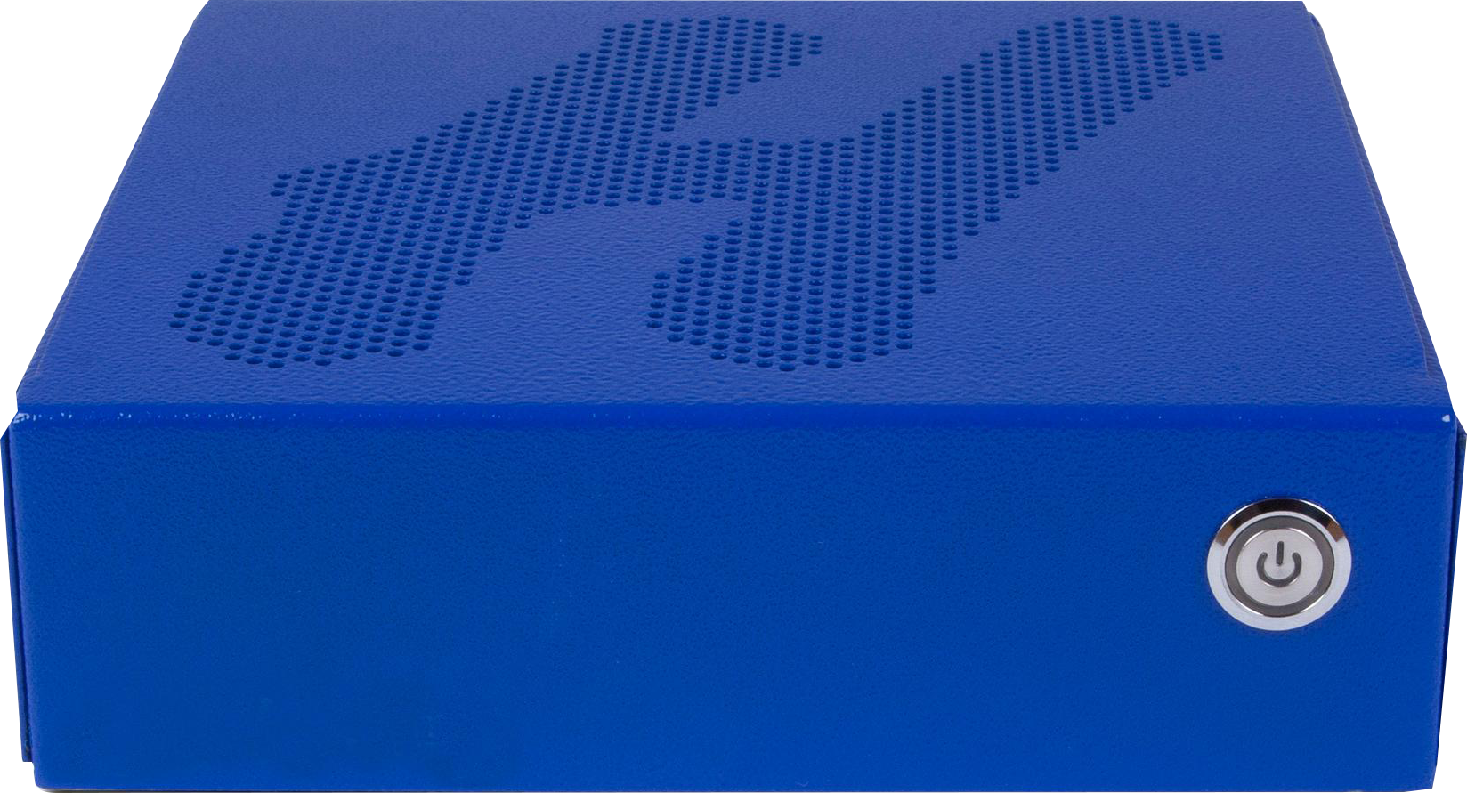
POWERED BY HOWARD INNOVATION
At Howard, we pride ourselves in the quality of our products and the level of Product Support we give to all of our customers. Our products are made and assembled here in the USA and are thoroughly tested for quality assurance. We use high quality components from manufacturers such as Intel, LG, and Samsung. We also provide FREE, 100% U.S. based, telephone technical support, 24/7, 365 days a year for as long as you own your Howard product.
Computing, Healthcare Mobility, Infection Control, Kiosk, and Telehealth Solutions

Slide 20








SHOP BY CONTRACT
Howard is dedicated to ensuring that our customers are equipped with the IT products and services they need to succeed in today’s digital environment. No matter the type, size, or location of your organization, Howard has the customizable technology solutions that will meet or exceed any specifications required to bring your facility up to 21st Century standards, and most of these are available on state or federal contracts, such as:

Slide 21
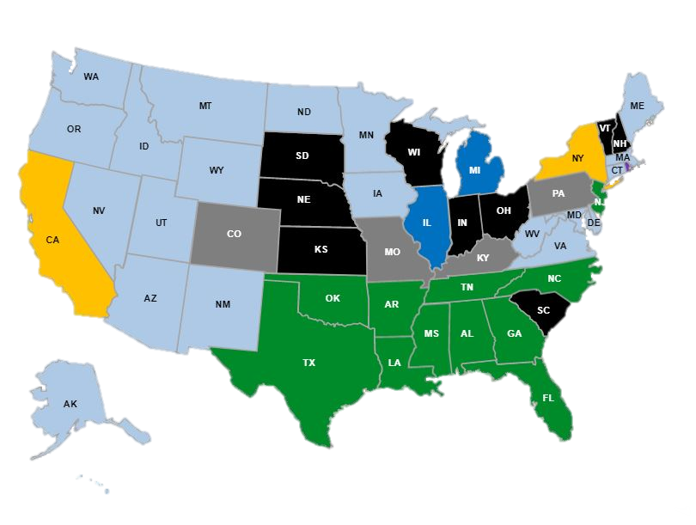
SECURITY LICENSES BY STATE
Current
Required
Local Only
Not Required
In Process
Register Only
On Hold
Expired
Pending
Expiring < 30d
2021 TOTAL PROJECTS BY TYPE
Audio Visual - 1055
Networking - 120
Security - 59
Professional Development - 11
(Note: many PD orders go in without project numbers, and therefore may not appear)

Slide 22
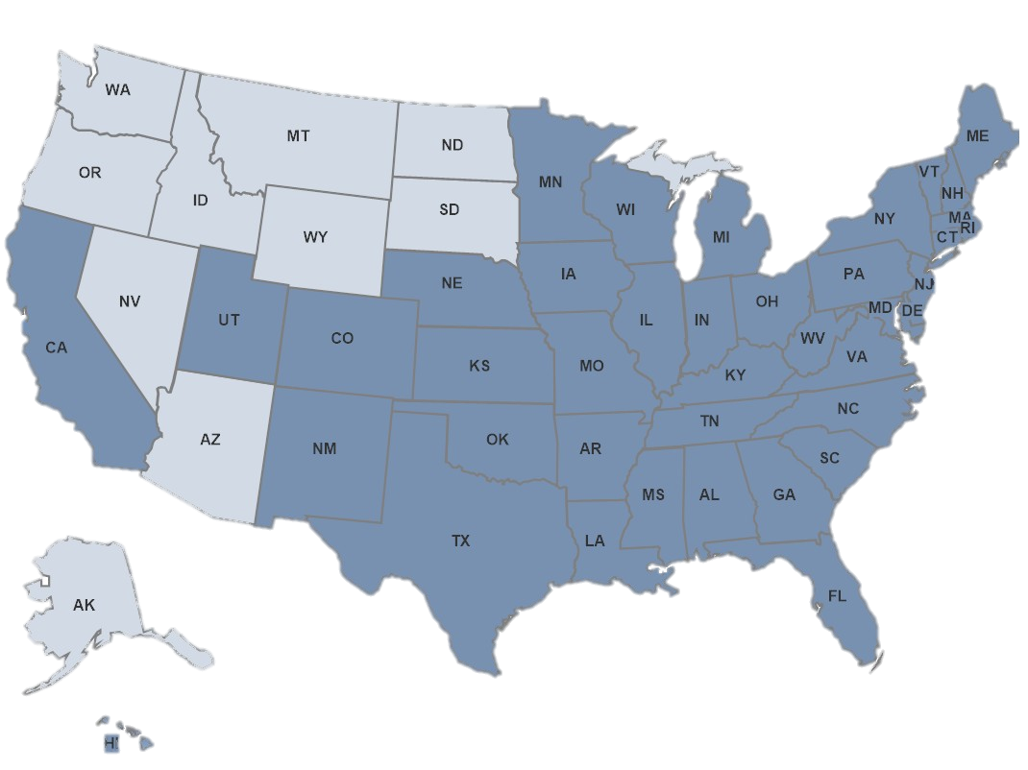
EDU, MED, BIZ-GOV Sales Force 2022
Current
Open – All Positions To Be Filled By End Of Year

Slide 23
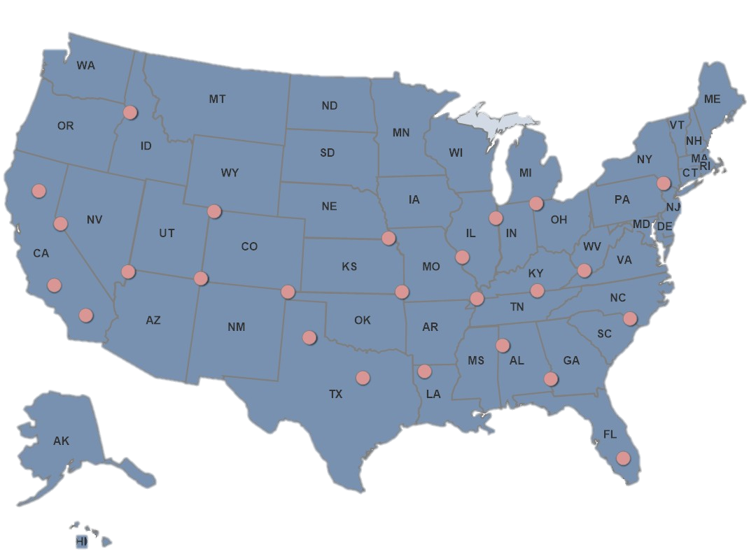
EDU, MED, BIZ-GOV Sales Force 2023
Current Reps in All States
Future
Growth

Slide 24
THANK YOU
Presented by

