Slide 1

HOWARD INTERACTIVE
KIOSK SOLUTIONS

Slide 2

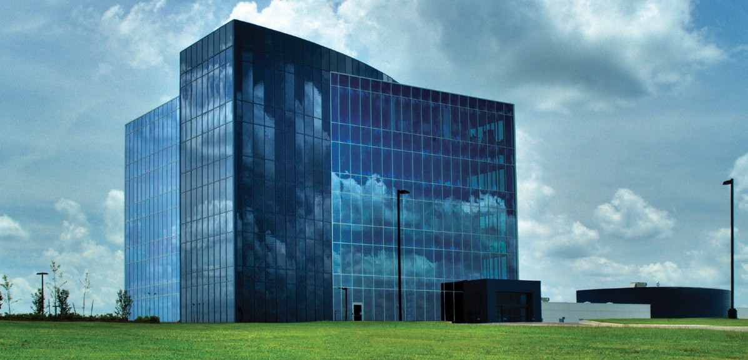
TABLE OF CONTENTS
The Howard Story 3
Company Overview 4 Kiosk Models 5 Advantages, Benefits and Features 6 – 7 Market Solutions and Advertising 8 – 9 Software 10 – 11 Contact Information 12
HOWARD DIVISIONS
Howard Power Solutions
1968
Howard Transportation 1982
Howard Lighting
1994
Oil-filled Transformers
Carrier Truck Line
LED, Lamps, Fixtures & Ballasts
2

Slide 3


THE HOWARD STORY
THE EVOLUTION OF THE HOWARD ADVANTAGE
The Howard Advantage starts with being an actual manufacturer by trade, and not simply an integrator of parts. Howard Industries Inc., our parent company, was founded in 1968 by Billy Howard, Sr. Over the past four decades, this company has grown to become the nation’s leading manufacturer of distribution transformers, with over 9 million transformers in services throughout the United States and abroad.
Howard’s firmly established position as a leader of industry served as the springboard for a new division, which began production of computer technology in 1999, Howard Technology Solutions (HTS). Howard (HTS) designs and manufactures its own desktops, notebooks, and servers, as well as a variety of enterprise mobility solutions. In addition, strategic partnerships with other industry leaders enable us to offer a rich portfolio of over 300,000 name brand products.
We have dedicated representatives for each of the products we have listed, who
are equipped with the knowledge and expertise to answer questions and assist in the buying process. From purchase and delivery to installation, management, and servicing by industry-certified technicians, Howard is with you every step of the way.
Howard manufacturing and professional services support a variety of vertical markets. We provide government agencies and schools with innovative and affordable technology, help medical facilities maximize productivity, and give businesses an edge by reducing costs and increasing revenue. From single components for small organizations to large-scale solutions for enterprise level operations, Howard supplies superior technology and customizes it to fit your needs.
Howard Technology Solutions
1999
Over 300,000
products & services
Howard Medical 2006
Howard Store
2012
Howard Interactive 2014
Point-of-Care Carts & Technology
Consumer Shopping
Kiosks
3

Slide 4







ABOUT HOWARD INDUSTRIES
Howard Power Solutions, originally known as Howard Industries, was founded in 1968 by Billy W. Howard, Sr. Over the past four decades, this company has grown to become the world’s leading manufacturer of distribution transformers, with over 9 million transformers in service throughout the United States and abroad. Located in Laurel, MS, this facility has 2.3 million square feet, making it the largest transformer plant in the world. Our newest transformer division, Howard Substation Transformers, located near corporate headquarters, began manufacturing operations in April 2005, producing power transformers with higher KVA and voltage ratings.
Howard Medical is an elite manufacturer and distributor of revolutionary point-of-care medication carts, wall-mounted workstations, and patient bedside technologies. Our commitment to providing best-in-class healthcare solutions has resulted in several cart-engineered innovations that have been adopted as industry standards. This attention to detail and to the needs of healthcare workers enables us to provide our customers with real-world solutions that ease workloads, increase efficiency, facilitate care planning, and promote patient safety.
Howard Transportation (HT), a wholly owned subsidiary of Howard Industries, Inc., operates a full-load, long-haul, flat-bed common carrier truck line and brokerage firm that transports commodities and industrial goods throughout the continental United States. Originally established to transport Howard Power Solutions’ raw materials and finished products, this division, today, consists of over 200 tractor/trailers with regional terminal facilities located in Mississippi and North Carolina.
Howard Education focuses solely on the needs of K12 School and Higher Education facilities, supplying them with innovative educational solutions and affordable technology—everything needed to create the optimal learning environment. From distance learning and interactive assessment tools to mobile presentation carts, storage solutions, and network security, Howard Education is transforming education with affordable technology.
HowardStore is our online shopping center that includes a little bit of everything, from fashionable jewelry, clothing and home furnishings to trending beauty, health and wellness supplies; the latest electronics and sporting goods. It’s all there. Whether you’re an individual consumer or a professional retailer, HowardStore gives you more of what you’re looking for.
Howard Lighting designs and manufactures safe, energy- efficient lighting products that minimize impact on the environment. We offer a full line of electronic and magnetic fluorescent and HID ballasts, LED, fluorescent, and halogen lighting fixtures and lamps for indoor and outdoor, residential and commercial applications. Howard-designed lighting systems are all manufactured and tested in Mendenhall, Mississippi. From illuminating home and work environments to lighting the way on residential streets and improving security, Howard is your one-stop-shop for lighting solutions.
Howard Interactive comes from a strong manufacturing background decades in the making and a solid commitment to customer service beginning with our parent company,
Howard Industries. Howard companies include Howard Power Solutions, Howard Medical, and Howard Lighting Solutions; Howard Transportation, Howard Technology Solutions and Howard Interactive, where we manufacture our own successful line of desktops, notebooks, and servers, as well as a variety of mobility, self-service kiosk, and digital signage solutions.
Our Corporate Headquarters is also home to our technology division, Howard Technology Solutions, and its medical division, Howard Medical. These two divisions bring to market cutting-edge technology that includes audiovisual and instructional solutions, network security and storage solutions, as well as installation, consulting, and design services. From distance learning and interactive classroom products to point- of-care medical carts and specialized mobility solutions, we make great technology available, and we make it affordable.
4

Slide 5
MARKET SOLUTIONS & ADVERTISING
Market Solutions
Kiosks minimize staffing requirements, reduce operating and transaction costs while increasing sales/ revenue, foot traffic and efficiency; manage peak traffic flow, add off-hours convenience, and enhance the overall consumer experience, which, in turn, increases customer loyalty. How will your company use them?
Utility | Round-the-clock convenience (24/7) for bill pay and automated power restoration
Healthcare | Non-ER patient check-in, payment, information/insurance updates directory/ wayfinding, room look-up
Education | Attendance, schedules, meal cards, announcement/bulletin boards, print station, event ticketing, and visitor check-in
Government | Financial services, video-conferencing, scheduling; bill payment; DMV and university services
Financial | In-store bill payment & multi-function money service solutions
Gaming | Redemption, sports book, event ticketing, digital signage
Human Resources | Solutions integrate with HR automation platforms, including ADP, Oracle, Lawson, PeopleSoft, SAP, etc.
Ticketing & Check-In | Automated ticketing sales, check-in and will-call services
Retail Solutions | Endless aisle kiosks for increased product offerings
Security | Screening and document capture for customs & border protection requirements (traveler enrollment/verification programs)
Lockers | Delivery lockers and phone charging stations
Vending Solutions | Cost-effective sales footprint expansion, theft prevention and secure self-service sales delivery in unattended environments
Green | Recycling, bike rental, etc; can include solar power, low energy consumption components and alternative cooling systems for peak efficiency
Order Entry | We offer a spectrum of ordering application platforms to drive in-store efficiency and profitability
Advertising
Our solution includes a content delivery function to advertise your company’s message, community messages and/or a sponsor who wants to pay for ad space. Advertising campaigns are managed by the advertiser, but approved by the owner of the kiosk. Promote products and services, inform and advise- engage the entire customer community.
5

Slide 6
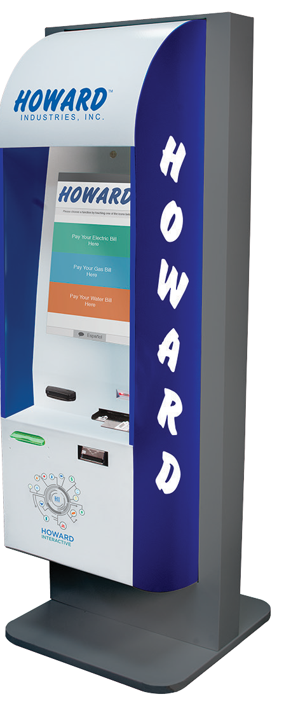
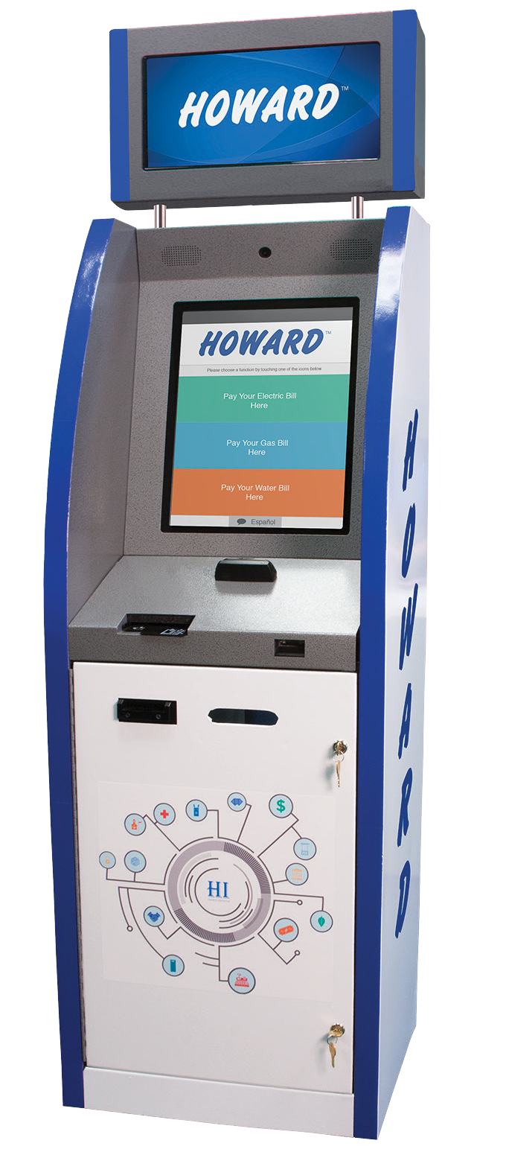
OUR AVAILABLE MODELS
HOWARD ONE
INDOOR
HOWARD TWO
INDOOR
Kiosk Standard Package
All kiosks come with the following standard package:
15” or 19” Touch Screens | Speakers | Bi-Lingual
Barcode Scanner | Camera | Windows Platform Dual
Encrypted Credit/Debit Card Reader | On-Site Training and Installation | Multiple Database Connections
Web Service Secure Connectivity | Receipt Printer | Customized Programming
SHIPPING INCLUDED
6

Slide 7
ADVANTAGES/BENEFITS/FEATURES
Software customization | Benefit/Feature
Potential revenue producer/Cost neutrality | Benefit
Low cost offsite payment collection | Advantage/Benefit/ Feature
PCI Compliant | Benefit/Feature
Decrease Customer Wait | Benefit
Reliability – Built to last for many years in all weather conditions | Benefit
Customer Service and Support – One call to make for hardware, software and service | Benefit/Feature
Increase communication to members | Benefit
Multi-lingual | Feature
Security – Continuous monitoring of kiosk | Feature
Lower customer service expenses | Benefit
100% Ownership – No middle man for transaction fees | Advantage
7

Slide 8
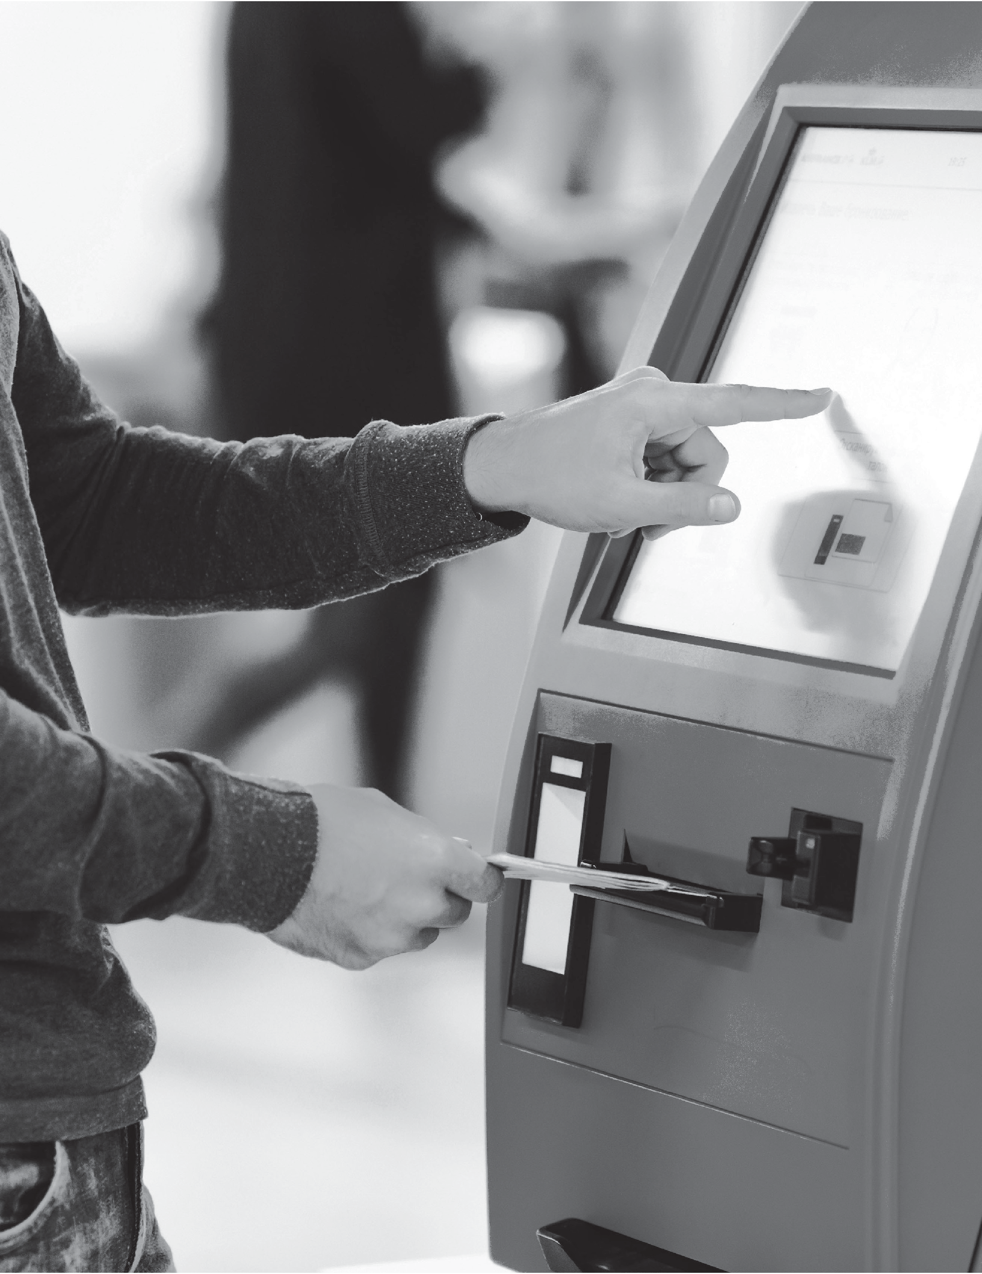
O W N E R S H I P
INVEST IN A KIOSK, NOT A BUILDING!
CONTRACT = NO CONTROL 100% OWNERSHIP = COMPLETE CONTROL
WE OFFER THAT CONTROL BY GIVING YOU 100% OWNERSHIP!
R E V E N U E
M A N A G E M E N T
The Kiosk by Howard Interactive provides the ability to collect cash, credit/debit card, and ACH (e-check) payments, 24/7.
8

Slide 9

Howard Interactive Kiosks offer a flexible array of services that can be customized to fit your needs, making it an ideal solution for:
Utility Healthcare Education Government Financial Gaming
Human Resources Ticketing
Digital Signage Retail
Tourism Security Retails/Lockers Prisons
Parking Travel
9

Slide 10
HOWARD INTERACTIVE SOFTWARE SUITE
Kiosk Application/Frontend
The Kiosk Application, or Frontend, is the customizable software that allows customers to look up account information and make payments.
Customization may include the following:
1
Alternate wording (“Enter Account #” vs. “Enter Member ID”, etc.)
2
Matching colors & graphics to reflect your current marketing brand
3
Additional “qualifiers” for account lookup (a PIN to verify, member ID, last 4 digits of the phone number associated with the account, etc.)
Customization
The Howard Kiosk concept is more than just a payment solution. Yes, our kiosk takes payments and works real-time with billing and other software. However, Howard has designed its kiosk to be flexible in other roles. A Howard kiosk can be customized by our staff to reflect the look and feel of your system or billing software. We can change the customer interface to behave the way you want it to interact with your customer. Work with our software specialists to see just how easily we can satisfy your business needs.
10

Slide 11
Backend Management Suite
The Backend Management Suite allows kiosk owners and advertisers to manage the kiosk and relationships they own and/or are associated with. The 3 primary purposes for the backend are as follows:
1
Configuration and Monitoring
Live Map showing kiosk locations can be installed
Advertising campaigns and individual ads (the owner’s own ads or third party advertisers)
Contacts for the owner account and for each location
A real-time map of the entire kiosk network with indications for problems (fault conditions)
Relationships with other payees.
2
Revenue Management
The kiosk provides the ability to collect cash, credit/debit card, and ACH (e-check) payments 24/7. The backend management suite allows owners and payees to manage and report on the revenue.
There are two primary functions within Revenue Management:
Transaction Reporting – viewing, filtering, sorting, and exploring lists of transactions for the whole owner/payee account by location or by kiosk.
Collection Management – viewing how much cash is in a kiosk (and how many bills), then recording and verifying collections when cash is pulled from those machines.
3
Alerts and Repair
We’ve designed the software to handle these issues gracefully, but when a fault occurs, we learn about it in the Backend. Faults are reported automatically to the owner and Howard Interactive.
When a fault is reported, it will appear in the backend management suite, and the appropriate contact for the owner will be notified (if a cashbox requries removal, accounting will be alerted; if the kiosk is down, a technical contact will be notified, etc.)
When a problem is noted requiring repairs, the owner can manage Repair Orders in the backend management suite whether they dispatch their own personnel to fix the issue or a Howard technician is required. Health checks are performed every 15 seconds.
11

Slide 12

CONTACT INFORMATION
If you have any questions about our line of technology partner products, feel free to contact us for more information.
General Information
Toll Free: 1.888.912.3151
Customer Support
Toll Free: 1.888.323.3151
Technical Support
We provide FREE telephone technical support 24/7 (excluding US holidays) for as long as you own your Howard product. Our friendly, US-based team of experts will answer your questions about the product, hardware setup, or installation, and with telephone hold times of typically less than 1 minute!
For technical support call 888.323.3151
For Kiosk Inquiries
Please call 601.399.5051 or email kiosk@howard.com.
FUTURE ENHANCEMENTS
Amber Alert Ability
Weather Alerts
HR Application Module
Service Order Requests
Other Company Payment Collection
Pre-Pay Revenue Stream
12
Point-Of-Sale options

