Slide 1

HOWARD
Kiosk Solutions

Slide 2

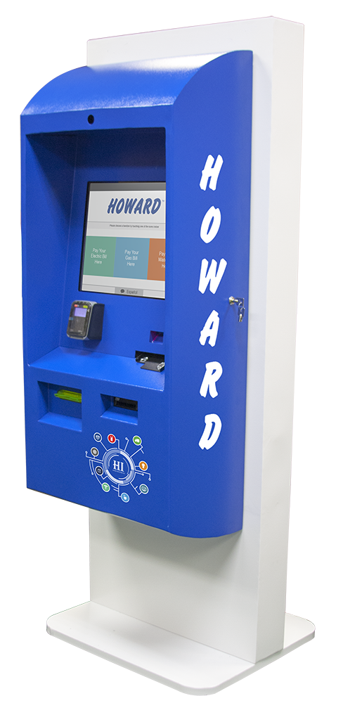



HOWARD ONE SERIES
The Howard One Series combines the best design aspects of our custom indoor and outdoor models, yet delivers the simplicity and economy of one design for multiple locations.
This versatile platform integrates smoothly with any indoor work environment, with standalone, wall-mounted, and through-the-wall mounting options available.
Additionally, its rugged outdoor design, equipped with adjustable AC control and a watertight seal, grant it longevity in the face of the elements and make it a simple, viable, and economical option.
Designed for virtually any feature mix, the One can accommodate peripheral options including a card dispenser, key pad, signature pad, or additional cash box.

Slide 3
MODEL COMPONENTS
BASE MODEL INCLUDES
Durable Powder Coated Steel Enclosure
Barcode Scanner
Encrypted EMV Credit Card Reader
Bill Acceptor
Check Reader
Howard Premier PC
Dual Amplified Speakers
19” Touch Screen
Thermal Receipt Printer
Internal Keyboard with Trackball
Camera
OPTIONAL COMPONENTS
Card Dispenser
Wide Thermal Printer
Ticket Printer
Signature Pad
Key Pad
Extra Cash Box
Outdoor Design with AC Control
ENCLOSURE DIMENSIONS
• 71.2” High, 26” Wide, 24” Deep
Weight: 375 pounds

Slide 4

CUSTOMER BENEFITS
Faster service with extended hours capable of taking partial or whole payments
Real-time confirmation for payments with
up-to-date bill presentation
Secure payments
Option for an offsite location for bill payment such as grocery stores or other community touchpoints
Multi-lingual user interfaces

Slide 5



CUSTOMER BENEFITS
Targets the un- or under-banked or cash preferred by providing a legitimate, safe, simple way to pay bills in cash (in addition to card and check systems)
Provides proactive financial management (avoiding late fees, service interruption, and reconnect fees)
Easily look up account balance
Options for email and/or printed receipts

Slide 6

BUSINESS BENEFITS
Improved customer service
Improved brand equity and customer perception
Increased daily sales productivity and increased cash flow
Reduced transaction costs, accelerating ROI with each payment
Bill payment transactions facilitated in less than 2 minutes, improving service efficiency and revenue recognition
Howard is partnered with Vantiv for credit card processing and Sage Check 21 for check processing

Slide 7

BUSINESS BENEFITS
Reduced human error and reconciliation costs
Cost effective delivery of repetitive transactions
Lowered staffing/overhead costs by lowering the number of personnel required to accept payments
Simplified reporting
Reduced time to disconnect and to reconnect service
Optional advertising sales to additionally increase revenue

Slide 8

SOFTWARE SUITE
Kiosk Application/Frontend
The Kiosk Application, or Frontend, is the customizable software that allows customers to look up account information and make payments.
Customization May Include:
1
Alternate wording (“Enter Account #” vs. “Enter Member ID”, etc.)
2 Matching colors & graphics to reflect your current marketing brand.
3
Additional “qualifiers” for account lookup (a PIN to verify, member ID, last 4 digits of the phone number associated with the account, etc.)
Customization
A Howard kiosk can be customized by our staff to reflect the look and feel of your system or billing software. We can change the customer interface to behave the way you want it to interact with your customer.

Slide 9
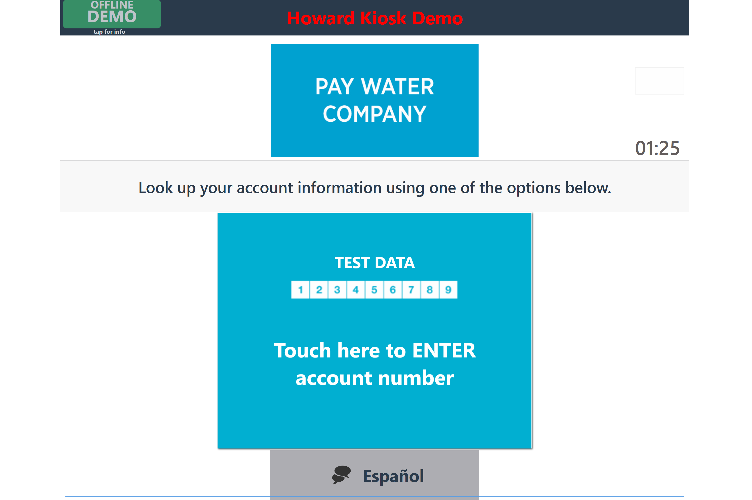
SOFTWARE SUITE DEMO
1

Slide 10
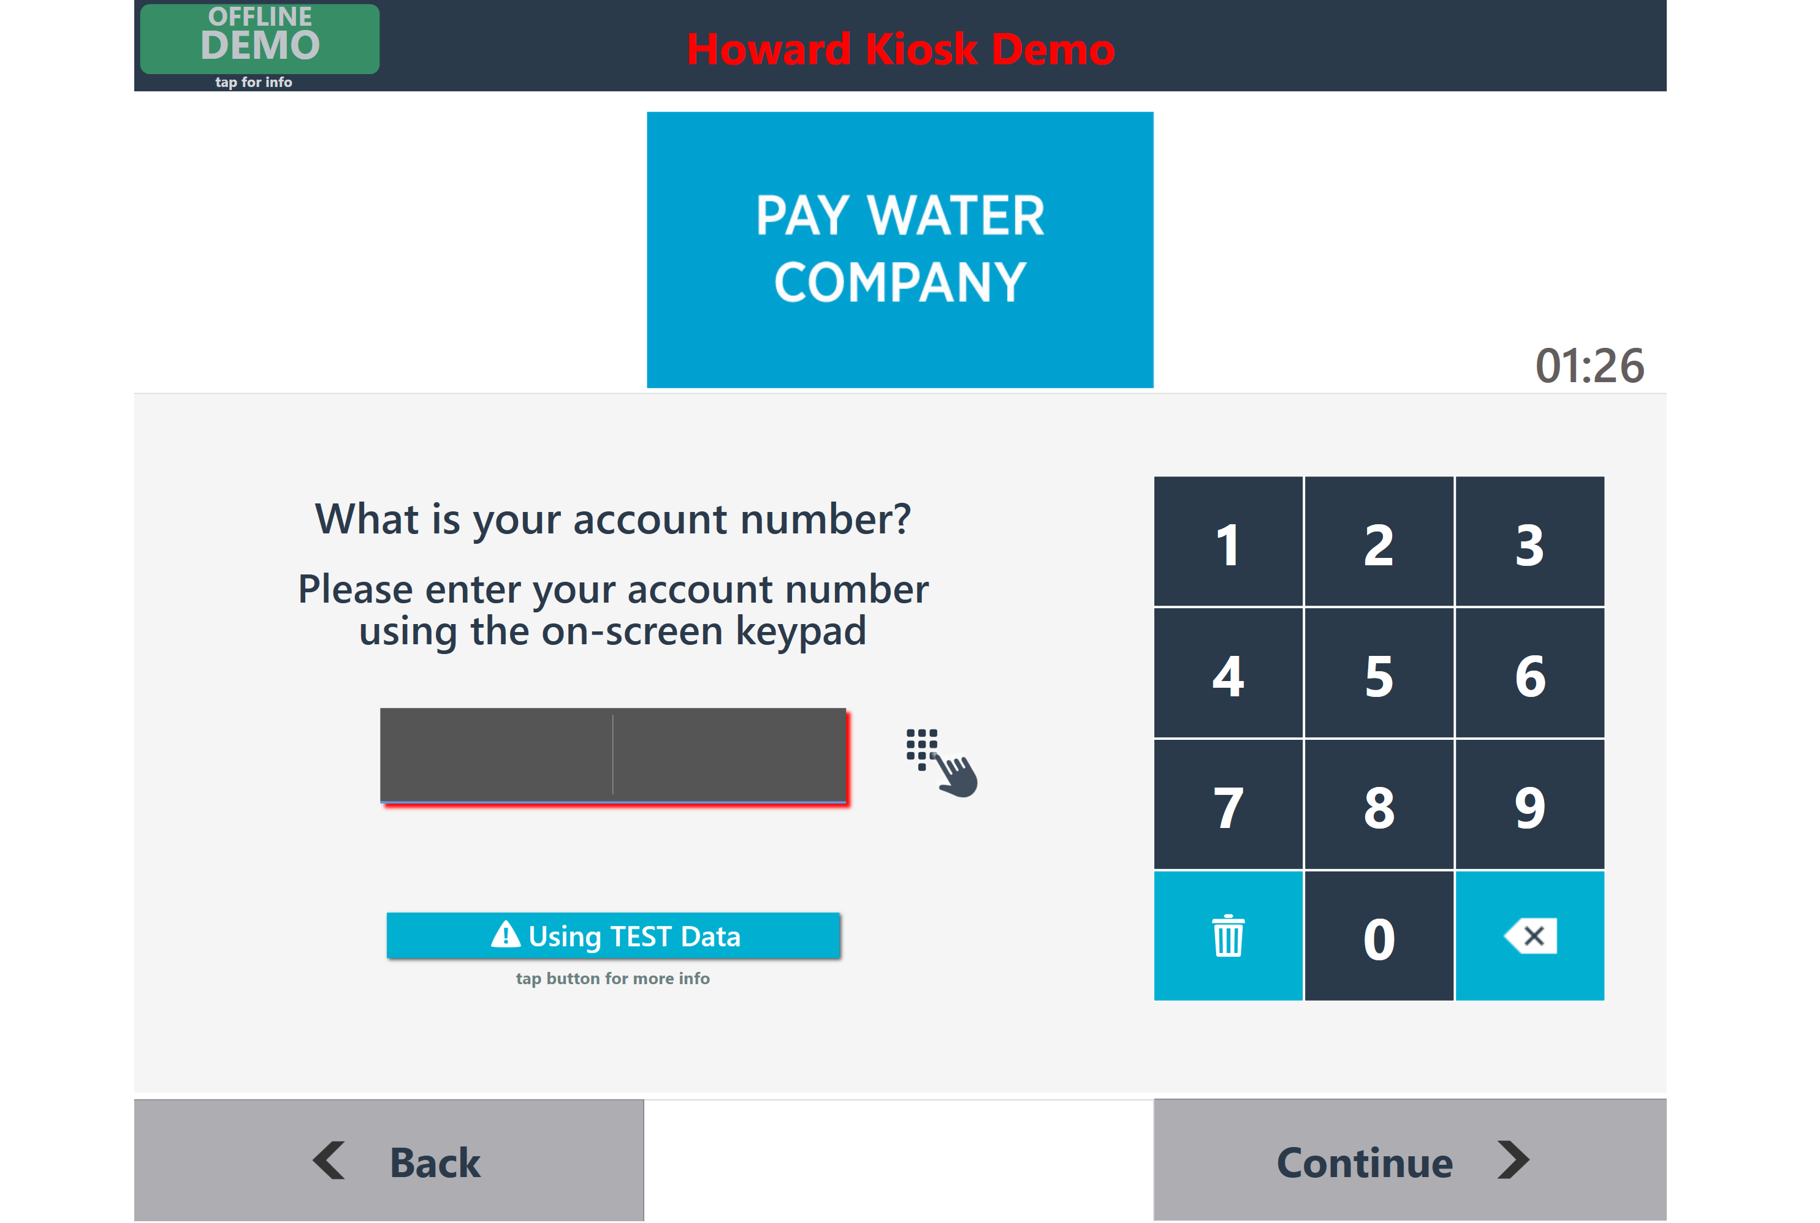
SOFTWARE SUITE DEMO
1

Slide 11
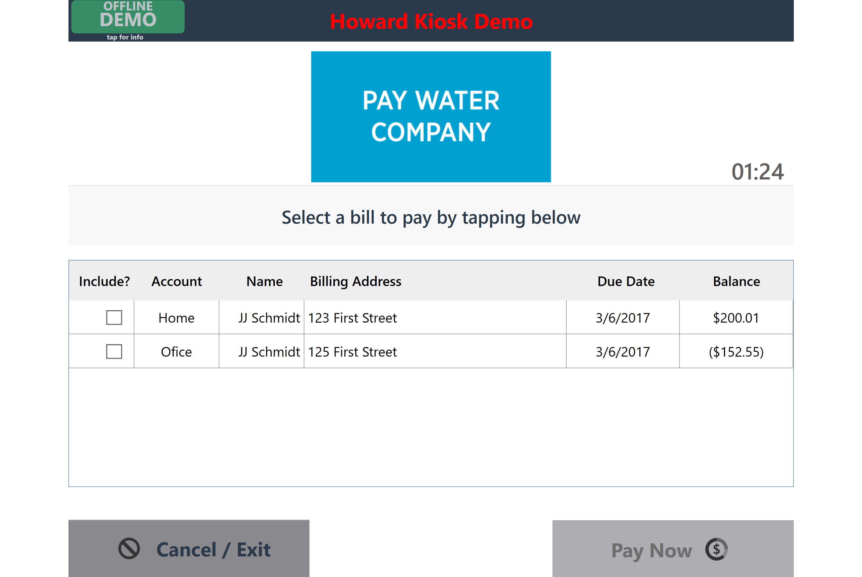
SOFTWARE SUITE DEMO
1

Slide 12
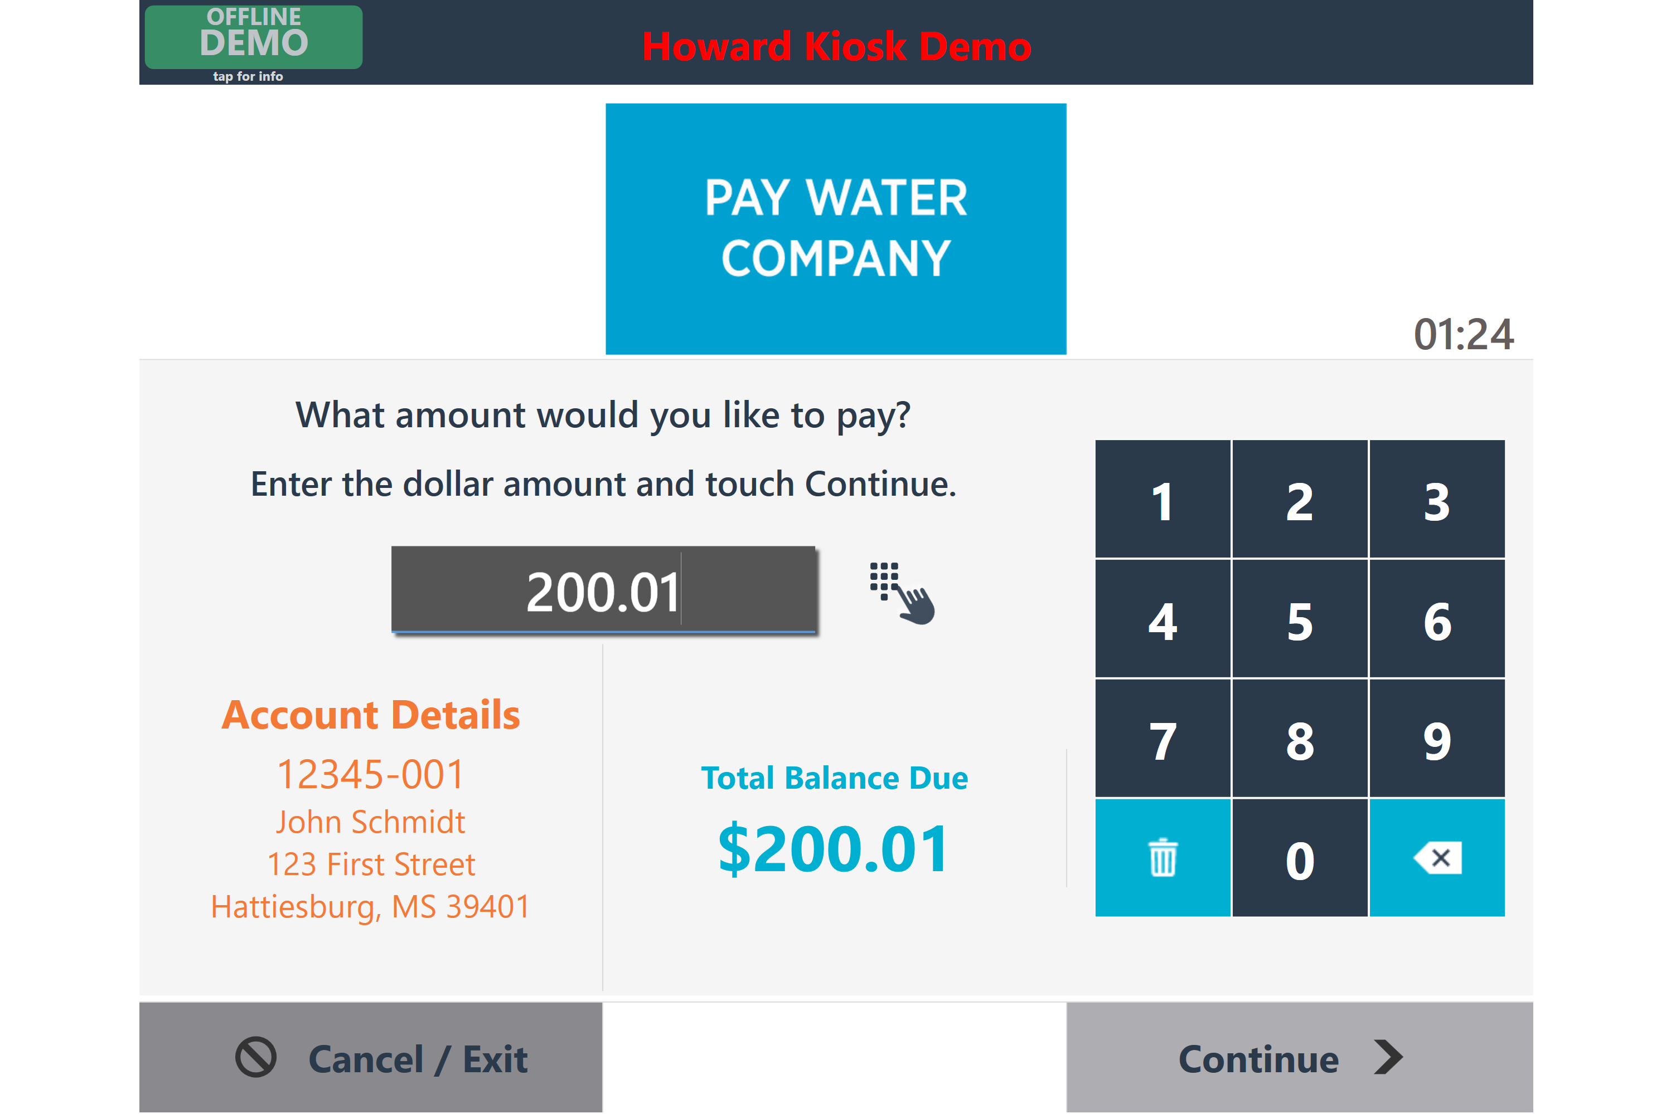
SOFTWARE SUITE DEMO
1

Slide 13
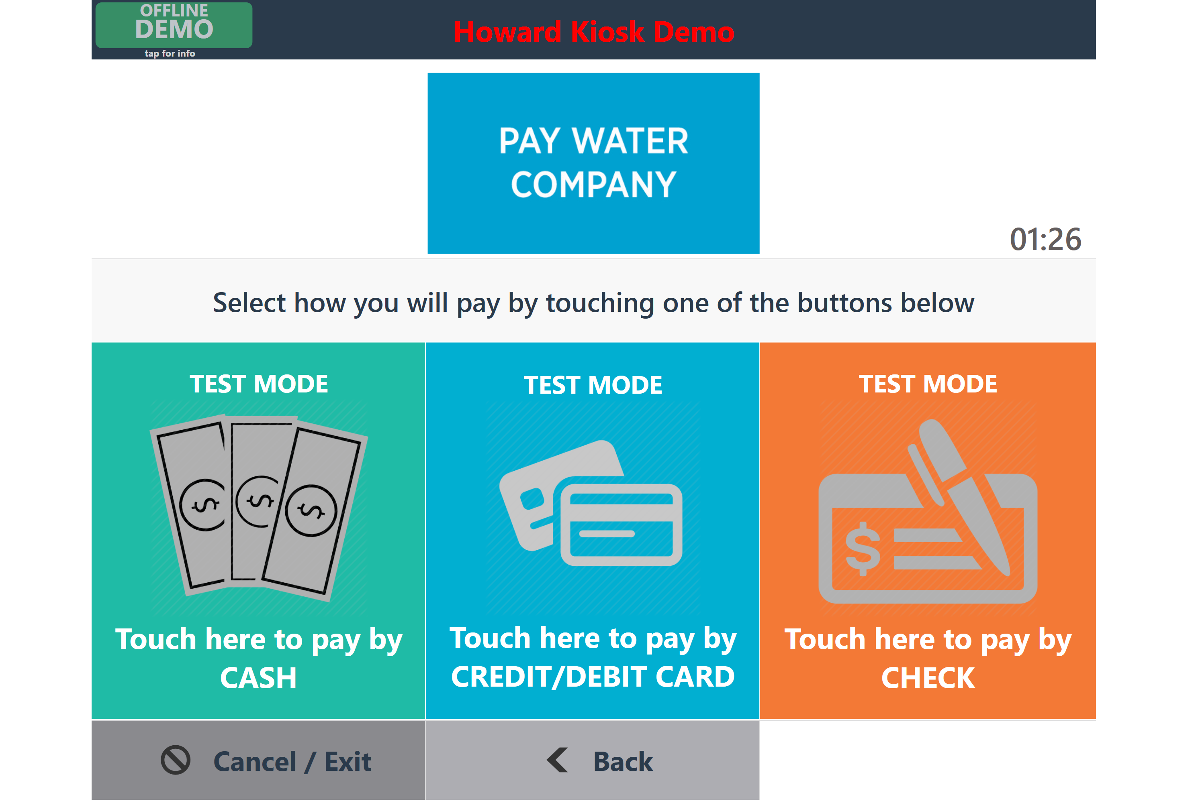
SOFTWARE SUITE DEMO
1

Slide 14
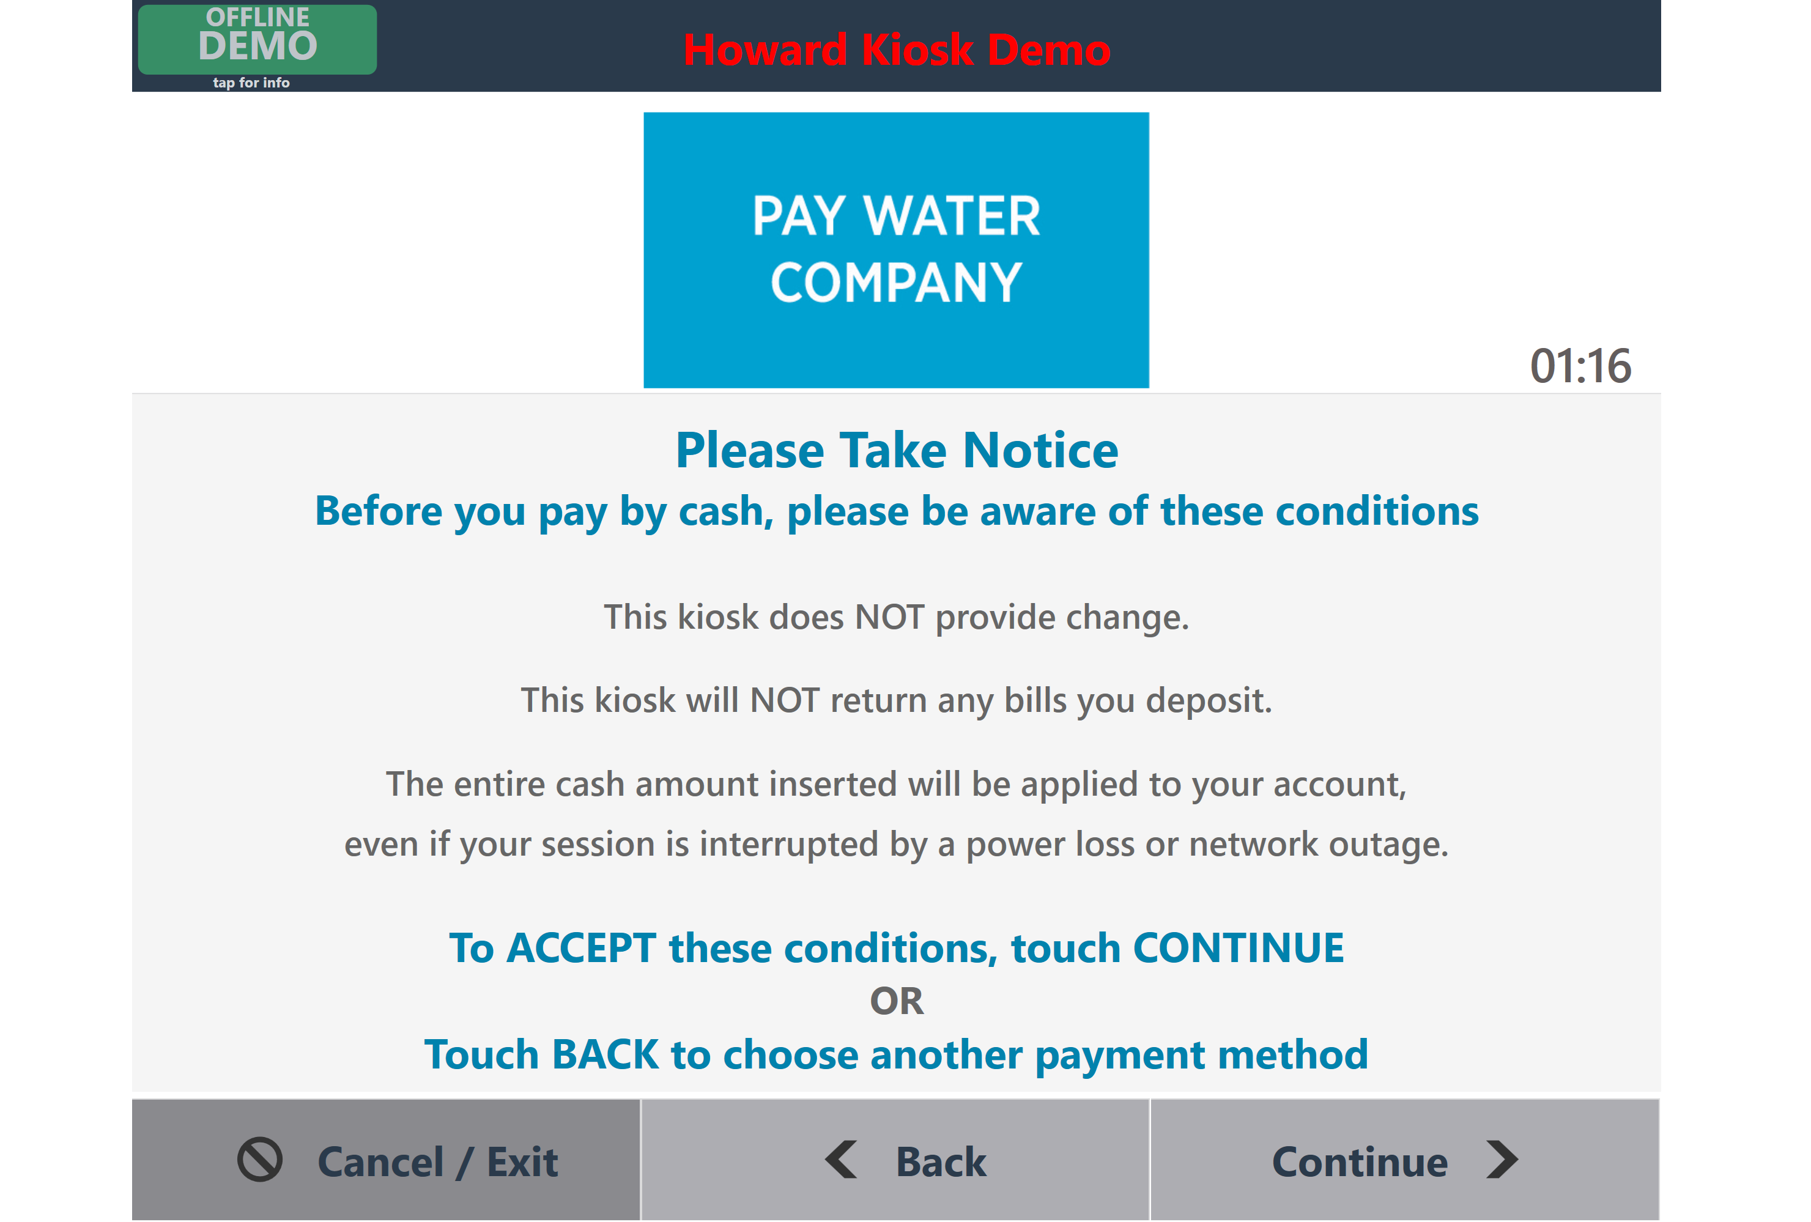
SOFTWARE SUITE DEMO
1

Slide 15
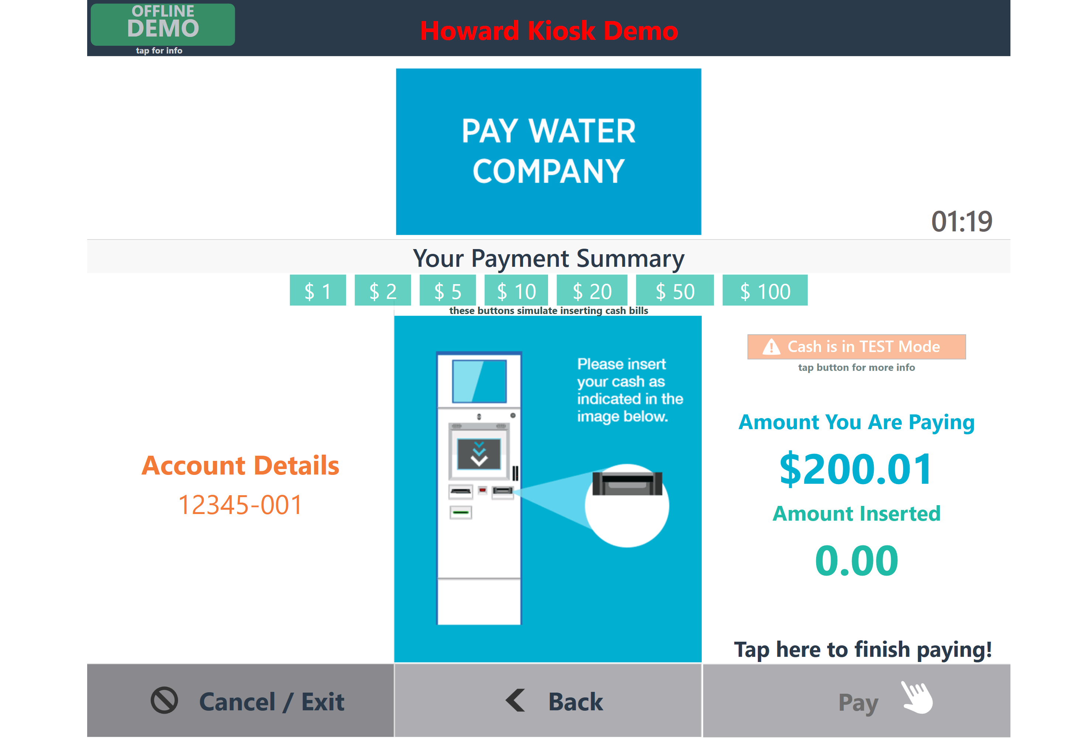
SOFTWARE SUITE DEMO
1

Slide 16
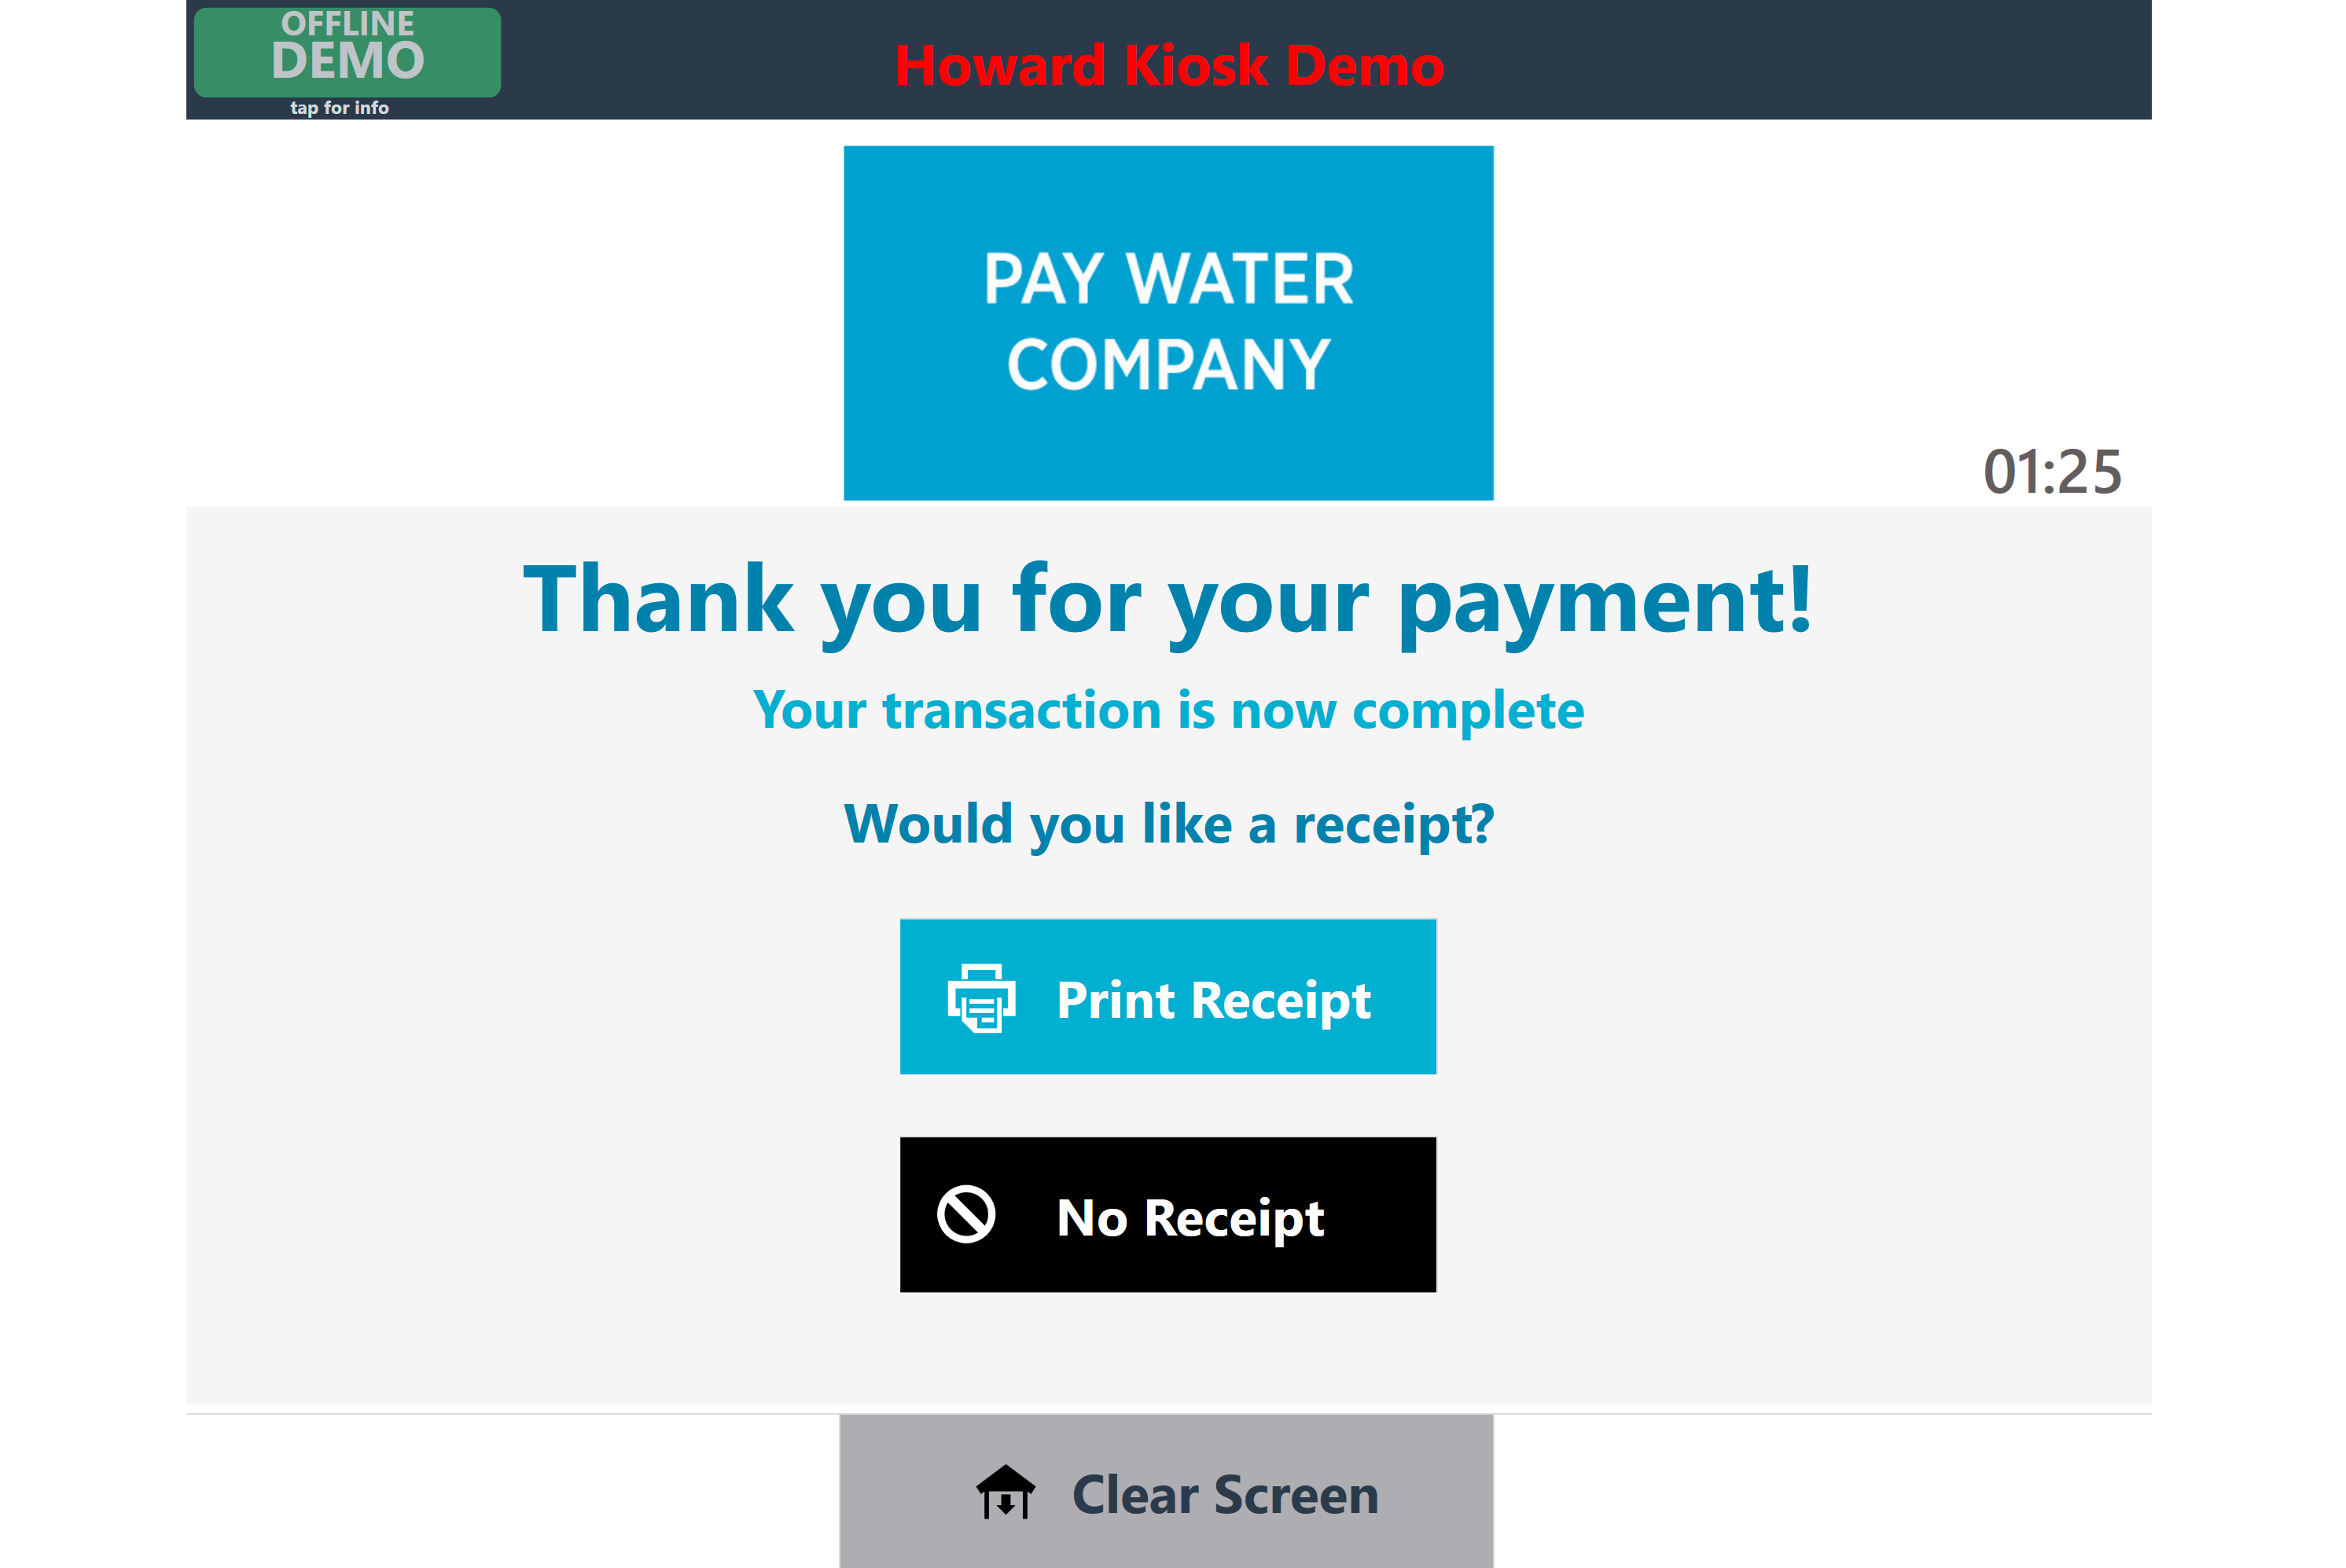
SOFTWARE SUITE DEMO
1

Slide 17
BACKEND MANAGEMENT
The Backend Management Suite allows kiosk owners and advertisers to manage the kiosk and relationships they own and/or are associated with. The 3 primary purposes for the backend are as follows:
1
Configuration and Monitoring
Live map showing kiosk locations can be installed
Advertising campaigns and individual ads (the owner’s own ads or third party advertisers)
Contacts for the owner account and for each location
A real-time map of the entire kiosk network with indications for problems (fault conditions)
Relationships with other payees

Slide 18
BACKEND MANAGEMENT
2
Revenue Management
The kiosk provides the ability to collect cash, credit/debit card, and ACH
(e-check) payments 24/7. The backend management suite allows owners and payees to manage and report on the revenue.
There are two primary functions within Revenue Management:
Transaction Reporting – viewing, filtering, sorting, and exploring lists of transactions for the whole owner/payee account by location or by kiosk.
Collection Management – viewing how much cash is in a kiosk (and how many bills), then recording and verifying collections when cash is pulled from those machines.

Slide 19
BACKEND MANAGEMENT
3
Alerts and Repair
We’ve designed the software to handle these issues gracefully, but when a fault occurs, we learn about it in the backend. Faults are reported automatically to the owner and Howard.
When a fault is reported
It will appear in the backend management suite, and the appropriate contact for the owner will be notified (if a cashbox requries removal, the account manager will be alerted; if the kiosk is down, a technical contact will be notified, etc.)
When a problem is noted requiring repairs
The owner can manage repair orders in the backend management suite whether they dispatch their own personnel to fix the issue or a Howard technician is required.
Health checks are performed every 15 seconds.

Slide 20
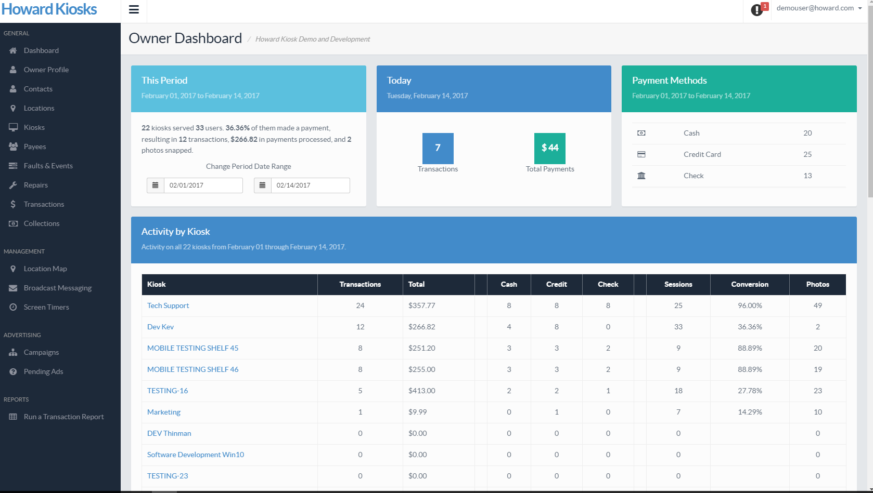
BACKEND MANAGEMENT

Slide 21
COLOR OPTIONS
It is important to consider the finish choice when selecting the color of paint for your machine. Standard selections all come with textured, semi-gloss finish, which provides a more consistent and polished surface coverage.
A paint application with the textured Hammertone finish is recommended for the following reasons:
The finish is the most fingerprint resistant.
Texture provides the best coverage, making any minor metal variations indistinguishable.
Graphics hold well on all textured finishes for smooth, professional branding.
Textured paint is the most cost-effective process, eliminating any additional preparation steps for the enclosure metals.

Slide 22
COLOR OPTIONS

Slide 23
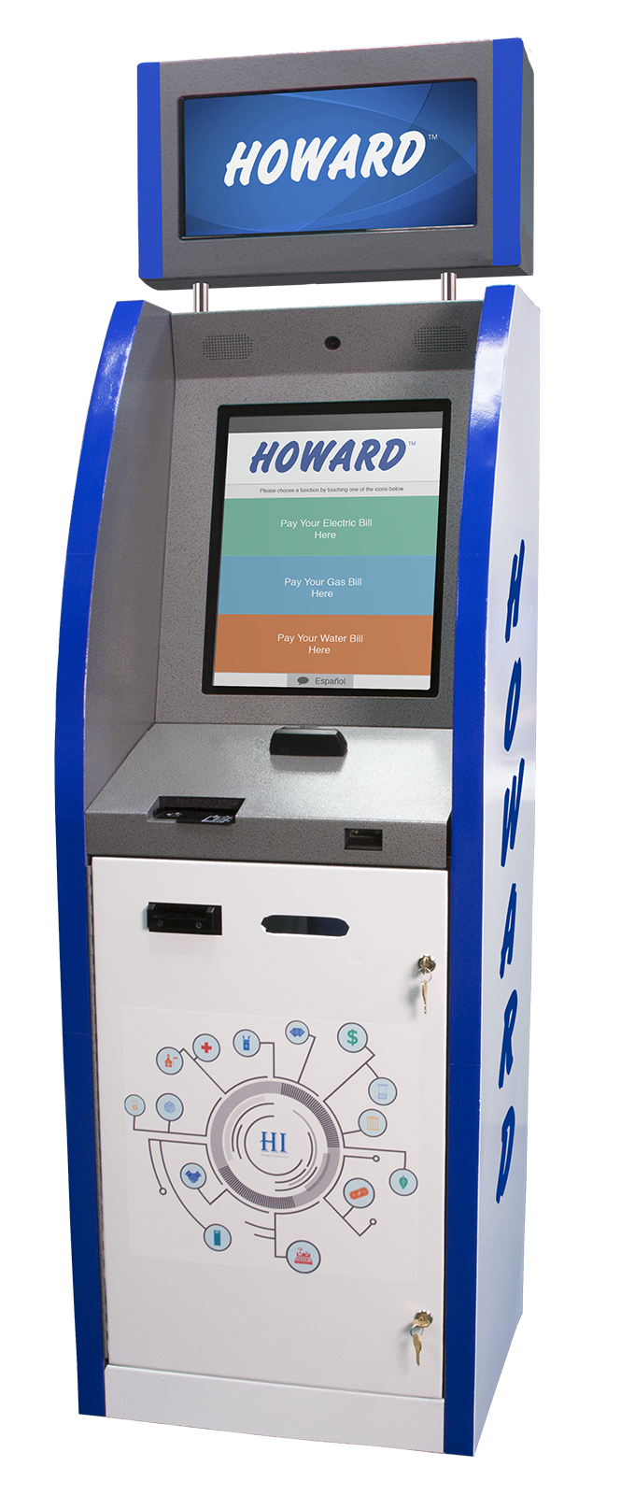
CUSTOM COLORS
Custom colors and finishes can be provided. Please consider the following when choosing your palette:
All powder coat paint choices are environmentally friendly and RoHS Compliant. All are industrial quality and applied to withstand years of heavy public use and exposure to the elements.
Smooth high gloss or flat finish paints require additional metal grinding and priming steps prior to paint application for a quality end product. There is an additional fee for these steps.
Smooth high gloss paints (especially dark colors) show fingerprints and require more frequent upkeep. Powder coat is recommended over wet paint for kiosks.
Powder coat provides far better resistance to color degradation from the elements and superior durability. Additional fees are applied for wet paint process.

Slide 24
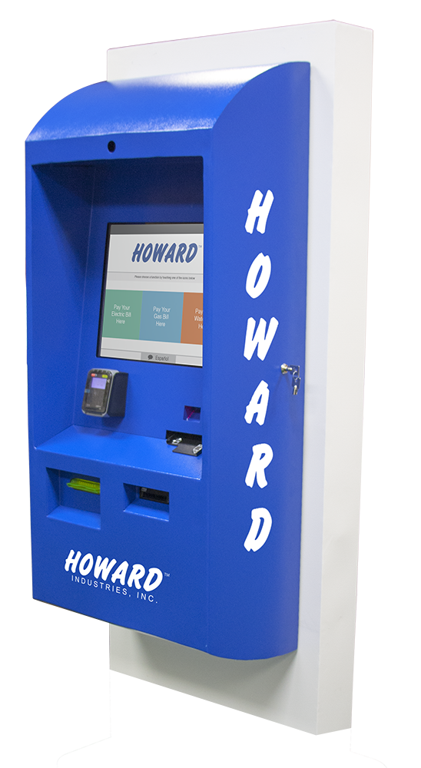
HOWARD ONE SERIES
Howard One
Indoor/Outdoor
Howard Two
Indoor
Howard One
Indoor/Outdoor
Through Wall Unit

