Slide 1



Healthcare Solutions | 2019

Slide 2
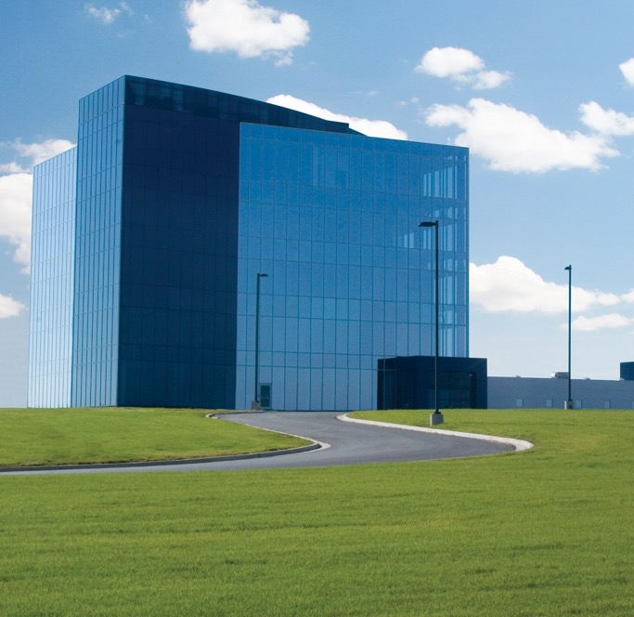
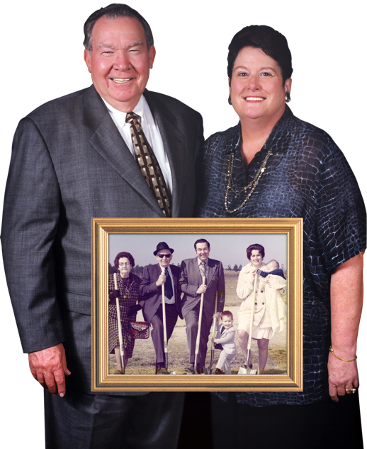
Howard Industries
1968 Howard Industries is established and grown by Billy W. Howard and Linda Howard
A billion dollar company that is family owned
Corporate headquarters located in south Mississippi

Slide 3
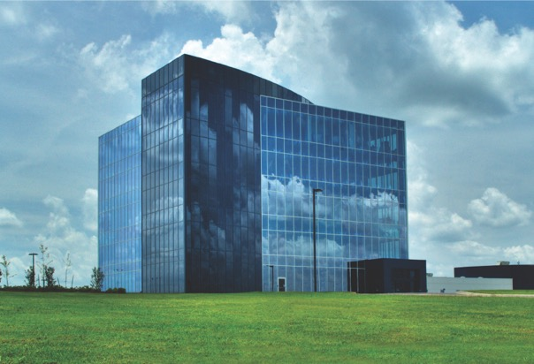
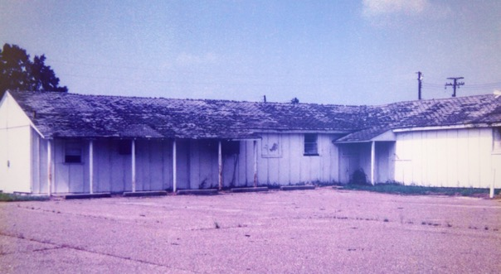
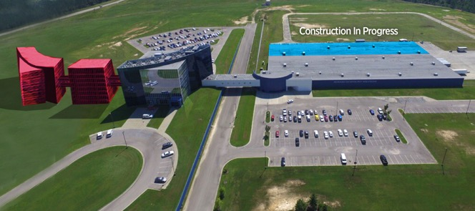
Howard – Then, Now, and the Future
The first Howard building in
an old army barracks
Current corporate headquarters & production facilities
Plans for future growth
& expansion

Slide 4
Howard Industries
Over 2-Million Square Feet
More Than
500 Engineers
6 Different Facilities
Six different facilities including corporate headquarters, manufacturing facilities, and a transportation facility
Over 2 million square feet of manufacturing space – Transformers, Lighting, Kiosks, Medical Equipment, Computers, & more…
Over five hundred mechanical & electrical engineers with thousands of combined years of experience

Slide 5




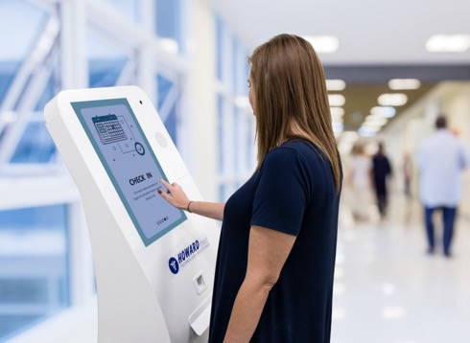
Healthcare Solutions
Mobility Solutions
Audiovisual Solutions
Telehealth Solutions
Patient Experience Solutions
Kiosk Solutions

Slide 6


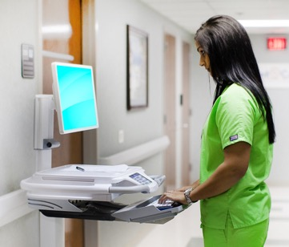

Mobility Solutions
Why Mobility Solutions?
Effective and ergonomic
Enhances patient care
Increase security
Reduce human error
Ease workloads
Versatile to fit any workflow

Slide 7
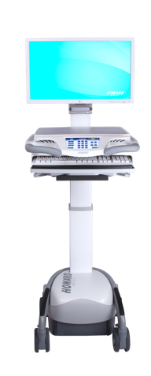
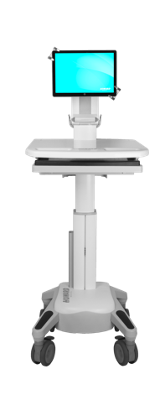
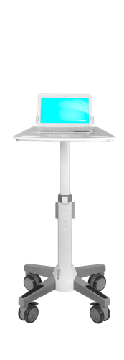
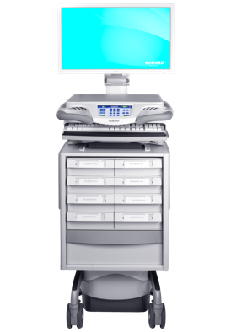
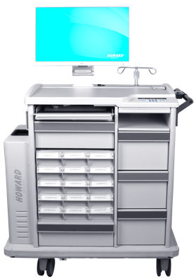
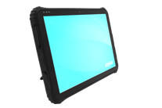
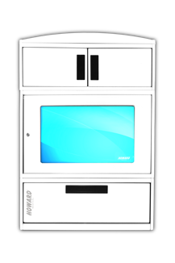
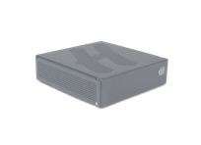
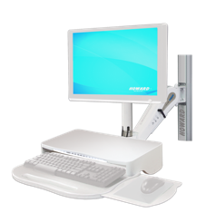
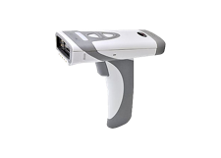
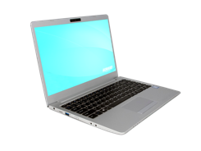
Mobility Solutions
Point-of-Care Technology
Mobile Point of Care Solutions
Med Dispense Solutions
Fixed Solutions
(HI-Care, HI-Core, HI-Swift)
(HI-Paradigm, HI-Pinnacle, Med-Hub, Transfer Cart, MedServe Cabinets)
(Arms, Cabinets)
(Technology/Software In POC)

Slide 8
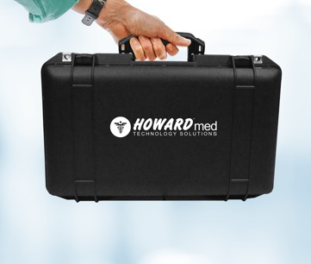



Telehealth Solutions
Why Telehealth Solutions?
Healthcare to remote areas
Remote patient monitoring
Reduce readmission rates
Medical consultations
Patient education and staff training
Specialty in-field services

Slide 9
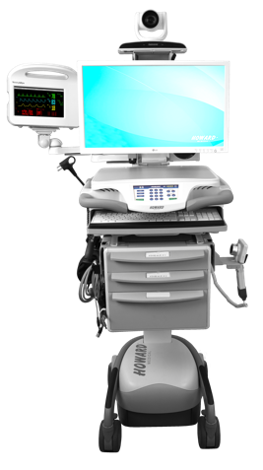
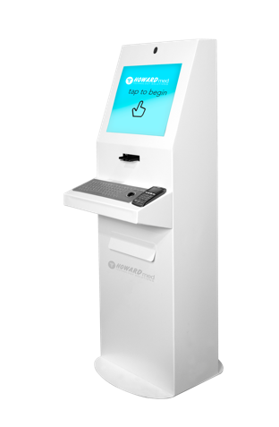
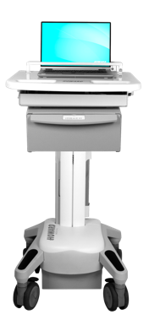
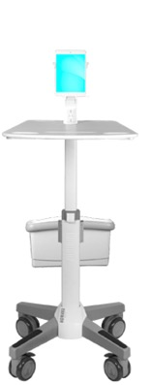
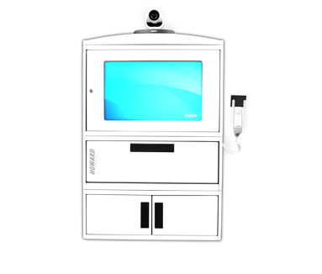
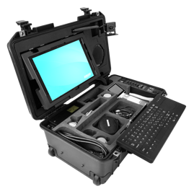
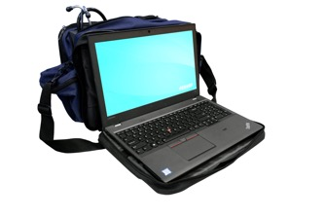
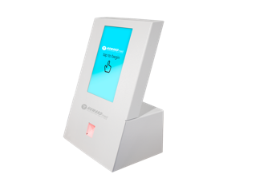
Telehealth Solutions
Cart Solutions
Wall-Mounted Solutions
Kit Solutions
Kiosk Solutions
(TeleCare, TeleCore,
Kubi Swift)
(Telehealth Cabinet)
(Rugged Telemedicine Kits, Soft Telemedicine Kit)
(Telehealth Kiosks)

Slide 10

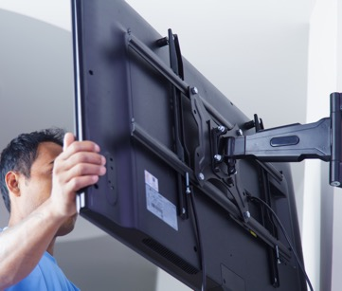


Audiovisual Solutions
Why Audiovisual Solutions?
Interactive teaching
More effective training
Make remote consultation & diagnosis possible
Facilitate collaboration
Increase security and communication

Slide 11

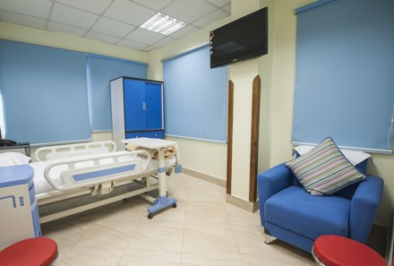
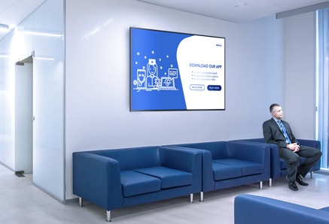

Audiovisual Solutions
Meeting Room Solutions
Patient Room Solutions
Waiting Room &
Hallway Solutions
Learning Center & Auditorium Solutions
Audio Solutions | Cables | Furniture | Interactive Solutions | Interactive Touchscreen LCDs | Monitors & Displays | Mounts | and more

Slide 12




Patient Experience Solutions
Why Patient Experience Solutions?
Alleviate stress
Increase patient comfort
Improve clinical outcomes
Individualize patient care
Better HCAHPS scores
Improve population health

Slide 13
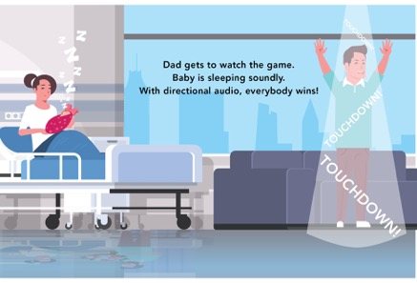



Patient Experience Solutions
Noise Pollution Solutions
Lighting Solutions
Media Solutions
Communication Solutions
(directional audio)
(patient adjustable
smart lighting)
(streaming platforms)
(interactive whiteboards, medical information, patient updates, daily goals)

Slide 14
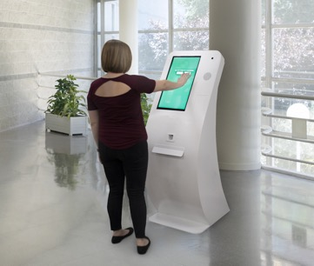
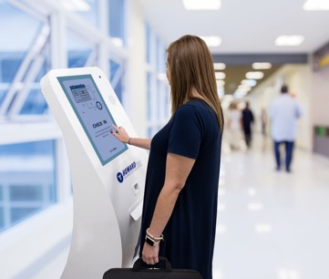
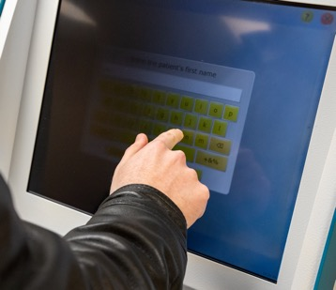
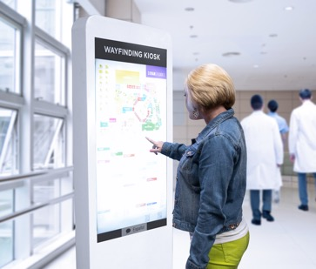
Kiosk Solutions
Why Kiosk Solutions?
HIPAA compliant
EMR compatible
Patient check-in and bill-pay
Wayfinding in and around the facility
Vendor check-in
24/7 Information access
Virtual concierge

Slide 15
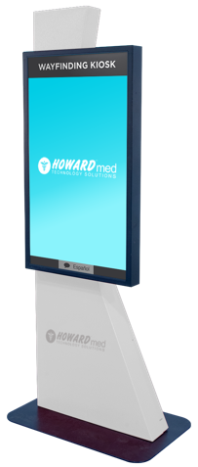
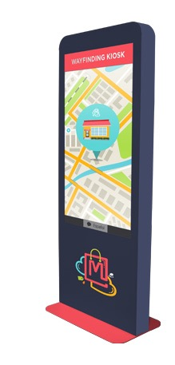
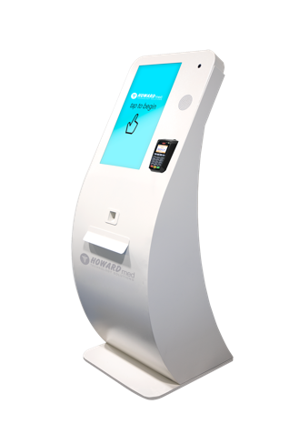
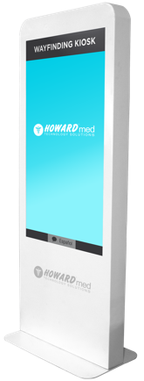
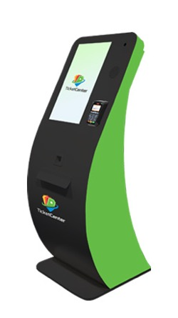
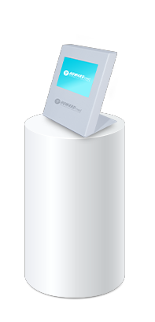
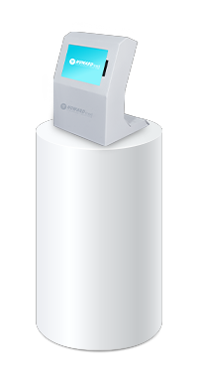
Kiosk Solutions
Freestanding
Kiosk Solutions
Tabletop
Kiosk Solutions
Wayfinding
Kiosk Solutions
Custom
Kiosk Solutions
(W-Series )
(A-Series)
(D-Series)
(custom solutions to fit your facility)

Slide 16
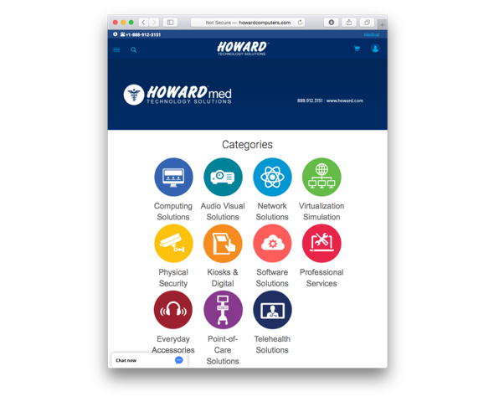
Thank You
Want to view more of Howard Medical’s solutions?
Scan the QR code below to view our online linecard.
^{Web:}
^{www.howard-medical.com}
Live chat available M-F, 8-5 CST
^{Customer & Technical Support:}
^{Toll Free: 1.888.323.3151}
^{24/7 (excluding US holidays)}
^{General Information:}
^{Toll Free: 1.888.912.3151}
Website:
www.howard-medical.com
Live chat available M-F, 8-5 CST
Customer & Technical Support:
Toll Free: 1.888.323.3151
24/7 (excluding US holidays)
General Information:
Toll Free: 1.888.912.3151

