Slide 1

Audiovisual Solutions

Slide 2

Audiovisual Solutions
  Enables more effective training
  Provides better communication between hospitals, staff, patients and visitors
  Extends the reach of healthcare through remote/virtual diagnostic and consultation visits
  Facilitates better collaboration between doctors and hospitals
  Offers more enjoyable patient and visitor experiences

Slide 3

Patient Room Displays

Slide 4


Patient Room Displays
  Adds Smart TV features
  Easy Integration with Nurse Call systems
  Compatible with advanced Patient Experience planforms
  Versatile content delivery options

Slide 5

Boardrooms

Slide 6
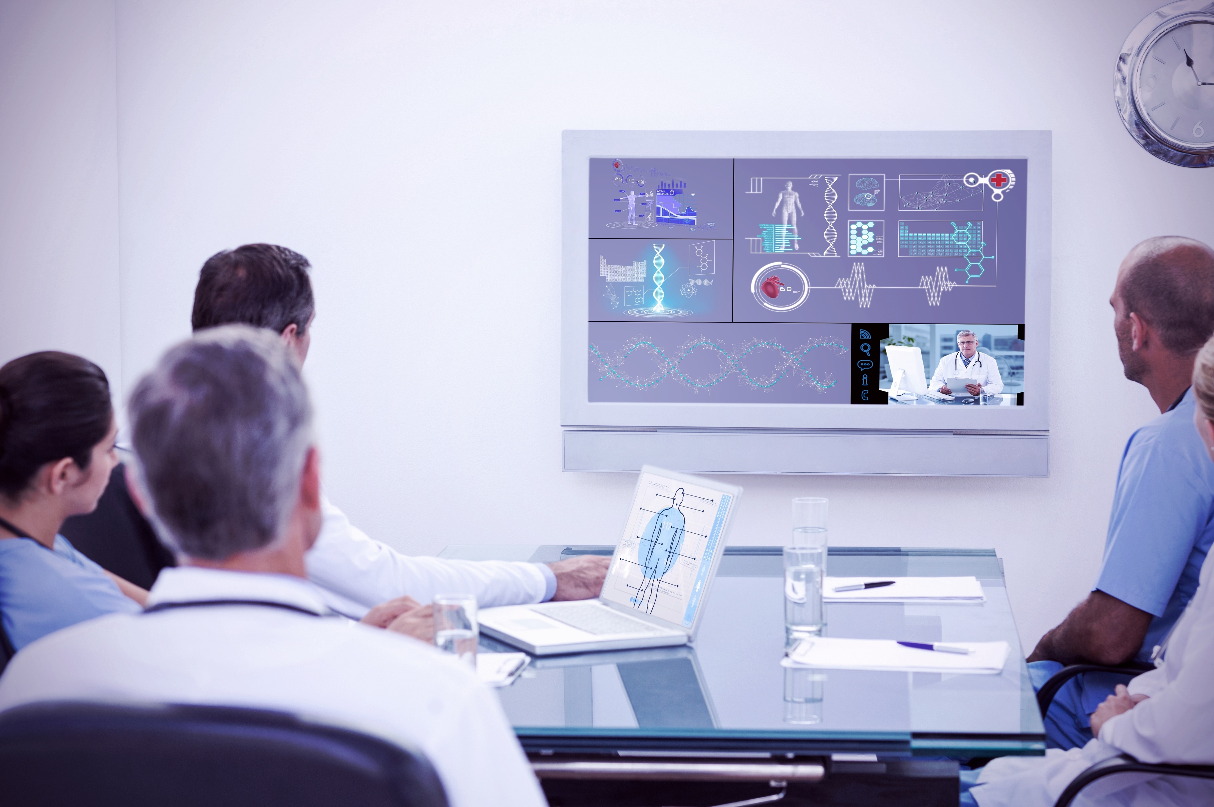

Boardrooms
  Next generation displays and projectors for crystal clear images
  Integrated microphones and speakers
  User friendly Touch-Screen Control Systems
  Wireless content sharing

Slide 7

Collaboration Rooms

Slide 8
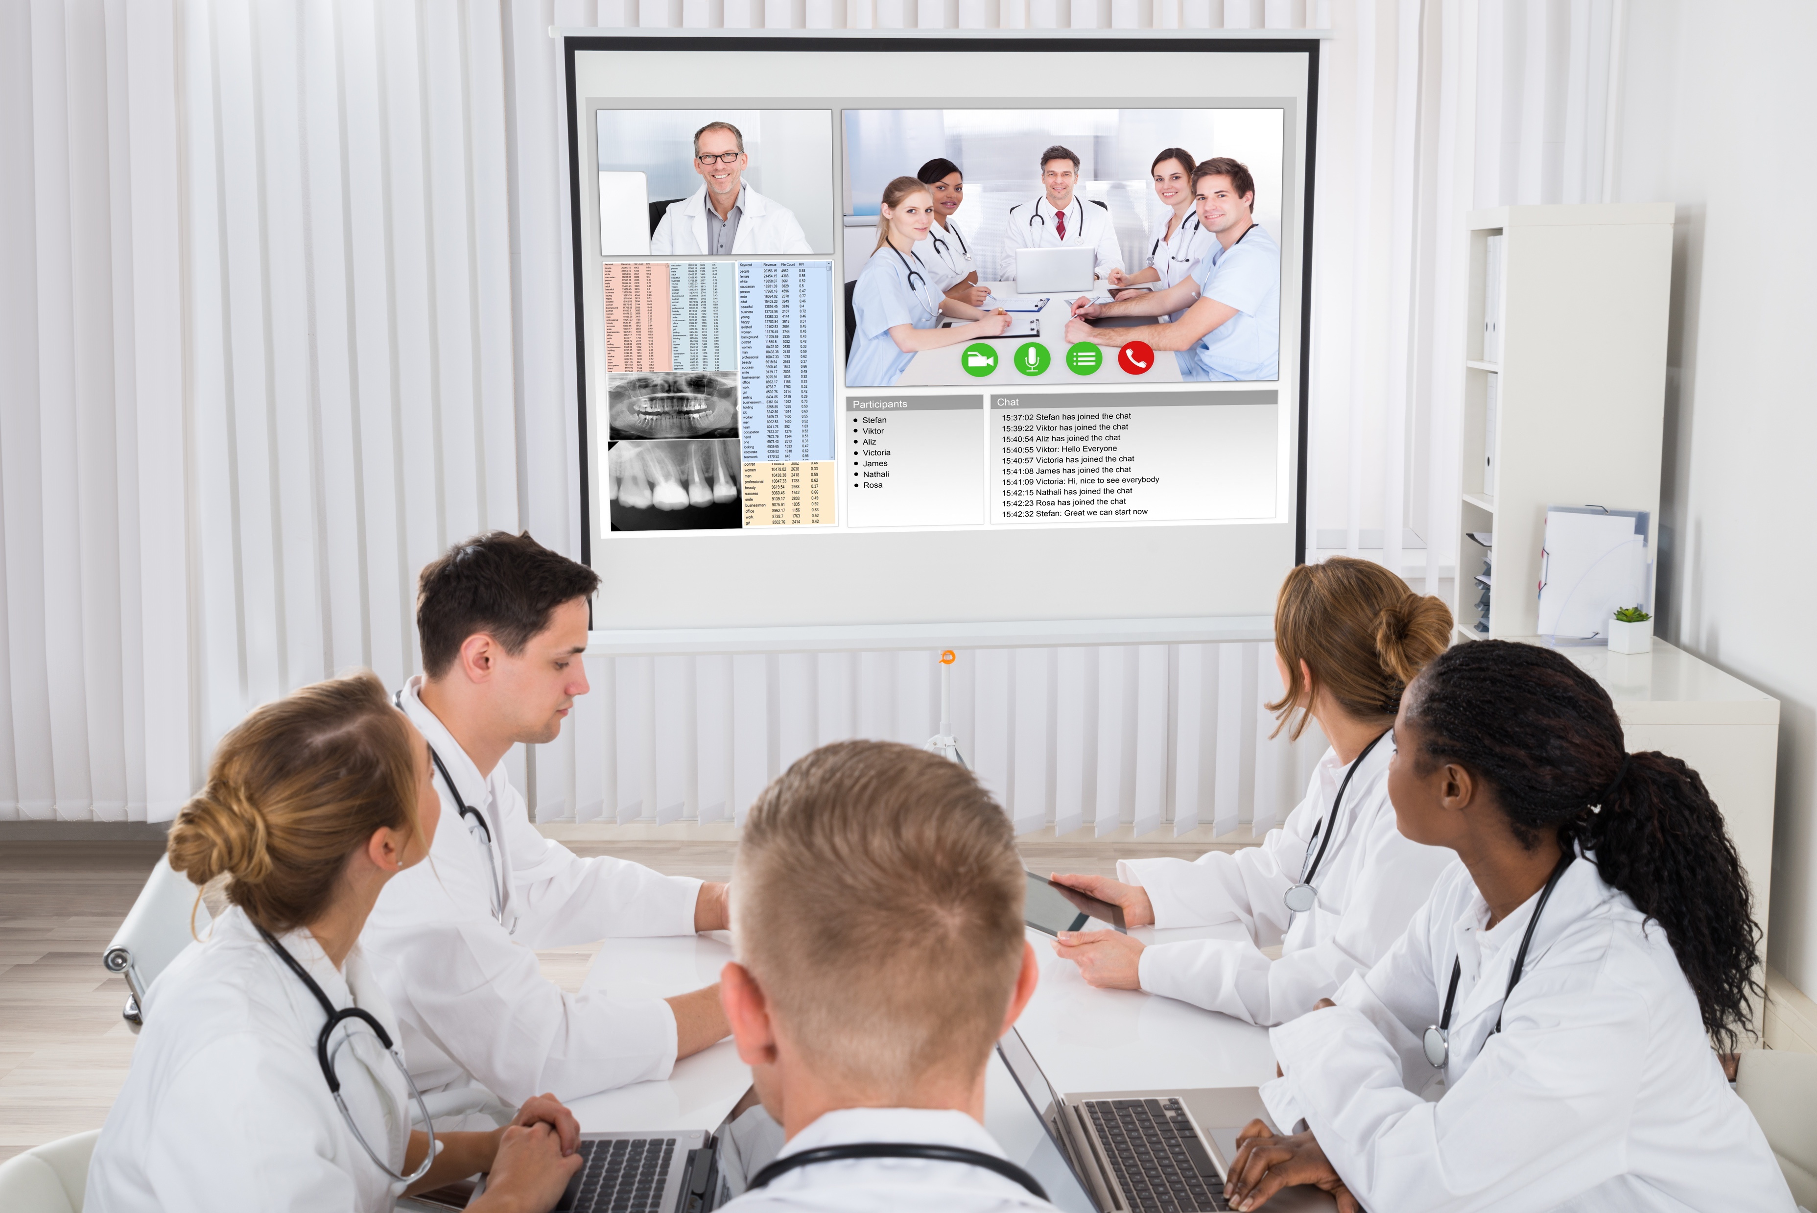
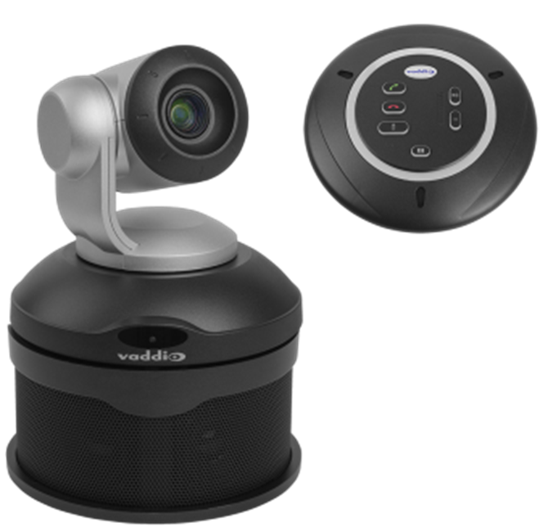
Collaboration Rooms
  Integrate with new or existing infrastructure
  Easy to use technology
  Enjoy an immersive conferencing experience
  Plug & Play options available
  Affordable and scalable technology

Slide 9
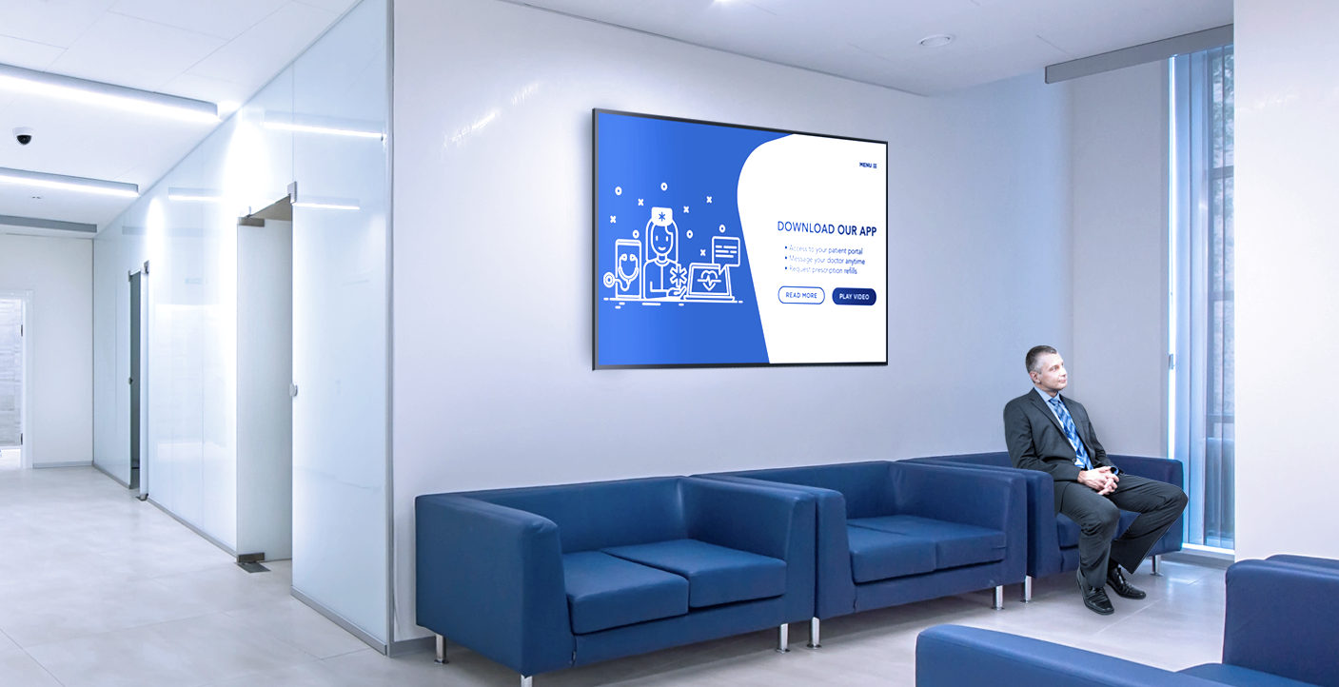
Waiting Room Displays

Slide 10
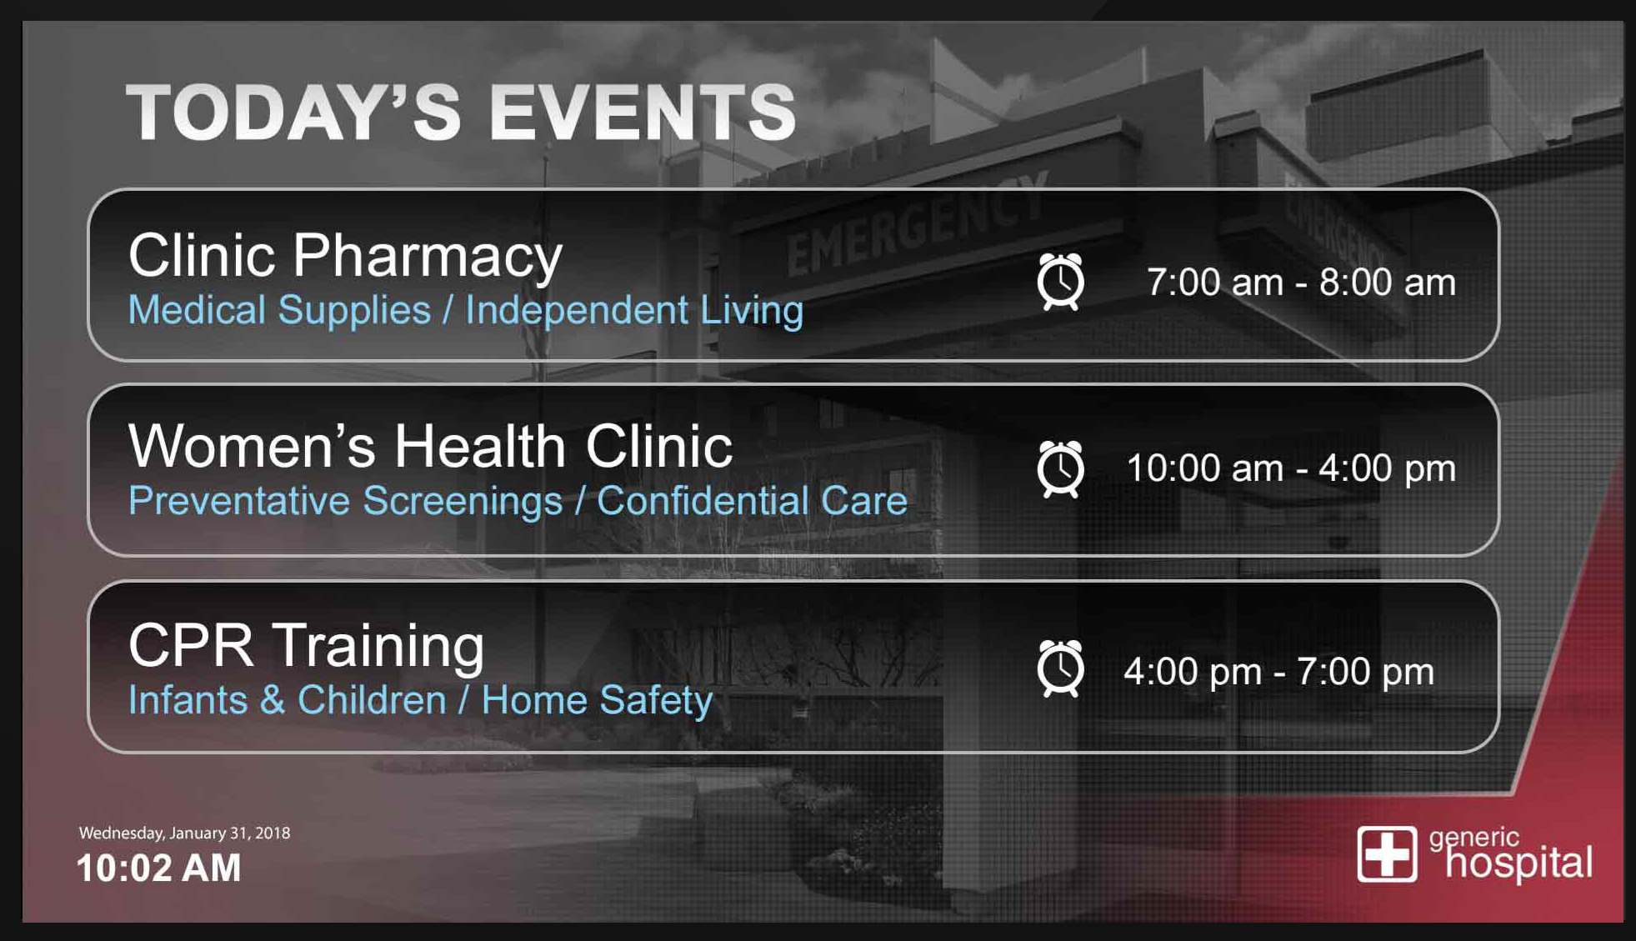

Waiting Room Displays
  Improve visitor experience
  Add wellness messages and other Rich Media
  Display ED wait times and outpatient surgical tracking information
  Display RSS feeds and hospital information
  Integrates with your CATV, ipTV or SAT content providers

Slide 11
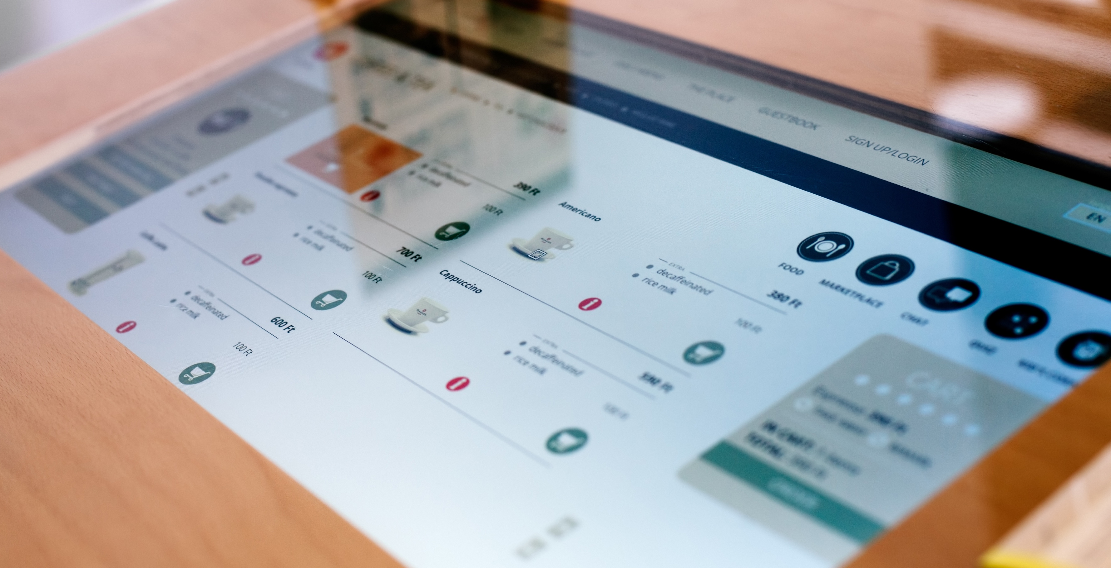
Digital Menu Boards

Slide 12
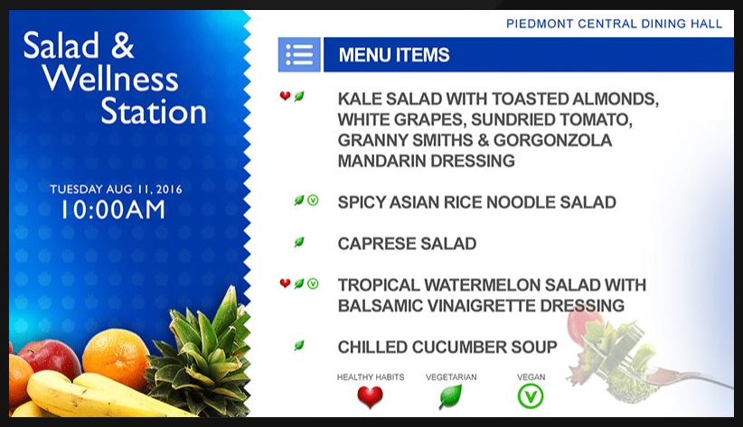
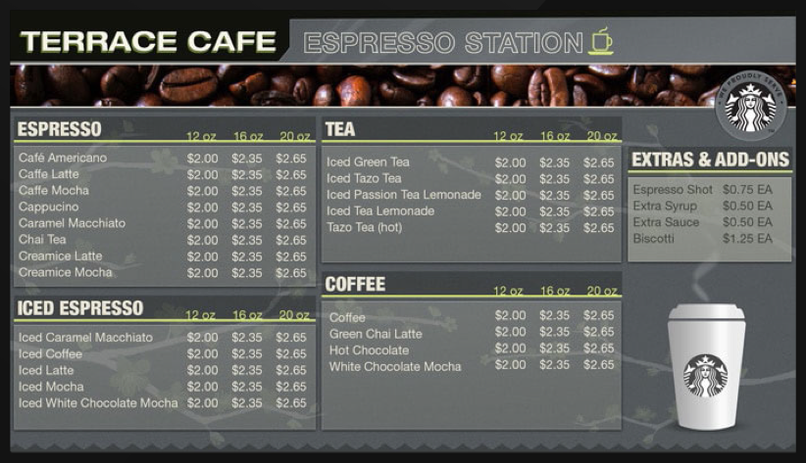
Digital Menu Boards
  Replace fixed conventional signage with easy manage digital signs
  Promote healthy food choices and wellness messages
  Easily change prices, specials and promoted food items
  Easily change food items for breakfast, lunch and dinner

Slide 13
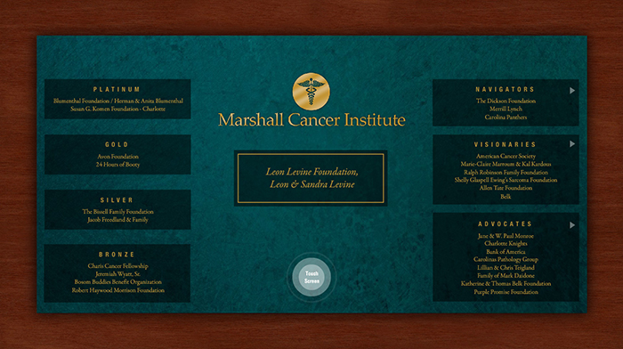
Digital Donor Boards

Slide 14
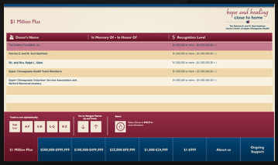
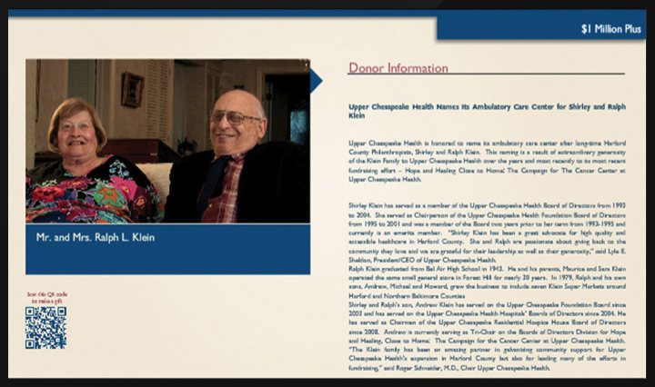
Digital Donor Boards
  Augment or replace costly fixed installations
  Add donor commemorations to more areas of the hospital
  Honor more donors at more gift levels
  Add more information on legacy donors

Slide 15
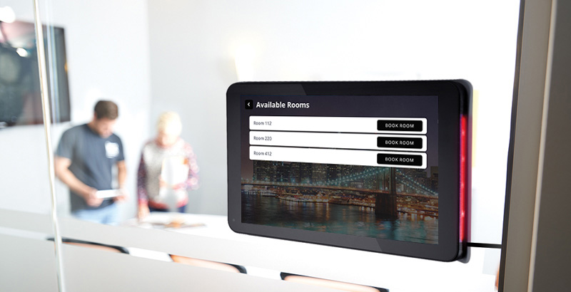
Meeting Room Signs

Slide 16
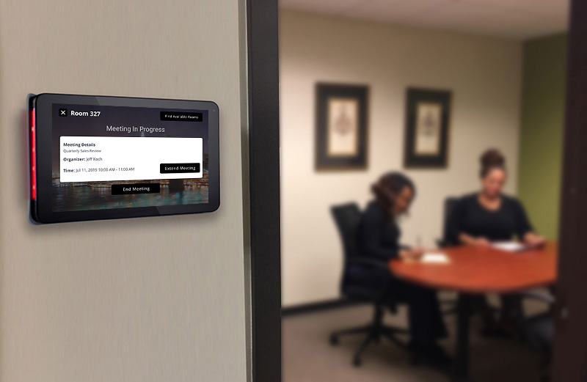
Meeting Room Signs
  Determine room availability status at a glance
  Book rooms directly from the sign
  Integrate with Active Directory, Outlook, Google Calendars and other enterprise tools
  Increase room use efficiency

Slide 17
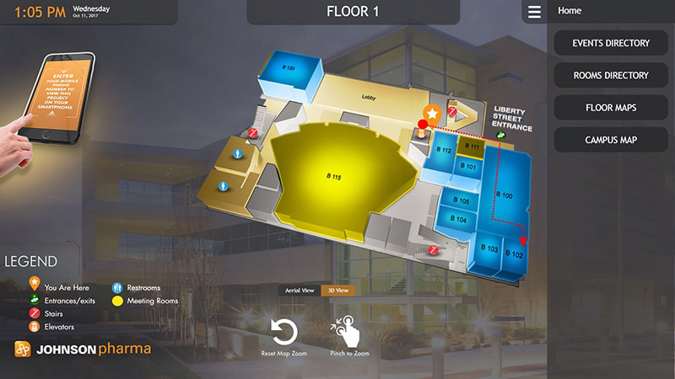
Wayfinding Stations

Slide 18
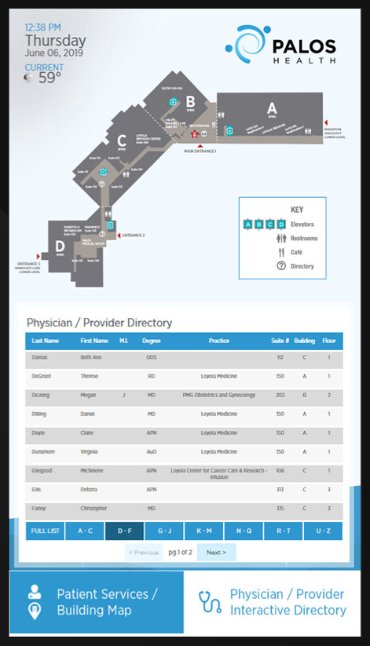
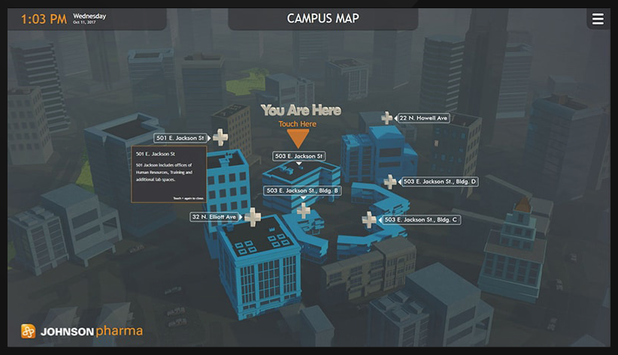
Wayfinding Stations
  Improves patient and visitor satisfaction
  Helps ease hallway congestion
  Easy to update content
  Compatible with mobile and print devices
  Highly scalable

Slide 19

Video Walls

Slide 20
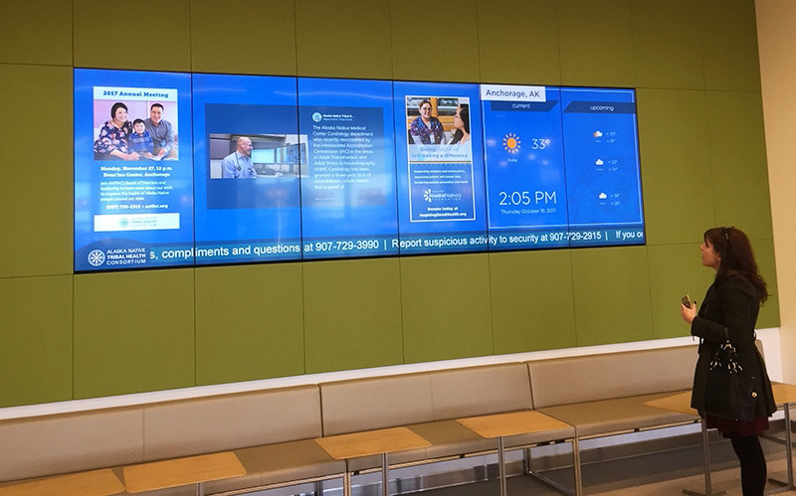

Video Walls
  Offers a bold canvass for messaging and branding
  Scalable in ratios not limited to 16:9
  Allows for arresting and creative visual presentations

Slide 21
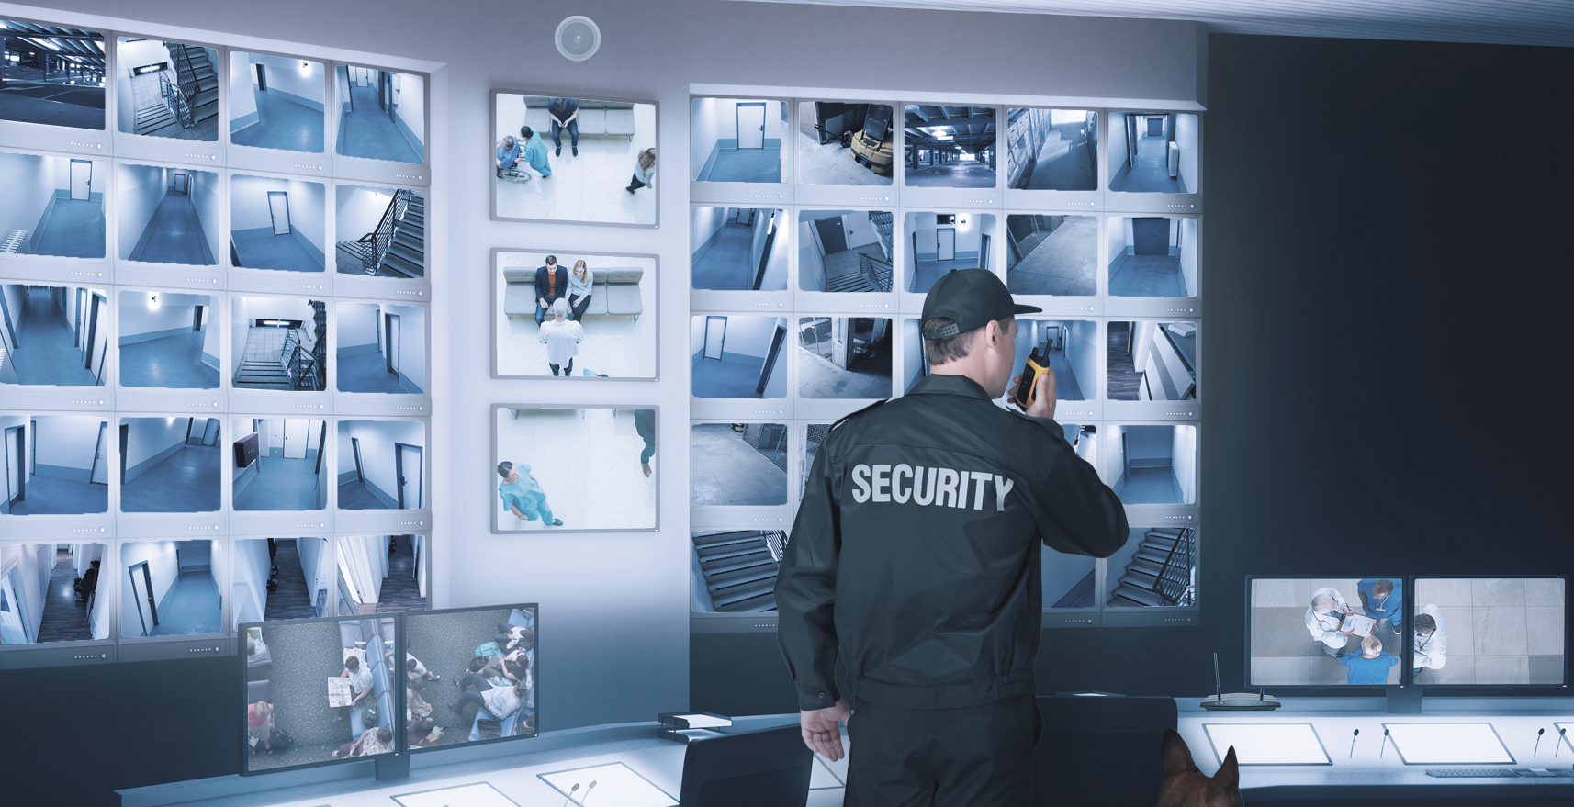
Physical Security

Slide 22
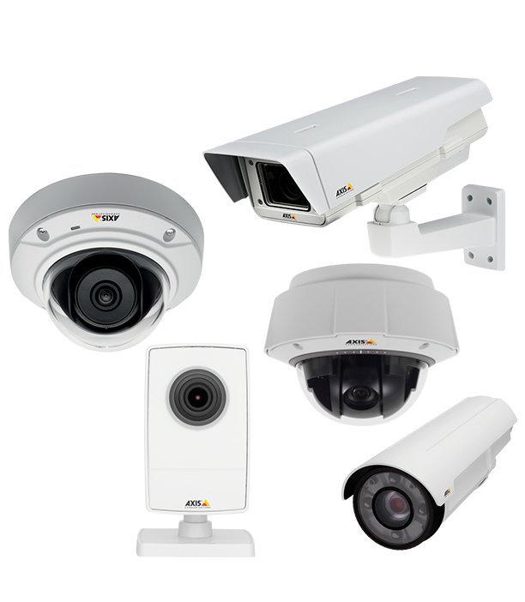
Physical Security
  Broad array of video surveillance options
  Electronic access control
  Ingress and Egress tracking
  Video Content Management Systems
  Cloud and on Prem options

