Slide 1


HOWARD TECHNOLOGY SOLUTIONS

Slide 2

About Us
Headquarters is located within the 504 acre Howard Technology Park in Ellisville, MS and houses our executive offices, including Howard Technology Solutions.
Plus a 72,000 sq ft manufacturing plant.
ISO 9001/14001 Certified
EPEAT Certified

Slide 3

Howard Partner Program Benefits
NCPA Contract
Unique Product Offerings
Tradeshow Support
Co-branded Marketing Materials
Dedicated Inside Sales Support
Financial Backing on Large Opportunities
HTPP
Access to National, Multi-State Level Contracts
  Tips/Taps

Slide 4
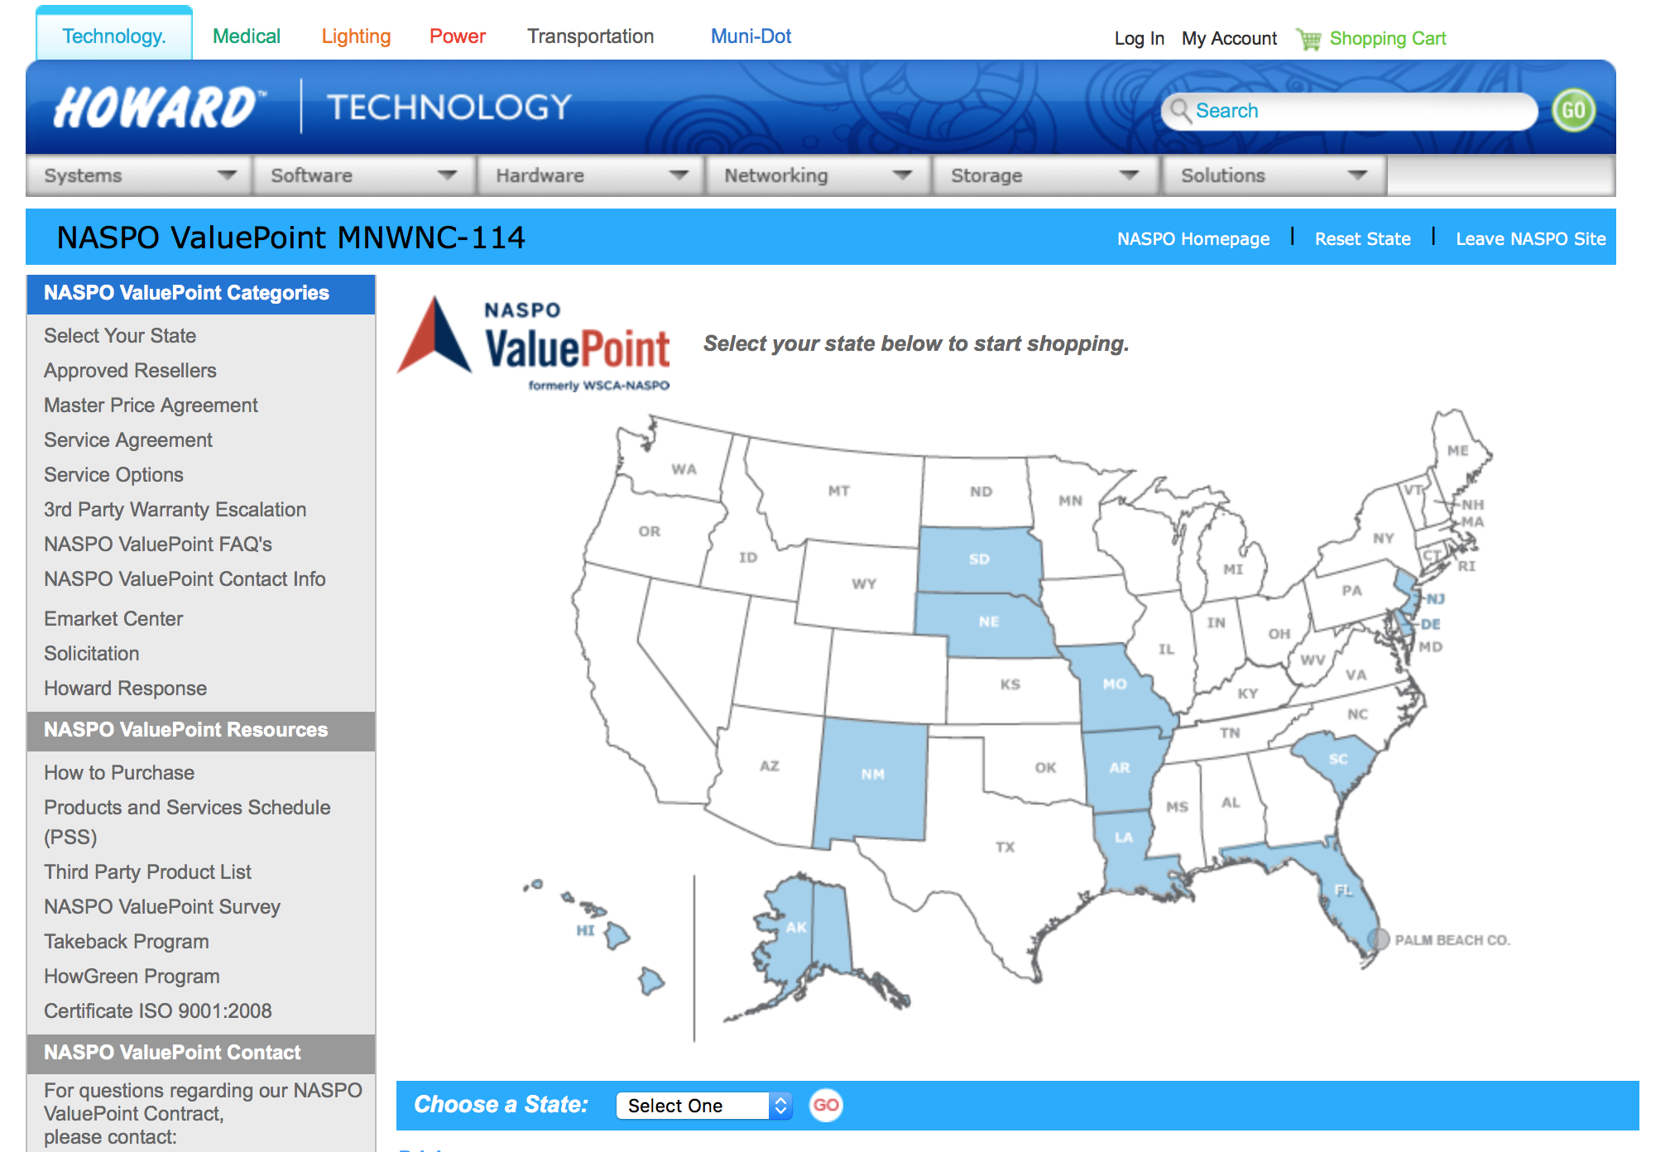
NCPA Website

Slide 5

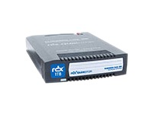
NCPA Approved Servers
HOWARD
LENOVO

Slide 6
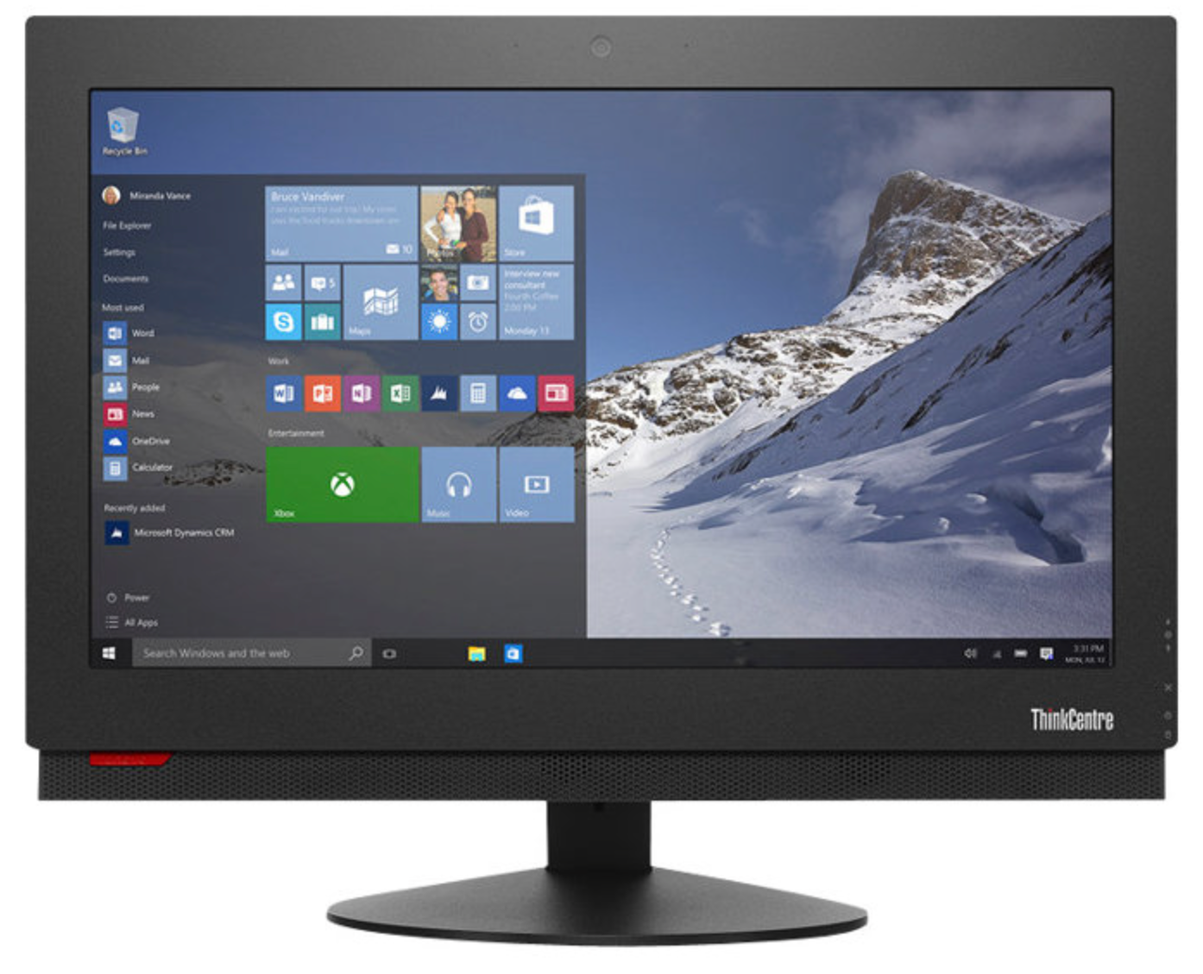

NCPA Approved for Workstations
Howard
Panasonic
Fujitsu
Toshiba
Lenovo
Acer
Intel Reader
Ideal for sophisticated, graphic-intensive programs like AutoCAD, Photoshop, & other 3D applications
Delivers peak levels of performance while using less energy, dramatically reducing operating costs.

Slide 7
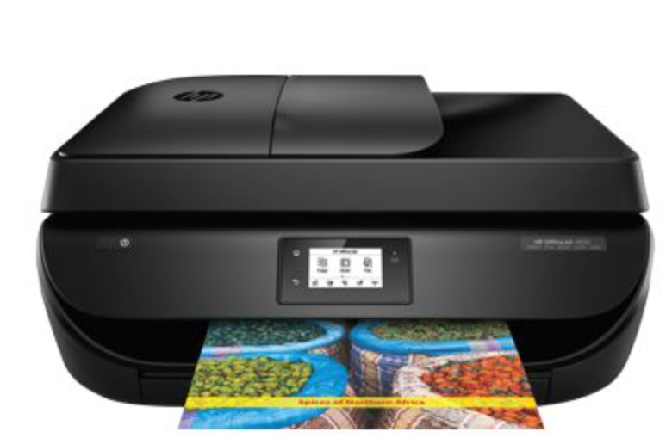
NCPA Approved for Printers
HP
Lexmark
Brother
OkiData
Samsung
Ricoh
Konica
Xerox

Slide 8


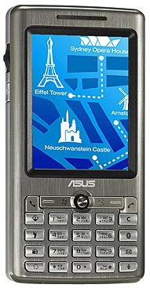
NCPA Approved for PDAs
PDAs - Pharos - Viewsonic

Slide 9
Instructional and Public Safety Bundles
Elmo TT02RX + NCPA approved desktop/laptop
FrontRow Pro Digital + NCPA approved desktop/laptop
Turning Point 24/32 student response cards + NCPA approved desktop/laptop
Mimio + NCPA approved desktop/laptop
Dyknow software + NCPA approved desktop/laptop
AverMedia CP155 + NCPA approved desktop/laptop
Panasonic Toughbook/ Arbitrator/ Havis/ Gamber Johnson
21st Century Classrooms
BASIC- NCPA approved desktop/laptop, Mimio Interactive, Mimio Wireless, & Elmo TT02RX
INTERMEDIATE- NCPA approved desktop/laptop, Mimio Wireless, Mimio Interactive, Turning Point 32 pack response cards & Elmo TT02RX
INTERMEDIATE- NCPA approved desktop/laptop, Mimio Wireless, Mimio Interactive, Turning Point 32 pack response cards, FrontRow Pro Digital & Elmo TT02RX
Howard Petcarts (Basic, Aver, Elmo Models)

Slide 10



NCPA Approved for Monitors
3M
Acer
Asus
AOC
BenQ
LaCie
LG
HP
Hyundai
Lenovo
NEC
Planar
Samsung
ViewSonic

Slide 11
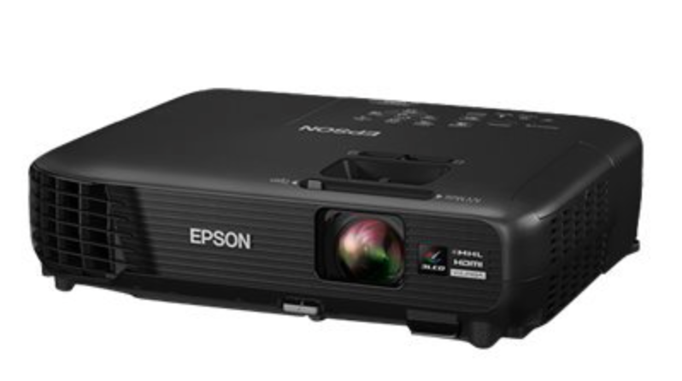
NCPA Approved for Projectors
3M
Acer
BenQ
Canon
Epson
Infects
Mitsubishi
NEC
Optomo
Planar
Samsung
ViewSonic
Sanyo
Sharp

Slide 12












NCPA Approved for OS/ Software

Slide 13
NCPA Approved LAN / WAN
Hubs/ Switches/ Bridges/ Routers
The following manufacturers have been approved for this category via our NCPA Contract:
ADC, Adtran, Alcatel, Allied Telesis, Alvarion, ABL, APC, Asus, Belkin, Brocade, Cisco, 3Com, Cnet, Dlink, DigiConnect, Enterasys, Hawking, HP, EMC, Extreme, Kentrox, Kramer, Linksys, Lantronix, Ncomputing Netgear, Netopia, Nortel, Mobile Edge, Panasonic, Qlogic, SMC, Startech, MiLAN, TrendNet, USRobotics, Xerox, Xirrus, Zoom, ZyXEL

Slide 14
NCPA Approved Accessories
The following manufacturers have been approved for this category via our NCPA Contract
UPS and Power Supplies
Ink/Toner
Computer Cases
Keyboards/Mice
Memory
Motherboards
Processors
Modems
CD/DVD Drives
Hard Drives
Tape Drives
Wireless Access Points
Network Cables
Network Cards and Adapters
Storage Cables
Flash Memory and Devices
NOTE : Please check www.howardcomputers.com/ncpa, to see if a particular manufacturer and part number are approved under the contract.

Slide 15
TIPS/TAPS
A purchasing cooperative that is completely bid to save members the time and expense of bidding each purchase
Howard holds three of the contracts
PC and Peripherals - all brands that Howard offers
Networking - all brands that Howard offers
Audio Visual
  States Participating in TIPS/TAPS
  Washington, Oregon, Idaho, California, Nevada, Utah, Arizona, Colorado, New Mexico, North Dakota, Nebraska, Kansas, Oklahoma, Texas, Missouri,
  Arkansas, Louisiana, Illinois, Indiana, Kentucky, Tennessee, Alabama, Florida, Georgia, South Carolina, North Carolina, Ohio, Virginia, Pennsylvania,
  Maryland, Delaware, Rhode Island, Massachusetts, and Vermont

Slide 16


Howard Desktops
Howard All-N-One
Howard Q67MKB
Touch Screen
Integrated Intel Graphics
Fully Customizable
Tower PC
Small Form Factor
Fully Customizable

Slide 17

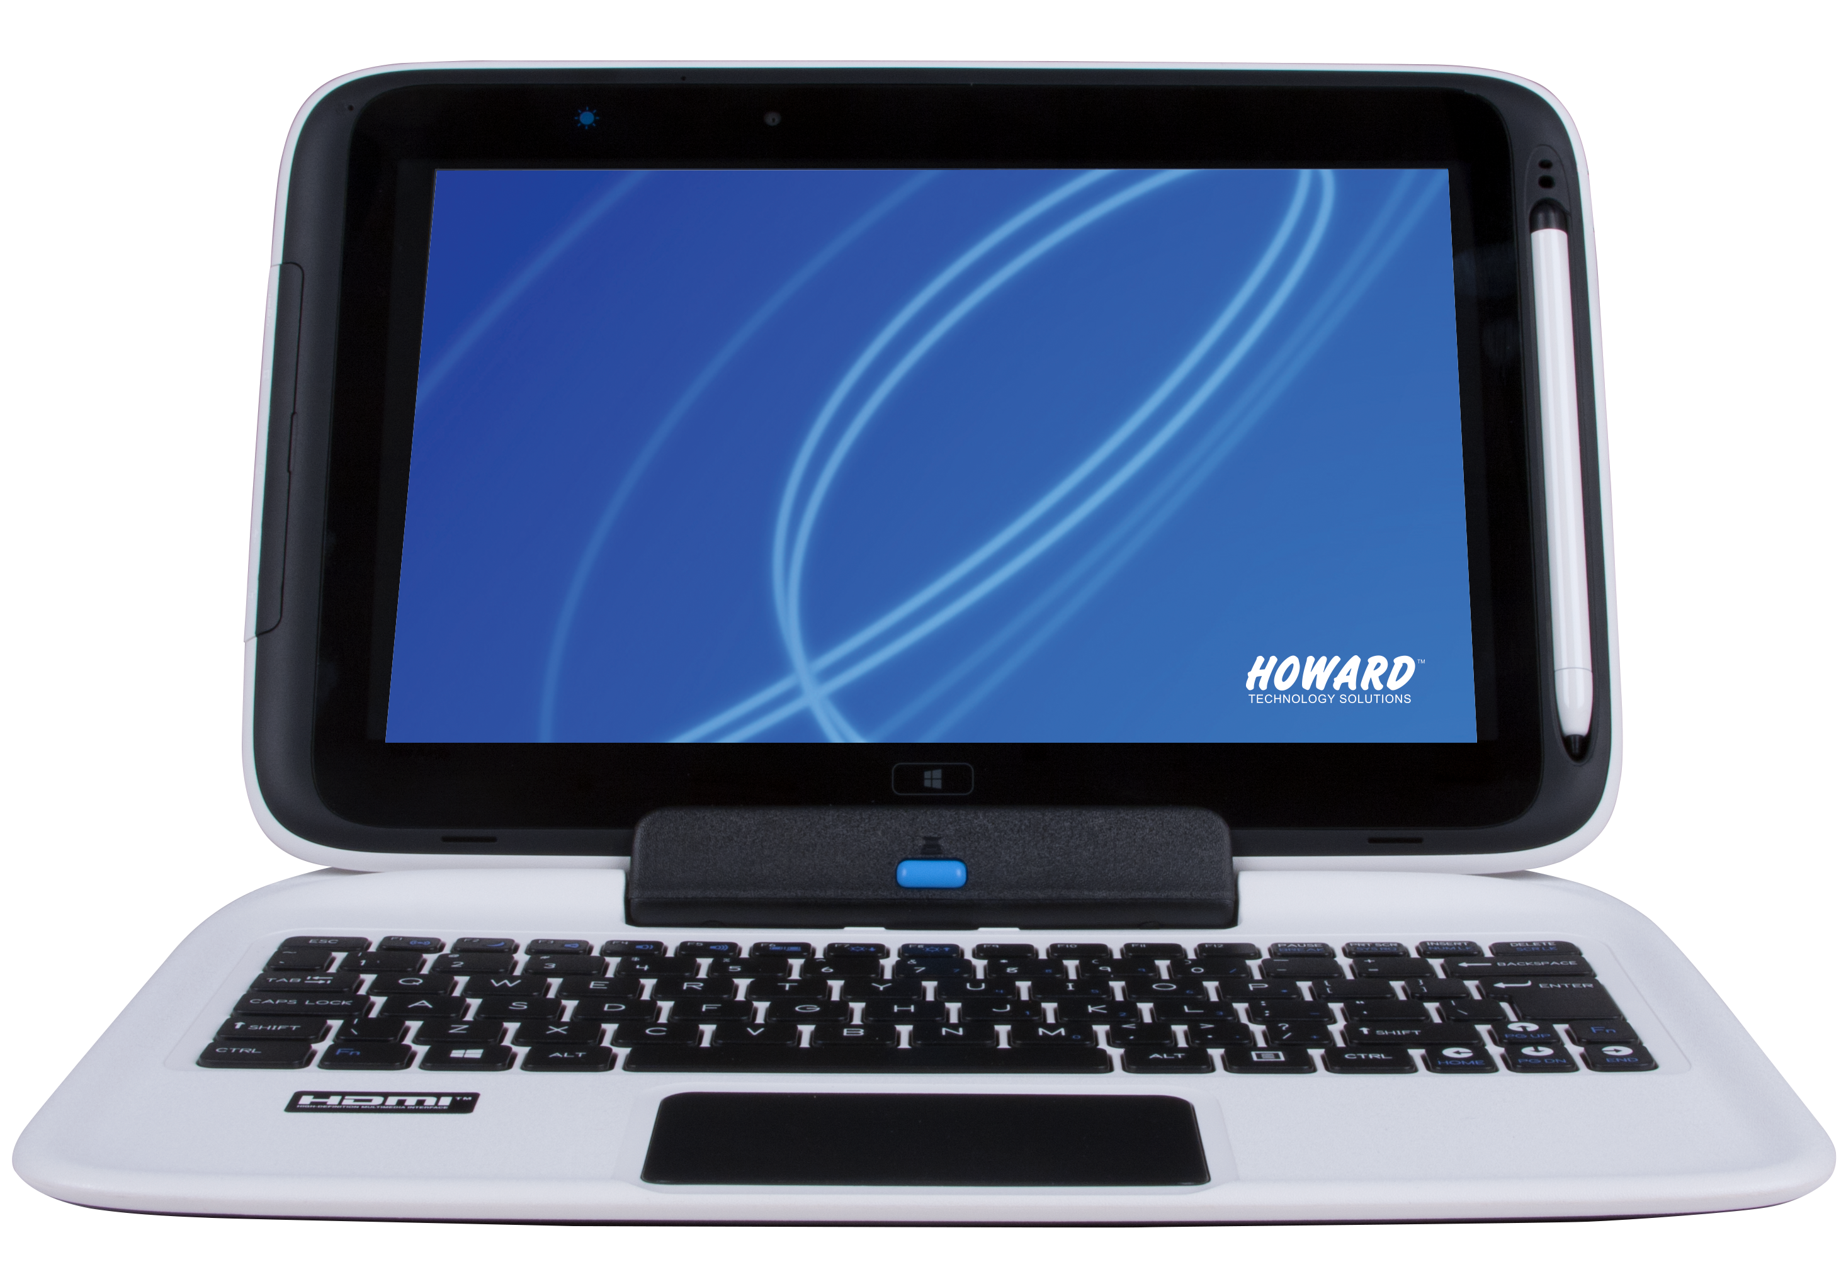
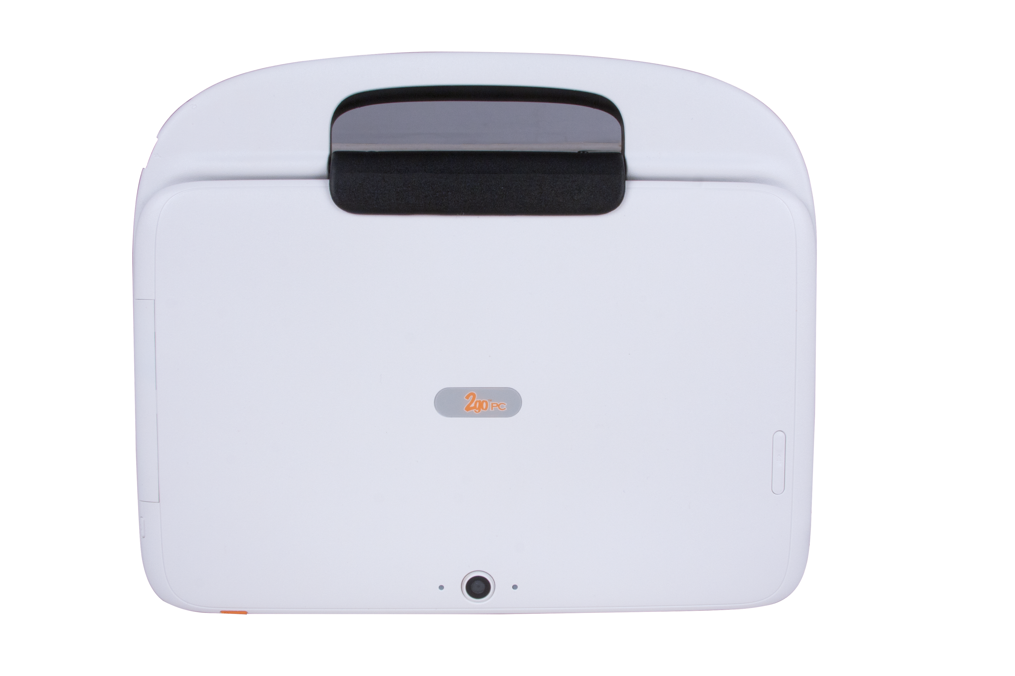
Howard Laptops
Rugged, affordable, and student friendly
Faster, smarter and more versatile
The 2goPCT2 is Howard’s newest Intel-powered classmate PC. Loaded with features that truly improve the learning experience.
That’s what they’re saying about the new Spring Peak notebooks.

Slide 18
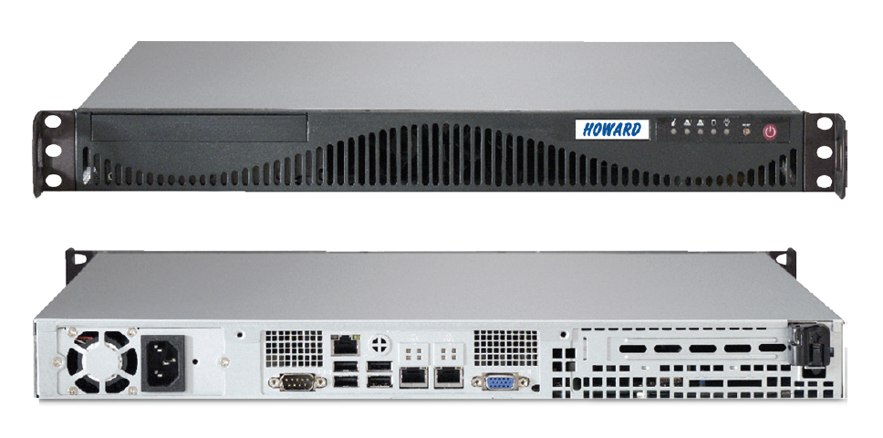
Howard Servers
Reinforce network security, reduce downtime and increase overall productivity with server solutions from Howard. Choose pedestal or rack-mount configurations, with customizable performance options to suit your business needs.

Slide 19
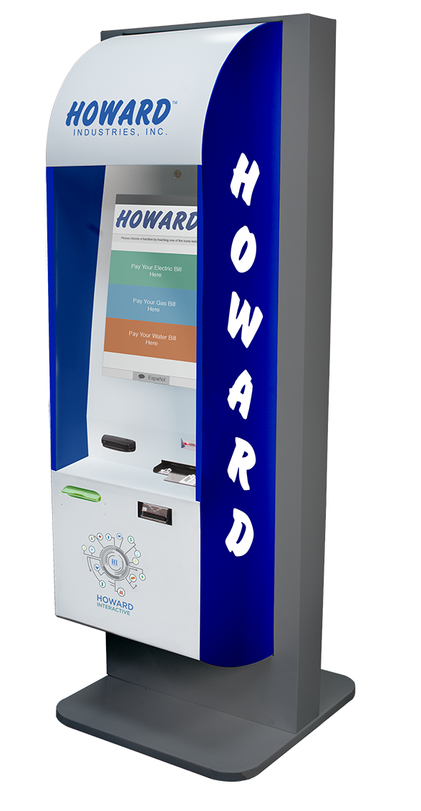
Howard Kiosk Solutions
The Kiosk by Howard provides the ability to collect cash, credit/debit card, and ACH (e-check) payments, 24/7.
We offer a flexible array of services that can be customized to fit your needs, making it an ideal solution for your business.
All kiosks come with the following standard package:
19” Touch Screens
Barcode Scanner
Encrypted Credit/Debit Card Reader
Check Reader
Bill Acceptor
Web Service Secure Connectivity
Speakers
Camera
Howard IQ PC
Receipt Printer
Bi-Lingual
Multiple Database Connections
Customized Programming

Slide 20

Office Solutions
Howard can alleviate your need to go through multiple sites by providing you with comprehensive office solutions. From furniture to software, and everything in between, we have a the right solution for you.
Computing Solutions
Audio Visual Solutions
Networking Infrastructure Solutions
Network Video Solutions
Virtualization
Software
Professional Services
E-Commerce and Accessories
Mobile Solutions
Kiosk
Control Rooms and Operation Centers

Slide 21






Digital Signage
Deliver fresh, relevant information to a wider audience in seconds.
100% web-based (unlimited user access via a browser)
Access from anywhere to anywhere
Single content manager (fully scalable, allows growth over time)
Populate Image, Media formats, combine bulletins, audio, video, data feeds, flexible multi-window layouts—All in the comfort of your office
Better message recall
Attractive and Informative
Easy, fast customization
Target messaging – Desktop messenger, screensaver, RSS publisher, text messenger
Conference Room on-site manager- allows you to schedule meetings right at the room sign
Revenue producer for your business

Slide 22

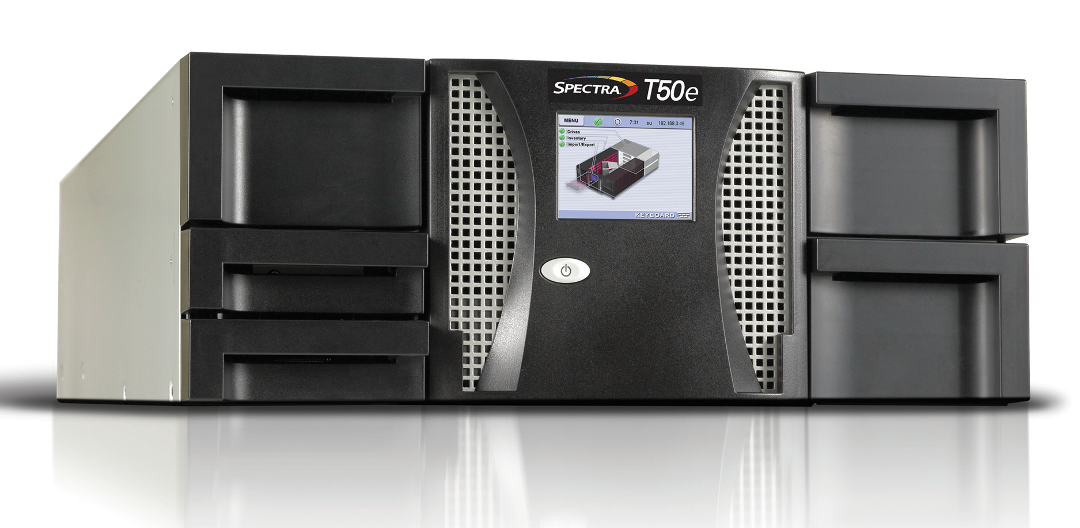






Storage / Infrastructure
Storage and data security are at the heart of any organization’s success. With multi-scale servers to keep your infrastructure running around the clock, routers to deliver information to its designated location, and omnipresent security to ensure the longevity of your system, Howard offers the most advanced storage area network solutions on the market today. So, regardless of the size or need of your organization, Howard can keep you up and running safely.

Slide 23

Conference Room & Training Solutions
From your laptops and tablets, software, digital signage and projectors, to your boardroom furniture, Howard can provide you with a comprehensive solution for your conference room and training needs.

Slide 24
HTPP
Howard Technical Partnership Program
Howard Technology Solutions realizes that many organizations handle basic hardware service and support in one of two ways:
make significant investment in establishing and maintaining a group of local service providers
they use their own internal support staff
For this reason, we have developed the Howard Technical Partnership Program (HTTP)
so we can satisfy either option by facilitating timely, cost-effective, quality service in conjunction with our high standards for customer satisfaction.
Managed by our 100% US-based support engineers and technicians, HTTP is an integral part of our strategy to establish direct, personal relationships with our customers to ensure we meet all of their organizations needs. Participation is easy; simply complete an HTTP application online at www.howardcomputers.com/support.

Slide 25
HTPP
Howard Technical Partnership Program
Program Highlights
Program Details
No subscription fee or certification requirements
Labor reimbursements for authorized repairs
Expedited service and/or replacements part ordering
Free consultation to determine your optimal parts inventory with on-site parts inventory available to qualifying organizations
You NEVER pay for defective parts and shipping is FREE!
No annual subscription fee.
No certification requirements.
Labor reimbursements
Expedited spare parts ordering.
Recommended spare parts list.
On-site consignment spare parts inventory.
Centralized inventory of spare parts.

Slide 26
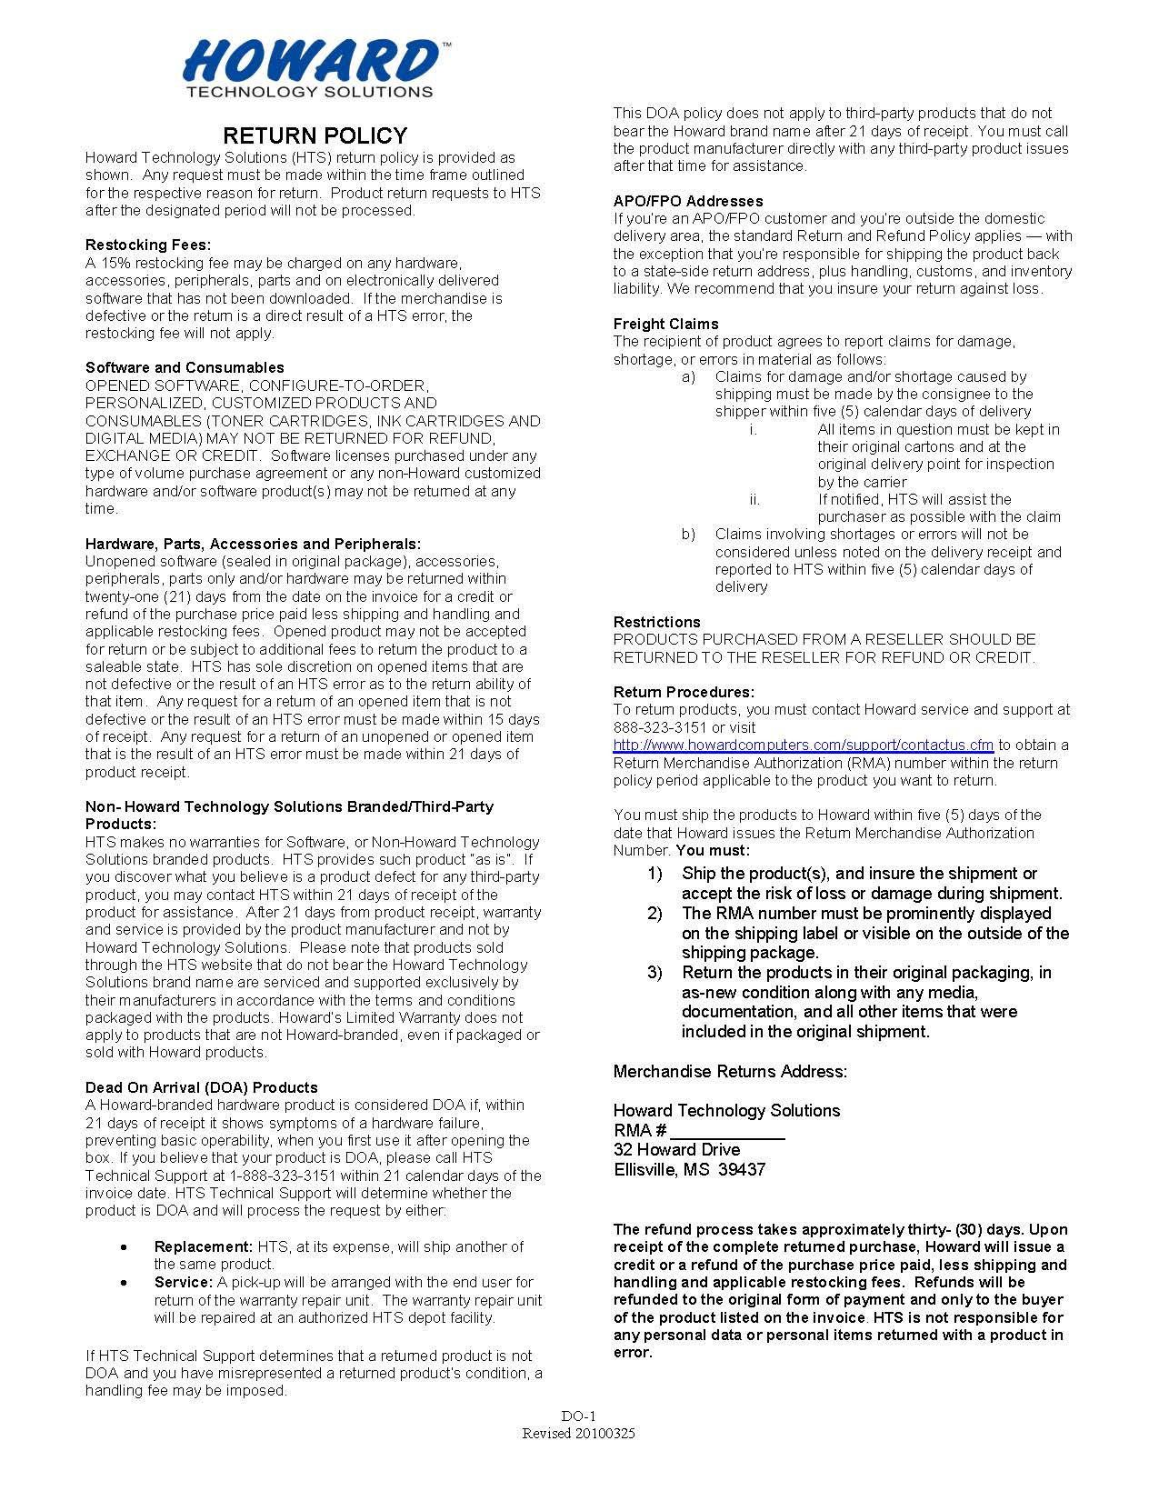
Howard Return Policy
At Howard, we strive to make the return process simple and straightforward by clarifying options and simplifying choices.
It is our goal to see that each transaction is handled promptly and efficiently.
Our return policy is now way you will experience the Howard advantage.

Slide 27
Quotes / Orders
All quotes will be completed in a timely manner.
For Government, Business, and Utility quotes, please send email to:
Howard Inside Representative:
Heather Wigington
Phone: 601-399-5712
Fax: 601-399-5077
Email: hwigington@howard.com
Enterprise Inside Sales Manager:
Kristi Bush
Phone: 601-399-5677
Fax: 601-399-5077
Email: kbush@howard.com

Slide 28
Ordering
Be sure the Purchase Order is made out to Howard Technology
Make certain customer PO references Howard Technology ordering information -Net 30 -FOB Destination
Make certain customer PO references Howard Technology ordering information -Customer number: -Agent number:
Commission
Agent Model, Howard will pay _% commission on orders.
Commission will be paid on the 10th of the following month after Howard Technology Solutions receives a payment from the customer. Commission will be based on a _% unless the products do not have enough room for margin for both companies at that time the commission will be discussed with the sales rep and they will know the percent at the time of quote. Reseller will get a commission statement along with a commission check and on the statement it will list the end-users name and the amount of the commission being paid on that order.

Slide 29
Flow Chart
Contract
Partner/Reseller
Spec Op
Partner/Reseller
Quotes Howard
Installation by
Partner/Reseller
Customer Sends PO
To Howard
Howard Quotes
Customer
Howard Invoices
Customer
Customer Pays
Howard
Howard Pays
Partner/Reseller

Slide 30
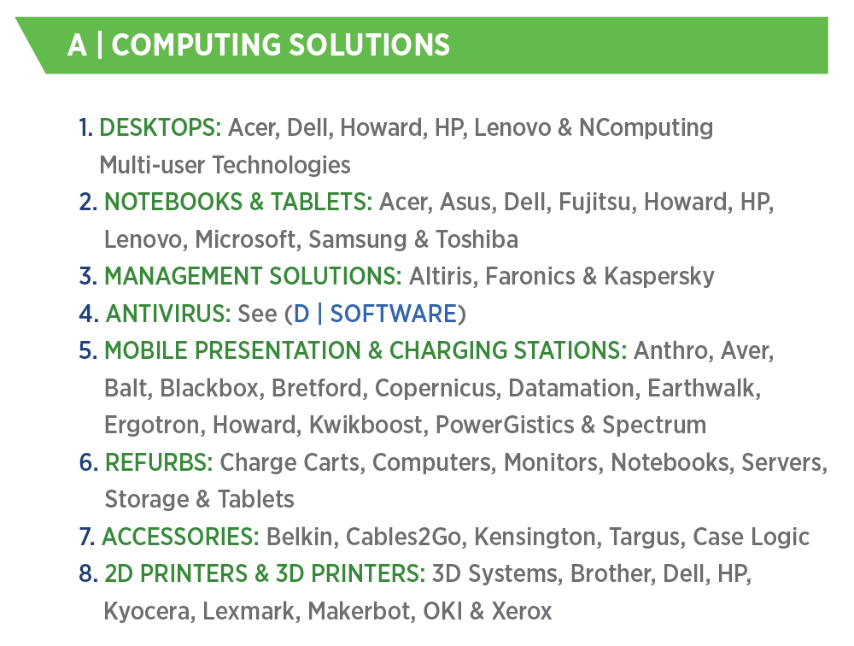
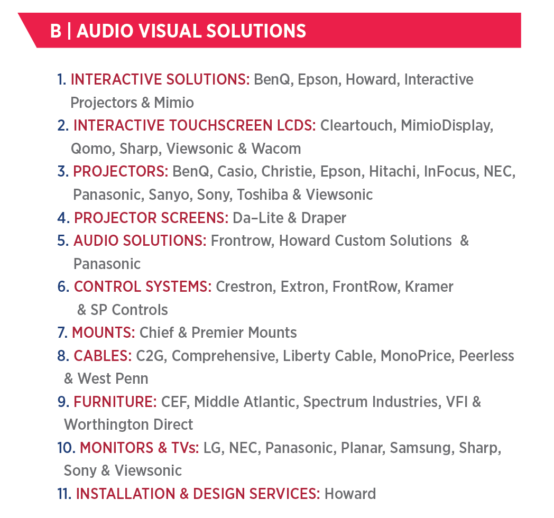
Howard Products & Services

Slide 31
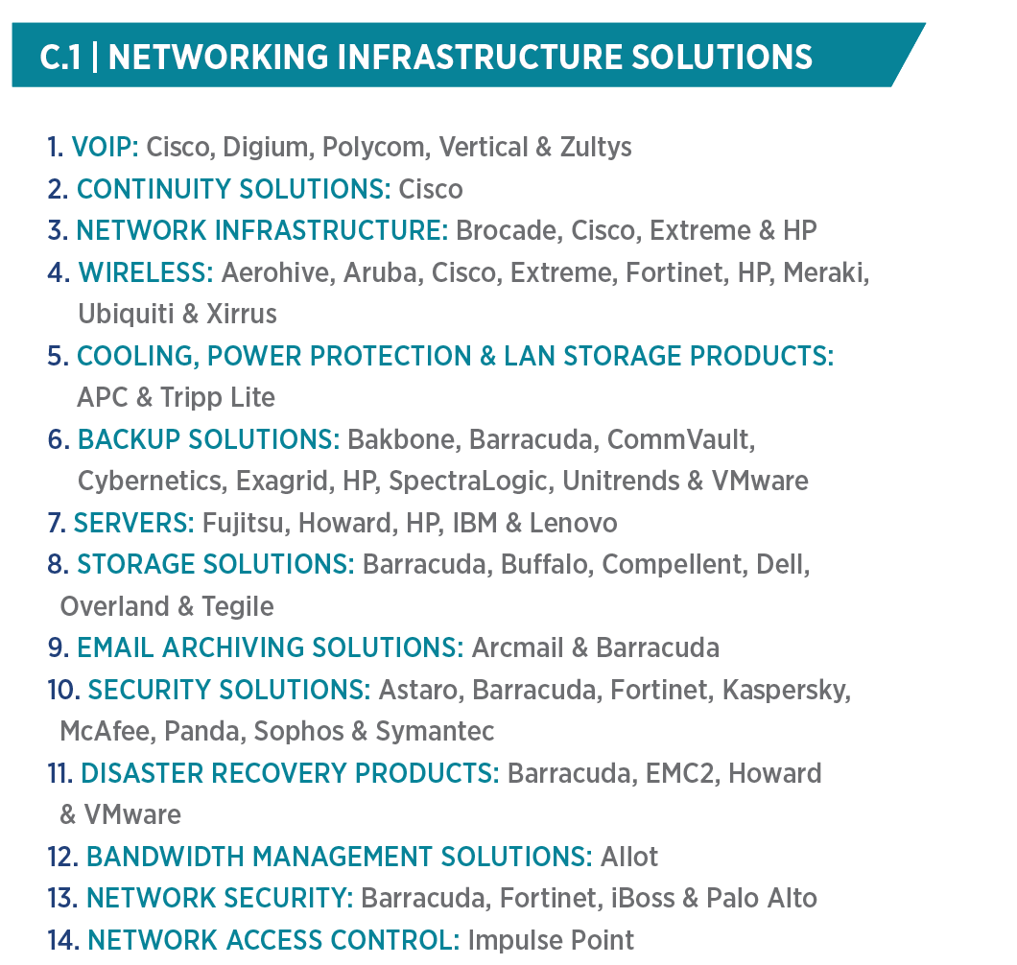
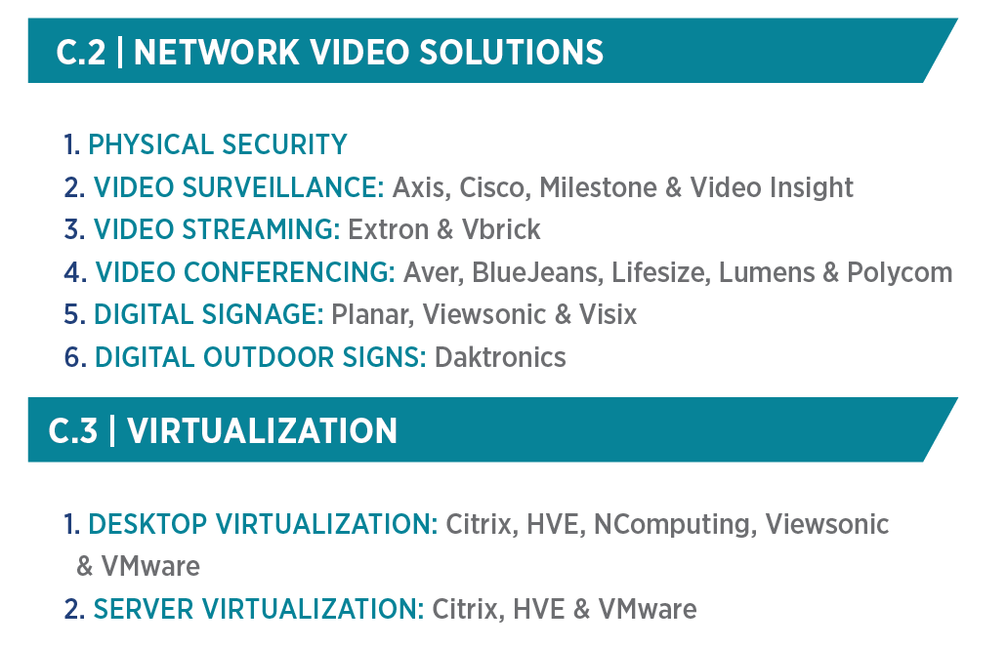
Howard Products & Services

Slide 32
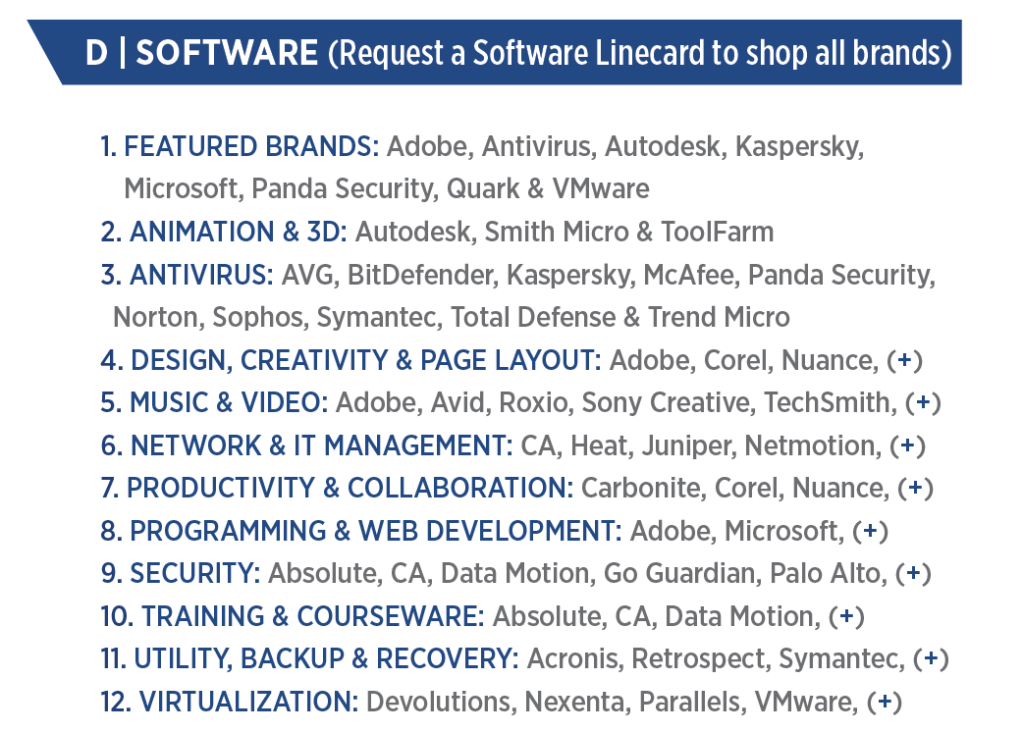
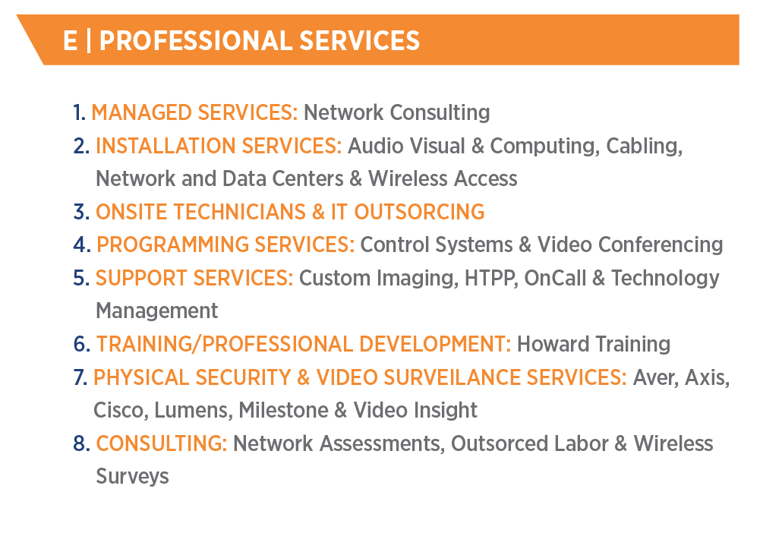
Howard Products & Services

Slide 33
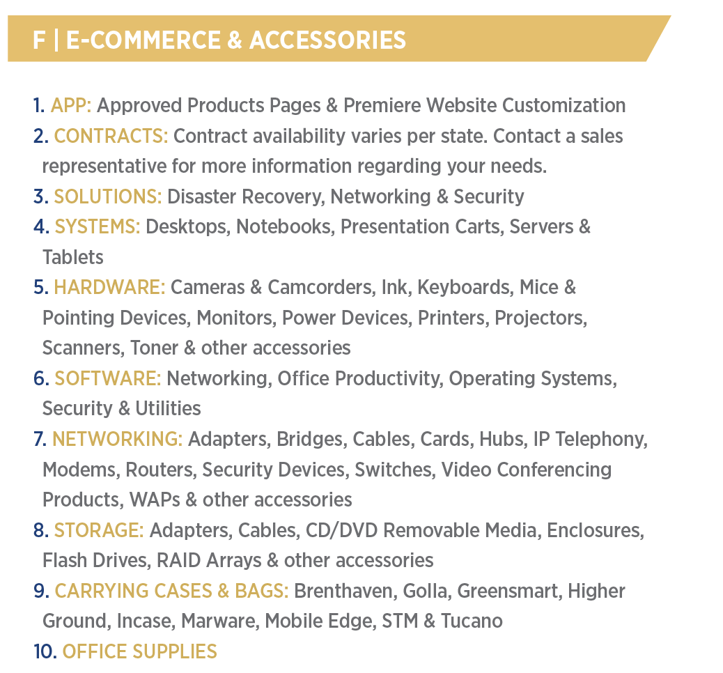
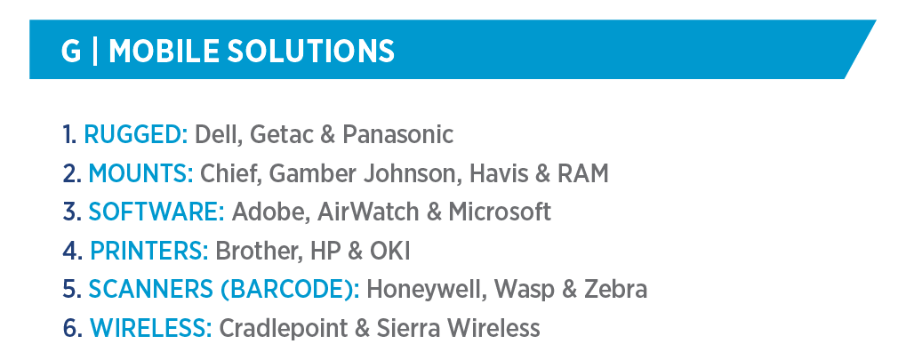

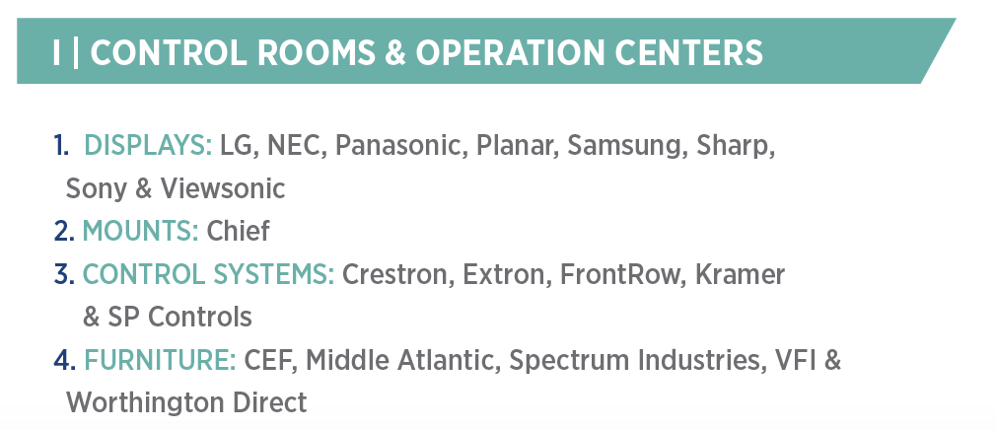
Howard Products & Services

