Slide 1
2014
Stockholder’s
Meeting
WELCOME
WELCOME

Slide 2
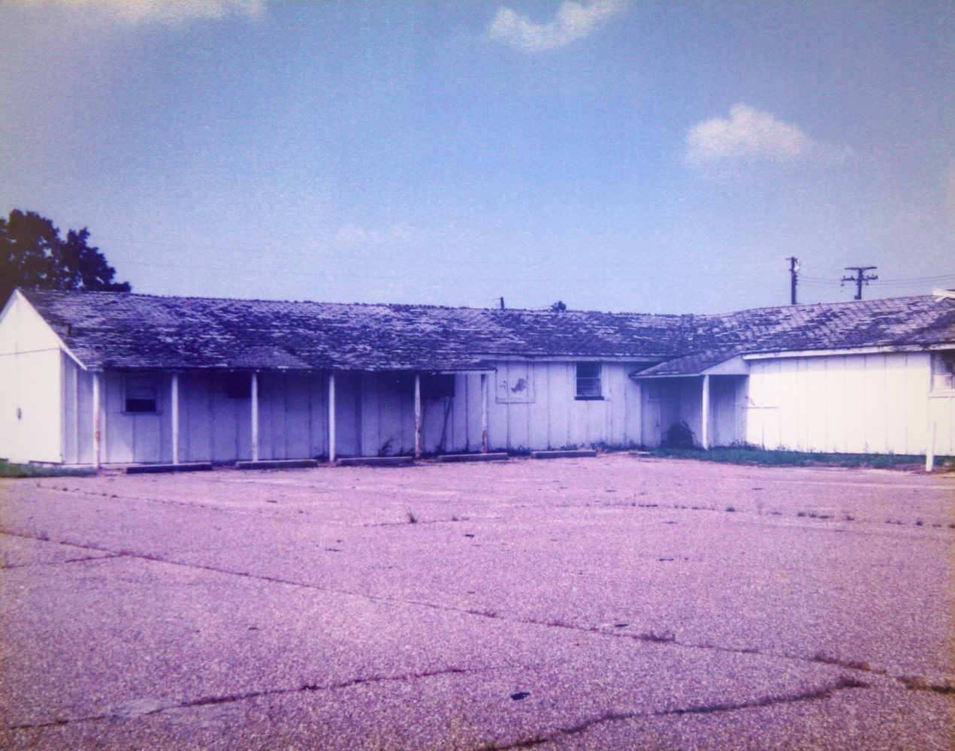
FIRST HOWARD BUILDING

Slide 3
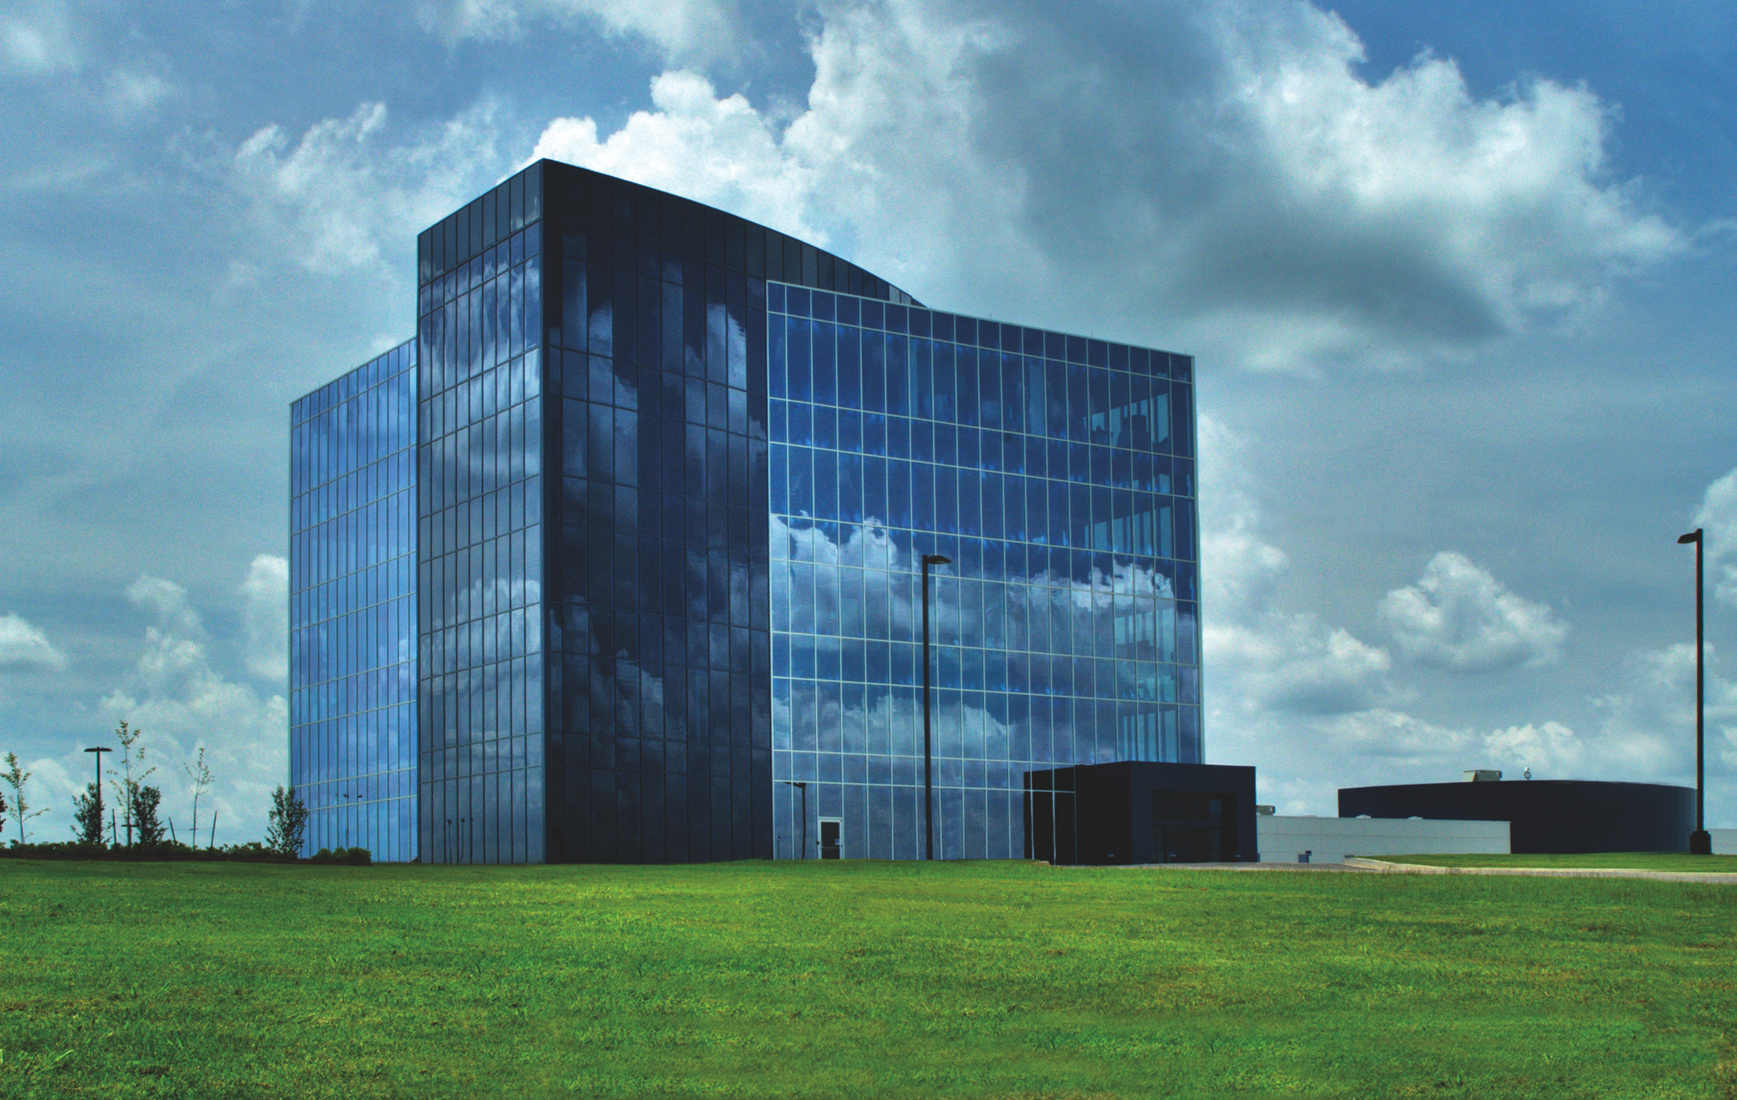
OUR CORPORATE HEADQUARTERS
• 60,000 ft² of office space
• A 72,000 ft² manufacturing plant for our technology and medical products

Slide 4
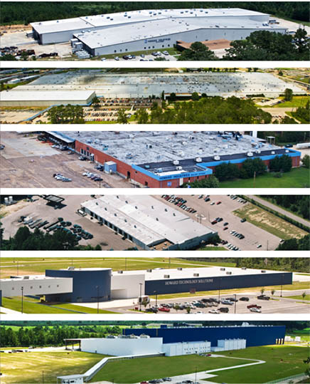
SANDERSVILLE LIGHTING & TRANSFORMER FACILITY
LAUREL TRANSFORMER FACILITY Largest transformer facility in the world. Over 2,400,000 sq. ft.
MENDENHALL LIGHTING FACILITY
ELLISVILLE TRANSPORTATION FACILITY
ELLISVILLE TECHNOLOGY & MEDICAL FACILITY
ELLISVILLE SUBSTATION FACILITY
OUR FACILITES: OVER 3,300 EMPLOYEES

Slide 5
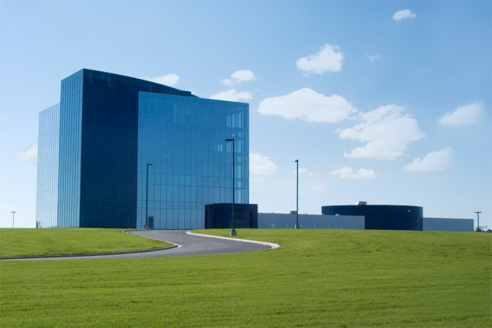
PAST
GE
Westinghouse
Allis Chalmers
RTE
Moloney
McGraw Edison
Standard
Central
Penn
Kuhlman
United
AB Chance
Uptegraph
Dowzer
HK Porter
Wagner
Heavy Duty
18-22 Others
TRANSFORMER COMPANIES
PRESENT
Howard Industries 40%
Eaton Company 22% (acquired Cooper Co.)
ABB 16%
ERMCO 14%
Central Moloney 6%
Prolec/GE 5%
CG 5%
23. Howard Industries
Cooper, (Lumberton, MS) closed their transformer plant 2011 and their equipment was purchased by Howard Industries

Slide 6
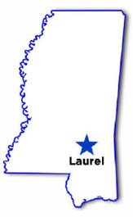
OUR IMPACT ON MISSISSIPPI
Our employees’ annual payroll is over 121 million dollars.
Between Howard Industries and our employees, we pay over 40 million dollars in taxes each year.
We’ve invested over 375 million dollars in Mississippi and purchase approximately 80 million dollars of materials from Mississippi companies annually.
According to the Mississippi Economic Authority, our total impact on our state is 520 million dollars each year.

Slide 7
BUSINESS MODELS
The most important decisions a company makes is to develop its Business Model and their selection of employees.
Here are some examples of companies business models and how they have changed over time

Slide 8
BUSINESS MODEL EXAMPLES
Apple – Business Model #1 – was within 3 months of declaring bankruptcy
Focus on selling PC’s and servers to Education Minor Player
Apple – Business Model #2
Improve existing products already on the market
Ipod and Smartphones
Focus on all markets Consumer, Business, Education, Government and Healthcare
Steve Jobs – New CEO – developed the new Business Model #2
Market Value: $499 Billion – Number one company in USA.

Slide 9
BUSINESS MODEL EXAMPLES
Wal-Mart – Business Model #1
Open stores in small towns
Provide low price
Wal-Mart – Business Model #2
Open stores in small, medium and large cities
Develop distribution centers
Develop vendor relations
Develop forecasting technology
Market Value: $246 Billion

Slide 10
BUSINESS MODEL EXAMPLES
Howard Industries, Inc. – Business Model #1
Improve existing pole type transformer
Sales through manufacturing agents to utility companies

Slide 11
BUSINESS MODEL EXAMPLES
Howard Industries, Inc. – Business Model #2
Improve existing single phase pad transformers and three phase pad transformers
Sales through manufacturing agents to utility companies
Diversify into lighting
Sales through agents and distributors

Slide 12
BUSINESS MODEL EXAMPLES
Howard Industries, Inc, – Current Business Model #3
Continue to expand and improve transformer products, focus on utilities, industry and international markets.
Develop Research & Development Engineering Departments in each division to improve existing products and develop new ones.
Expand and improve lighting products, focus on all markets.
Develop a consumer presence with HowardStore.com, Amazon, Ebay and other marketplaces.
Develop new products and markets – Kiosk, Digital Signage, Telemedicine and Infection Control.

Slide 13
Most Important Job
What is the most important job of the President,
Vice President, and Manager?
• Having the right people for each position
• Firing the non-producers

Slide 14
Mental Models
What is the mental model of the President, Vice President (VP), and Manager?
• Are they satisfied with the school’s growth and department growth? What are the Mental Blocks that prevent them from changing?
• Examples of VP sales Mental Model and President’s Mental Model
• David Perkins—Sales Growth vs Profit

Slide 15
Budget Types
Two Budget Types:
• Operational Budget
• Growth Budget
Total Budget

Slide 16
POLM
Plan
Organization
Development
Measurement

Slide 17
Education Growth Budget
David Perkins and Billy Howard Mental Model
(Education Operational Plans)

Slide 18
JCJC School Model
One campus—How many campuses?
What types of Degrees
What types of Trade and Training
How many Scholarships
How many partial Scholarships
How to lower Total Yearly Cost
How can JCJC earn money to reduce costs
How to find part time jobs for students

Slide 19
Window of Opportunity
Step Down Transformer
GE
Khulman
Wagner
Allis Chalmers
RTE—McGraw-Edison merger
Problems:
GE

Slide 20
Education Project List
Hire salespeople until you have as many as CDW— Sales Long Term Goal $1.5 Billion, Profit 5% before taxes
Make an estimated list of CDW’s salespeople by state
Evaluate each employee according to goals, etc. Replace the people with the Right People.
Increase the Services sales and profit
List sales dollar goals and profit goals each year for 5 years—Budget for one year only
Hire engineers to develop unique products—Same for Services.
Develop a software department to create software to sell to Education
Develop a partnership with major software companies that sell to Education
Improve Education websites so that they are better than CDW. Make a request for software programmers.

Slide 21
Education Project List (continued)
Hire one or two service application and system specialists to travel with your salespeople to sell Services. Develop excellent Powerpoint and other material to present to customers. Use customer reference name, school, etc.
Make speeches and presentations at conventions—customer state, regional and nationwide meetings and conventions
Publish service papers, etc.
Establish customer advisory committee
Add 50 outside salespeople a year
Develop a report to show existing customers’ last year sales and MI% by month vs this year’s sales and MI% by month—same for quotes
Same as above for new customer sales and quotes, except leave off last year
Do the same for Services
Develop a report to show sales and MI% for each state and show CDW estimated costs by state. On the same report, show number of outside salespeople vs number of estimated CDW outside salespeople.

Slide 22
Education Project List (continued)
Increase MI% to 16%.
Add Howard to Vendor contract
List customer contacts by state—HI status on each contract or not on contract—Education person assigned to be listed, status, etc.
Certifications goal and status
Evaluate marketing and selling internationally
Organize to increase E-Rate sales
Partner and vendor to sell and provide service for their products
Work with vendors daily and make calls as a team and ask for leads, etc.
Develop sales programs to sell kiosk, digital signage, Howard servers, Howard computers—all Howard products
Hiring outstanding salespeople and service people is critical. Do you need to assign employees to ask customers in new states who are the best salespeople to use to call on them? Use LinkedIn to find people.

Slide 23
Education Project List (continued)
Make a list of the service contracts you have completed and sell these same services to other customers—request references
Assign someone to study CDW’s website page-by-page and add features, services, products, special shipments, etc. If we don’t have the same offering as CDW, add them.
What changes do you need to make to Education’s special approval website?
Train employees how important it is to register each job by working with vendors.

Slide 24
EDUCATION 5 YEAR MINIMUM SALES GROWTH & PROFIT PLAN
YEAR | 2017 | 2018 | 2019 | 2020 | 2021 | TOTAL
SALES INCREASE | $50M | $100M | $100M | $100M | $100M | $450M
PROFIT INCREASE | 2.5M | 5M | 5M | 5M | 5M | $22.5M
PROJECTS TO IMPLEMENT TO MEET THE SALES AND PROFIT GOALS
Add 50 new outside salespeople each year – Total 250 Salespeople
Add Sales Managers as needed.
Selectively implement the projects listed in the attached Education Project List.

Slide 25
Howard Overview

