Slide 1


WELCOME
Presented by

Slide 2
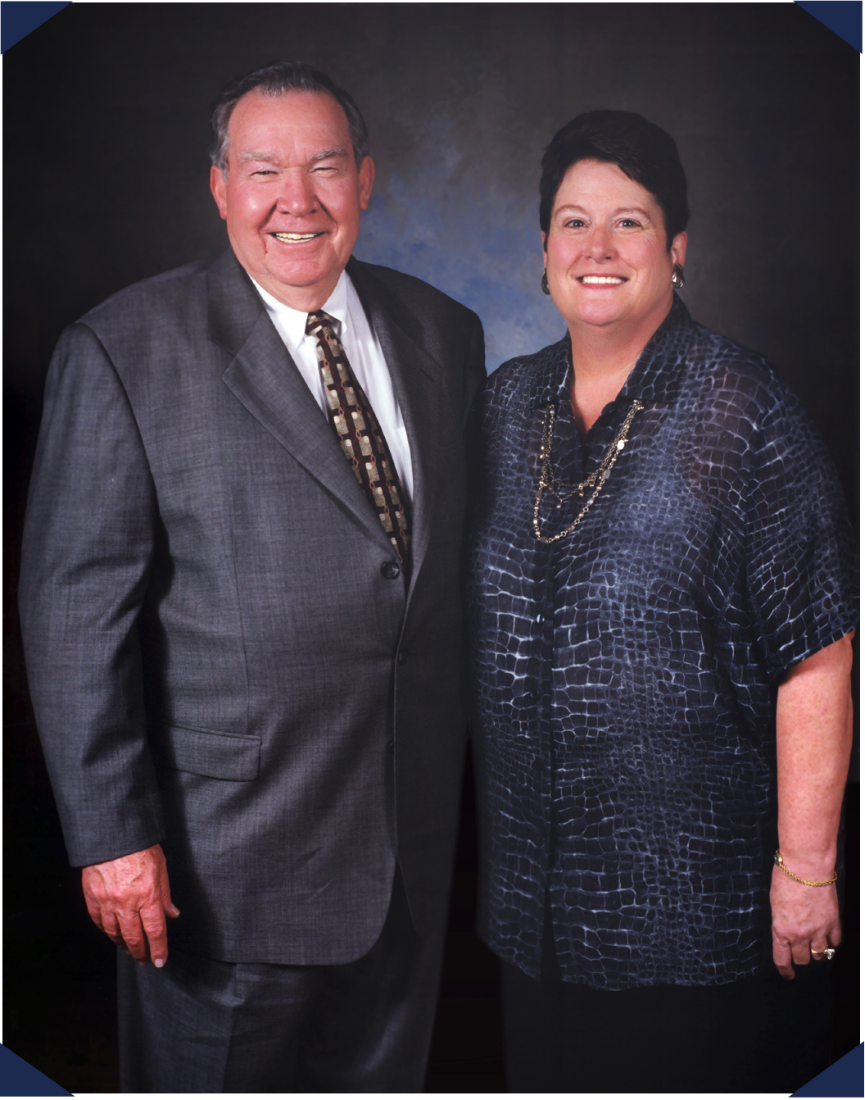
HI
CORPORATE HISTORY
In 1968, a young Billy W. Howard Sr. left his successful career at General Electric to return to his native Mississippi and create his own company –
Howard Industries.
Over the next five decades and with the assistance of his wife, Linda, Howard Industries has grown to become a billion dollar company consisting of four separate divisions and a wholly-owned subsidiary, Howard Transportation.

Slide 3
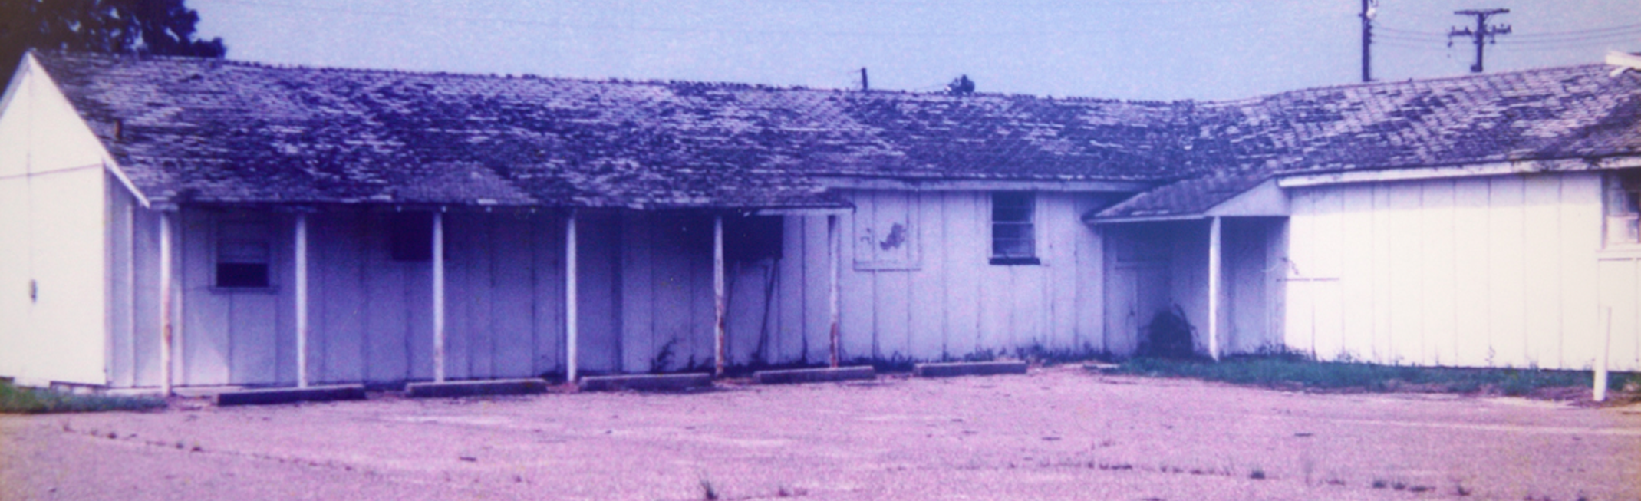
HI
THE FIRST HOWARD BUILDING
Established 1968 | Located in Laurel, Mississippi

Slide 4
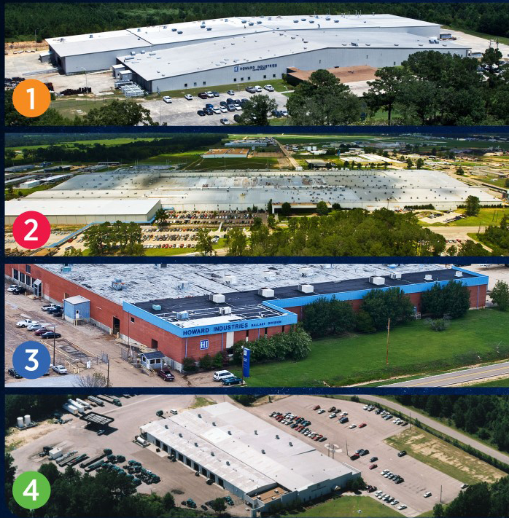
HI
CORPORATE FACILITIES
1
Laurel Transformer Facility
Over 4,300 employees
Largest employer for the privately-held companies in the state of MS
2
Ellisville Transportation Facility
3
Sandersville Ballast Facility
4
Mendenhall HID Facility

Slide 5
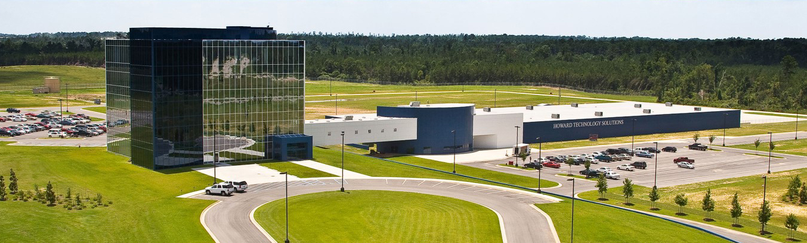
HI
CORPORATE HEADQUARTERS
Our Corporate Headquarters, in Ellisville
Mississippi, is a 5-Story structure wrapped
in two tones of blue glass which includes:
60,000 ft² of office space
72,000 ft² manufacturing plant
for technology products

Slide 6
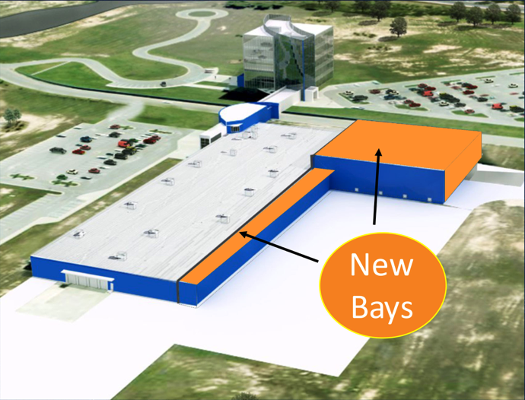
RECENTLY COMPLETED EXPANSION
Newly Expanded Production Facility
Completed in September 2018
New Total Production Facility Floor Space: 112,000 sq. ft.

Slide 7
OUR IMPACT ON MISSISSIPPI
Howard has approximately 4000 employees.
Across all verticals, we have 200+ sales teams.
Our employees’ annual payroll is over $135 million.
Between Howard Industries and our employees, we pay over
$50 million in taxes every year.
We’ve invested over $261 million in Mississippi and purchase approximately $75 million of materials from Mississippi
companies annually.
According to the Mississippi Economic Authority, our total impact on
our state is $460 million each year.

Slide 8
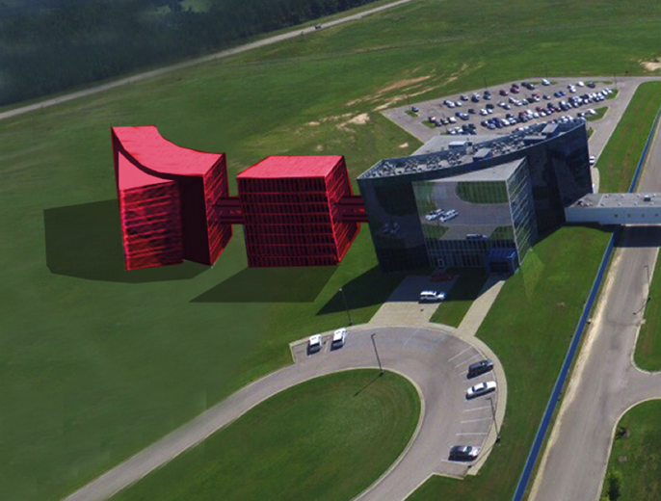
HI
PLANS FOR FUTURE GROWTH
Headquarters Expansion to include additional Office Towers (I and II)

Slide 9
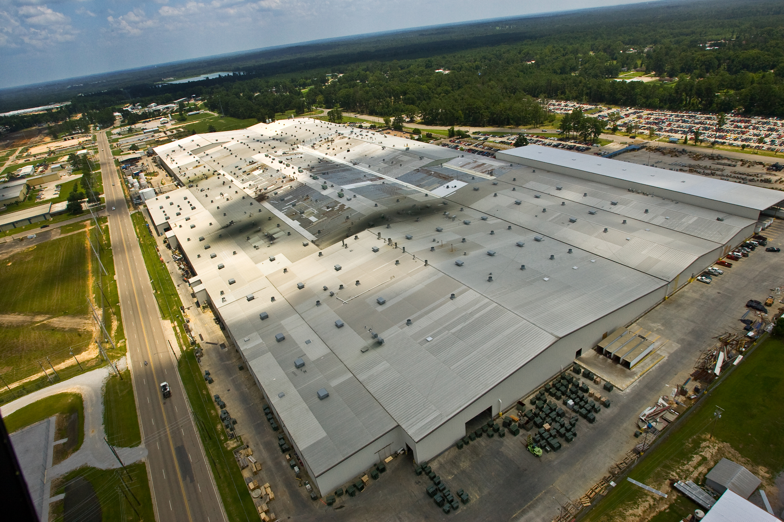
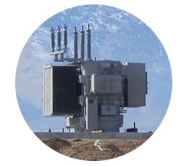
HI
HOWARD POWER SOLUTIONS
Established 1969
Located in Laurel, Mississippi
Largest single transformer manufacturing facility in the world over 2 million ft² (2,500,000 sq. ft.)
Transformer division is the #1 producer of oil-filled distribution transformers in the United States.
Manufacturer of Distribution, Small Power and Medium Power Transformers; Voltage Regulators, Components and Metal Enclosures

Slide 10
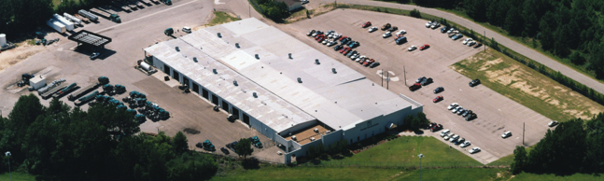


HOWARD TRANSPORTATION
Established 1983 | Located in Ellisville, Mississippi
Howard Transportation operates a full-load, long haul, flatbed common carrier truck line and brokerage operation with over 200 trucks, transporting commodities and industrial goods throughout the continental United States.

Slide 11
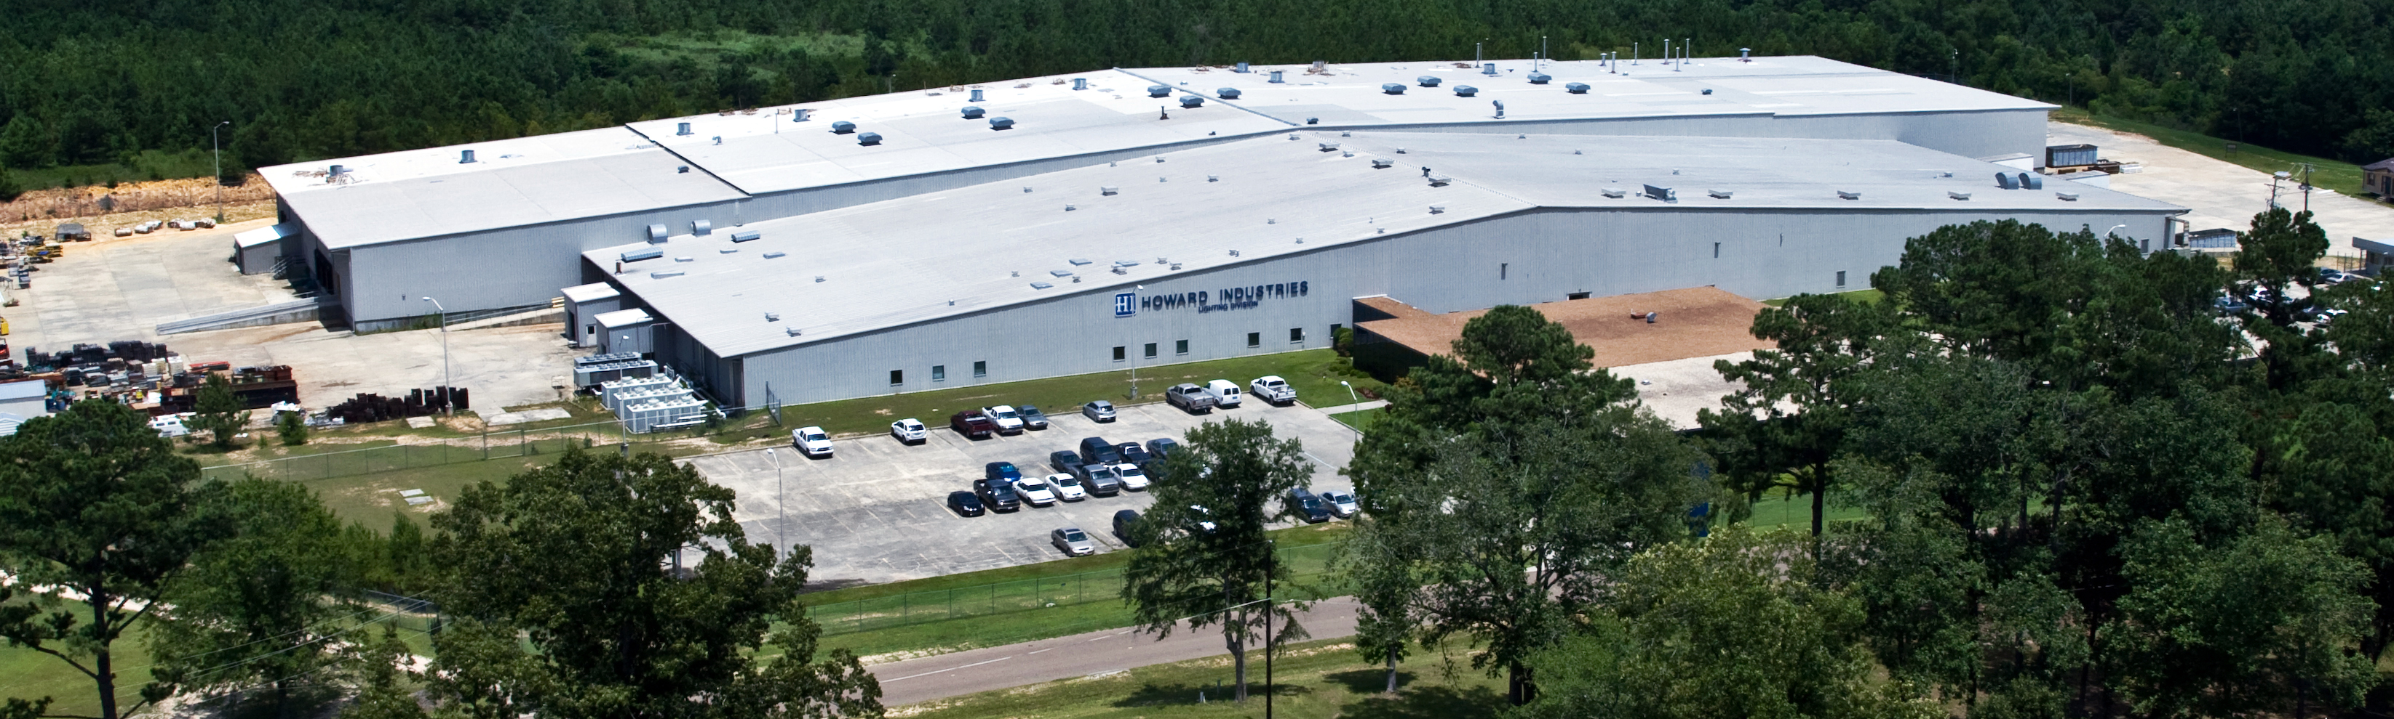

HI
HOWARD LIGHTING
Established 1994 | Located in Sandersville, Mississippi
Howard Lighting designs and manufactures safe, energy efficient lighting that includes a full line of high-quality, fluorescent and HID ballasts, fixtures, and lamps. Howard is committed to a brighter future.

Slide 12



HI
CORPORATE DIVISIONS
POWER SOLUTIONS
TRANSPORTATION
LIGHTING PRODUCTS
Howard Power Solutions is the nation’s leading producer of distribution transformers. Howard Power Solutions also produces medium-power transformers, substation transformers, voltage regulators, junction enclosures, pad-mounted sectionalizing equipment, dry-type transformers, and OEM transformer components.
Howard Transportation is a wholly-owned subsidiary of Howard Industries that operates a fleet of 200+ trucks that transport goods throughout the U.S. as a long-haul, flat-bed common carrier truck line and brokerage operation.
Howard Lighting Products offers lamps, ballasts, and fixtures, including linear fluorescent, compact fluorescent, high intensity discharge (HID), and halogen lamps as well as electronic and magnetic fluorescent, and magnetic HID ballasts. In addition, Howard Lighting also offers a wide array of HID fixtures.

Slide 13

HI
CORPORATE DIVISIONS
Our corporate headquarters is also home to our technology division, Howard Technology Solutions. This division brings to market cutting-edge technology that includes audiovisual and instructional solutions, network security and storage solutions, as well as installation, consulting, and design services. From distance learning and interactive classroom products to point-of-care medical carts and specialized mobility solutions, we make great technology available, and we make it affordable.
HOWARD Education
HOWARD Medical
HOWARD Business
HOWARD Government
HOWARD Interactive
TECHNOLOGY SOLUTIONS

Slide 14











Business and Government One-Stop-Shop
Computing Solutions
Audiovisual Solutions
Network
Solutions
Virtualization Solutions
Physical
Security
Kiosks and
Digital Signage
Software Solutions
Professional
Services
Everyday
Accessories
Vehicle
Solutions
Infection
Control

Slide 15


Education One-Stop-Shop
Computing Solutions
Audiovisual Solutions
Network
Solutions
Virtualization Solutions
Physical
Security
Kiosks and
Digital Signage
Software Solutions
Professional
Services
Everyday
Accessories
Professional
Development
eSPORTS
Solutions
Infection
Control

Slide 16



Healthcare One-Stop-Shop
Computing Solutions
Audiovisual Solutions
Network
Solutions
Virtualization Solutions
Physical
Security
Kiosks and
Digital Signage
Software Solutions
Professional
Services
Everyday
Accessories
Point-of-Care
Solutions
Telehealth
Solutions
Infection
Control
Patient
Experience

Slide 17
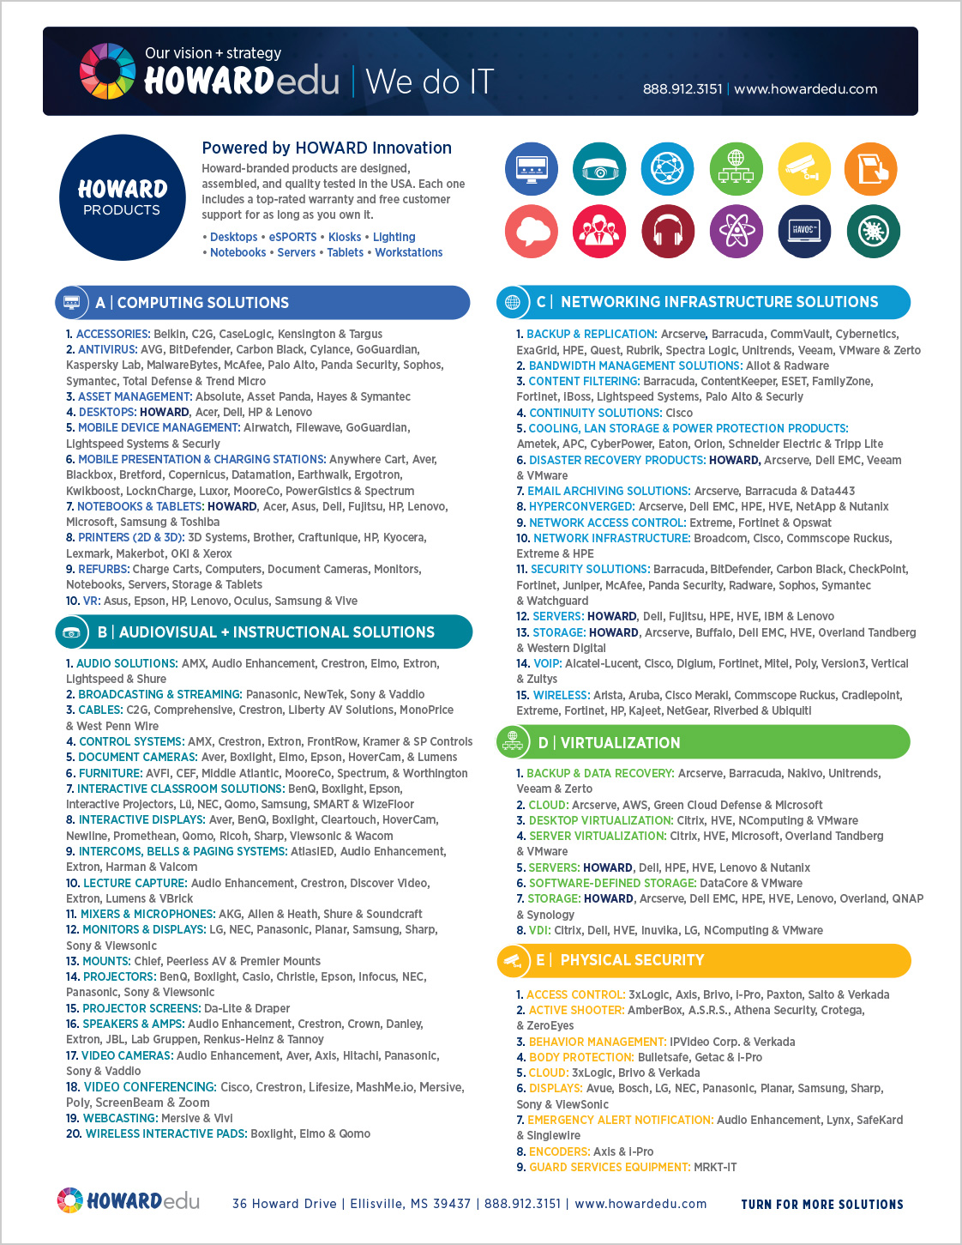

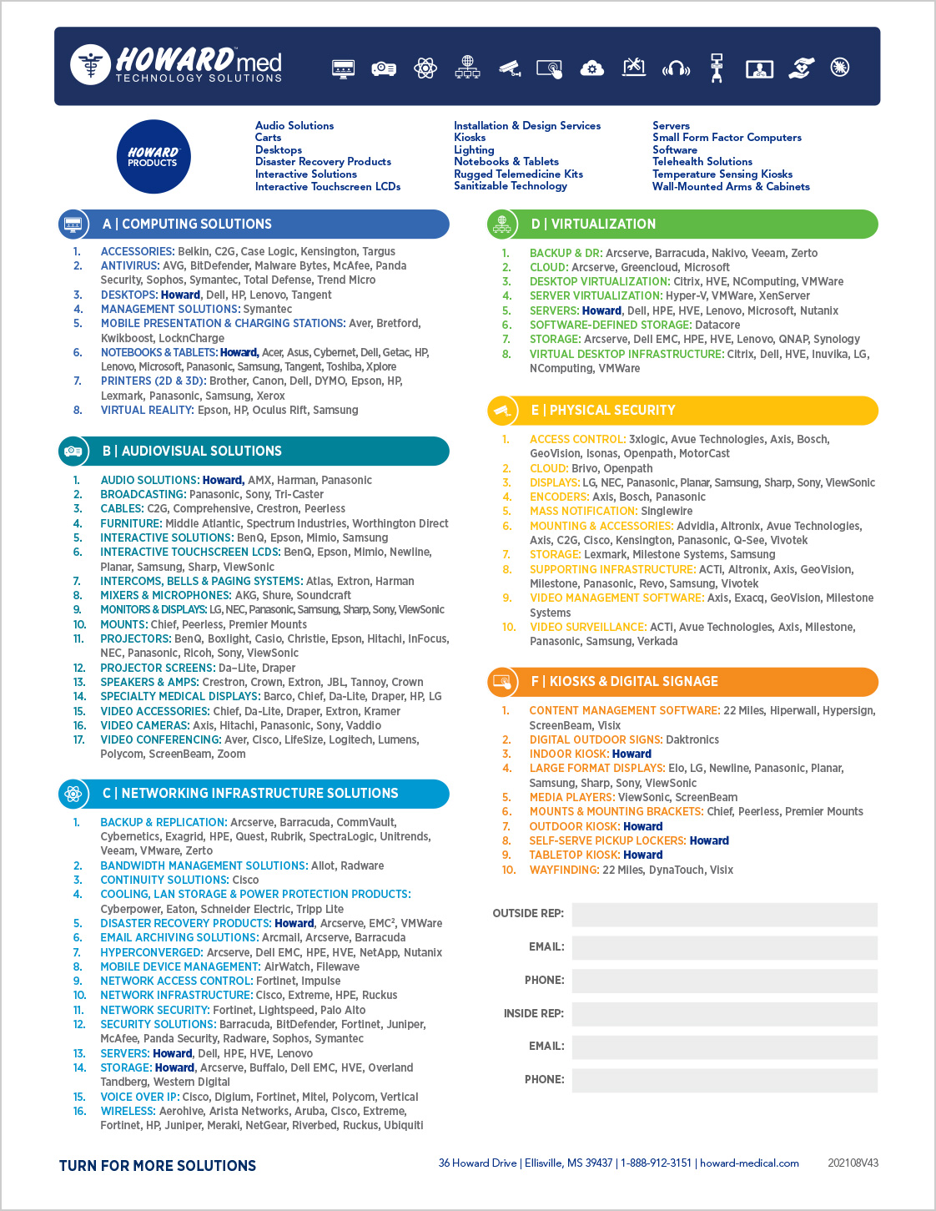
Our Product Linecards are available in your bag!

Slide 18
Did you know? HOWARD offers:
Computing Solutions
• Accessories • Antivirus • Asset Management • Desktops • MDM
• Mobile Presentation and Charging Stations • Notebooks • Printers (2D & 3D) • Refurbs • Tablets • VR
Audiovisual Solutions
• Audio Solutions • Broadcasting and Streaming • Cables • Control Systems • Document Cameras • Furniture
• Interactive Classroom Solutions • Interactive Displays • Intercoms, Bells and Paging Systems
• Lecture Capture • Mixers and Microphones • Monitors and Displays • Mounts • Projectors
• Projector Screens • Speakers and Amps • Video Cameras • Video Conferencing • Webcasting
• Wireless Interactive Pads
Network Solutions
• Backup and Replication • Bandwidth Management Solutions • Content Filtering • Continuity Solutions
• Cooling, LAN Storage and Power Protection • Disaster Recovery Products • Email Archiving Solutions
• Hyperconverged • Network Access Control • Network Infrastructure • Security Solutions • Servers • Storage
• VOIP • Wireless

Slide 19
Did you know? HOWARD offers:
Virtualization Solutions
• Backup and Data Recovery • Cloud • Desktop Virtualization • Server Virtualization • Servers
• Software-Defined Storage • Storage • VDI
Physical Security
• Access Control • Active Shooter • Behavior Management • Body Protection • Cloud • Displays
• Emergency Alert Notification • Encoders • Guard Services Equipment • Intercoms • Lighting
• Mobile Security • Mounting • Perimeter Security • Storage • Supporting Infrastructure • Video Management
• Video Surveillance • Visitor Management
Kiosks and Digital Signage
• Content Management Software • Digital Outdoor Signs and Scoreboards • Indoor Kiosks
• Large Format Displays • Media Players • Mounts and Mounting Brackets • Outdoor Kiosks
• Self-Serve Pickup Lockers • Tabletop Kiosks • Telemedicine Kiosks • Through-the-Wall Kiosks
• Wayfinding Kiosks

Slide 20
Did you know? HOWARD offers:
Software Solutions
• Antivirus • Backup, Recovery and Utility • Chromebook-Enabling Software • Content Creation
• Creativity, Design and Page Layout • Data Analytics • IT and Network Management • Network Security
• Print Management • Programming and Web Development • Virtualization and Storage
Professional Services
• Consulting • Installation and Design Services • Managed Services
• Physical Security and Video Surveillance Services • Professional Development/Training
• Programming Services • Support Services
Everyday Accessories
• Bags and Cases • Hardware • Headphones and Headsets • Networking • Office Supplies
• Printing Consumables

Slide 21
Did you know? HOWARD offers:
Professional Development
• FUSION has been created with the goal of working with and empowering educators to harness the use of technology so they can foster a classroom environment that engages and ignites learning.
• Audio Enhancement • Coding • MobileMind • STEMFuse
eSPORTS Solutions
• Gaming Desktops • Gaming Furniture • Gaming Headsets • Gaming Keyboards • Gaming Laptops
• Gaming Mice • Gaming Monitors • Graphic Cards
Infection Control
• Cleaning Supplies and PPE Equipment • Custom Protective Acrylic Shields
• Electrostatic Disinfectant Sprayers • Hand Sanitizer Stations • Sanitizable Technology
• Temperature Sensing Kiosks • UVC Sanitizing Solutions

Slide 22
Did you know? HOWARD offers:
Point-of-Care Solutions
• All-in-One Computers • Authentic Devices • Barcode Scanners • Carts • Document Scanners
• Medical-Grade LCD • Signature Pads • Small Form Factor Computers • Software • Specialty Printers
• Standard LCD • Thin Clients • Wall-Mounted Arms and Cabinets • Washable Keyboards and Mice
Telehealth Solutions
• Carts • Computing Technology • Rugged Telemedicine Kits • Software • Telehealth Kiosk
• Telehealth Technology • Wall-Mounted Cabinets
Patient Experience
• Charging Solutions • Color Turntable and Adjustable Lighting • Digital Signage • Directional Audio
• Displays • Interactive Solutions • Notebooks and Tablets • Patient Entertainment and Education
• Telehealth • Wayfinding

Slide 23
Did you know? HOWARD offers:
Vehicle Solutions
• Mounts • Printers • Rugged • Scanners (Barcode) • Software • Video Solutions • Wireless

Slide 24
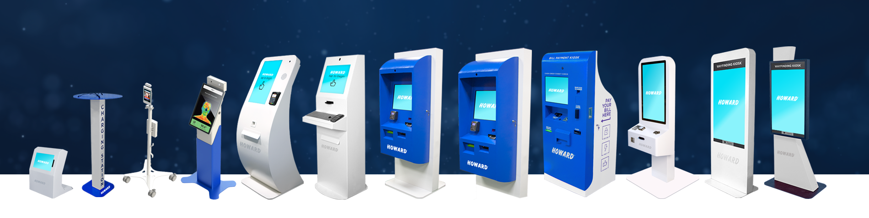
KIOSK SOLUTIONS
Kiosks minimize staffing requirements, reduce operating and transaction costs while increasing sales/revenue, foot traffic and efficiency; manage peak traffic flow, add off-hours convenience, and enhance the overall consumer experience.
Bill Pay
Digital Signage
Telemedicine
Temperature Detection
Ticketing
Wayfinding

Slide 25

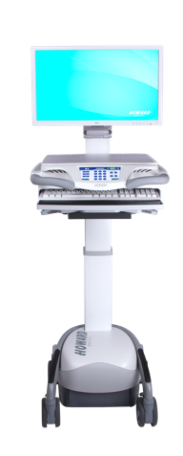
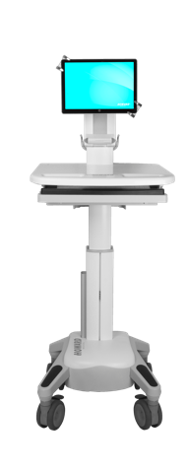
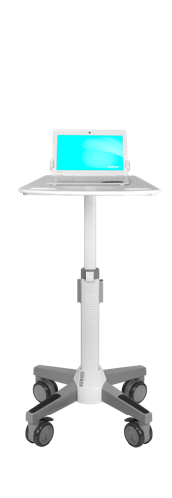
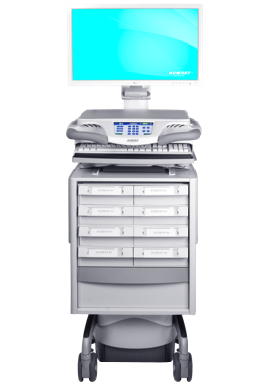
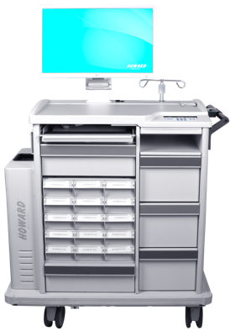
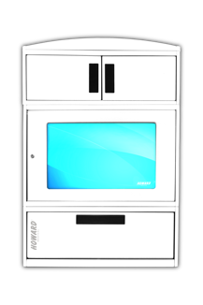
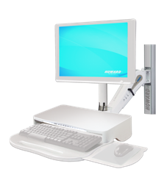
HEALTHCARE MOBILITY SOLUTIONS
Mobile Point-of-Care Solutions
HI-Care, HI-Core and HI-Swift
Med Dispense Solutions
HI-Paradigm, HI-Pinnacle,
Med-Hub, Transfer Cart
and MedServe Cabinets
Fixed Solutions
Arms and Cabinets

Slide 26
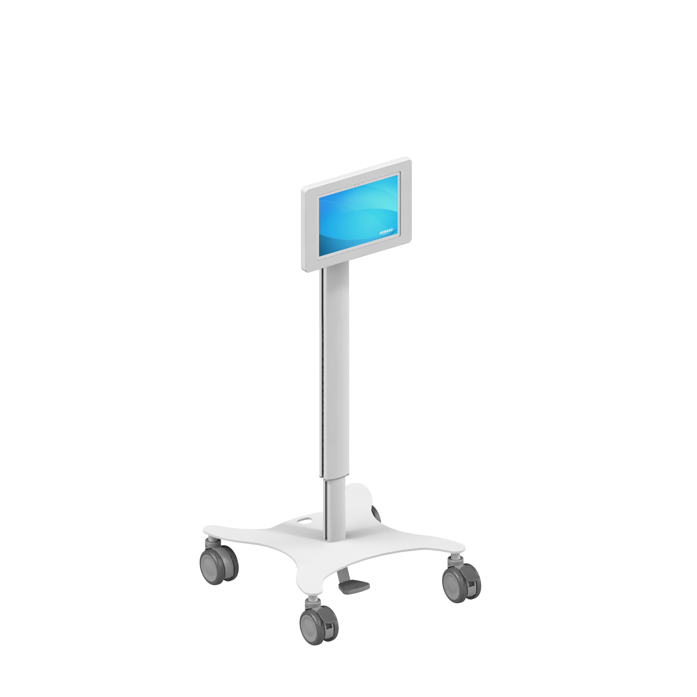
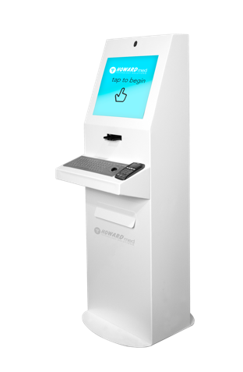
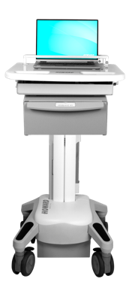
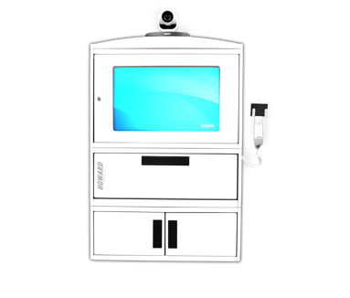
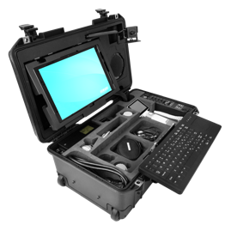
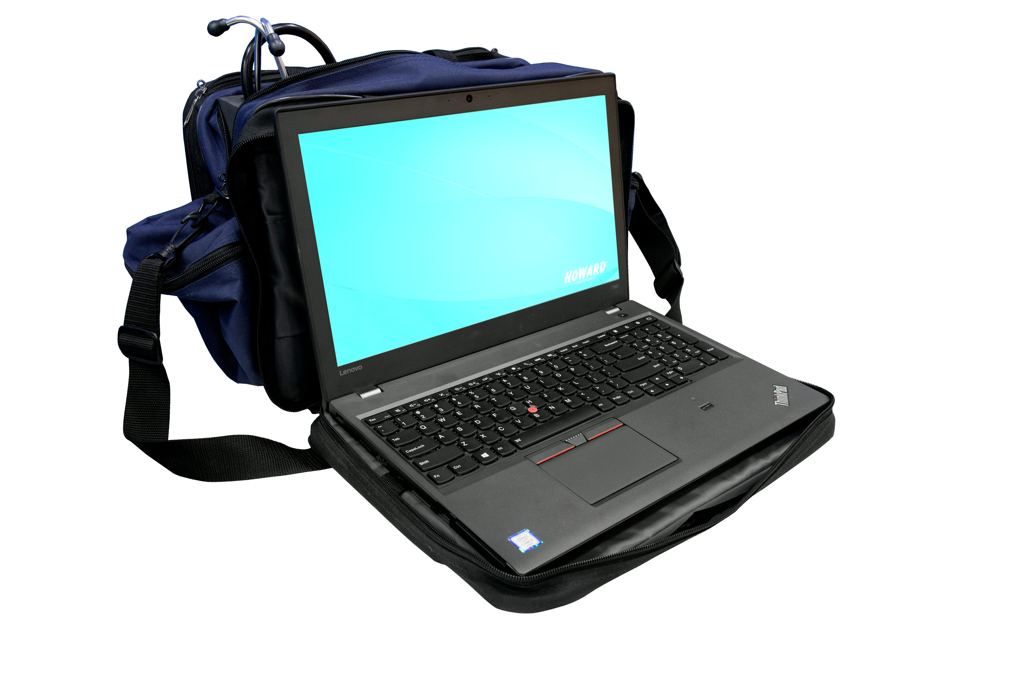
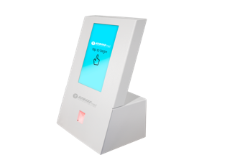
TELEHEALTH SOLUTIONS
Mobile Solutions
Tele-Care, Tele-Core
and HI-Rise
Wall Mounted Solutions
Telehealth Cabinet
Kit Solutions
Rugged Telemedicine Kits and Soft Telemedicine Kits
Kiosk Solutions
Telehealth Kiosks

Slide 27
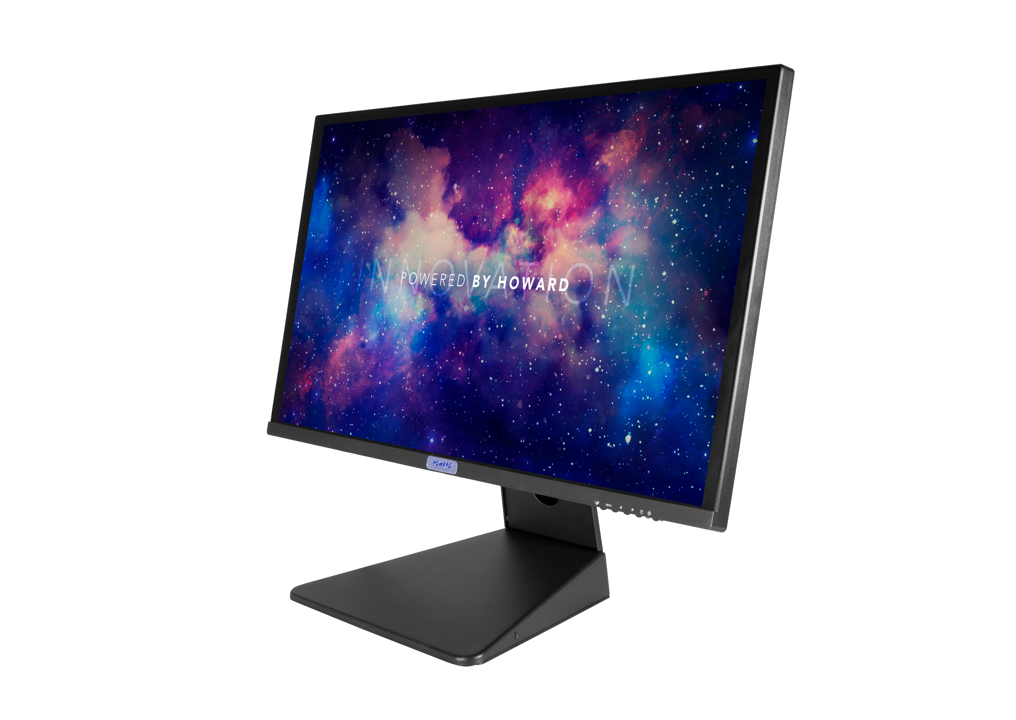
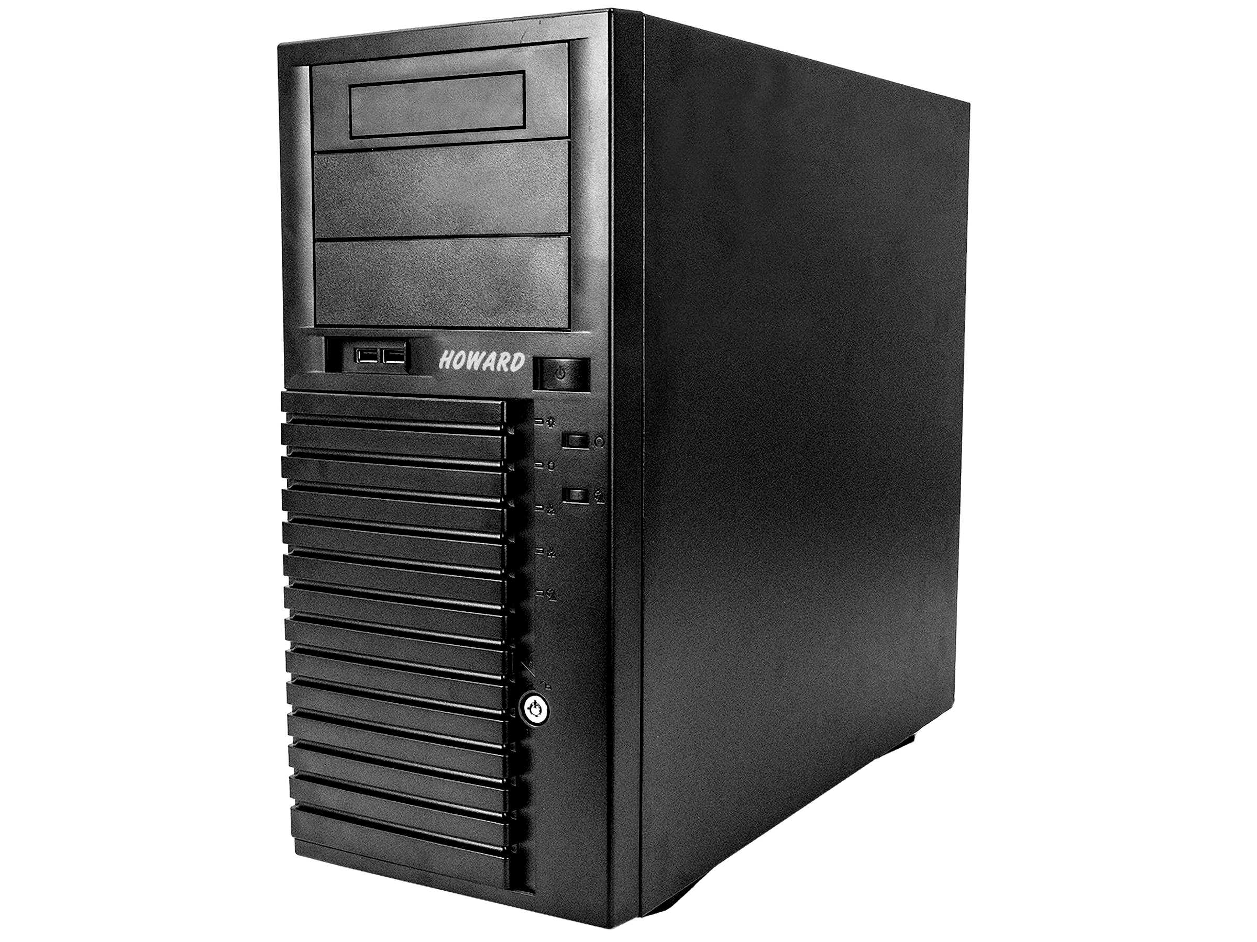
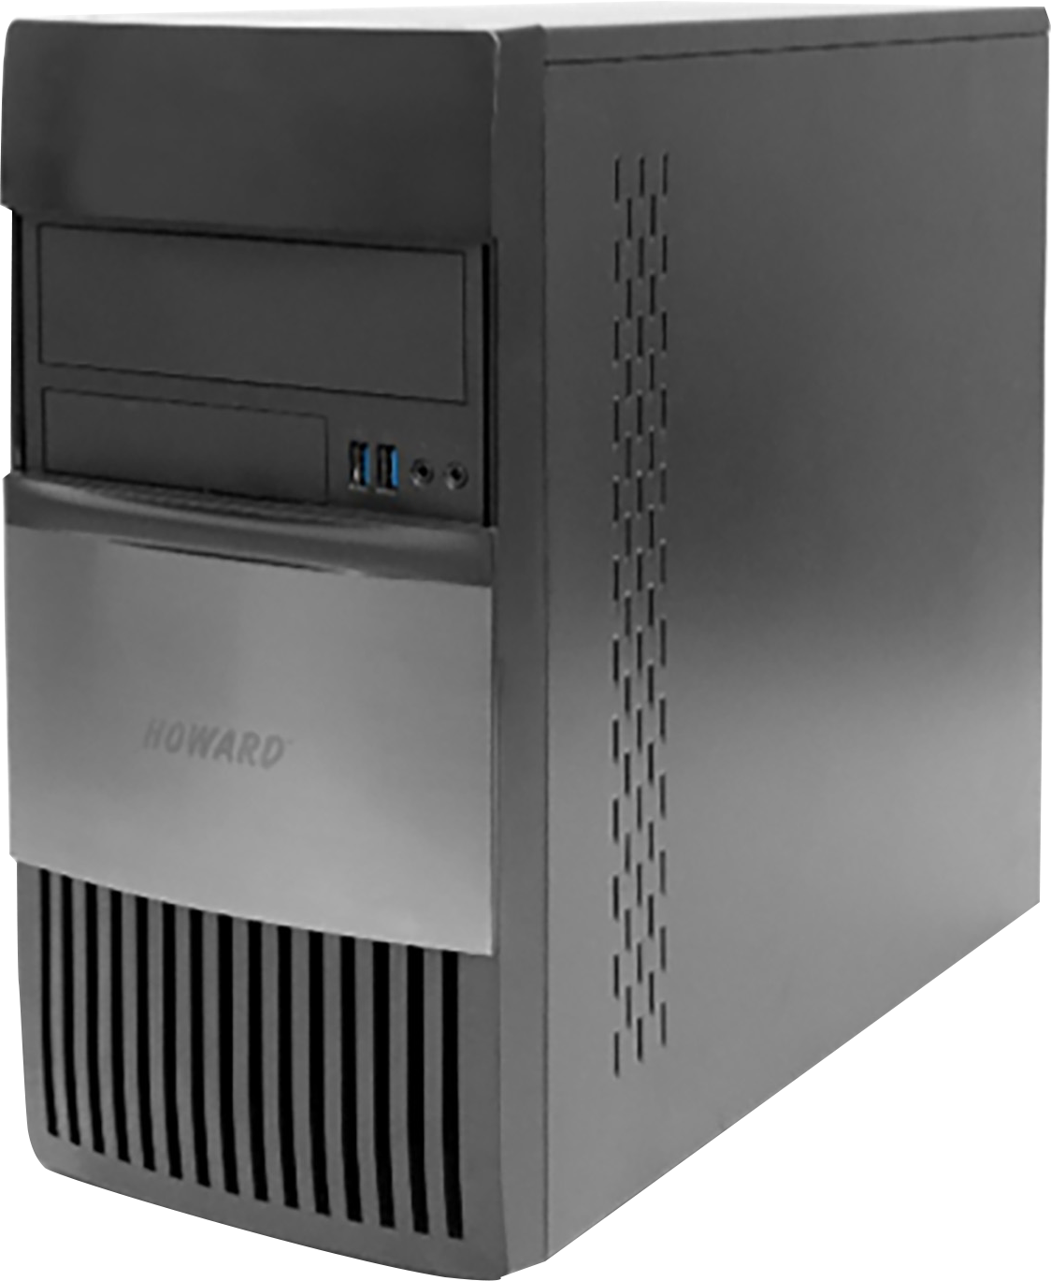
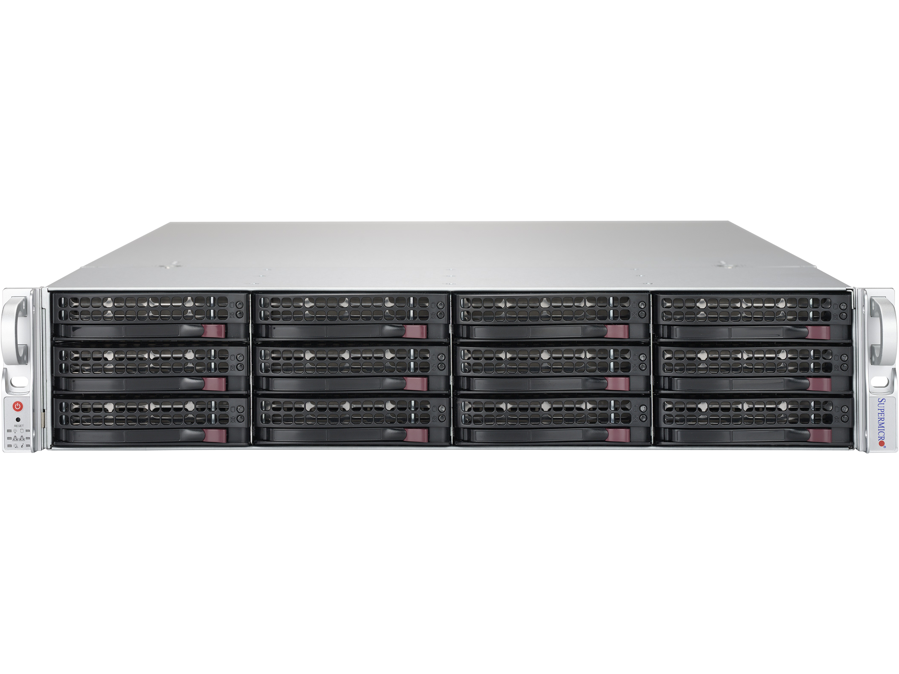
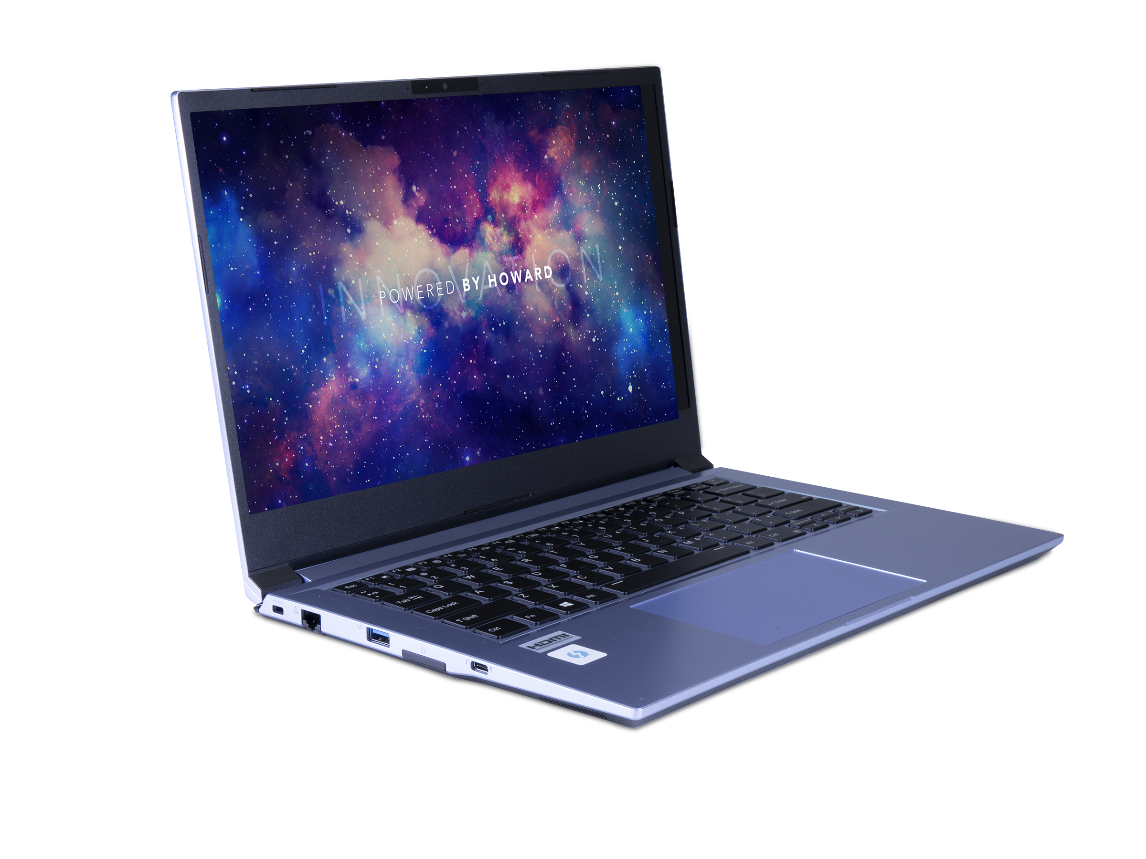
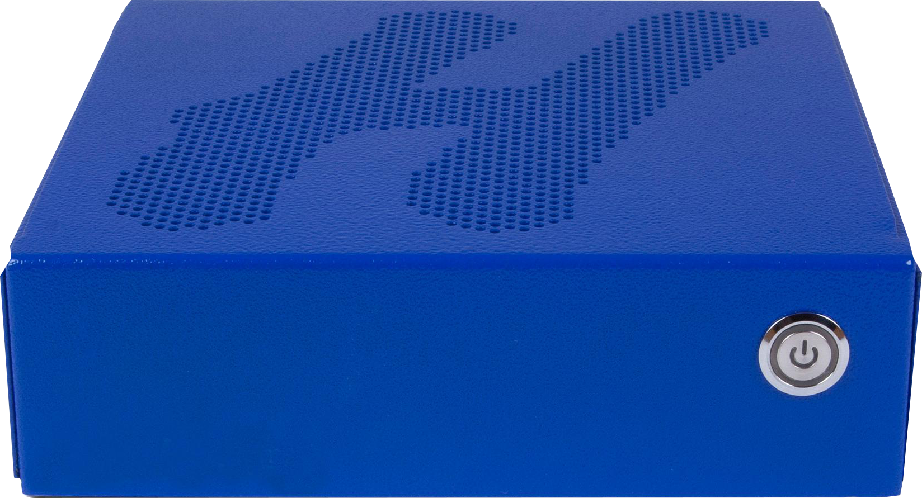
Powered by Howard Innovation
HOWARD COMPUTING SOLUTIONS
Desktops | All-in-Ones | Notebooks | Tablets | Servers | Storage

Slide 28
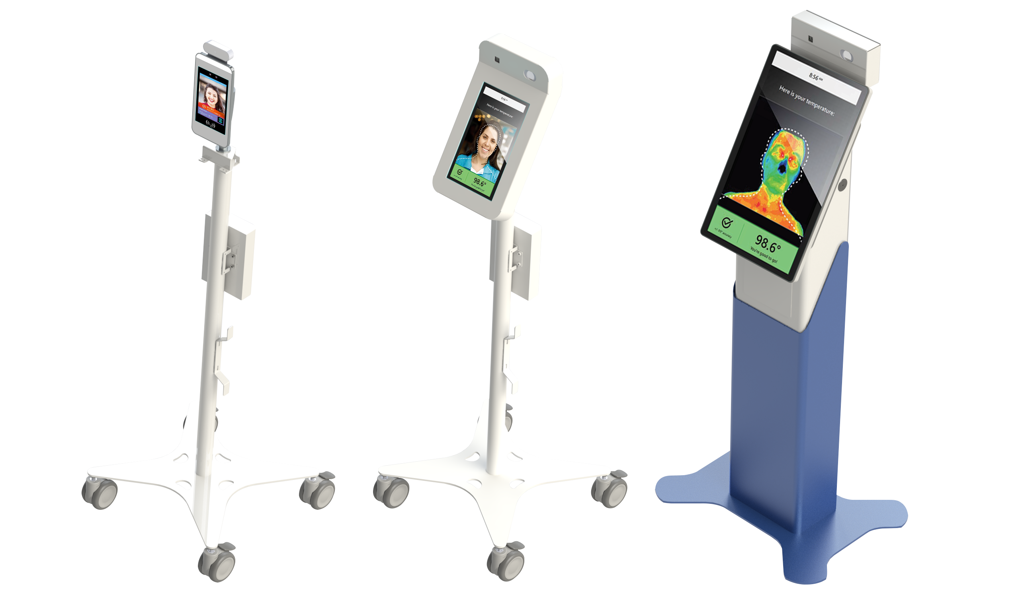
INFECTION CONTROL SOLUTIONS
Howard Temp Detection Kiosks
The Howard Temp Detection Kiosks with facial recognition and contactless features help to keep your environment infection free.
Cleaning Protocol Solutions
Significantly limit the spread of viruses with protective gear, as well as effective antimicrobial and germicidal agents
from Howard.
Howard Acrylic Health Shields
Howard Health Shields act as protective barriers, shielding employees and customers from the spread of airborne pathogens.

Slide 29








SHOP BY CONTRACT
Howard is dedicated to ensuring that our customers are equipped with the IT products and services they need to succeed in today’s digital environment. No matter the type, size, or location of your organization, Howard has the customizable technology solutions that will meet or exceed any specifications required to bring your facility up to 21st Century standards, and most of these are available on state or federal contracts, such as:

Slide 30
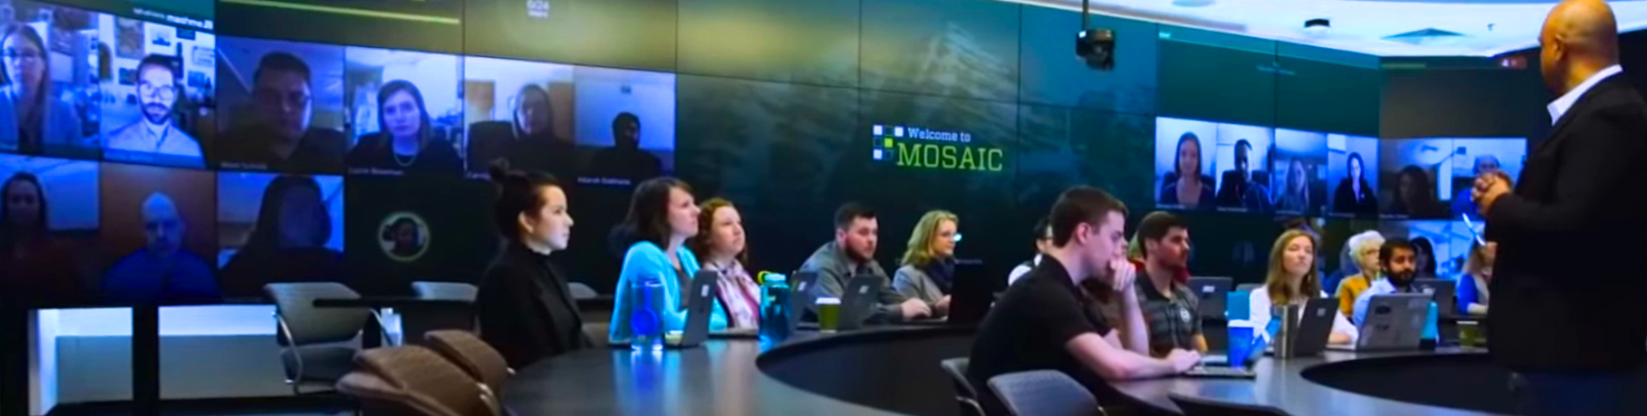
PROFESSIONAL SERVICES
From design services, network
consulting, programming, cabling,
and audiovisual solutions to
management services that range
from routine system maintenance
to complete IT outsourcing, Howard
can provide the level of support you
need at a price that is right for your
Institution’s budget.
Audiovisual Services
Cabling
Cloud Services
Consulting
Contractor’s Licensing (per state)
Design Services
Installation Services
Managed Services
Networking Services (wired/wireless)
Onsite Technicians and IT Outsourcing
Physical Security and Video Surveillance
Programming Services
Storage
Support Services
Training and Professional Services
Virtualization Services
VOIP
Website Development and Management

Slide 31

PROFESSIONAL SERVICES
JOBS COMPLETED
Type | 2019 | 2020 | 2021
AV | 741 | 787 | 968
NT | 92 | 129 | 114
SEC | 36 | 42 | 49
TOTAL | 869 | 958 | 1,131

Slide 32
THANK YOU
Presented by

