Slide 1
WELCOME
Presented by |

Slide 2
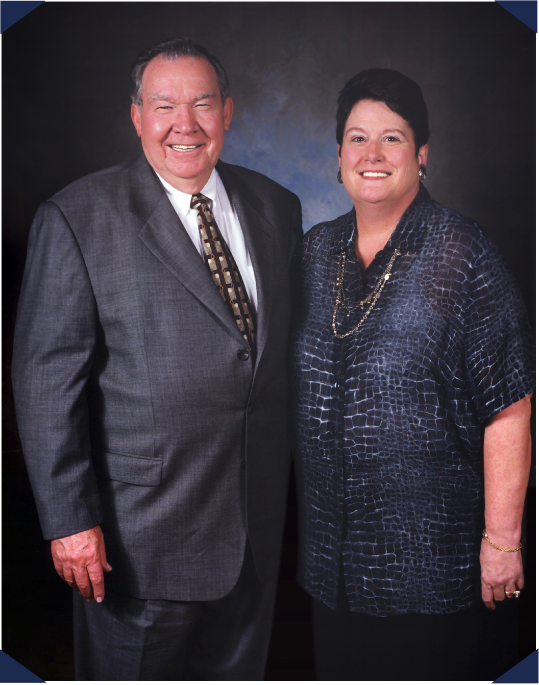
HI
CORPORATE HISTORY
In 1968, a young Billy W. Howard Sr. left his successful career at General Electric to return to his native Mississippi and create his own company –
Howard Industries.
Over the next five decades and with the assistance of his wife, Linda, Howard Industries has grown to become a billion dollar company consisting of four separate divisions and a wholly-owned subsidiary, Howard Transportation.

Slide 3
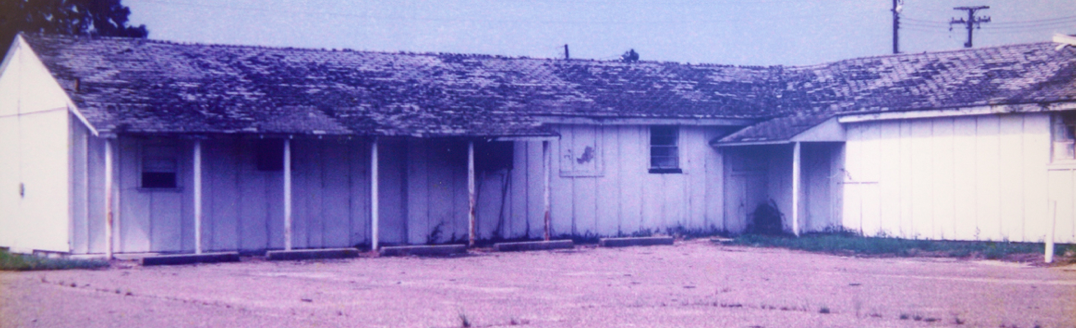
HI
THE FIRST HOWARD BUILDING

Slide 4
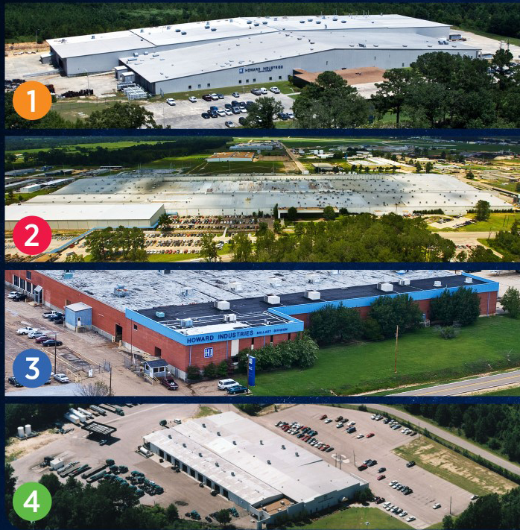
HI
CORPORATE FACILITIES
1
Laurel Transformer Facility
Over 4,300 employees
Largest employer for the privately-held companies in the state of MS
2
Ellisville Transportation Facility
3
Sandersville Ballast Facility
4
Mendenhall HID Facility

Slide 5
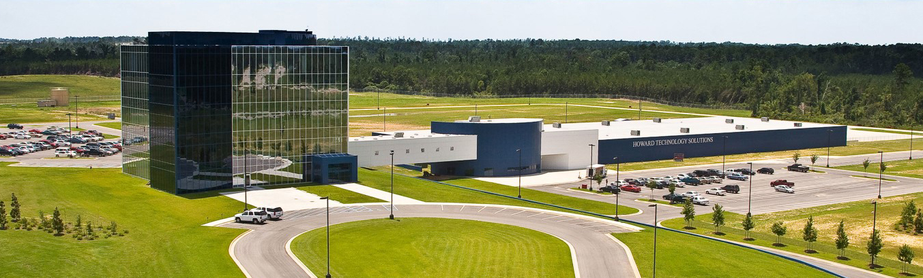
HI
CORPORATE HEADQUARTERS
Our Corporate Headquarters, in Ellisville
Mississippi, is a 5-Story structure wrapped
in two tones of blue glass which includes:
60,000 ft² of office space
72,000 ft² manufacturing plant
for technology products

Slide 6
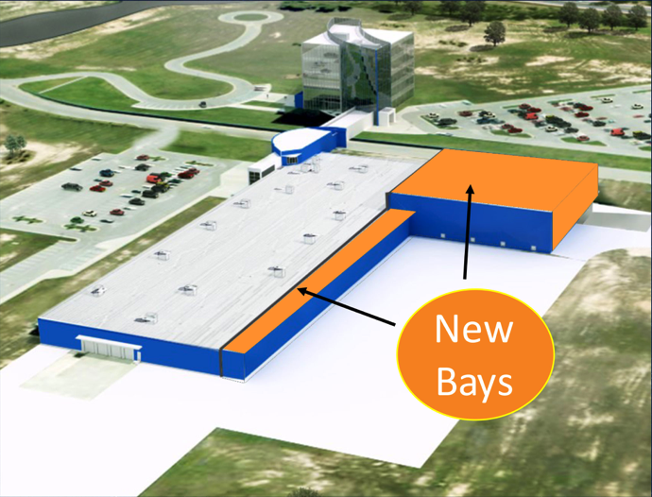
RECENTLY COMPLETED EXPANSION
Newly Expanded Production Facility
Completed in September 2018
New Total Production Facility Floor Space: 112,000 sq. ft.

Slide 7
OUR IMPACT ON MISSISSIPPI
Howard has approximately 4000 employees.
Across all verticals, we have 200+ sales teams.
Our employees’ annual payroll is over $135 million.
Between Howard Industries and our employees, we pay over
$50 million in taxes every year.
We’ve invested over $261 million in Mississippi and purchase approximately $75 million of materials from Mississippi
companies annually.
According to the Mississippi Economic Authority, our total impact on
our state is $460 million each year.

Slide 8
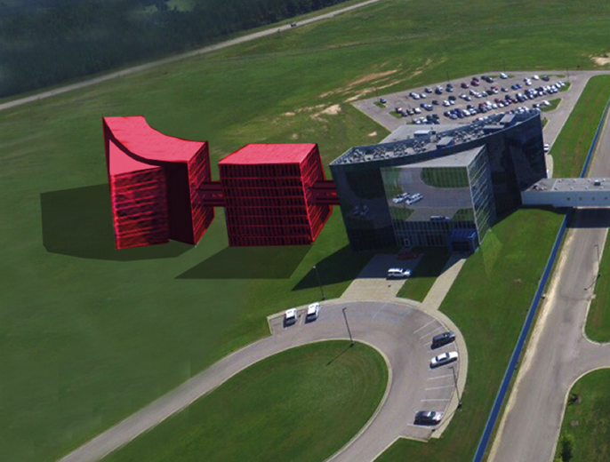
PLANS FOR FUTURE GROWTH
Headquarters Expansion to include additional Office Towers (I and II)

Slide 9
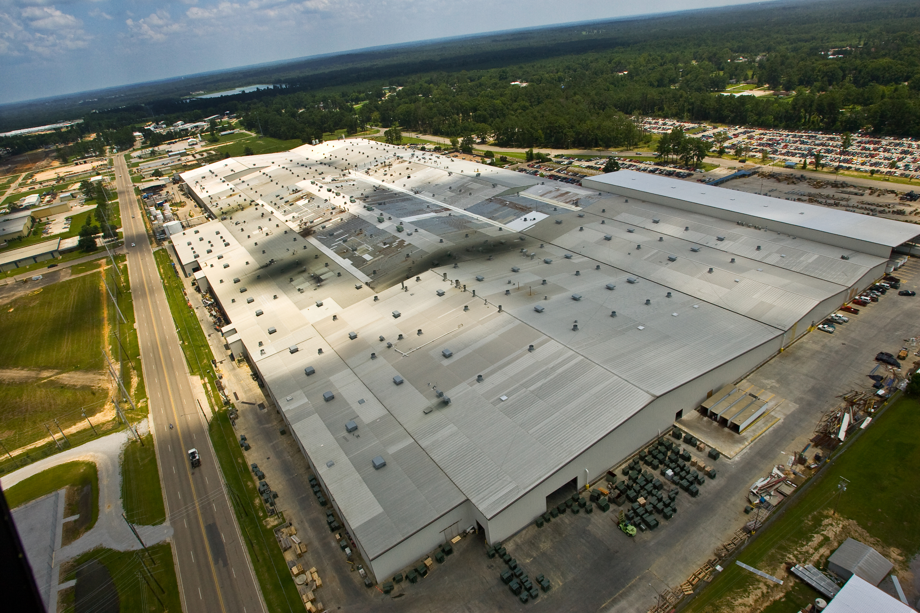
HI
HOWARD TRANSFORMER PLANT
Located in Laurel, Mississippi
2,500,000 sq. ft.
Equivalent to over 1,000
2,500 sq. ft. homes
Largest single transformer manufacturing facility in the world – over 2 million ft²
Transformer division is the #1 producer of oil-filled distribution transformers in the United States.

Slide 10
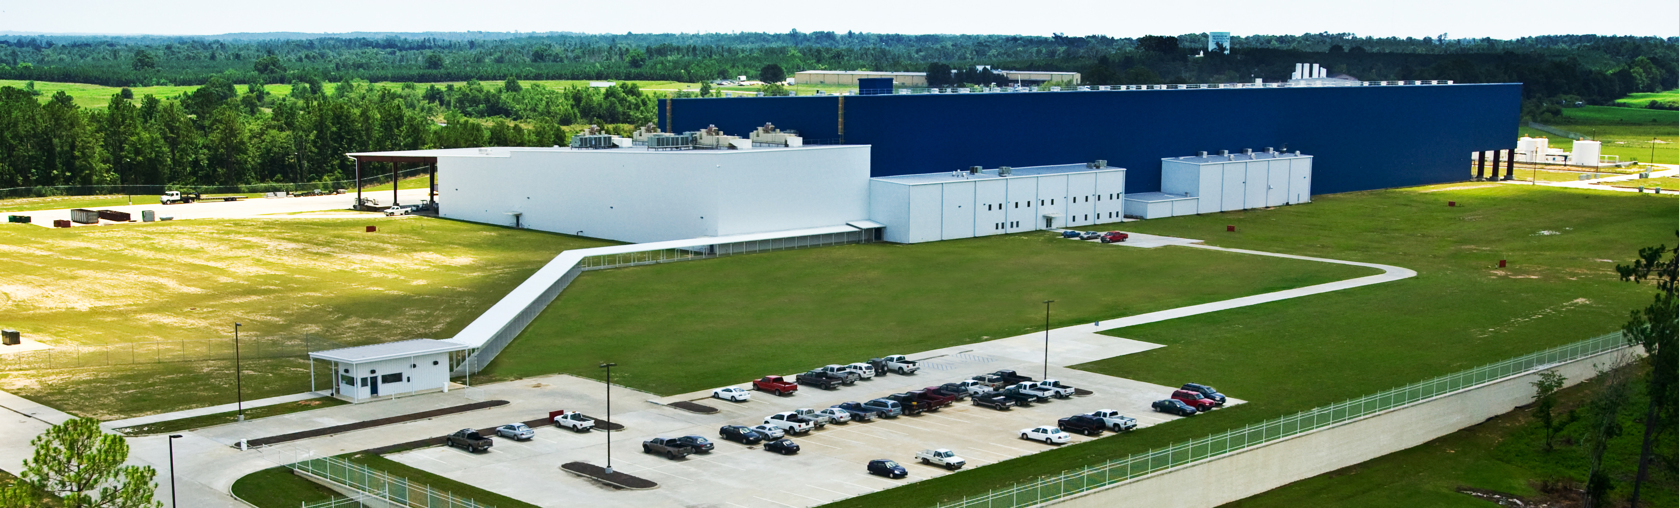
HI
HOWARD SUBSTATION PLANT
Ellisville, Mississippi

Slide 11
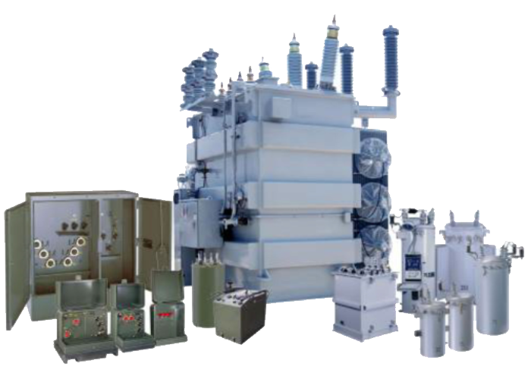
HI
HOWARD POWER SOLUTIONS
Distribution Transformers
Small Power Transformers
Medium Power Transformers
Voltage Regulators
Transformer Components
Metal Enclosures

Slide 12
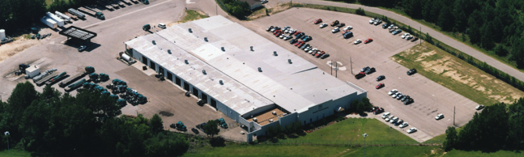

HOWARD TRANSPORTATION PLANT
Ellisville, Mississippi

Slide 13
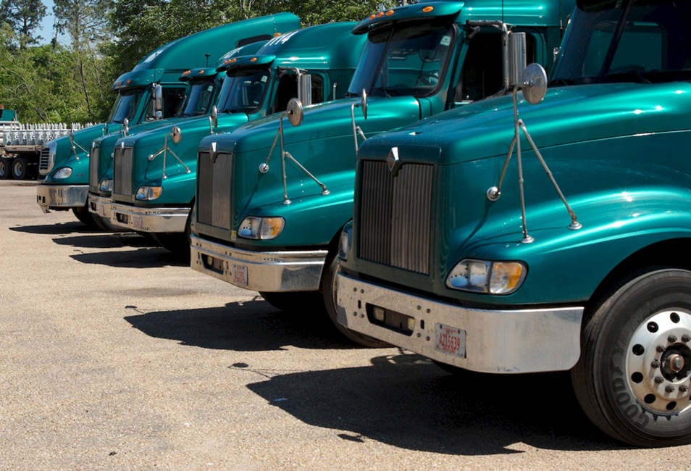
HOWARD TRANSPORTATION
200 Trucks
GPS Tracking
Nationwide Cargo
Brokerage Operation
Terminal and Headquarters in Ellisville, MS
200 Employees

Slide 14
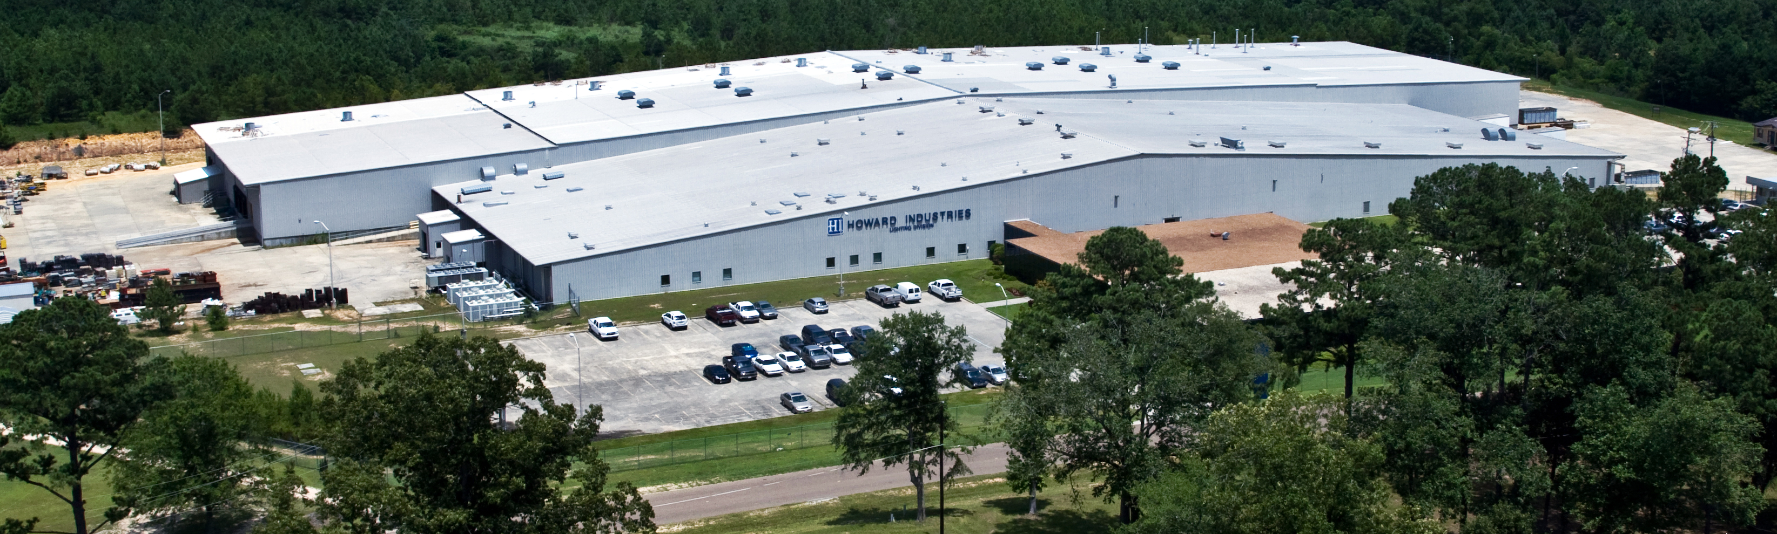
HI
HOWARD LIGHTING PLANT
Sandersville, Mississippi

Slide 15
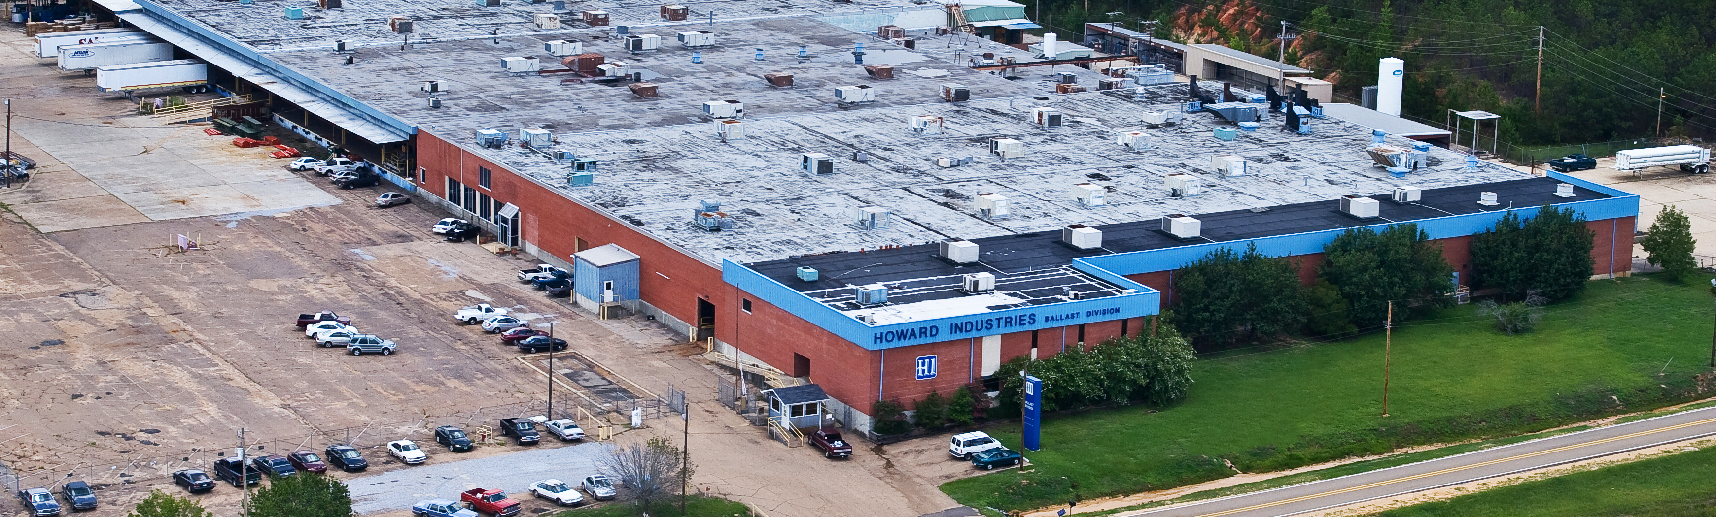
HI
HOWARD LIGHTING PLANT
Mendenhall, Mississippi

Slide 16
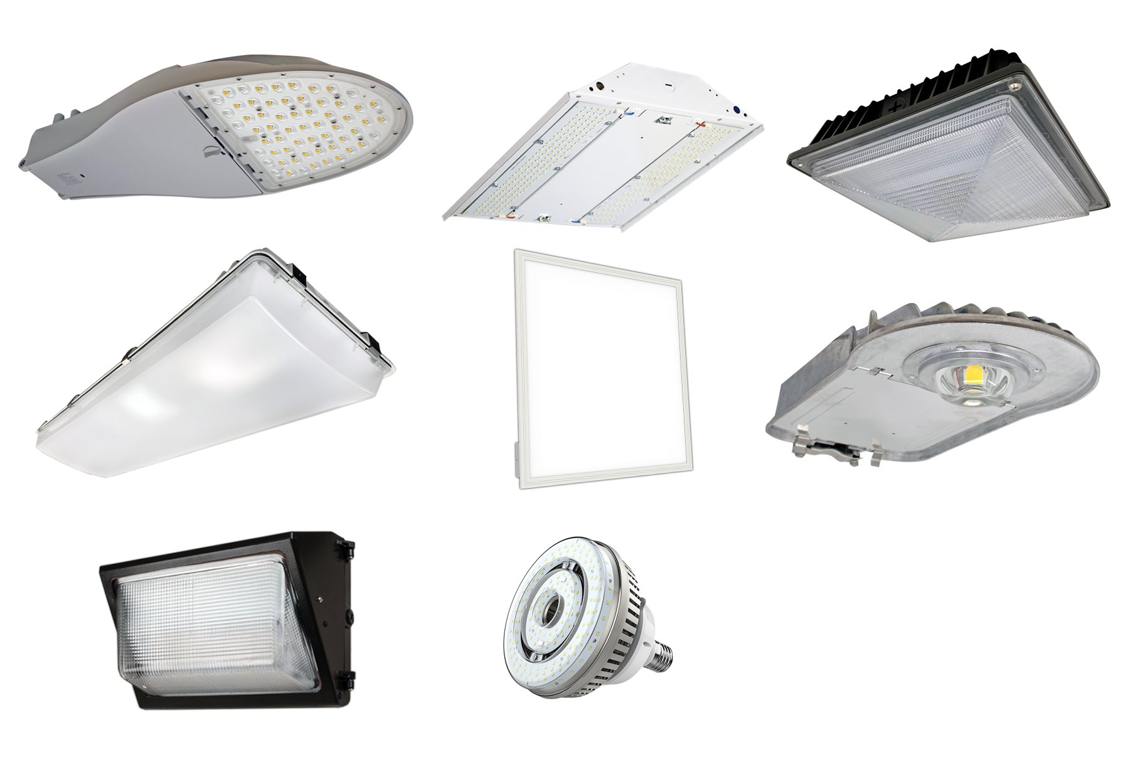
HI
HOWARD LIGHTING PRODUCTS
Area Lights
Ballasts
Canopy Lights
Flat Panels
Flood Lights
High Bay and Low Bay Lighting
Lamps
Lighting Strips
Solar Lights
Utility Lighting
Wall Packs

Slide 17



HI
CORPORATE DIVISIONS
POWER SOLUTIONS
TRANSPORTATION
LIGHTING PRODUCTS
Howard Power Solutions is the nation’s leading producer of distribution transformers. Howard Power Solutions also produces medium-power transformers, substation transformers, voltage regulators, junction enclosures, pad-mounted sectionalizing equipment, dry-type transformers, and OEM transformer components.
Howard Transportation is a wholly-owned subsidiary of Howard Industries that operates a fleet of 200+ trucks that transport goods throughout the U.S. as a long-haul, flat-bed common carrier truck line and brokerage operation.
Howard Lighting Products offers lamps, ballasts, and fixtures, including linear fluorescent, compact fluorescent, high intensity discharge (HID), and halogen lamps as well as electronic and magnetic fluorescent, and magnetic HID ballasts. In addition, Howard Lighting also offers a wide array of HID fixtures.

Slide 18

HI
CORPORATE DIVISIONS
Our corporate headquarters is also home to our technology division, Howard Technology Solutions. This division brings to market cutting-edge technology that includes audiovisual and instructional solutions, network security and storage solutions, as well as installation, consulting, and design services. From distance learning and interactive classroom products to point-of-care medical carts and specialized mobility solutions, we make great technology available, and we make it affordable.
HOWARDedu
HOWARDmed Technology Solutions
HOWARD Enterprise
HOWARD Interactive
Howard Store
TECHNOLOGY SOLUTIONS

Slide 19
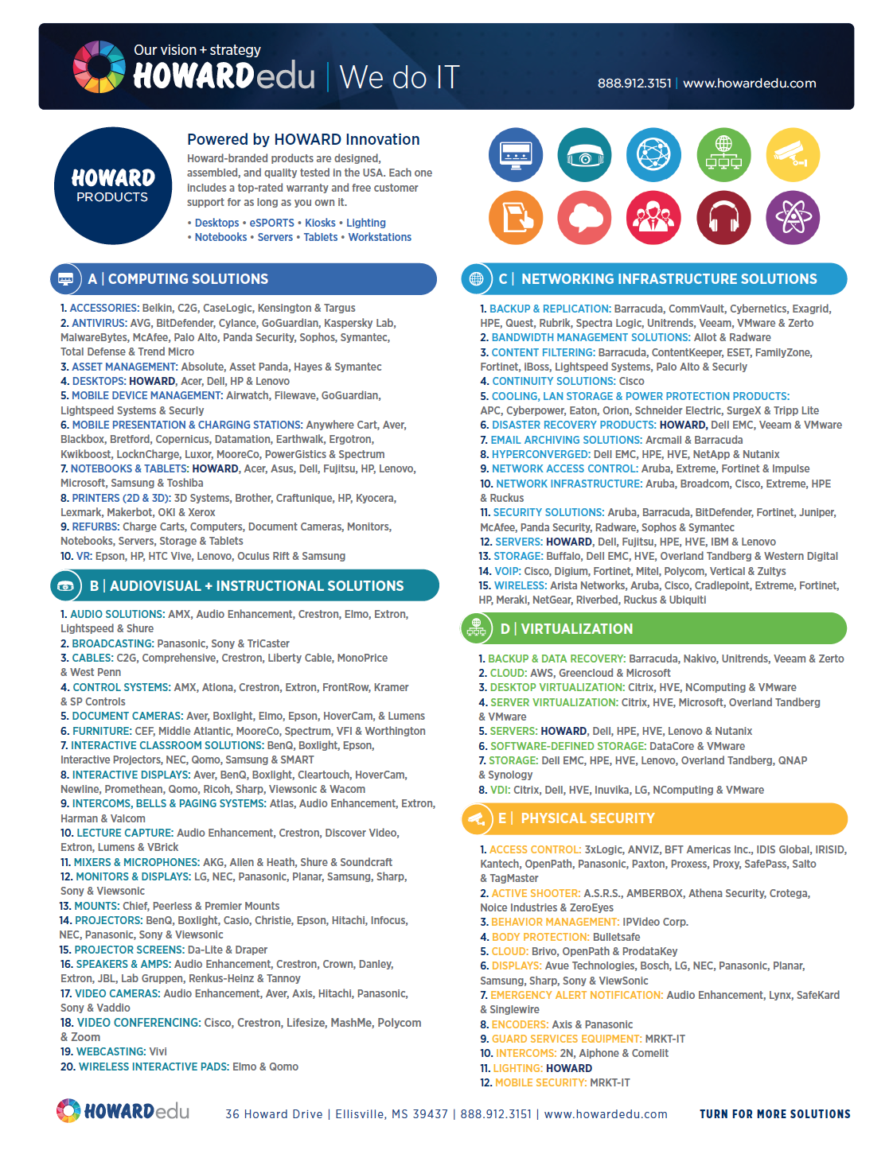
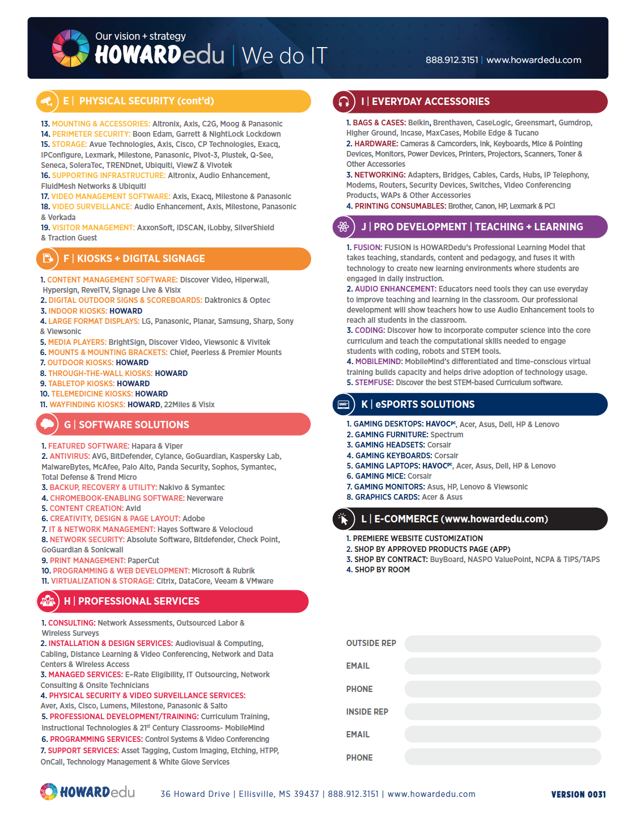

Slide 20










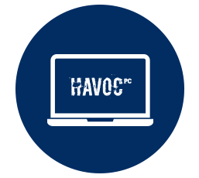

THE ONE-STOP-SHOP
Computing Solutions
Audiovisual Solutions
Network
Solutions
Virtualization Solutions
Physical
Security
Kiosks and
Digital Signage
Software Solutions
Professional
Services
Everyday
Accessories
Professional
Development
eSPORTS
Solutions
E-Commerce
Presence

Slide 21
CATEGORIES
Computing Solutions
Audiovisual Solutions
Network Solutions
• Accessories
• Antivirus
• Asset Management
• Desktops
• MDM
• Mobile Presentation
and Charging Stations
• Notebooks
• Printers (2D & 3D)
• Refurbs
• Tablets
• VR
• Audio Solutions
• Broadcasting
• Cables
• Control Systems
• Document Cameras
• Furniture
• Interactive Classroom Solutions
• Intercoms, Bells
and Paging Systems
• Lecture Capture
• Mixers and Microphones
• Monitors and Displays
• Mounts
• Projectors
• Projector Screens
• Speakers and Amps
• Video Cameras
• Video Conferencing
• Webcasting
• Furniture
• Wireless Interactive Pads
• Backup and Replication
• Bandwidth Management Solutions
• Content Filtering
• Continuity Solutions
• Cooling, LAN Storage and Power Protection
• Disaster Recovery Products
• Email Archiving Solutions
• Hyperconverged
• Network Access Control
• Network Infrastructure
• Security Solutions
• Servers
• Storage
• VOIP
• Wireless

Slide 22
CATEGORIES
Virtualization Solutions
Physical Security
Kiosks and Digital Signage
• Backup and
Data Recovery
• Cloud
• Desktop Virtualization
• Server Virtualization
• Servers
• Software-Defined
Storage
• Storage
• VDI
• Access Control
• Active Shooter
• Behavior Management
• Body Protection
• Cloud
• Displays
• Emergency Alert Notification
• Encoders
• Guard Services Equipment
• Lighting
• Mobile Security
• Mounting and Accessories
• Perimeter Security
• Storage
• Supporting Infrastructure
• Video Management
Software
• Video Surveillance
• Visitor Management
• Content Management Software
• Digital Outdoor Signs and Scoreboards
• Indoor Kiosks
• Large Format Displays
• Media Players
• Mounts and Mounting Brackets
• Outdoor Kiosks
• Through-the-Wall Kiosks
• Tabletop Kiosks
• Telemedicine Kiosks
• Temperature Measurement Kiosks
• Wayfinding Kiosks

Slide 23
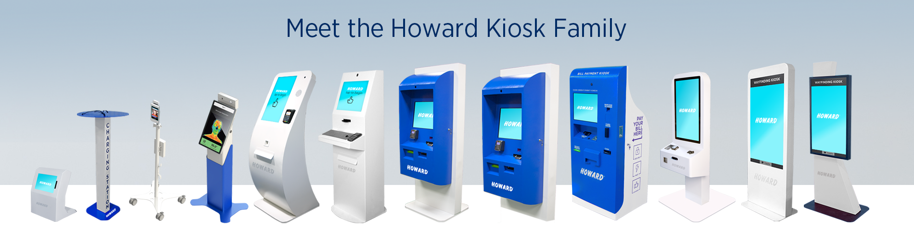
Kiosks minimize staffing requirements, reduce operating and transaction costs while increasing sales/revenue, foot traffic and efficiency; manage peak traffic flow, add off-hours convenience, and enhance the overall consumer experience, which, in turn, increases customer loyalty.
Howard offers a variety of kiosk models, from indoor tabletop and freestanding to outdoor and through-the-wall; all customized to suit your facility’s interactive needs.
Bill Pay
Body Cams
Digital Signage
E-Citation
Telemedicine
Temperature Detection
Ticketing
Wayfinding

Slide 24
CATEGORIES
Software Solutions
Professional Services
Everyday Accessories
• Antivirus
• Backup, Recovery and Utility
• Chromebook-Enabling Software
• Content Creation
• Creativity, Design and Page Layout
• IT and Network Management
• Network Security
• Print Management
• Programming and Web Development
• Virtualization and Storage
• Consulting
• Installation and Design Services
• Managed Services
• Physical Security and Video Surveillance Services
• Professional Development/Training
• Programming Services
• Support Services
• Visitor Management
• Bags and Cases
• Hardware
• Networking
• Printing Consumables

Slide 25
CATEGORIES
Professional Development
eSPORTS Solutions
E-Commerce Features
• FUSION
• Backup, Recovery and Utility
• Chromebook-Enabling Software
• Content Creation
• Creativity, Design and Page Layout
• Gaming Desktops
• Gaming Furniture
• Gaming Headsets
• Gaming Keyboards
• Gaming Laptops
• Gaming Mice
• Gaming Monitors
• Graphic Cards
• Premier Website Customization
• Shop By Approved Products (APP)
• Shop By Contract
• Shop By Room

Slide 26




SHOP BY CONTRACT
HOWARDedu is dedicated to ensuring that our K12 and Higher Education customers are equipped with the IT products and services they need to educate our future. No matter the type, size, or location of the educational entity, HOWARDedu has customizable education solutions that will meet or exceed the required specifications to bring your facility into the 21st century. And, most of these are available on state or federal contracts such as:

Slide 27
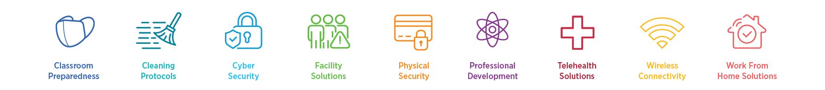
CARES ACT FUNDING SOLUTIONS
Let HOWARDedu Bring Innovative Solutions To Your Educational Institution.

Slide 28

Prevent infectious diseases by implementing strong hygiene and infection prevention measures. Using appropriate
personal protective gear, as well as effective antimicrobial and germicidal agents, significantly helps to limit the spread
of viruses and other resistant airborne contagions. Stay safe with proven products and superior solutions from Howard.

Slide 29

Howard Health Shields act as protective barriers, shielding employees and customers from sneezes and coughs and helping to impede the spread of airborne droplets containing COVID-19 coronavirus, as well as other viruses and bacteria. These transparent protective shields are made from durable, easy-to-disinfect acrylic. They help to establish a clear measure of physical separation, reinforcing social distancing while allowing customers and employees to interact effectively.

Slide 30
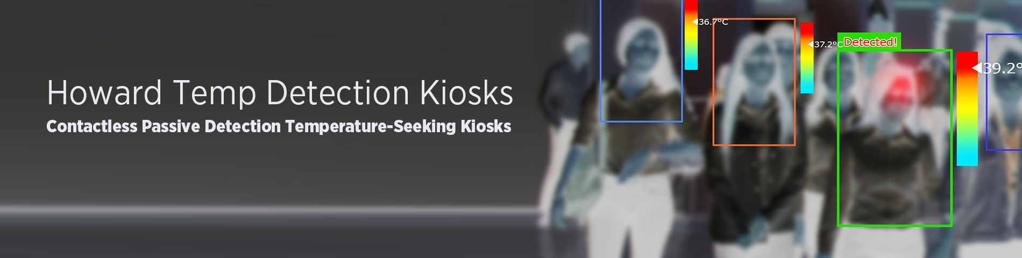
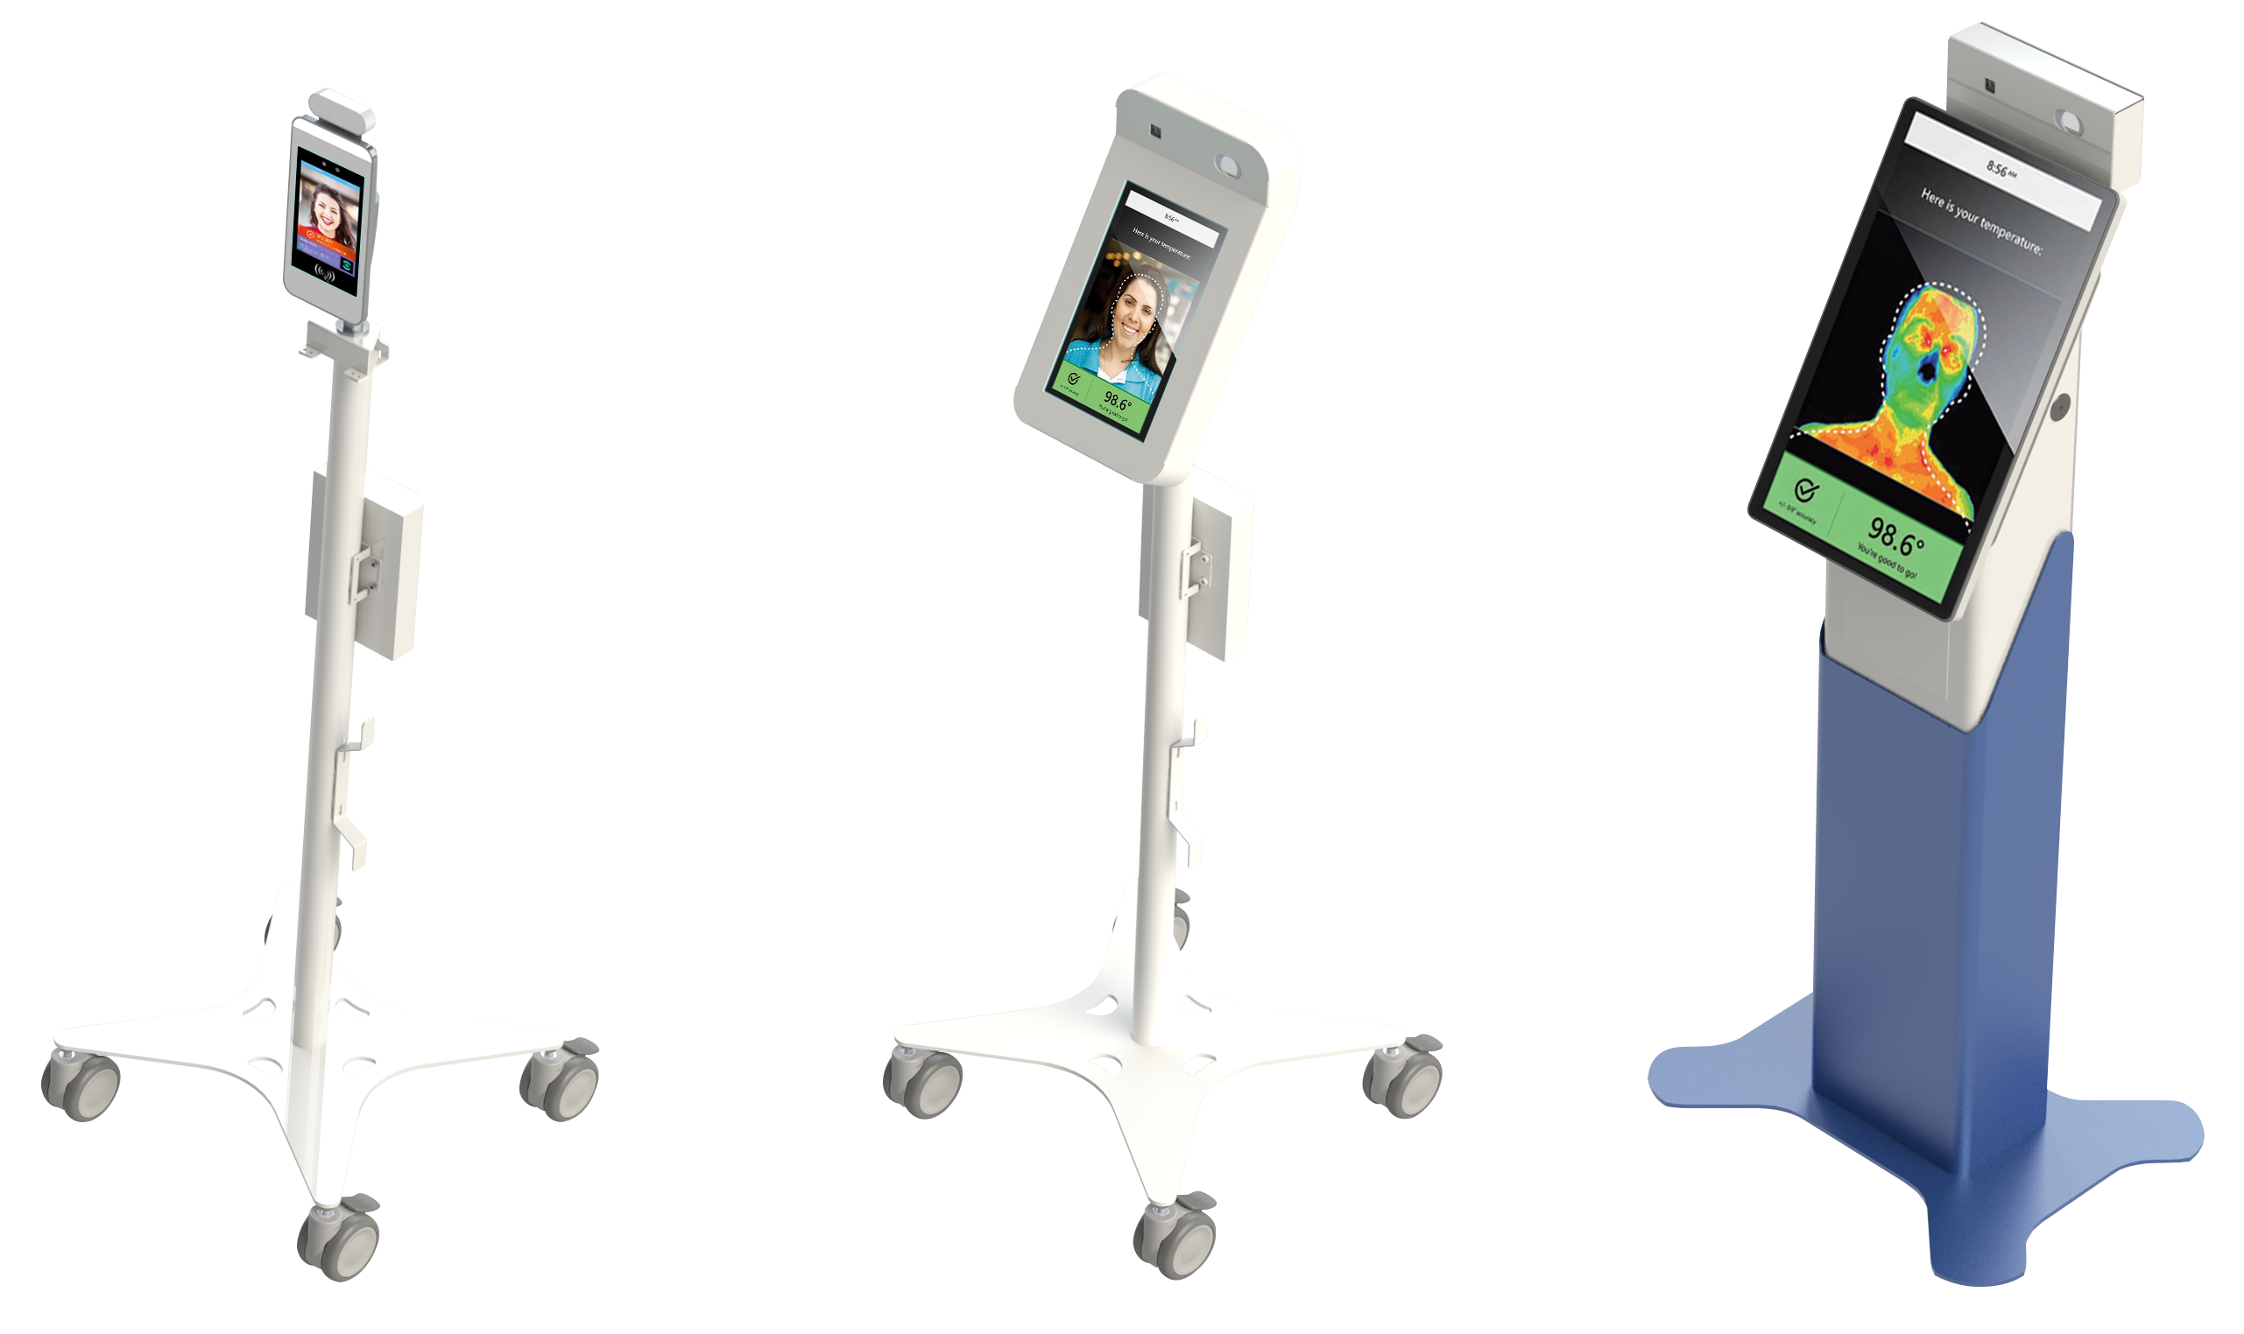
The Contactless Howard Temperature Detection Kiosks with facial recognition help maintain a healthy environment for employees, customers, students, visitors, and the general public. These innovative gate-keeping solutions can sense the temperature of anyone who passes through its sensors, allowing you to detect those with elevated temperatures to prevent them from entering your establishment. Designed for medical and HR applications and ideal for businesses, schools and universities, restaurants, retailers, and anywhere else you want to be proactive about avoiding the spread of infection.

Slide 31

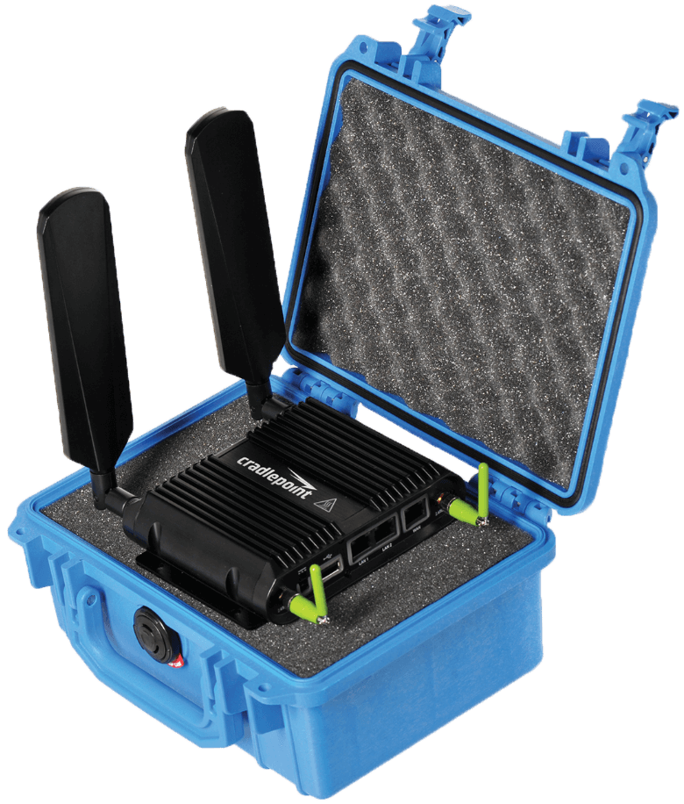
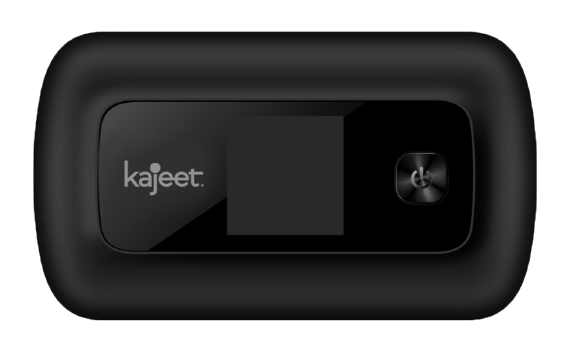
For organizations that depend on field forces and mobile networks—like first responders, transportation departments, utility crews, insurance disaster teams, and now schools—secure and reliable LTE connectivity is essential. Vehicles and mobile command centers have become the field communications hub, allowing users to access mission-critical applications and the Internet from anywhere, and keeping data flowing to the cloud from on-board telemetry, sensors, surveillance cameras, and other devices.

Slide 32

From design services, network
consulting, programming, cabling,
and audiovisual solutions to
management services that range
from routine system maintenance
to complete IT outsourcing, Howard
can provide the level of support you
need at a price that is right for your
Institution’s budget.
Audiovisual Services
Cabling
Cloud Services
Consulting
Contractor’s Licensing (per state)
Design Services
Installation Services
Managed Services
Networking Services (wired/wireless)
Onsite Technicians + IT Outsourcing
Physical Security + Video Surveillance
Programming Services
Storage
Support Services
Training + Professional Services
Virtualization Services
VOIP
Website Development + Management

Slide 33
THANK YOU
Presented by |

