Slide 1
Title Here
Presented by |

Slide 2
AGENDA
Type here.

Slide 3
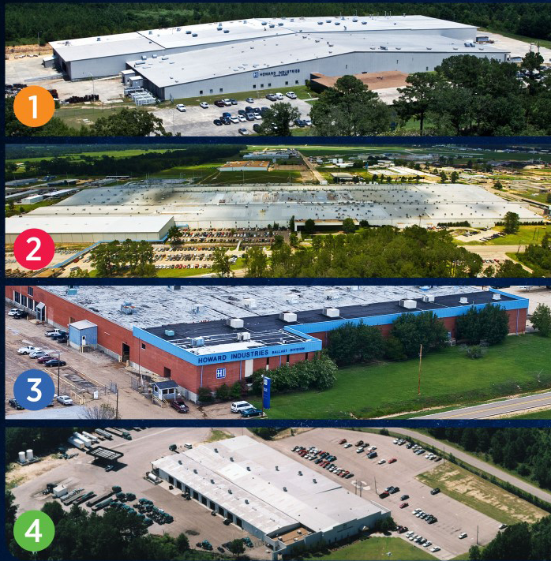
HI
CORPORATE FACILITIES
1
Laurel Transformer Facility
Over 4,300 employees
Largest employer for the privately-held companies in the state of MS
Largest transformer manufacturing facility in the world – over 2 million ft²
Transformer division is the #1 producer of oil-filled distribution transformers in the United States.
2
Ellisville Transportation Facility
3
Sandersville Ballast Facility
4
Mendenhall HID Facility

Slide 4



HI
CORPORATE DIVISIONS
POWER SOLUTIONS
TRANSPORTATION
LIGHTING PRODUCTS
Howard Power Solutions is the nation’s leading producer of distribution transformers. Howard Power Solutions also produces medium-power transformers, substation transformers, voltage regulators, junction enclosures, pad-mounted sectionalizing equipment, dry-type transformers, and OEM transformer components.
Howard Transportation is a wholly-owned subsidiary of Howard Industries that operates a fleet of 200+ trucks that transport goods throughout the U.S. as a long-haul, flat-bed common carrier truck line and brokerage operation.
Howard Lighting Products offers lamps, ballasts, and fixtures, including linear fluorescent, compact fluorescent, high intensity discharge (HID), and halogen lamps as well as electronic and magnetic fluorescent, and magnetic HID ballasts. In addition, Howard Lighting also offers a wide array of HID fixtures.

Slide 5

HI
CORPORATE DIVISIONS
Our corporate headquarters is also home to our technology division, Howard Technology Solutions. This division brings to market cutting-edge technology that includes audiovisual and instructional solutions, network security and storage solutions, as well as installation, consulting, and design services. From distance learning and interactive classroom products to point-of-care medical carts and specialized mobility solutions, we make great technology available, and we make it affordable.
HOWARDedu
HOWARDmed Technology Solutions
HOWARD Enterprise
Howard Store
TECHNOLOGY SOLUTIONS

Slide 6
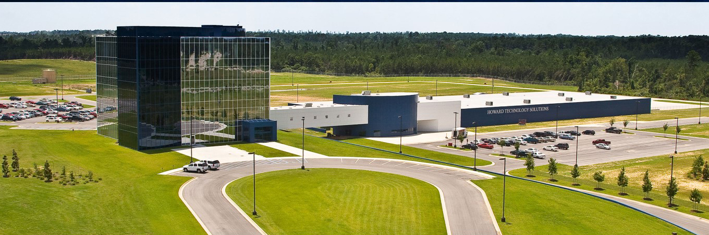
HI
CORPORATE HEADQUARTERS
Our Corporate Headquarters is a
5-Story structure wrapped in two
tones of blue glass and includes:
60,000 ft² of office space
72,000 ft² manufacturing plant
for technology products

Slide 7
Type Here

