Slide 6
Newly Expanded Production Facility
Completed September 2018
New Total Production Facility Floor Space:
112,000 ft²

Slide 7
Expansion Plans:
Additional Office Towers I & II

Slide 34
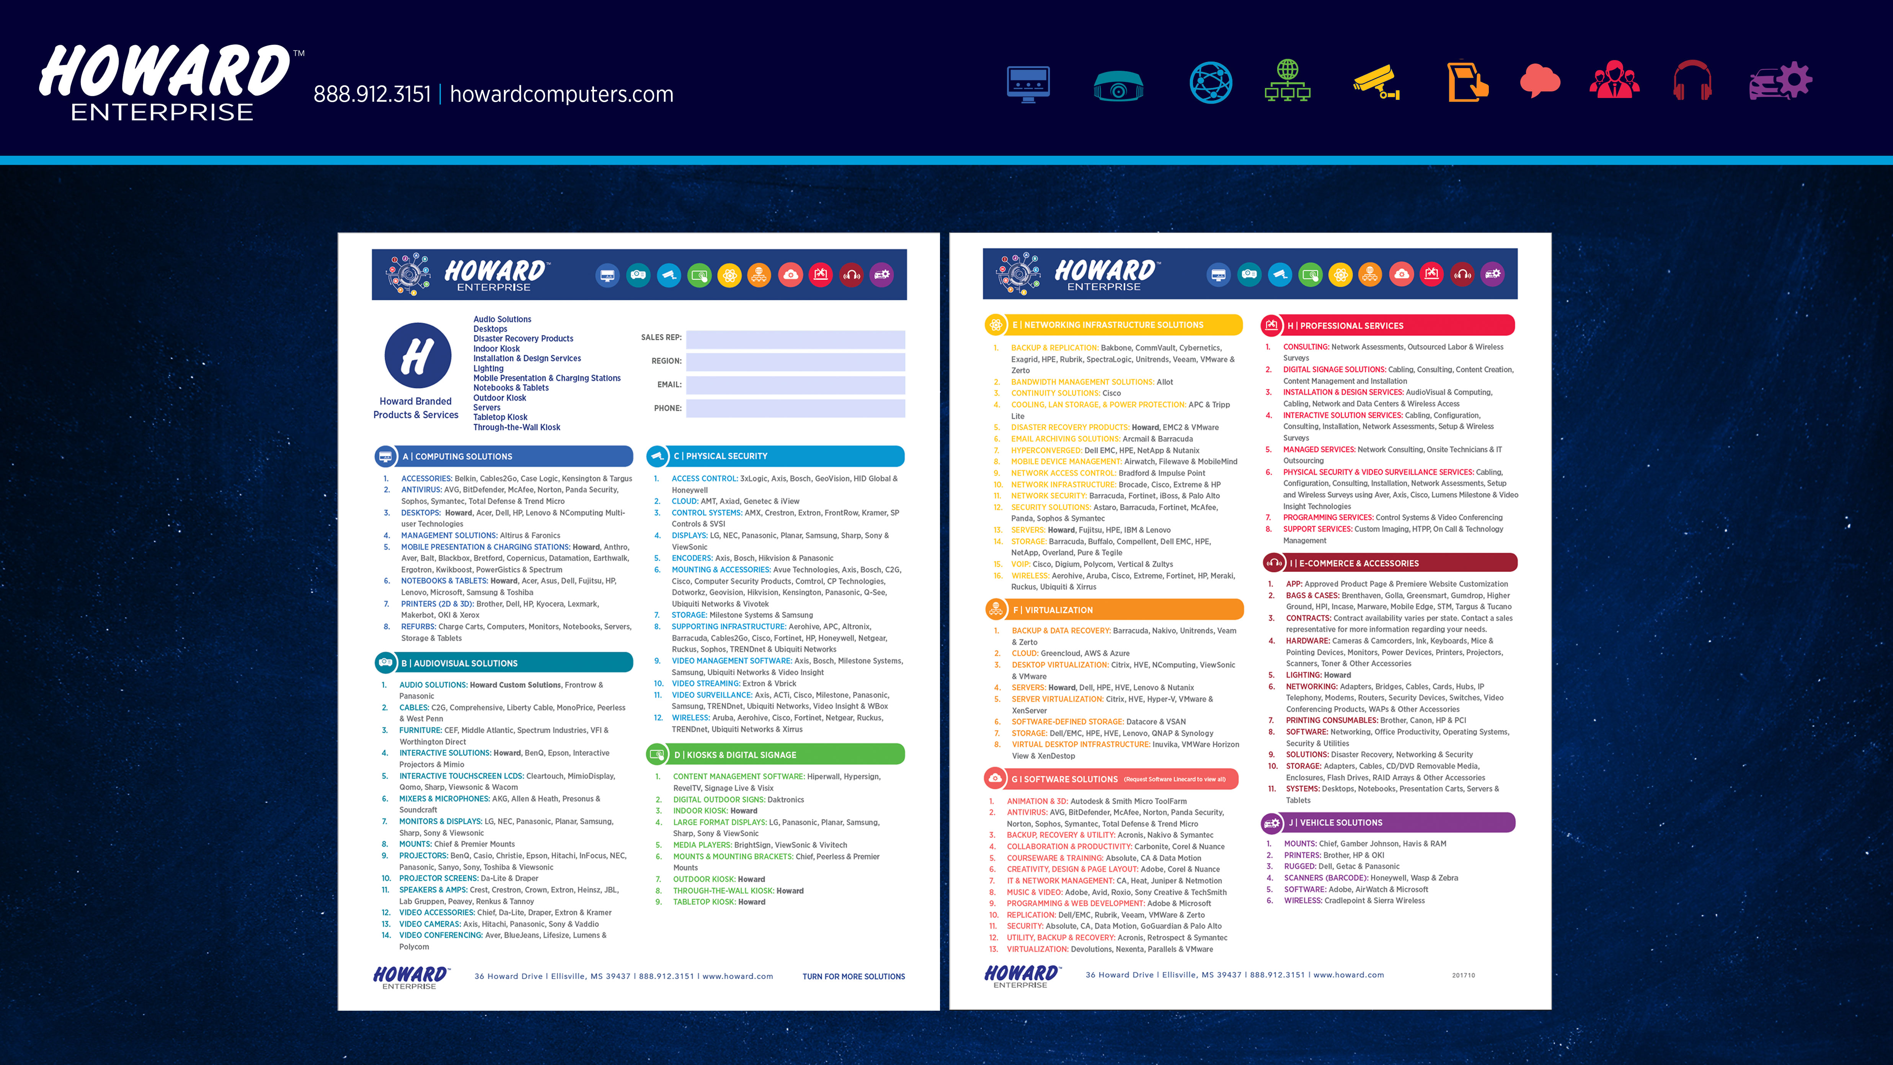

Slide 37
