Slide 1
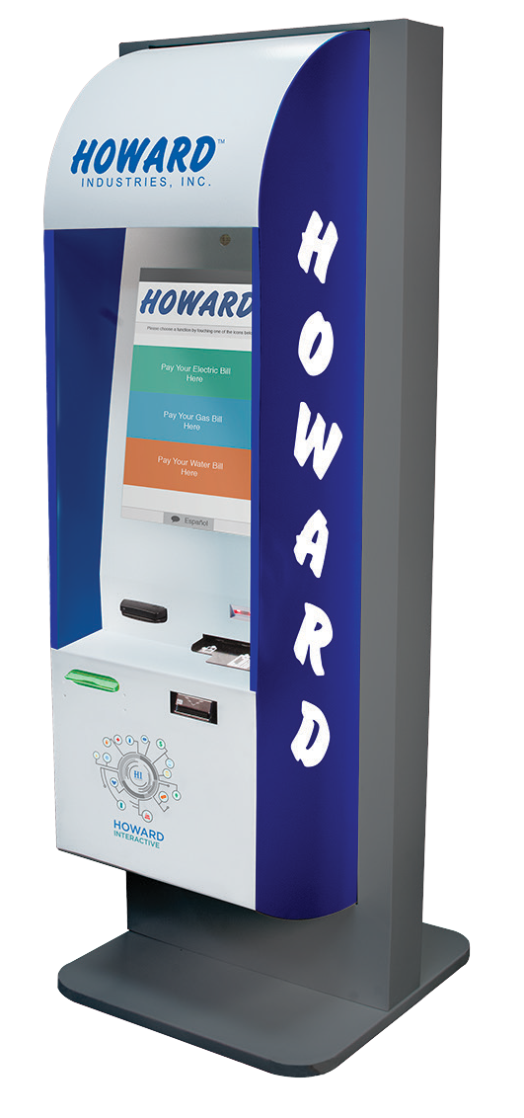
HOWARD ONE
The Howard One model series combines the best design aspects of our custom indoor and outdoor designs, yet delivers the simplicity and economy of a standard product. This highly versatile platform integrates smoothly with any indoor work environment, with standalone, wall-mounted, and through-wall mounting options available. Additionally, its rugged design, equipped with adjustable AC control and a watertight seal, grant it longevity in the face of the elements and make it a simple, viable, and economical option for outdoor deployment. Designed for virtually any feature mix, the One can accommodate peripheral options including a card dispenser, key pad, signature pad, or additional cash box.
Base Model Includes
Durable Powder Coated Steel Enclosure Barcode Scanner
Encrypted EMV Credit Card Reader Bill Acceptor
Check Reader Howard Premier PC
Dual Amplified Speakers 19” Touch Screen Thermal Receipt Printer
Internal Keyboard with Trackball Camera
Climate Controlled
Optional Components
Card Dispenser Wide Thermal Printer Ticket Printer Signature Pad
Key Pad
Extra Cash Box
Enclosure Dimensions
71.2” High, 26” Wide, 24” Deep
Weight: 375 pounds

Slide 2
HOWARD TWO
The Howard Two model series incorporates best-in-class features and functionality with a highly flexible standalone multimedia platform. Smartly constructed and rigorously designed, the Howard Two model kiosks support a host of printers, readers, and other devices, each of which is seamlessly and securely integrated into the kiosk and easily configured to deliver functionality specific to your organizational, customer, and employee needs. The Two model offers customization options for a 17” or 15” touch screen monitor and a mounted overhead display for incorporation of digital signage. Howard Two kiosks provide a dynamic interactive experience, high uptime, and measurable ROI.
Base Model Includes
Durable Powder Coated Steel Enclosure Barcode Scanner
Encrypted EMV Credit Card Reader Bill Acceptor
Check Reader Howard Premier PC
Dual Amplified Speakers 17” Touch Screen Thermal Receipt Printer
Internal Keyboard with Trackball Camera
Optional Components
Card Dispenser Wide Thermal Printer Ticket Printer
Extra Cash Box 15” Touch Screen
Enclosure Dimensions
57.96” (72.46” with Monitor Box) High,
23.14” Wide, 18.15” Deep
Weight: 275 pounds

