Slide 1
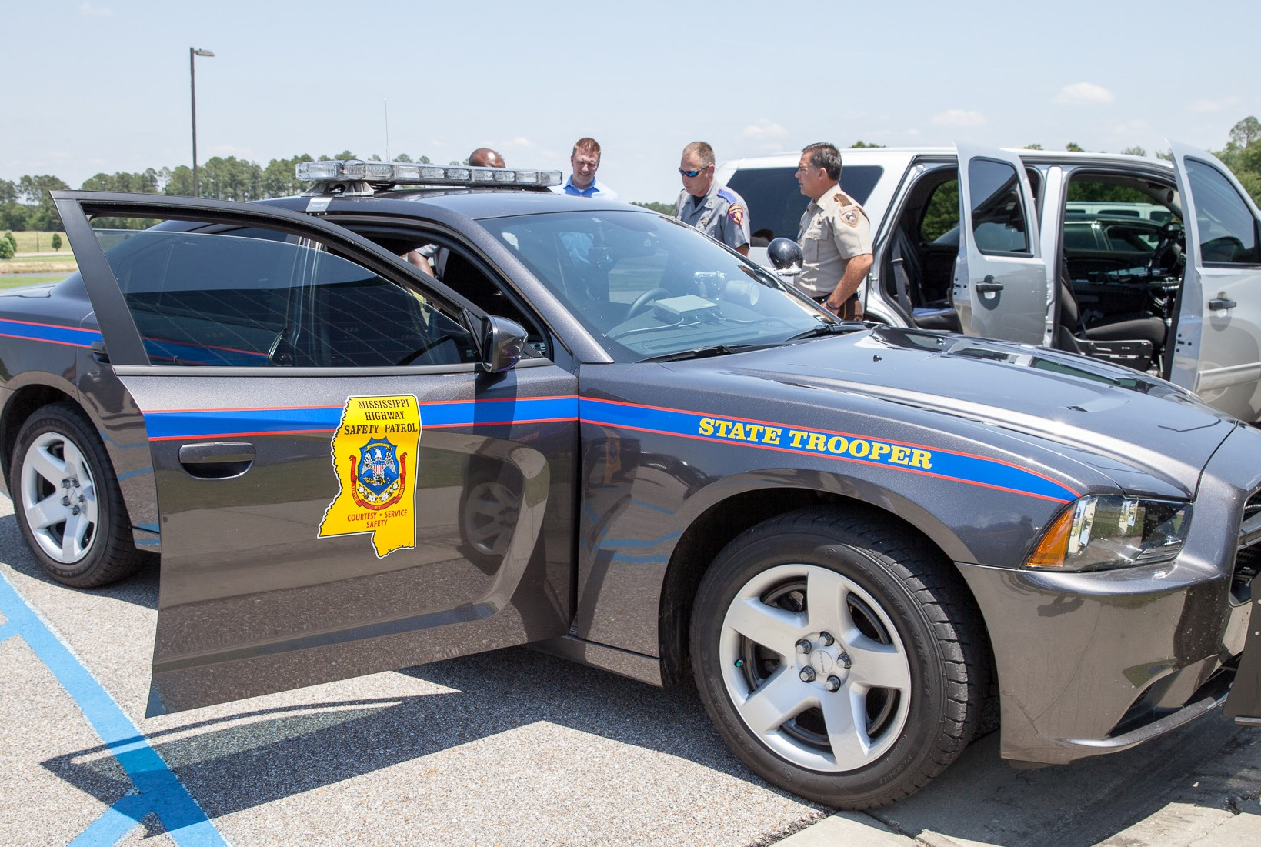







Public Safety
Vehicle Outfitting
From outfitting a single vehicle to maintaining an entire fleet, Howard has the products and services to ensure that law enforcement vehicles are equipped with the most advanced technology available.
We offer name brand products and customized solutions for a wide range of needs—everything from lights, sirens, and video cameras to rugged notebooks and mounting systems; GPS tracking, communications solutions, and anything else necessary to streamline day-to-day operations and enhance safety for personnel in the field. In addition to providing a full line of service and installations options, Howard certified technicians do what it takes to keep abreast of developments within the industry, ever alert for innovative products and new applications.

Slide 2
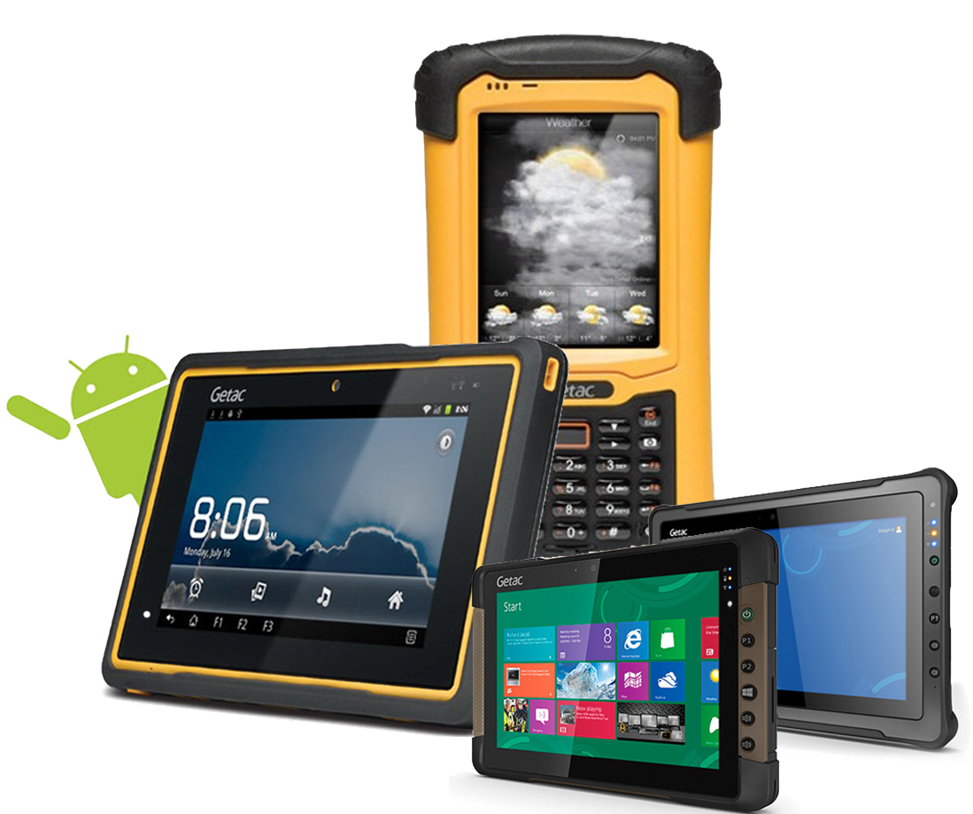

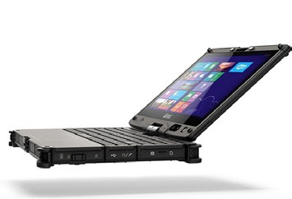
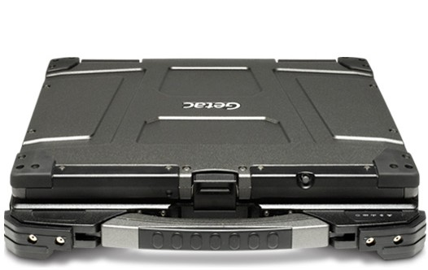
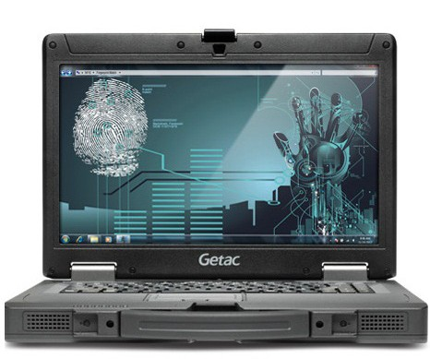
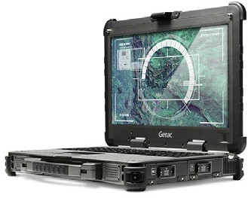
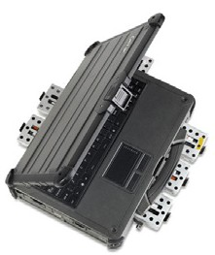
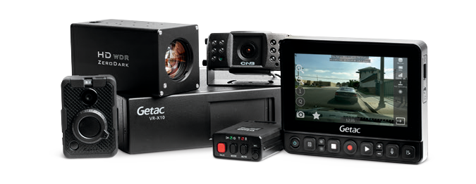
There’s no doubt that we think Getac rugged computers are hands down the best. But, we’re biased. Getac has over 250 full-time engineers dedicated to finding solutions to real life problems. From sunlight readability, thermal heat dissipation, power management and mechanical design to unique technologies like night vision and salt fog protection, Getac has you covered.
Since 1989, Getac has been manufacturing rugged computers for some of the most demanding users in some of the most demanding envi- ronments. As one of the leading rugged computer manufacturers, Getac offers the most extensive rugged computing product lines including notebook, tablets and handheld computers. Our products are found across the globe in a wide range of sectors from military and defense, law
enforcement and public safety, utility, field service, oil and gas, telecommunications, transportation to manufacturing.
For more information on these products, please contact your Howard Representative at (888) 912-3151 or visit our website www.howardcomputers.com.

Slide 3

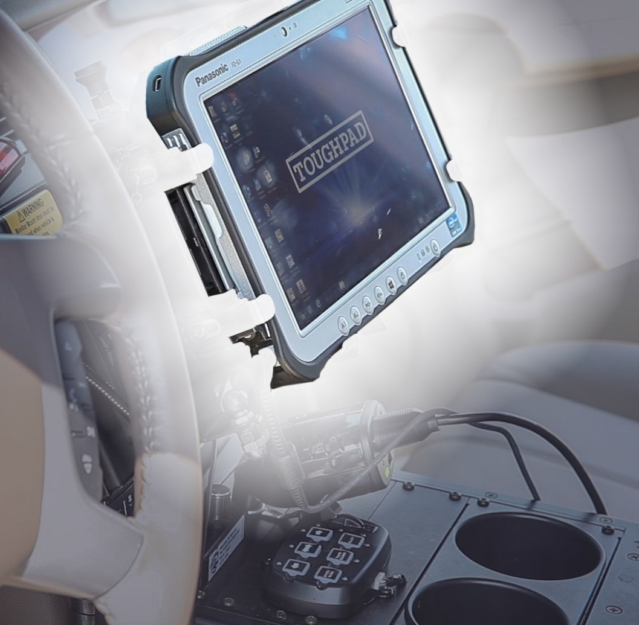


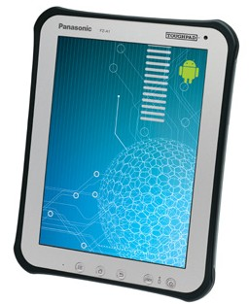
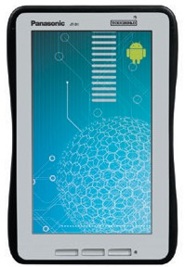
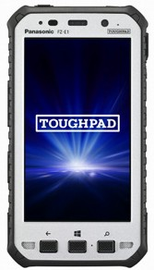
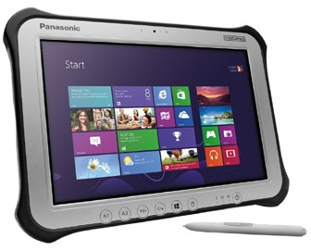
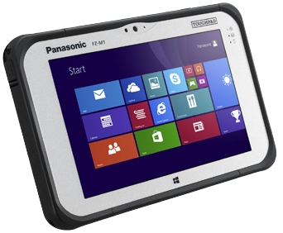
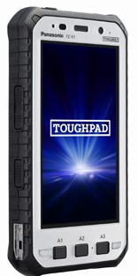
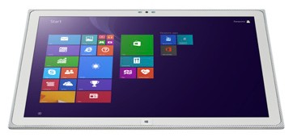

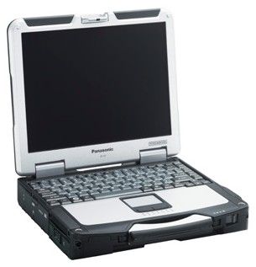
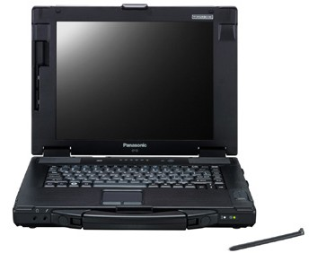
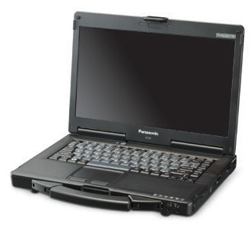
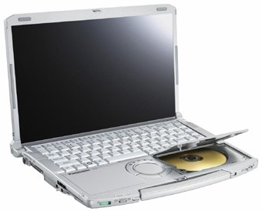
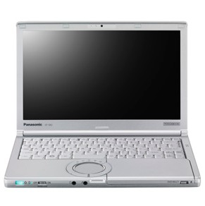
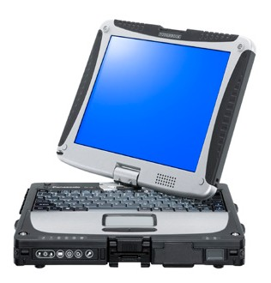
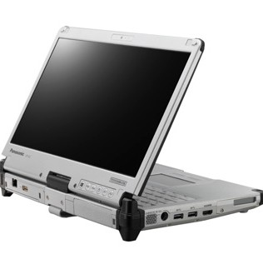
toughpads & toughbooks
When the going gets tough—the tough get ToughPads! Powerful, secure, and field-tested to MIL-STD-810G and IP65/68 standards for flawless operation in every environment, from intense heat and sunlight to pouring rain and freezing temperatures, ToughPads de-liver a level of reliability that is second to none. ToughPads also offer the broadest range of size and configuration options available for maximum flexibility, from a 5-inch rugged tablet that is small enough to drop in a pocket all the way to an impressive 4K model that offers spectacular resolution of up to four times 1080p display. Mobilize your office with Panasonic ToughPads.
For some jobs, your computer just has to be rugged; that’s when you need a ToughBook. Military-grade toughness paired with enterprise-class mobile computing power has made Panasonic’s Toughbook the laptop of choice for many governmental organizations. Engineered to withstand drops, spills, dust and grime, and to perform in conditions that would damage ordinary computers, ToughBooks enable an uncompromising level of productivity no matter where your work takes you. From its sealed, all-weather design to its shock-mounted hard drive that protects against vehicle vibrations, Panasonic’s Tough-Book laptops stand up to the challenges of a mobile environment.

Slide 4

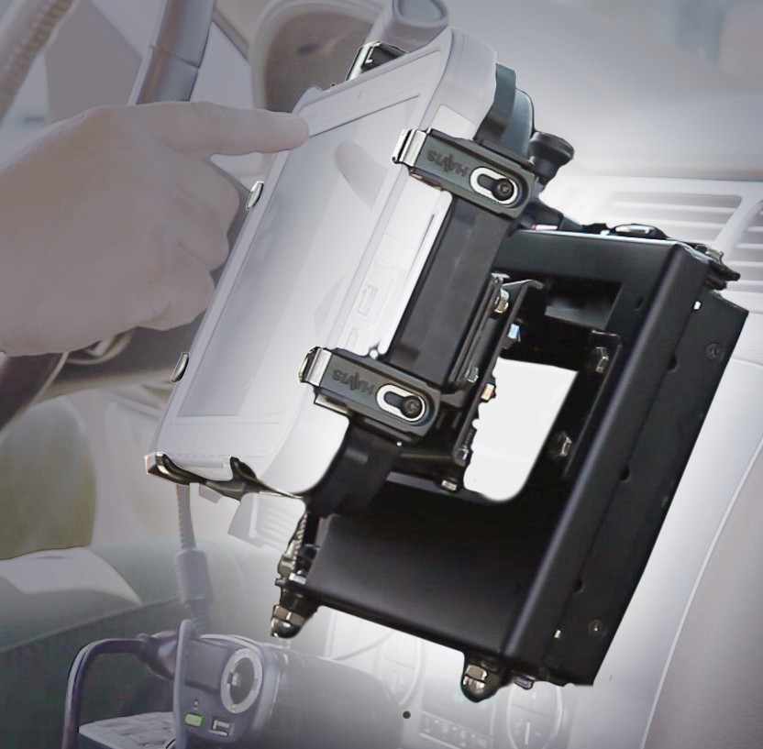
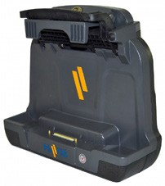
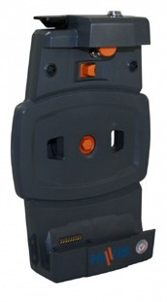

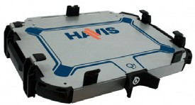
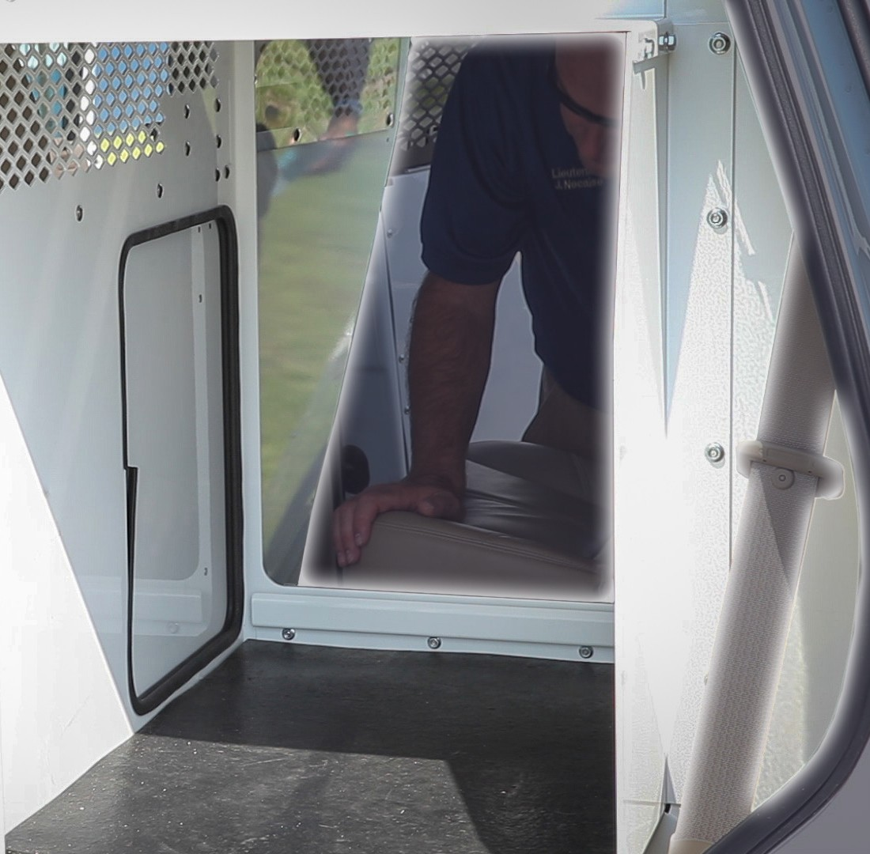
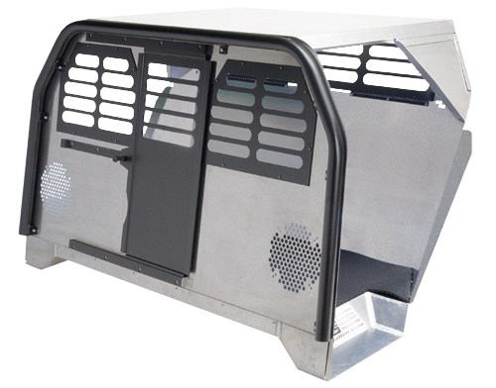

mounts, consoles, & transports
MOUNTS & DOCKING SOLUTIONS
LAPTOP | TABLET
Havis’ wide range of computing and mounting solutions and peripheral accessories are a perfect fit for any agency using their vehicle as a mobile workstation. We offer the industry’s most reliable platform for connecting peripherals, which will greatly improve productivity.
HAVIS TABLET MOUNT
Howard Eliminator outfitted with a Havis Tablet Mount
TRANSPORT SOLUTIONS
K9 | PRISONER
Kwik-Kit® transport systems easily convert cargo and passenger vans into heavy-duty inmate transports while ensuring officer and passenger safety. Offered in four different lengths and one to four compartment options, these units not only help transport people but can also be used for evidence or storage. Havis K9 units are designed for officers and their canine partners with safety, comfort, visibility, and space in mind. Available for sedans and for SUVs, these systems offer large side openings for improved K9 entry and exit as well as easier access for cleaning.
HAVIS K9 TRANSPORT
Partnered with Havis, Howard can make your K9 as comfortable as you are
For more information on these products, please contact your Howard Representative at (888) 912-3151 or visit our website www.howardcomputers.com.

Slide 5
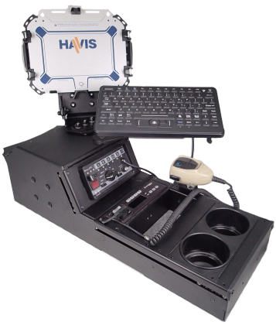
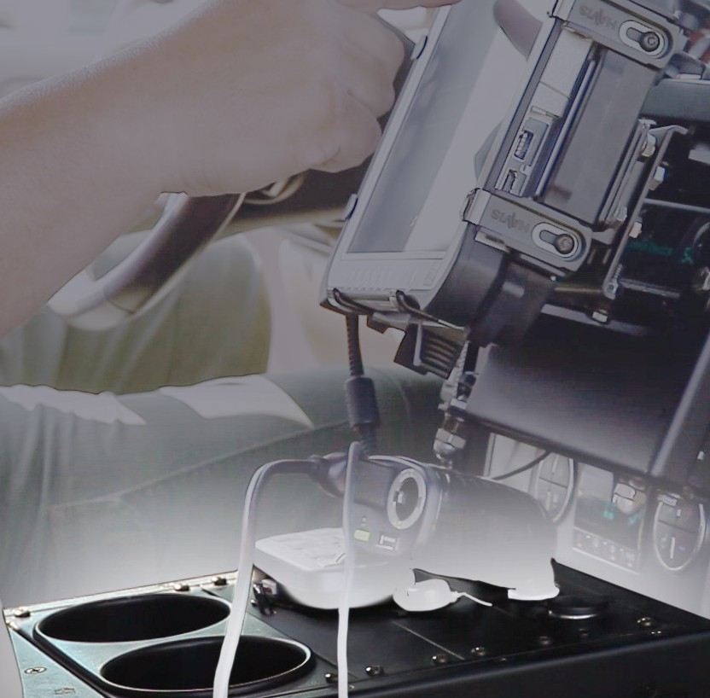
CONSOLE SOLUTIONS
HEAVY DUTY | MEDIUM DUTY | VEHICLE SPECIFIC | ACCESSORIES
Havis Consolidator® consoles are ergonomically designed to make your equipment easy to see, reach, and operate while creating additional space and comfort. Vehicle Specific consoles attach directly to or replace existing OEM console mounts for easy installation and no permanent modification to your vehicle. Angled Heavy Duty Consoles are the strongest and safest mounting solution for your mobile office.
HAVIS CONSOLE
Howard Eliminator outfitted with Havis Console accessories

Slide 6
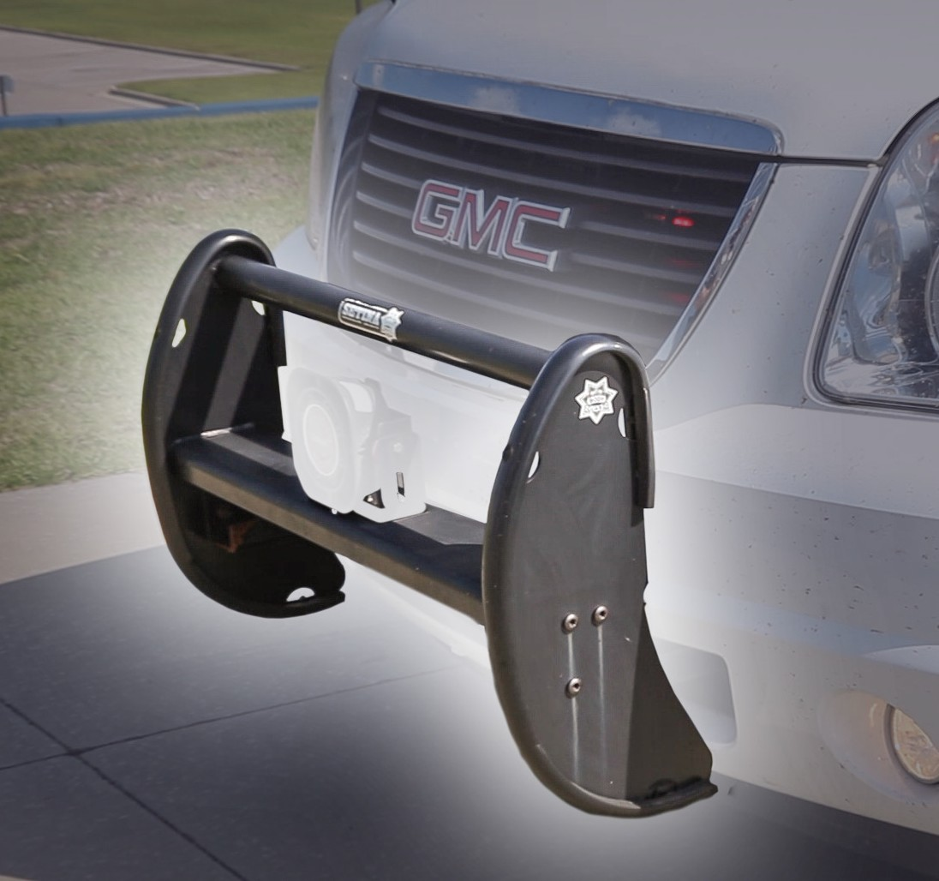

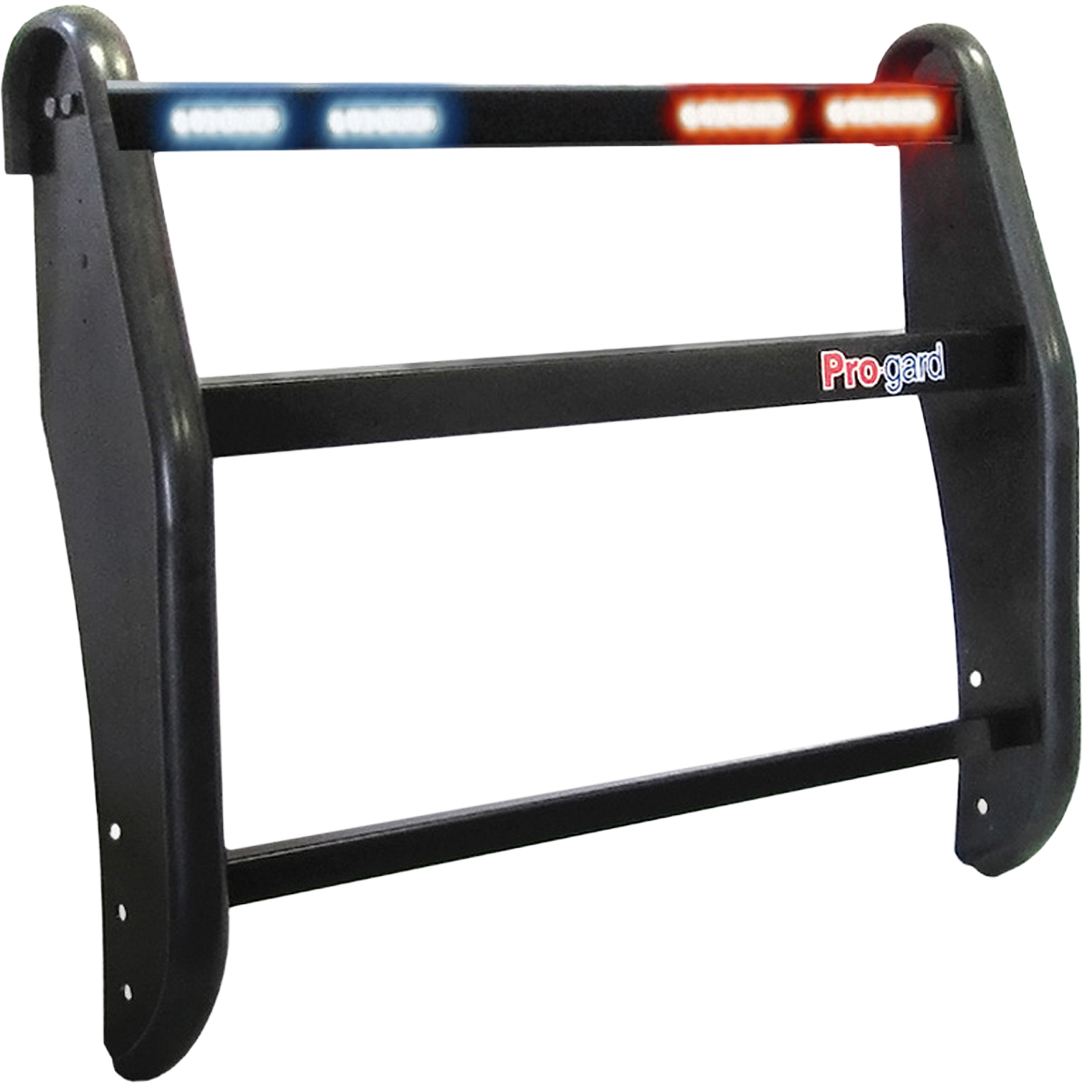
PUSH BUMPER SOLUTIONS
UNIVERSAL | VEHICLE SPECIFIC
Studies have shown that prompt removal of disabled vehicles from traffic patterns can greatly reduce the chances of additional accidents occurring. The addition of a Pro-gard Push Bumper allows for safe and easy removal of just such stranded vehicles. Our Push Bumpers are designed with wear and tear in mind. The rugged steel design allows offi- cers to softly push stranded vehicles to safety without fear of compromising the bumper structure or vehicle facia.
PRO-GARD PUSH BUMPER
Highly visible, front scene lighting is high on the mind of officers when they are working an accident scene or traffic stop. Our Push Bumpers offer the perfect platform for agen- cies to secure this much desired, driver eye-level lighting to their vehicles quickly and easily. Fleets can opt for one of our Integrated LED Lightbar Push Bumpers or utilize their own preferred lighting using our pre-drilled slots and holes which accommodate the most popular mounting patterns in the industry.
Howard Eliminator outfitted with a Pro-Gard Push Bumper

Slide 7
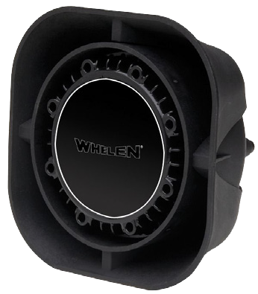
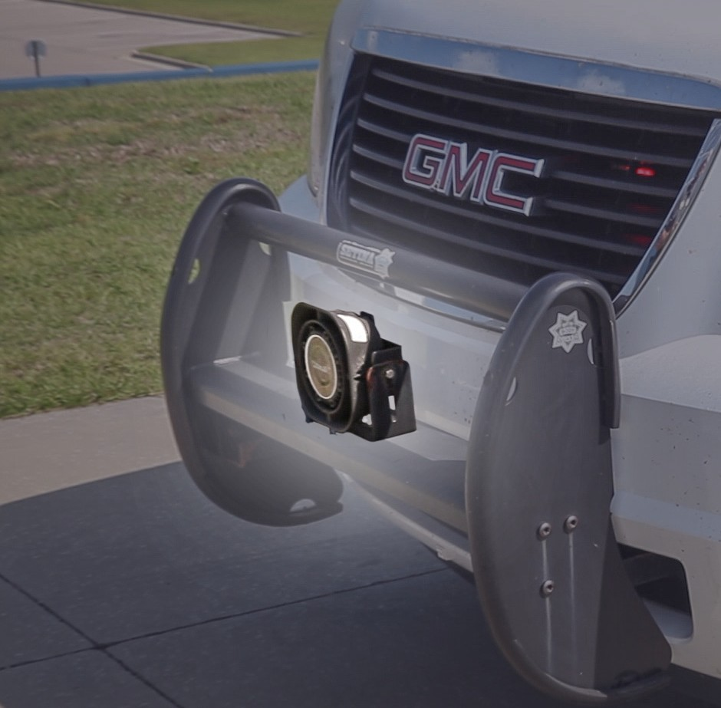

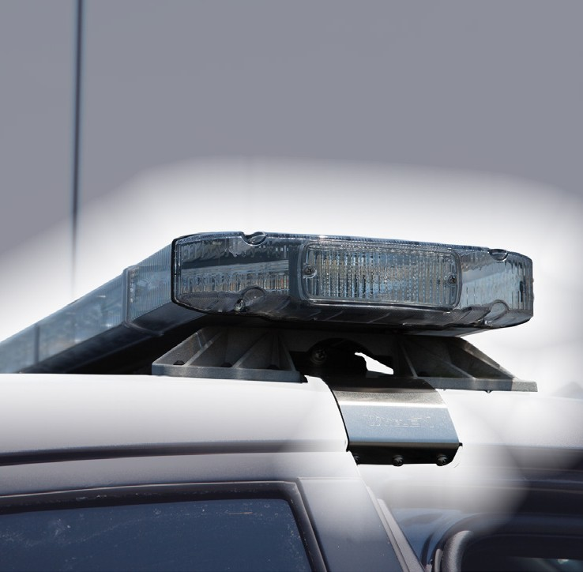
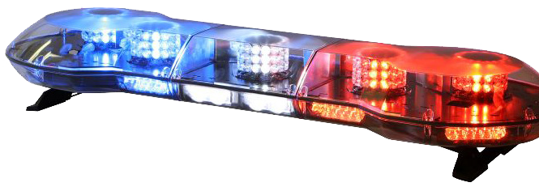
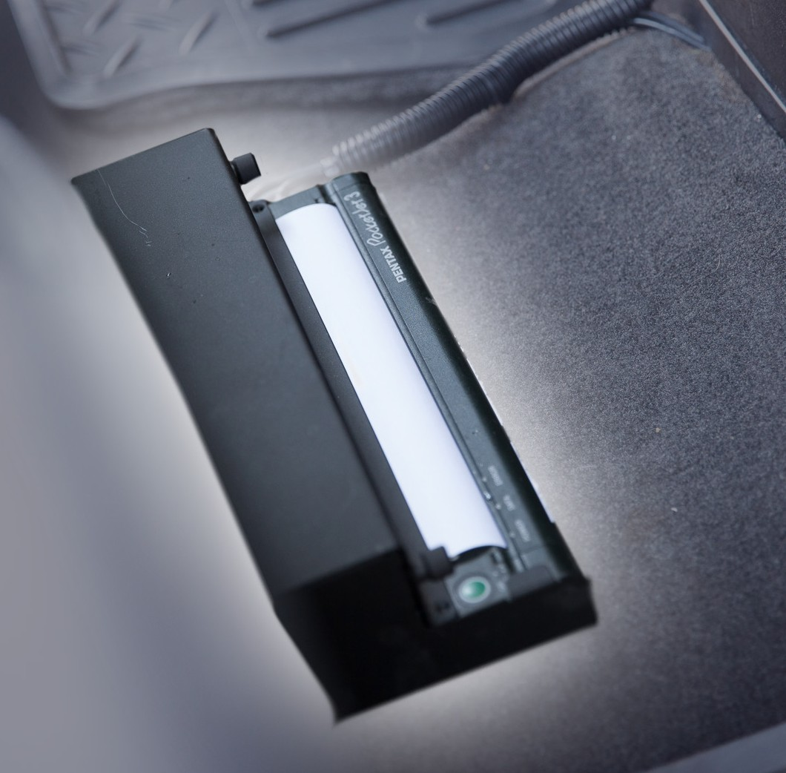

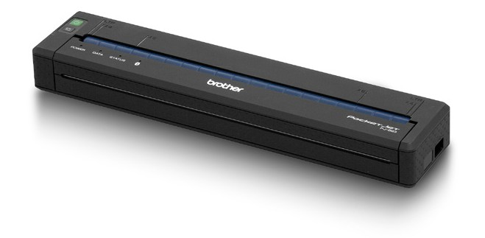
push bumpers, lightbars, printers & sirens
SIRENS
EDGE | DELTA | LEGACY | LIBERTY | JUSTICE | CENTURY | TOWMANS
Signal your presence with powerful, long-lasting vehicle sirens. For law enforcement, firefighter, emergency response, and public safety operations, audible warnings are key to getting the job done. From traditional sirens to state-of-the-art Rumblers, the right siren can dramatically increase traffic clearing capability and improve operator safety.
LIGHTBARS
EDGE | DELTA | LEGACY | LIBERTY | JUSTICE | CENTURY | TOWMANS
Emergency lighting gets attention! For police and fire departments, ambulances, and public safety agencies it is indispensable. From full-size light bars with varying configura- tions and programmable flash patterns to dash, grille, and strobe lights, Whelen products deliver the reliability and performance necessary to do the job right.
dJet
MOBILE PRINTER
PocketJet 6 |PocketJet 7 | Rugge
Equip your mobile workforce with rugged mobile printers designed to help them print the labels, receipts, and tags they need wherever they are. With IP54 certification to with- stand dust and moisture, and up to 6 ft. drop protection, Brother rugged mobile printers are tested-tough devices designed to handle what the real world dishes out every day. They’re easy to use and maintain in the field, and can connect wirelessly to iOS®, Android™, Windows® Mobile and Windows® based smartphones, handhelds, tablets and laptops.

Slide 8


For more information, please contact your Howard representatives:

