Slide 1

Business Review
Presented by |

Slide 2
Agenda
Type Here

Slide 3
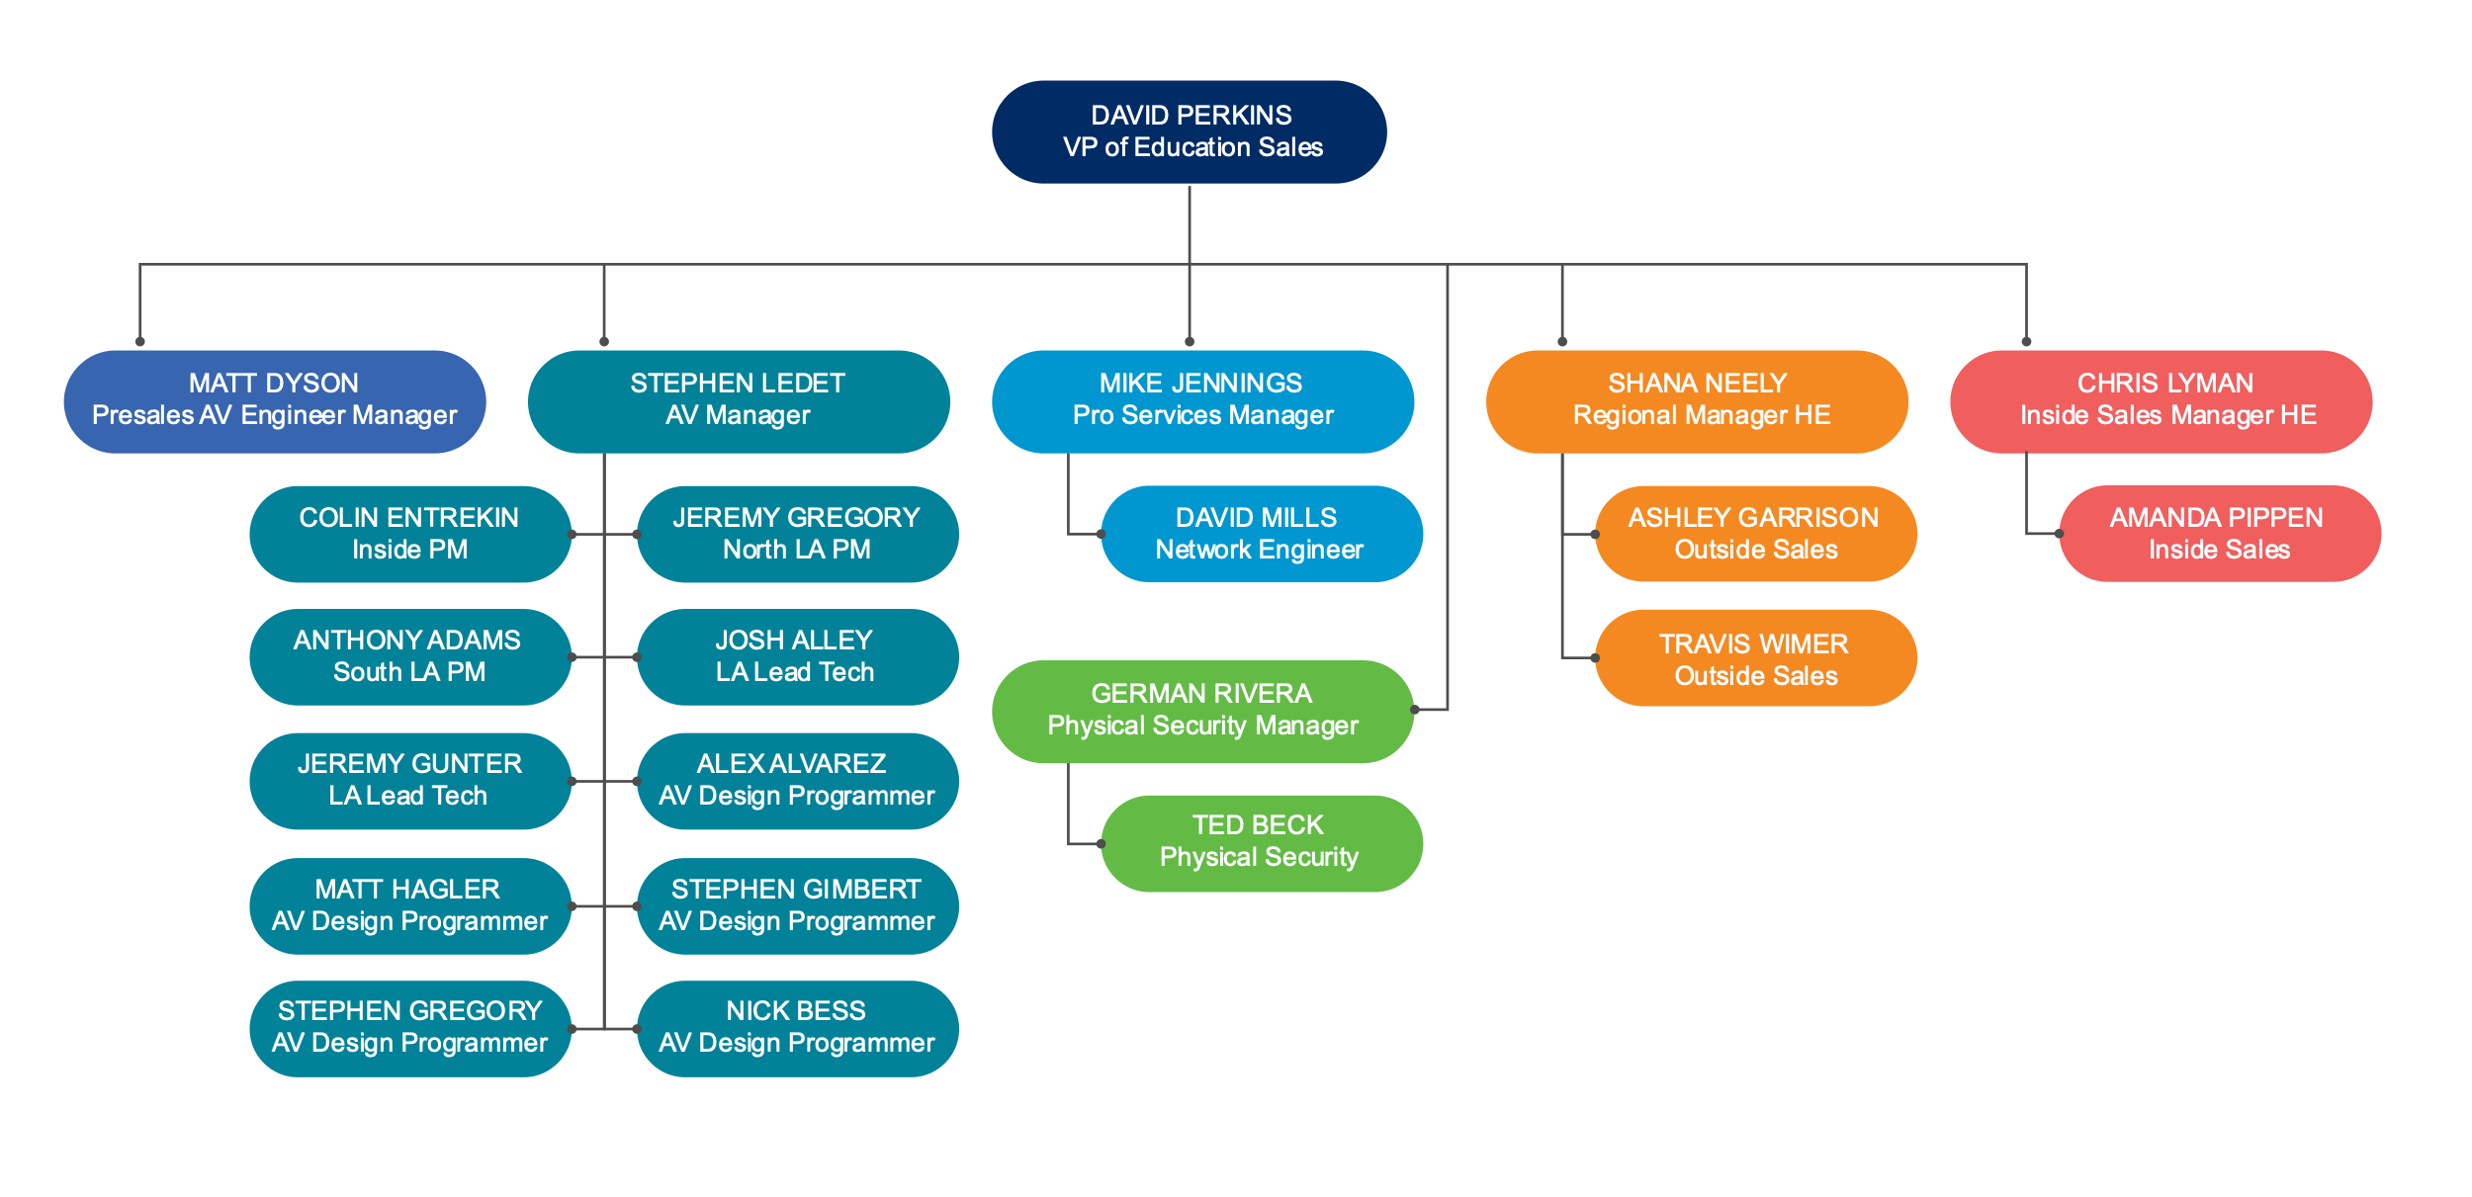
HOWARDedu LA CONTACTS

Slide 4
HOWARDedu AV CONTACTS
Type Here

Slide 5
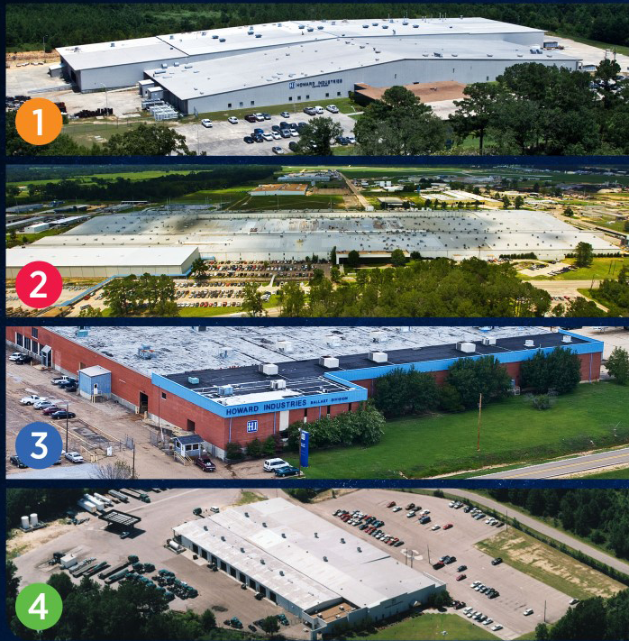
CORPORATE FACILITIES
HI
1
Laurel Transformer Facility
Over 4,300 employees
Largest employer for the privately-held companies in the state of MS
Largest transformer manufacturing facility in the world – over 2 million ft²
Transformer division is the #1 producer of oil-filled distribution transformers in the United States.
2
Ellisville Transportation Facility
3
Sandersville Ballast Facility
4
Mendenhall HID Facility

Slide 6



HI
CORPORATE DIVISIONS
POWER SOLUTIONS
TRANSPORTATION
LIGHTING PRODUCTS
Howard Power Solutions is the nation’s leading producer of distribution transformers. Howard Power Solutions also produces medium-power transformers, substation transformers, voltage regulators, junction enclosures, pad-mounted sectionalizing equipment, dry-type transformers, and OEM transformer components.
Howard Transportation is a wholly-owned subsidiary of Howard Industries that operates a fleet of 200+ trucks that transport goods throughout the U.S. as a long-haul, flat-bed common carrier truck line and brokerage operation.
Howard Lighting Products offers lamps, ballasts, and fixtures, including linear fluorescent, compact fluorescent, high intensity discharge (HID), and halogen lamps as well as electronic and magnetic fluorescent, and magnetic HID ballasts. In addition, Howard Lighting also offers a wide array of HID fixtures.

Slide 7

HI
CORPORATE DIVISIONS
Our corporate headquarters is also home to our technology division, Howard Technology Solutions. This division brings to market cutting-edge technology that includes audiovisual and instructional solutions, network security and storage solutions, as well as installation, consulting, and design services. From distance learning and interactive classroom products to point-of-care medical carts and specialized mobility solutions, we make great technology available, and we make it affordable.
HOWARDedu
HOWARDmed Technology Solutions
HOWARD Enterprise
Howard Store
TECHNOLOGY SOLUTIONS

Slide 8
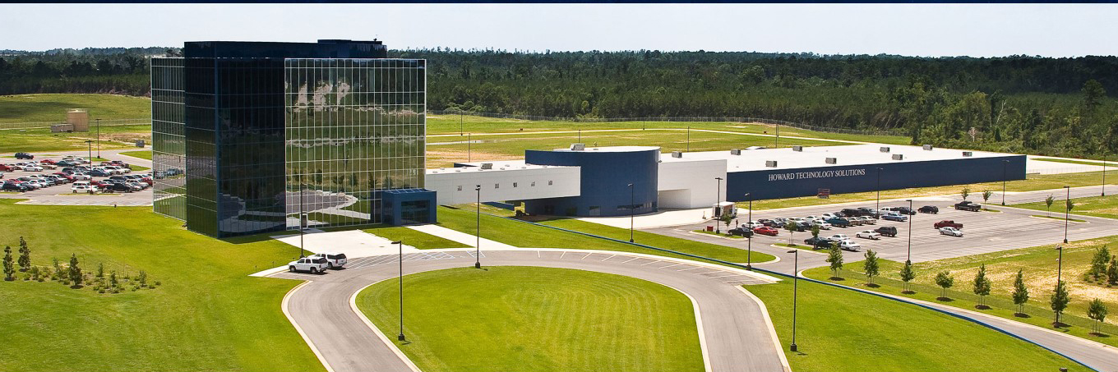
HI
CORPORATE HEADQUARTERS
Our Corporate Headquarters is a
5-Story structure wrapped in two
tones of blue glass and includes:
60,000 ft² of office space
72,000 ft² manufacturing plant
for technology products

Slide 9
FISCAL YEAR SALES COMPARISON
2018 | Category | 2018 | Sales $ Amount | 2019 | Category | 2019 | $ Sales Amount
Accessories | $45,229.00 | Accessories | $169,305.00
Digital AV Players and Recorders | $15,656.00 | Digital AV Players and Recorders | $778.00
Projectors | $13,837.00 | Projectors | $2,647.00
Audio Mixers | $10,555.00 | Audio Mixers | $26,780.00
Digital Signage | $9,889.00 | Digital Signage | $75,714.00
AV Installation | $7,447.00 | AV Installation | $58,529.00
AV Mounting | $3,942.41 | AV Mounting | $13,800.00
Microphones | $2,259.00 | Microphones | $11,407.00
Peripheral Device Accessories | $1,932.00 | Peripheral Device Accessories | -
AV Carts, Racks, and Cases | $1,929.00 | AV Carts, Racks, and Cases | 3,755.00

Slide 10
FISCAL YEAR SALES COMPARISON
2018 | Category | 2018 | Sales $ Amount | 2019 | Category | 2019 | $ Sales Amount
Monitors | $870.00 | Monitors | $2,724.00
Cables | $868.00 | Cables | $4,607.00
Document Cameras | $685.00 | Document Cameras | $1,781.00
System and Power Cables | $584.00 | System and Power Cables | -
Power Devices | $358.00 | Power Devices | $1,246.00
Networking Cables | $104.00 | Networking Cables | $453.00
Peripheral Device Cables | $26.00 | Peripheral Device Cables | $63.00
Networking Accessories | $18.00 | Networking Accessories | $191.00
AV Cables | $18.00 | AV Cables | $69.00

Slide 11
ADDITIONAL 2019 SALES
Category | $ Sales Amount
TVs and Home Theater Monitors | $11,980.00
Hubs and Switches | $2,702.00
Speakers | $1,610.00
Presentation | $439.00
Whiteboards | $439.00
Remote Controls | $428.00
Point of Sale Systems | $228.00
Batteries | $100.00

Slide 12
TOP 25 MANUFACTURERS COMPARISON
2018 | Brands | 2018 | Sales $ Amount | 2019 | Brands | 2019 | $ Sales Amount
1. Howard Technology Solutions | $21,737.00 | 1. Howard Technology Solutions | $76,394.00
2. Extron Electronics | $19,678.41 | 2. Visix | $60,759.00
3. Crestron Electronics | $16,685.00 | 3. Digium | $57,230.00
4. Epson | $15,901.00 | 4. Crestron Electronics | $45,369.00
5. Visix | $15,656.00 | 5. Polycom | $40,392.00
6. NEC Display Solutions | $7,503.00 | 6. Sonic Foundry | $25,176.00
7. Spectrum Industries | $3,858.00 | 7. NEC Display Solutions | $19,272.00
8. Chief | $3,424.00 | 8. Samsung | $11,980.00
9. Shure | $3,108.00 | 9. Shure | $11,507.00
10. Sharp | $2,386.00 | 10. Chief | $11,313.00
11. LG Electronics | $1,656.00 | 11. Extron Electronics | $5,775.00
12. Lumens Digital Optics | $863.00 | 12. Epson | $2,706.00
13. Comprehensive | $844.00 | 13. Extreme Networks | $2,606.00

Slide 13
TOP MANUFACTURERS COMPARISON
2018 | Brands | 2018 | Sales $ Amount | 2019 | Brands | 2019 | $ Sales Amount
14. HoverCam | $685.00 | 14. Middle Atlantic | $2,234.00
15. ViewSonic | $442.00 | 15. Newline | $2,000.00
16. Dell | $428.00 | 16. Spectrum Industries | $1,819.00
17. Radio Design Labs | $417.00 | 17. Wacom | $1,788.00
18 Comprehensive Cable | $330.00 | 18. JBL | $1,610.00
19. Tripp Lite | $280.00 | 19. Comprehensive | $1,556.00
20. West Penn | $152.00 | 20. Lumens Digital Optics | $1,245.00
21. PYLE Audio | $71.00 | 21. West Penn | $1,232.00
22. Furman Sound | $53.00 | 22. Crown Audio | $1,187.00
23. C2G | $49.00 | 23. Dell | $936.00
 |  | 24. Videoconference Furniture | $898.00
 |  | 25. MooreCo | $878.00

Slide 14
COMPARISON OF FY2018 AND FY2019
Comparison of Year Spend | FY2018 |  | Comparison of Year Spend | FY2019
Customer Name | Sales | Customer Name | Sales
Louisiana State University | $98,437.41 | Louisiana State University | $141,839.00
LSU Ag/Mech | $7,324.00 | LSU Ag/Mech | $5,472.00
LSU Health and Science Center | $10,445.00 | LSU Health and Science Center | $187,309.00
 |  | LSU Alexandria | $57,230.00
TOTAL | $116,206.41 | TOTAL | $391,850.00

Slide 15
SAVINGS ON SUPPLIES AND EQUIPMENT
Savings Type | Savings $ Amount
Total Spent on Equipment | $305,079.00
Total MSRP on Equipment | $510,614.00
Total Savings over MSRP | $205,535.00
Savings over MSRP | 40%

Slide 16
INSTALLATIONS SAVINGS IN DOLLARS
CUSTOMER | AMOUNT

Slide 17
PERFORMANCE METRICS
A.
B.
C.
D.

Slide 18
GREEN PRODUCTS & COMPONENTS
Type Here

Slide 19
DIVERSE BUSINESS REPORTING
Type Here

Slide 20
VALUE ADDED BENEFITS & SAVINGS
Type Here

Slide 21
TRAINING EVENTS
Type Here

Slide 22
CREDITS/SAMPLES
Type Here
SUPPLIER EXPO’S
Type Here

Slide 23
HOWARDedu/LSU PROJECTS - ORDERED
ORDER NUMBER | CUSTOMER NAME | ORDER DATE | PROJECT NAME

Slide 24
HOWARDedu/LSU PROJECTS - QUOTED
ORDER NUMBER | CUSTOMER NAME | ORDER DATE | PROJECT NAME

Slide 25
BUSINESS BARRIERS/ISSUES
Type Here

Slide 26
HOWARDedu CAPABILITIES
Type Here

Slide 27
INDUSTRY BEST PRACTICES
Type Here

Slide 28

THANK YOU
and

