Slide 1


Slide 2
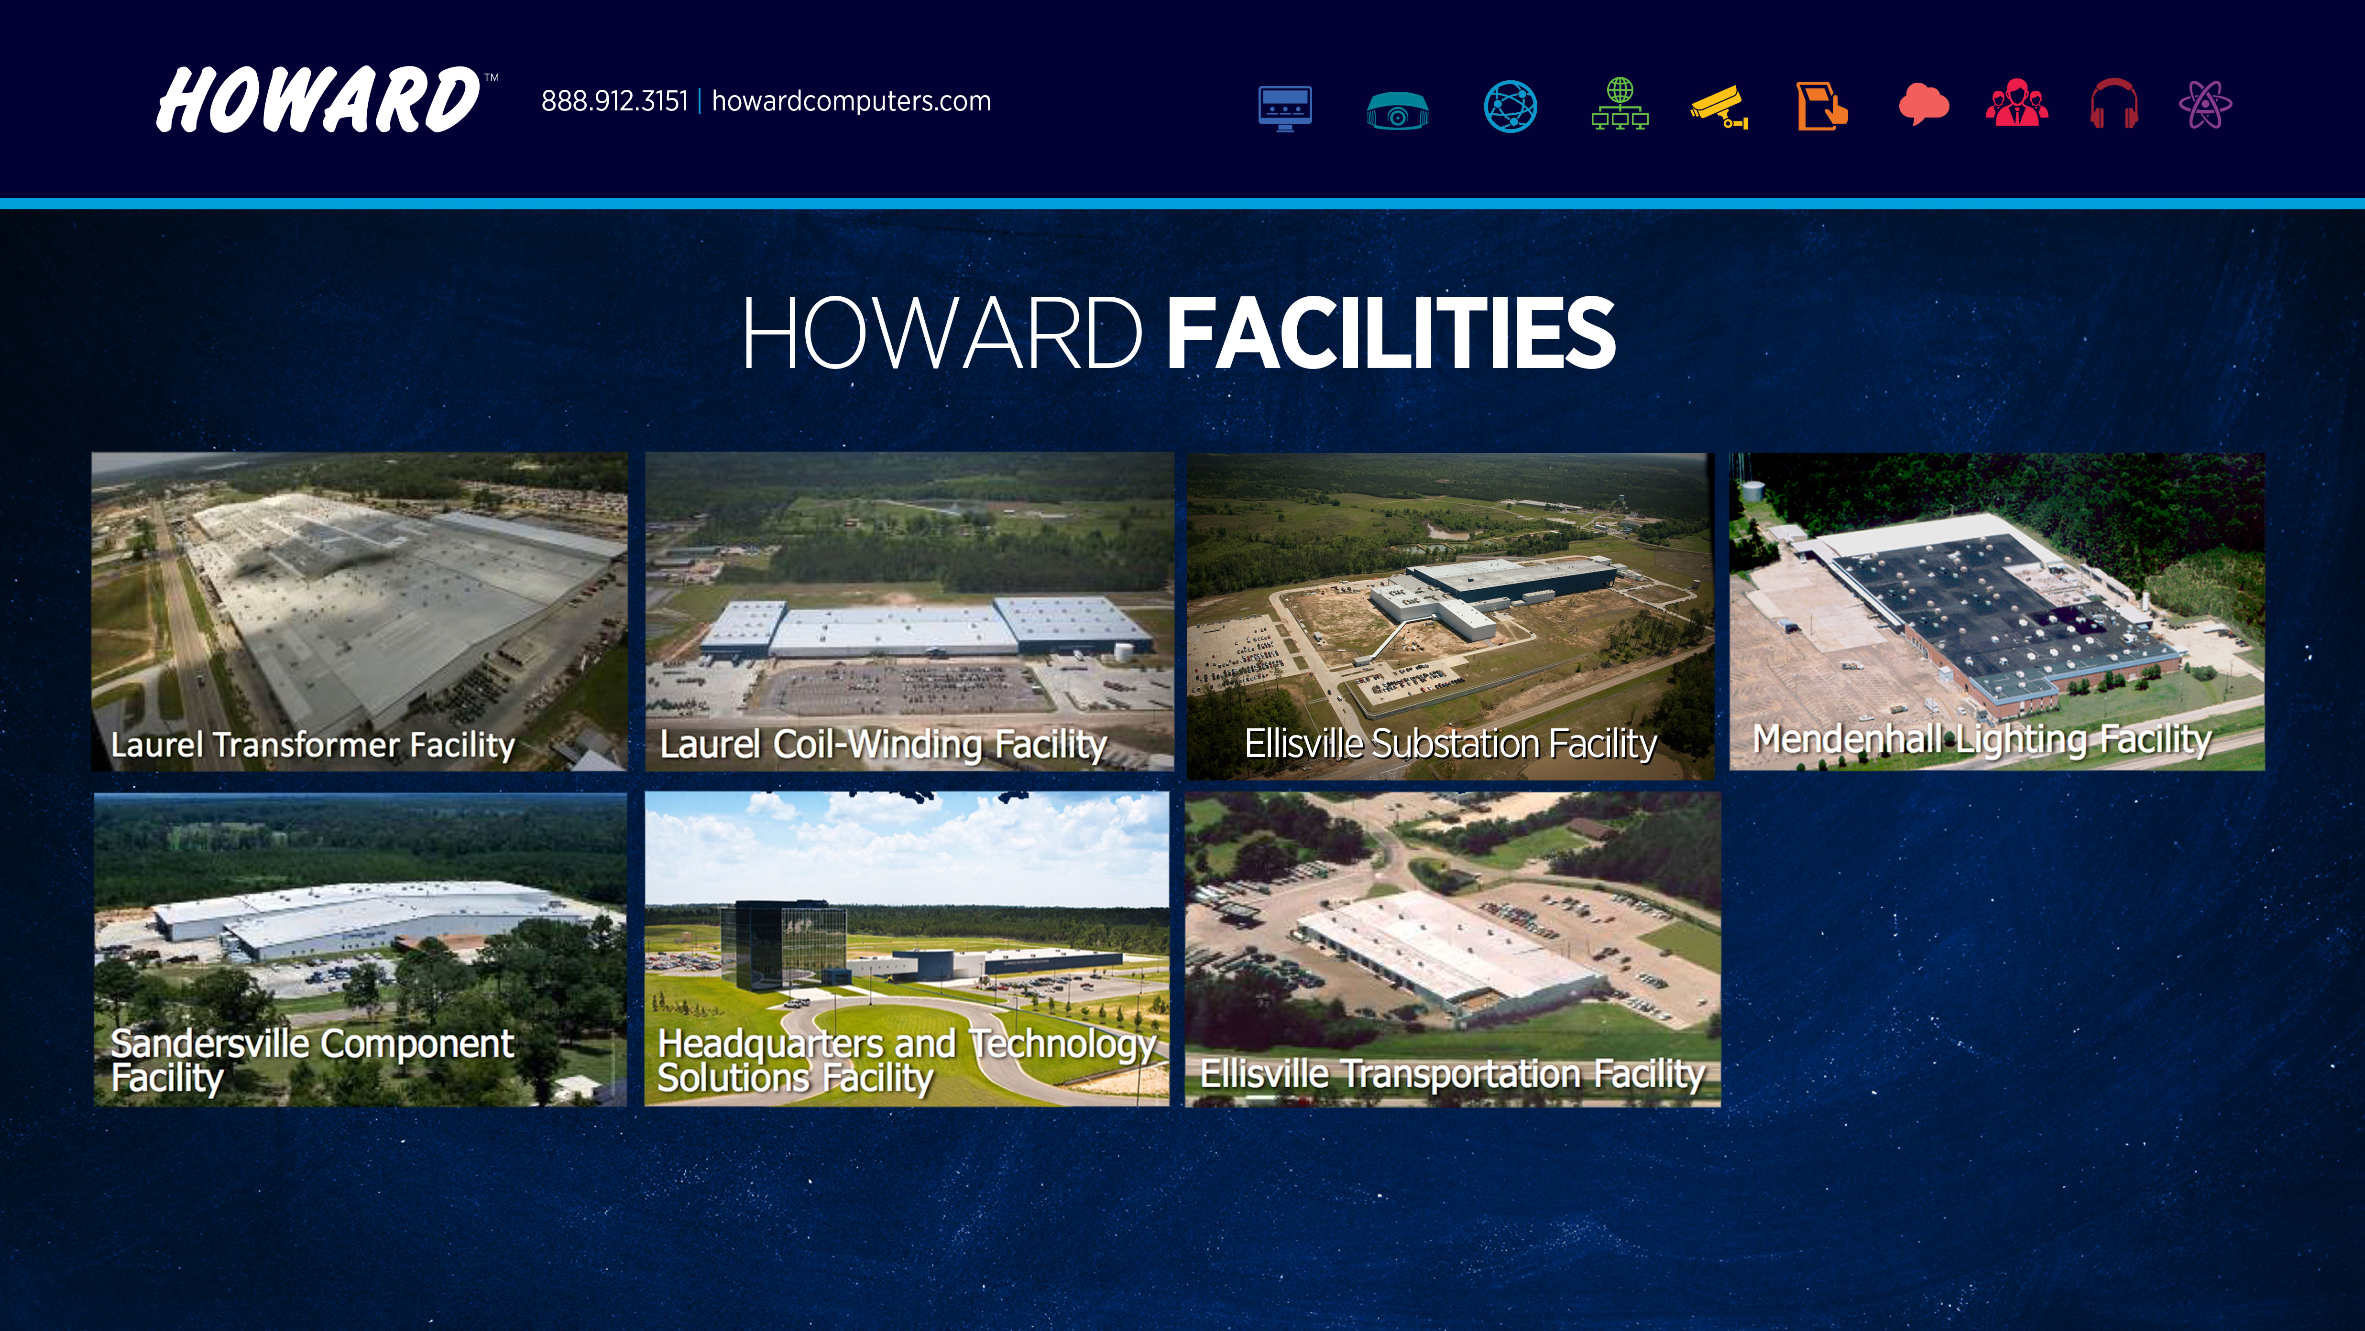

Slide 3
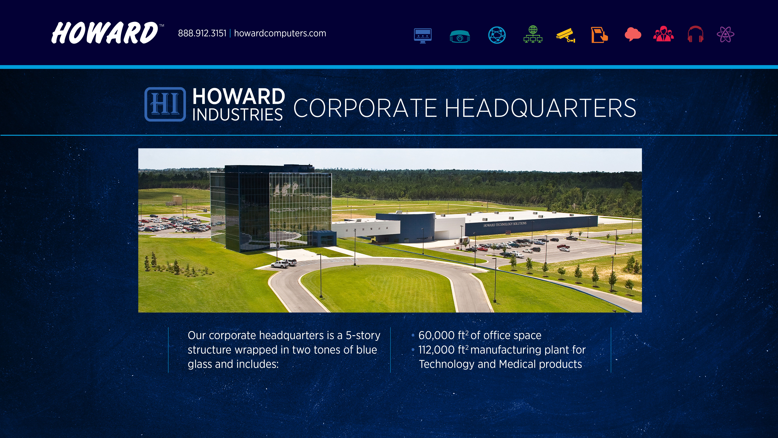

Slide 4
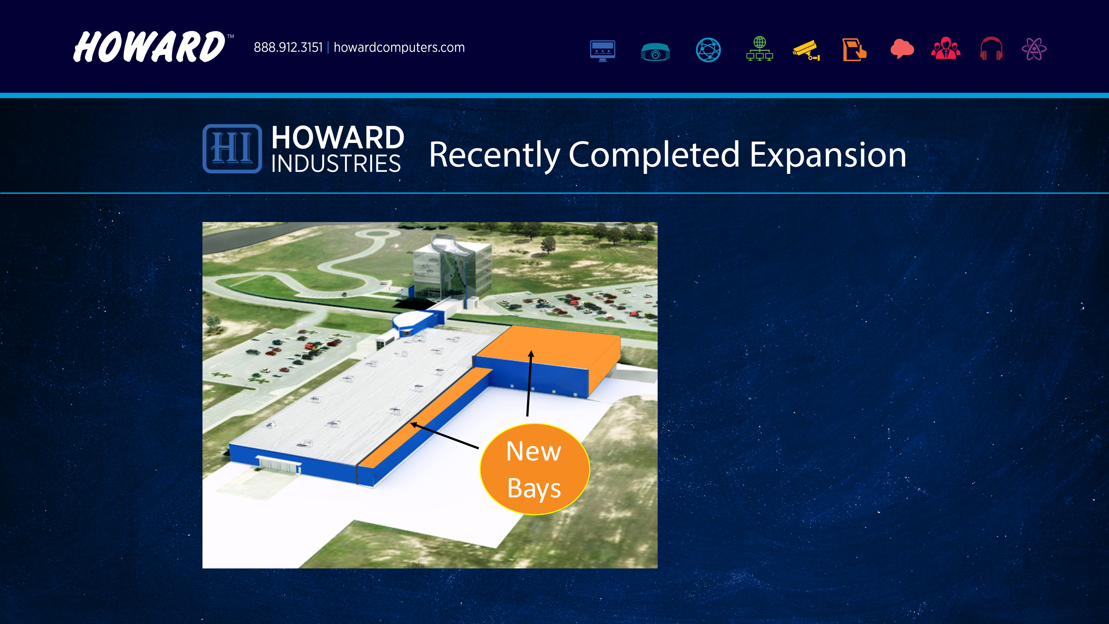
Newly Expanded Production Facility
Completed September 2018
New Total Production Facility Floor Space:
112,000 ft²

Slide 5

Expansion Plans:
Additional Office Towers I & II

Slide 6


Slide 7














THE ONE STOP SHOP
A: COMPUTING SOLUTIONS
B: AUDIOVISUAL &
INSTRUCTIONAL
SOLUTIONS
C: NETWORKING
INFRASTRUCTURE
SOLUTIONS
D: VIRTULIZATION
E: PHYSICAL SECURITY
F: KIOSK & DIGITAL SIGNAGE
G: SOFTWARE SOLUTIONS
H: PROFESSIONAL SERVICES
I: E-COMMERCE &
ACCESSORIES
J: PRO DEVELOPMENT
TEACHING & LEARNING

Slide 8







A COMPUTING SOLUTIONS
1. Accessories
2. Antivirus
3. Desktops
4. Management Solutions
5. Mobile Presentation and Charging Stations
6. Notebooks and Tablets
7. Printers (2D & 3D)
8. Refurbs

Slide 9


















SOFTWARE BRANDS
Ask your HOWARDedu Rep about special pricing for Education Customers.

Slide 10




H PROFESSIONAL SERVICES
1. Consulting
2. Installation and Design Services
3. Managed Services
4. Physical Security and Video
Surveillance Services
5. Professional Development/Training
6. Programming Services
7. Support Services

Slide 11
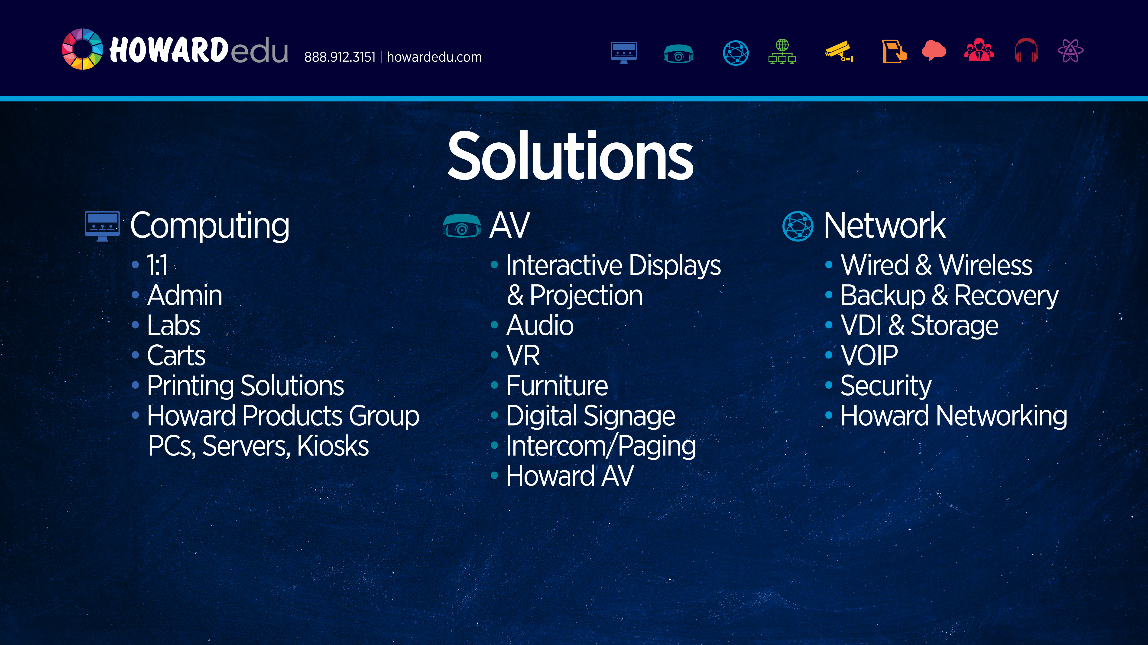

Slide 12
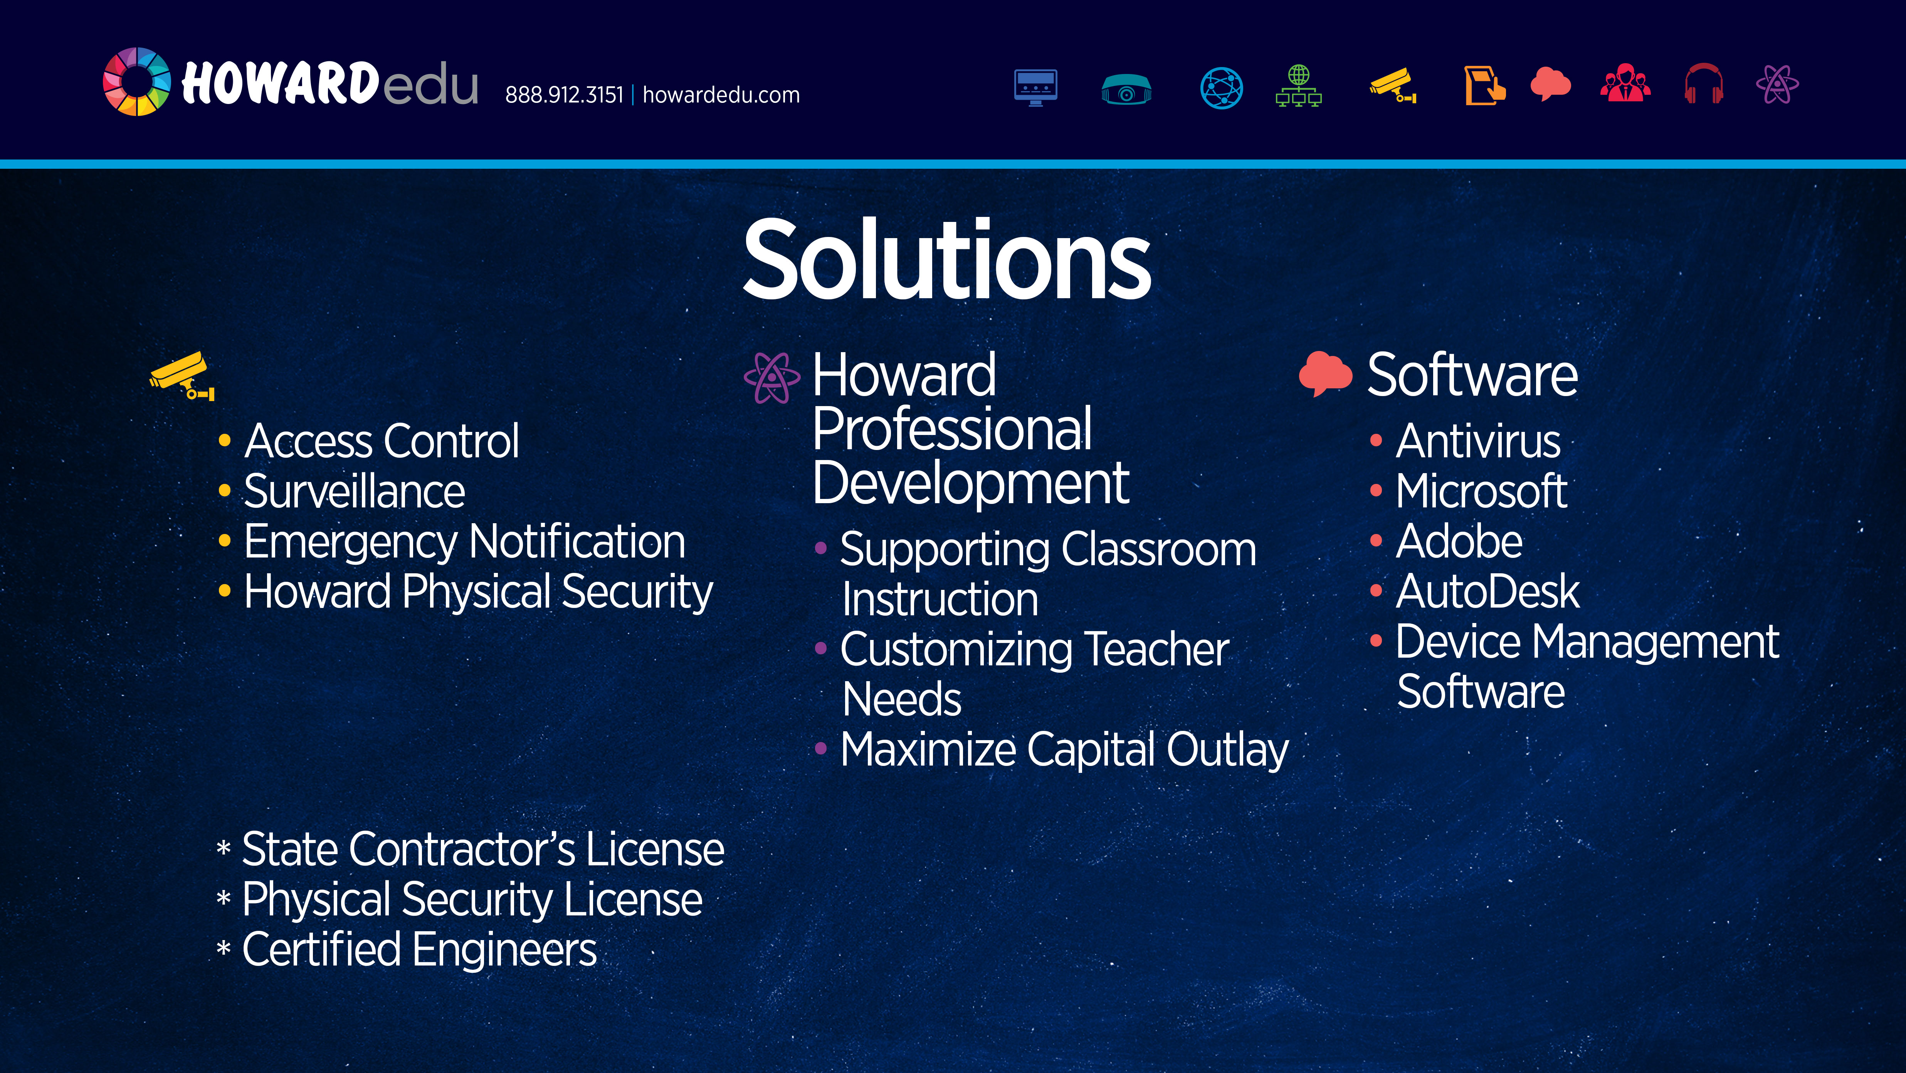
Physical Security

Slide 13


Slide 14


Slide 15


Slide 16
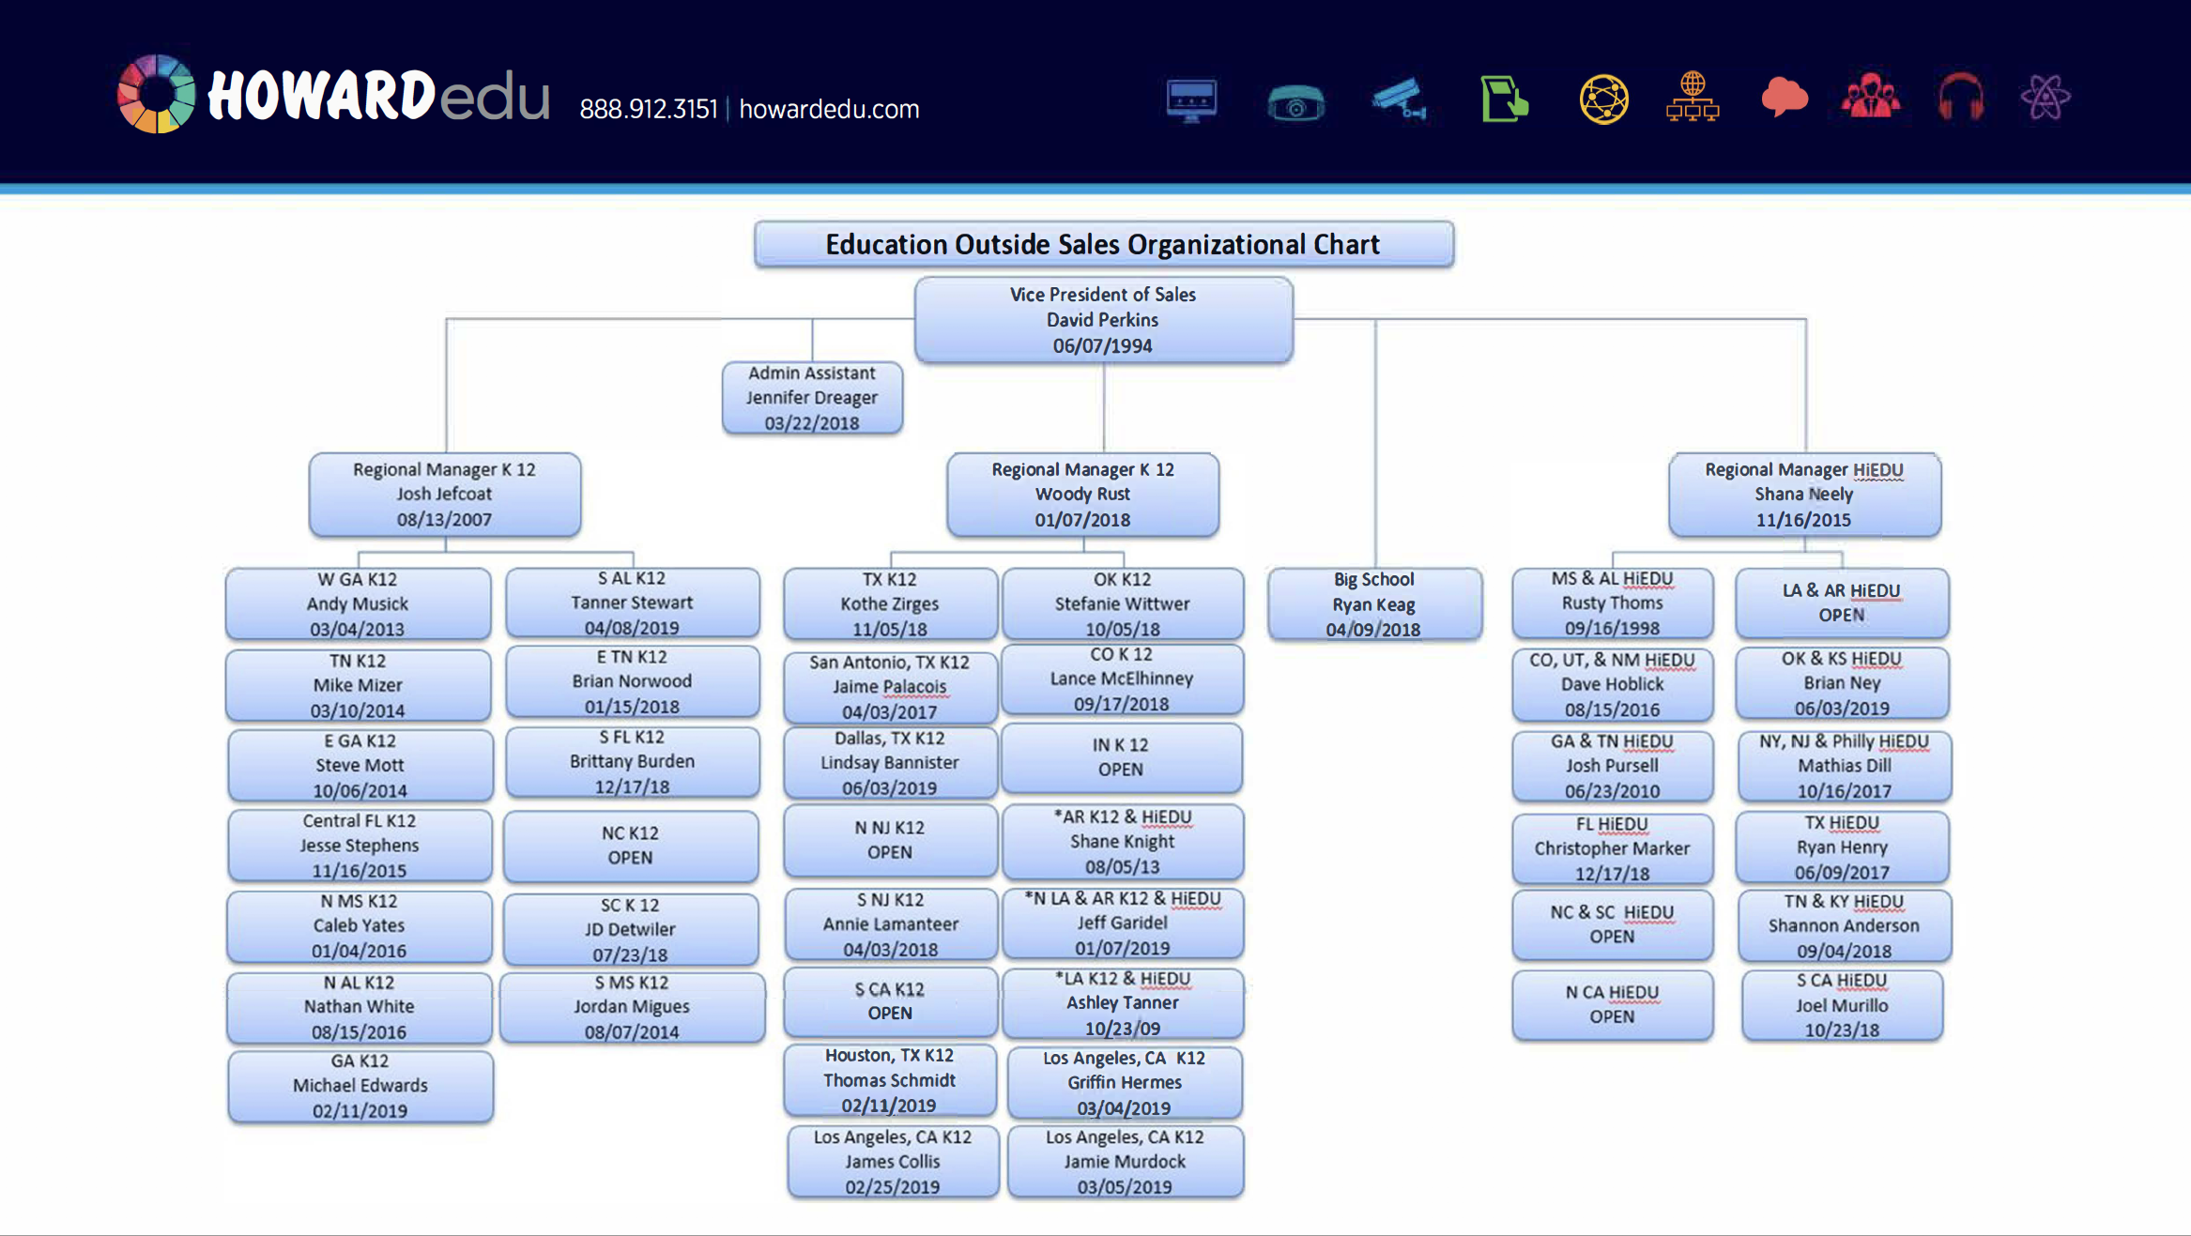

Slide 17


Slide 18


Slide 19


Slide 20


Slide 21
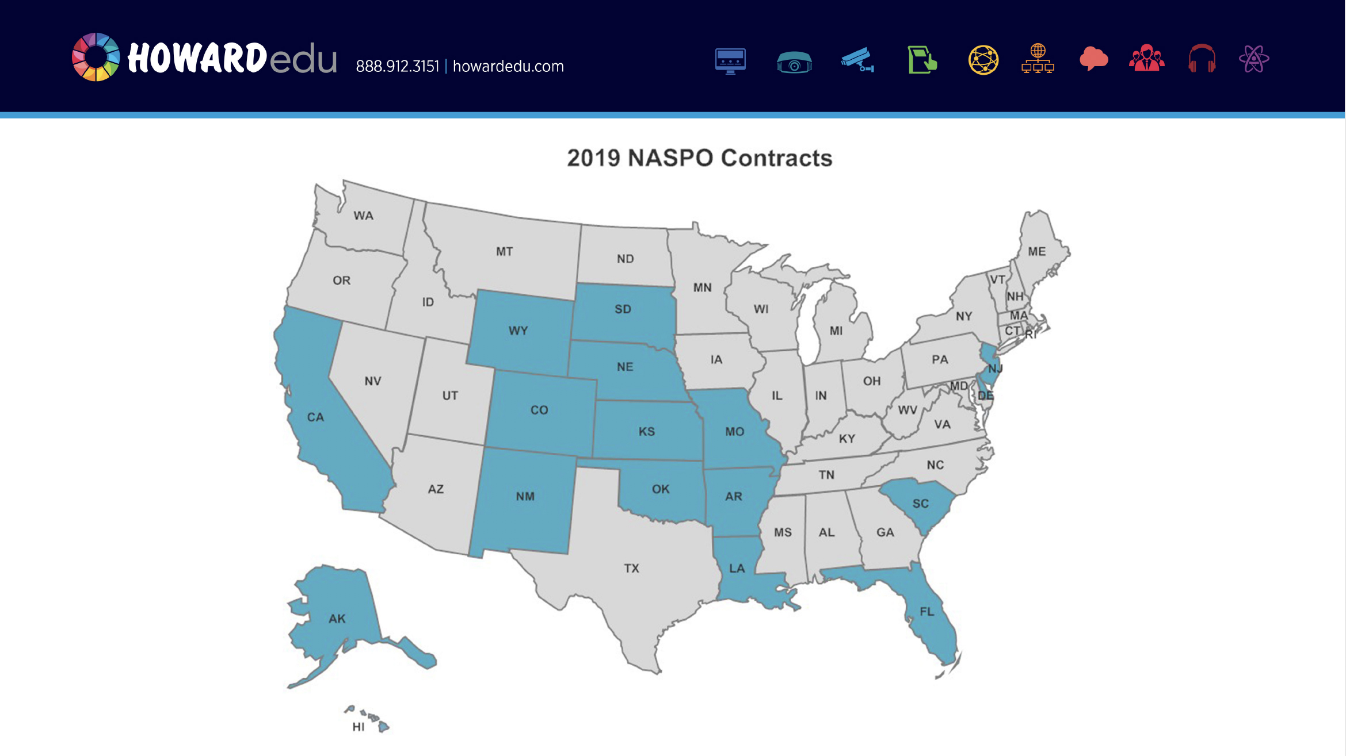

Slide 22
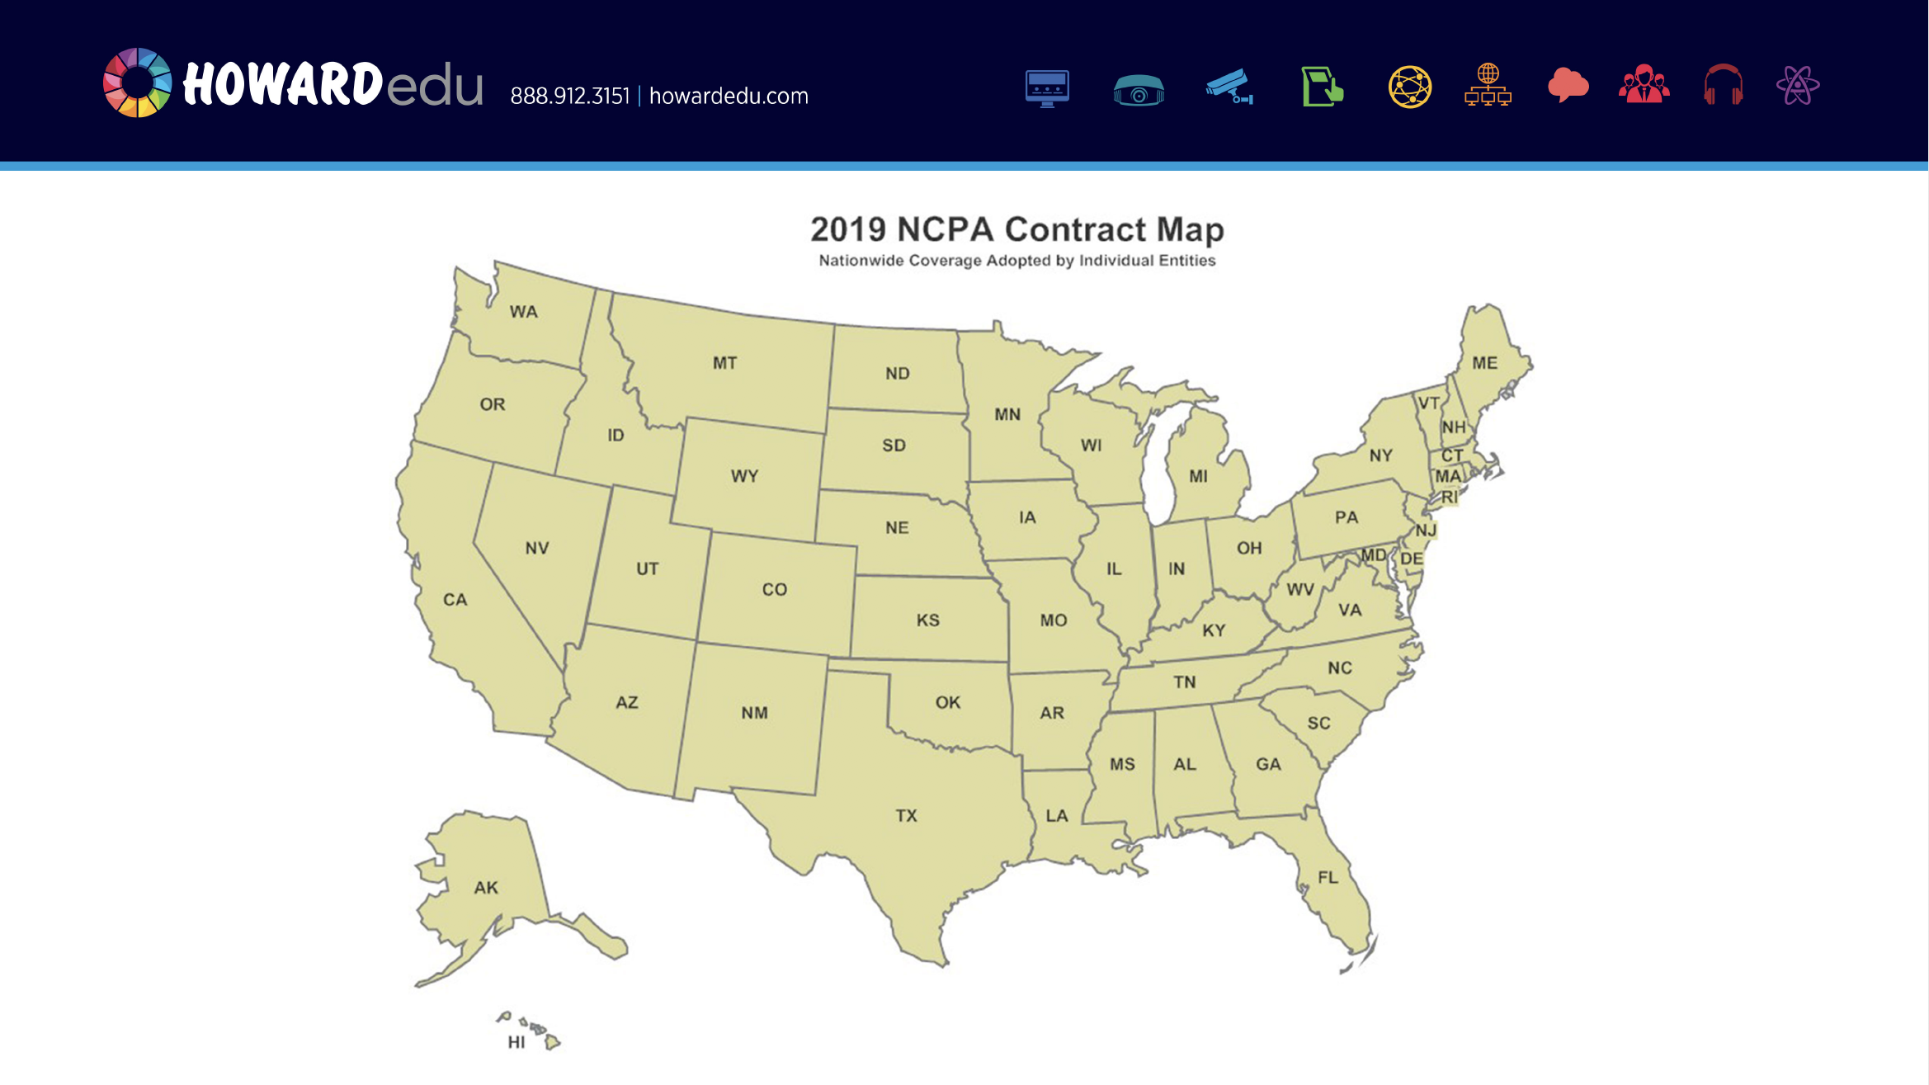

Slide 23


Slide 24
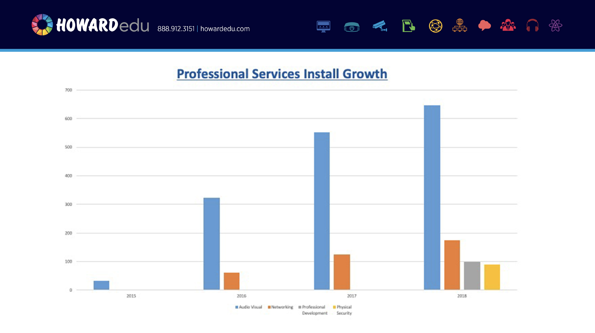

Slide 26
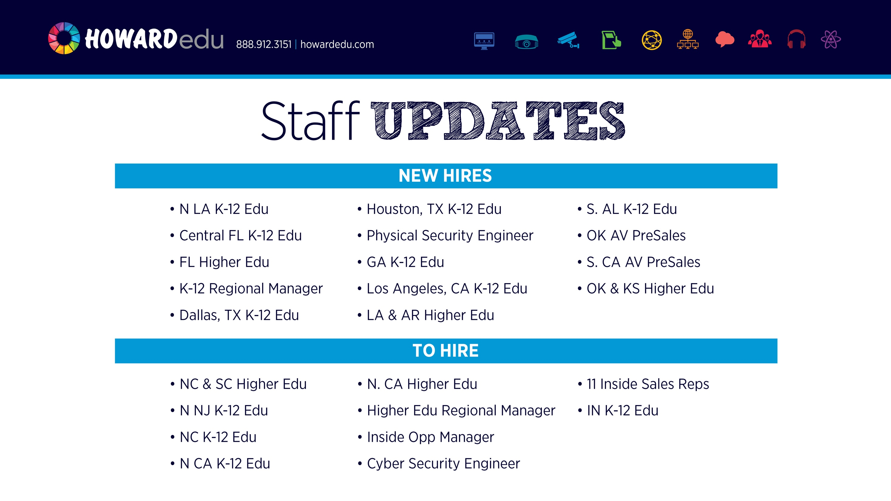

Slide 27
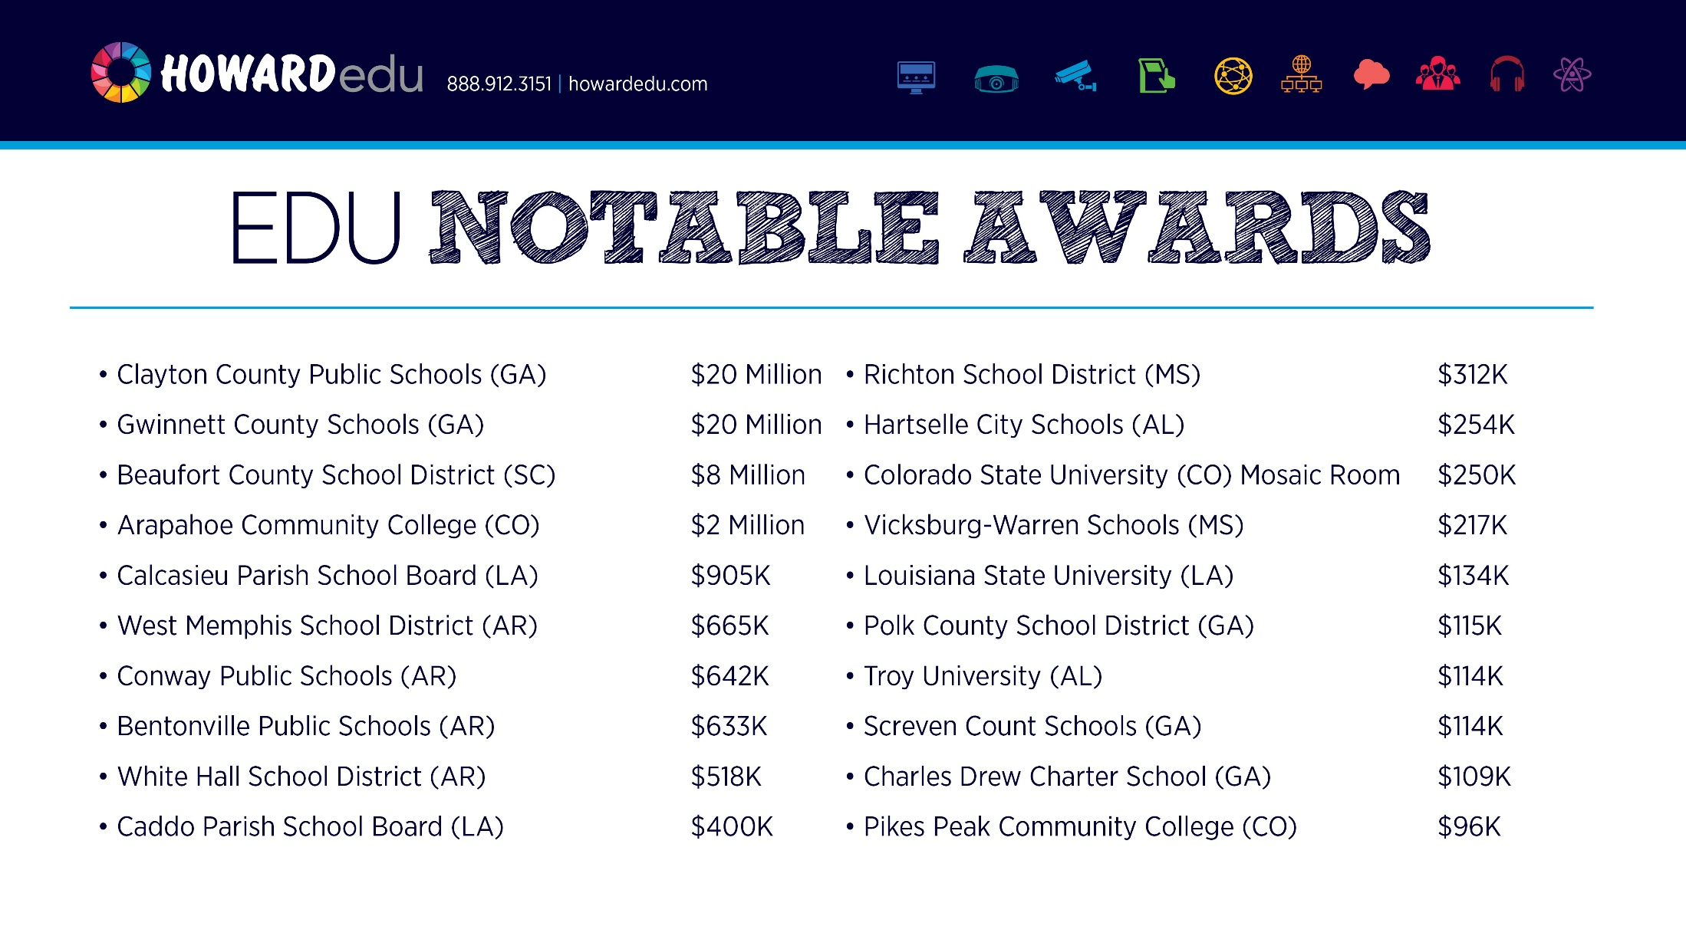

Slide 28
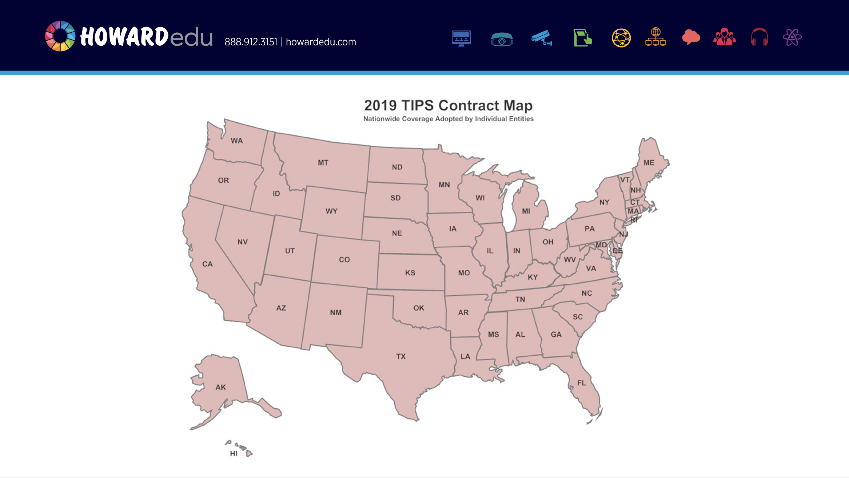

Slide 29


Slide 30
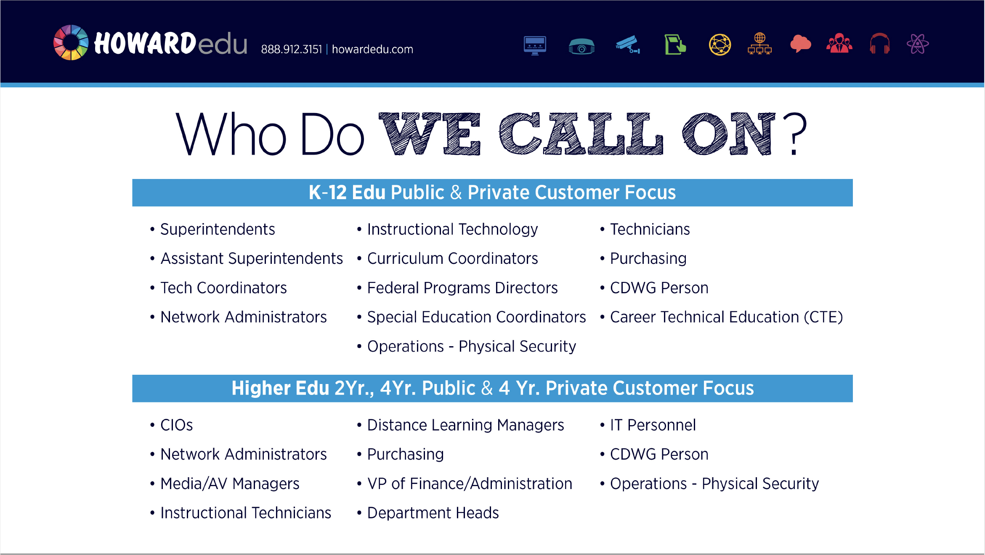

Slide 31

Nicholas Pry
HP Inc. Product Champion
HP Product Champion Goals
Time Period | 2018 Sales | 2019 Projected Growth Over 2019 | 2019 Sales Target | 2019 Actual Sales | % of Goal | Goal Over/Under
Q1 (Nov 2018 – Jan 2019) | 812,847.00 | 20% | 975,416.00 | 1,384,749.00 | 100.0% | +42.0%
Q2 (Feb 2019 – Apr 2019) | 867,188.00 | 20% | 1,040,626.00 | 1,933,819.00 | 100.0% | +85.8%
Q3 (May 2019 – Jul 2019) | 1,846,344.00 | 20% | 2,215,613.00 | 2,357,606.00 | 100.0% | +6.4%
Q4 (Aug 2019 – Oct 2019) | 1,350,241.00 | 20% | 1,620,289.00 | 156,438.00 | 9.7% | -90.3%
Total | 4,844,198.00 | 20% | 5,813,038.00 | 5,832,612.00 | 100.0% | +0.3%
HP Sales Howard Fiscal YTD
Jan – May TD 2018 | $ 3,280,376.00
Jan – May TD 2019 | $ 5,139,318.00
Increase/Decrease | +56.7%
HP Sales HP Fiscal YTD
Nov'17 - May'18 TD | $ 3,777,138.00
Nov'18 – May’19 TD | $ 5,832,612.00
Increase/Decrease | +54.4%

Slide 32

HP Sales by Howard Vertical YTD*
 | Education | Business | Government | Healthcare
HPQ1FY2019 | $1,107,035.00 | $44,940.00 | $58,727.00 | $1,564.00
HPQ2FY2019 | $1,712,503.00 | $83,021.00 | $54,765.00 | $3,081.00
HPQ3FY2019 | $2,032,865.00 | $86,266.00 | $74,538.00 | $8,329.00
HPQ4FY2019 | $152,646.00 | $1,882.00 | $1,910.00 | $0.00
Total HPFY2019
*Information gleaned from the Brand and Category hit Rate report, CRM.

Slide 33
HP, Inc. Distribution Sales Breakdown
By Category –
Updated at the close of each quarter
Category Sales
 | All | Chrome | Windows | Workstations | Warranty | Printers | Supplies | Misc.
Q1 (Nov17 - Jan18) | 1,384,749.00 | 680,564.00 | 201,819.00 | 99,161.00 | 2,326.00 | 154,928.00 | 76,733.00 | 169,218.00
Q2 (Feb19 - Apr19) | 1,933,819.00 | 1,049,596.00 | 500,971.00 | 6,630.00 | 43,038.00 | 66,543.00 | 96,644.00 | 267,041.00
Q3 (May19 - Jul19) | 2,201,998.00 | 540,324.00 | 1,242,657.00 | 34,503.00 | 52,464.00 | 132,601.00 | 91,980.00 | 199,449.00
Q4 (Aug19 - Oct19)
Fiscal YTD | 5,520,566.00 | 2,270,484.00 | 1,945,447.00 | 140,294.00 | 97,828.00 | 354,072.00 | 265,357.00 | 635,708.00
5/1/2019: Updated 2Q2019 numbers.

Slide 34
HP Active Quotes (>$100K) July 2019
Quote # | Customer | Category | Vertical | Total | Sales Rep | Status
946513 | Career Academy | Chrome | K-12 EDU | $93K | Migonnna P. | ECD 8/2/2019
931455 | Brown County Schools | Laptop | K-12 EDU | $190K | Tyler R. | RFP/ Time out
931508 | Conway Public Schools | Chrome | K-12 EDU | $140K | Kellie D. | Quoted
931505 | Conway Public Schools | Chrome | K-12 EDU | $120K | Kellie D. | Quoted
933284 | Sumter County BoE | Laptop | K-12 EDU | $322K | Darlene J. | Quoted
932494 | Public Schools of Petoskey | Laptop | K-12 EDU | $315K | Teena J. | Quoted
948630 | Barrow County Schools | Chrome | K-12 EDU | $132K | Kaitlin S. | Quoted

