Slide 1
Selling Windows 7
Help Your Customers Choose the Best Edition of Windows 7

Slide 2
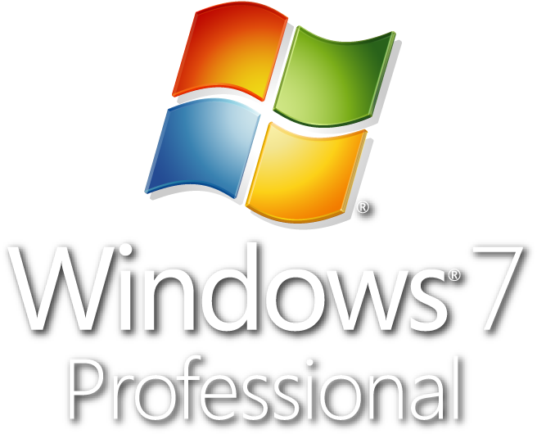
Learn Which Edition is Right for Your Customers
Why Windows 7 Home Premium?
Why Windows 7 Professional?
Notes:
Microsoft designed Windows 7 to be more reliable, more responsive and to make the things you do every day easier.
Find files quickly
Easier wireless set-up
Personalize your PC
Learn which edition is right for your customers.
Recommend Windows 7 Home Premium and Windows 7 Professional to your customers.
Home Premium offers the best entertainment experience, while Professional offers everything in Home Premium, plus features to help you at work and at home.

Slide 3
Learn Which Edition is Right for Your Customers
Why Windows 7 Home Premium?
Best Entertainment Experience
Easily create a home network and connect printers and other devices with HomeGroup
Enhancements to Windows® Media Center, including access to free Internet TV¹
Simplify everyday tasks with improved desktop navigation features like Pin, Snap, and Shake.
¹ Internet access required. Free Internet TV content varies by geography. Some content may require additional fees.
Notes:
Why recommend Windows 7 Home Premium? Because it’s the best entertainment experience—the best way to enjoy and share photos, videos, and music on your PC.
Windows 7 Home Premium makes it easy to create a home network and share all of your favorite photos, video, and music. You can even watch TV programs for free, whenever and wherever you want. If you like media, Home Premium is for you.
Home Premium specifically offers:
The ability to create a HomeGroup—to share photos, video, and music across your home network.
An enhanced Windows Media Center—watch many TV shows for free with Internet TV. You can also watch, pause, rewind, and record TV on your PC. Remember to tell your customers that Internet access is required for free Internet TV, and that Internet TV content is only available to US customers. Additional hardware may be required.
View and switch between all open windows--open favorite programs in just one click by pinning them to the Taskbar.

Slide 4
Learn Which Edition is Right for Your Customers
Why Windows 7 Professional?
For Work and Home
Everything from Windows 7 Home Premium PLUS:
Connect to company networks with Domain Join
Recover data easily with automatic backup
Location Aware Printing
Notes:
Recommend Windows 7 Professional to your customers who need everything for work and home.
Windows 7 Professional gives you all the entertainment features of Windows 7 Home Premium and the business features for your work demands.
Easily connect to company networks with Domain Join
Recover data easily with automatic backup and send files to a remote location safer with Encrypting File System
Easily print to the right printer with Location Aware Printing

Slide 5
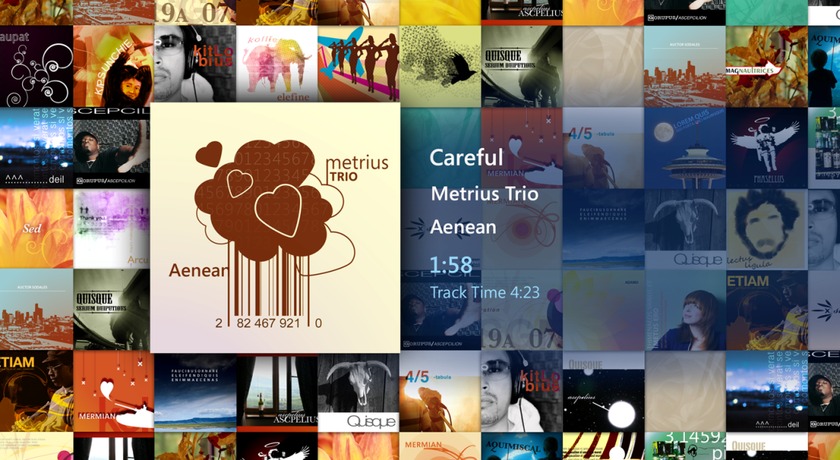
Recommend Windows 7 Home Premium
The best way to enjoy and share photos, videos, and music.

Slide 6
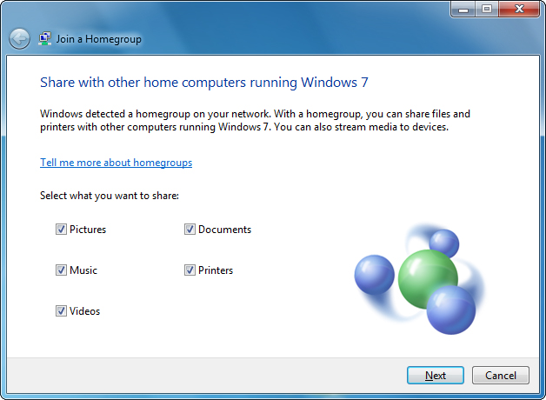
Recommend Windows 7 Home Premium
Customer: “I’d like the ability to access and share media files across multiple PCs.”
HomeGroup
Create a home network and easily share your music, videos, and photos between PCs running Windows 7.
Notes:
Many of your customers have more than one PC in the home, and would be interested in being able to access files across multiple PCs.
HomeGroup, a new feature in Windows 7, makes connecting the computers in your home a painless process. Computers running Windows 7 automatically identify and connect with each other, making it easy to set up or join a HomeGroup. After your HomeGroup is set up, sharing files across the various PCs in your home—and many other devices—is as easy as if all your data were on a single hard drive, making it easy to store digital photos on one computer and easily access those photos from a laptop anywhere in your home.
Similarly, once in a HomeGroup, the printer is shared automatically with all of the PCs in your home. HomeGroup also enables you to specify exactly what you want to share. You can choose to keep data on a PC private, or to share additional folders with your entire HomeGroup for quick and easy access.

Slide 7
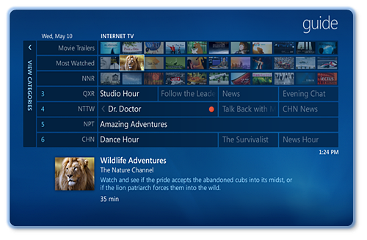
Recommend Windows 7 Home Premium
Customer: “I’d like to know more about using my PC to enjoy TV.”
Windows® Media Center
Watch many TV shows for free when and where you want with Internet TV.
Watch, pause, rewind, and record TV on your PC.
Notes:
Ask your customers if they want to enjoy shows on demand from the internet and turn their PC into a powerful DVR.
Home Premium offers Windows Media Center, with a new streamlined user interface and support for new content types and digital TV. Media Center in Windows 7 makes watching TV, movies, and other video content on your PC easier than ever. Key enhancements to Media Center in Windows 7 include:
• Internet TV. Choose from a variety of online TV shows and movies, all organized into a single TV guide view, populated automatically with Internet TV content when you have a broadband connection. **Internet access required. Free Internet TV is only available to US customers. Some content may require additional fees.
• Broader Support for Global TV Standards. Digital TV in Windows 7 works in more than 20 global markets.
Sharing TV Around the Home. If you have multiple PCs running Media Center in your HomeGroup, you can access TV libraries (in addition to your music, photos, and videos) on those different PCs. Easily copy a TV show to your portable PC to enjoy on-the-go.
• Enhanced UI. New features such as turbo scroll make finding the media you want faster, helping you to quickly move through a large library or TV guide by pressing and holding the right cursor. Click the seek bar to quickly jump to a show you want.

Slide 8
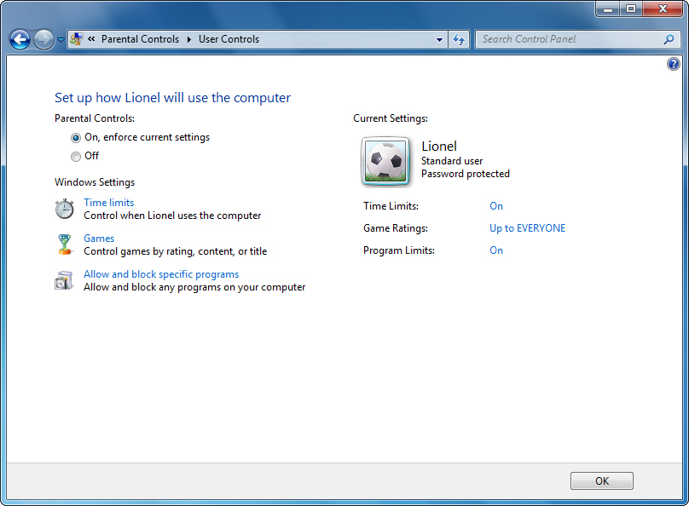
Recommend Windows 7 Home Premium
Ask: Do you want to monitor or safeguard the Web sites your children visit?
Parental Controls
Keep children safer online with improved customizable controls.
Notes:
Security is a top concern for customers with families. Make sure they know that Parental Controls in Windows 7 helps them control their kids’ access to online content, as well as games and even the hours and days they can log on to a PC.
Windows 7 Parental Controls offer parents greater peace of mind and confidence in their ability to manage what their kids can do on the computer. Parents can specify:
Which computer games their children can play and which applications they can use.
Can set specific times when children can use the computer to ensure that they aren’t playing games when they should be doing their homework.

Slide 9
Demonstration: Parental Controls
Notes:
Stop here to do a quick demonstration of Parental Controls

Slide 10
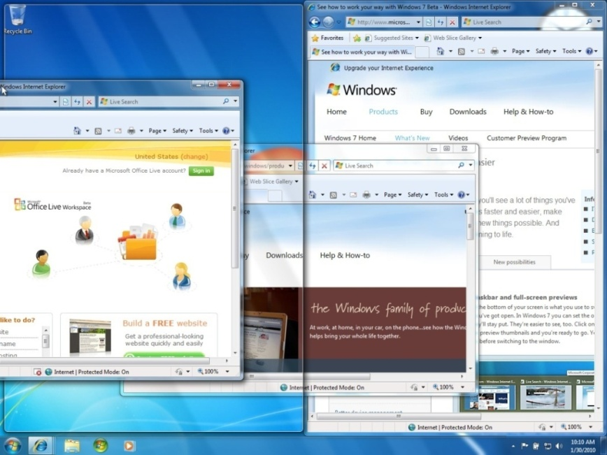
Recommend Windows 7 Home Premium
Ask: Do you view and switch among multiple open windows?
Snap
Easily resize windows to maximize vertically, or snap two documents side-by-side to compare content.
Notes:
Ask your customers if they view and switch among multiple open windows.
Snap, a new feature of Windows 7, allows users to maximize a window by dragging its border to top of the screen.
Compare contents by dragging two windows to opposite sides of the screen.
As your cursor touches the edge, windows will resize to half the screen.

Slide 11
Recommend Windows 7 Home Premium
Ask: Do you want your computer to keep track of your most commonly used programs and files?
Jump Lists
Right click on a program icon on the Taskbar to view and access the most recent and frequently used files.

Slide 12
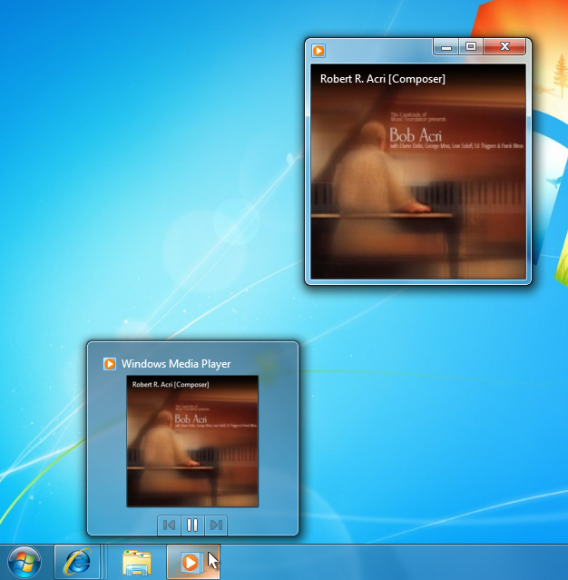
Recommend Windows 7 Home Premium
Ask: Do you want your computer to keep track of your most commonly used programs and files?
Windows ® Taskbar
Open your favorite programs in just one click by pinning them to your Taskbar.

Slide 13
Recommend Windows 7 Professional
Everything you need for work and home
Ask Your customers the following questions to find out
if Windows 7 Professional is the best fit.
Notes:
Why recommend Windows 7 Professional?
Windows 7 Professional includes all features in Windows 7 Home Premium, plus more. Everything you need for work and home.
Ask your customers a few questions to find out if they need Windows 7 Professional.

Slide 14
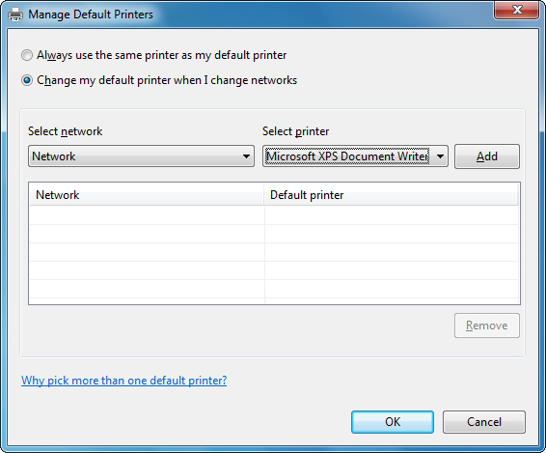
Recommend Windows 7 Professional
Customer: “I use my laptop at a variety of places; is there a quick way to configure my printers for each location?”
Location Aware Printing
Whether at home or at work, your computer connects and prints to the right printer.
Notes:
Help your customers work better when they are on the go.
Windows 7 Professional offers Location Aware Printing.
There is no need to manually select the printer to match your location. Instead, Location Aware Printing allows you to select a default printer for each network location you’ve configured. Then, automatically use that printer when you’re connected to that network.
For example, when you print at work, Windows 7 will automatically print to your work printer.

Slide 15
Recommend Windows 7 Professional
Ask: Are you on the go, working from the office, at home, and other
locations in between?
Domain Join
Connect to company networks easily and more securely.

Slide 16
Recommend Windows 7 Professional
Ask: Do you view and switch among multiple open windows?
Snap
Easily resize windows to maximize vertically, or snap two documents side-by-side to compare content.
Notes:
Ask your customers if they view and switch among multiple open windows.
Snap, a new feature of Windows 7, allows users to maximize a window by dragging its border to top of the screen.
Compare contents by dragging two windows to opposite sides of the screen.
As your cursor touches the edge, windows will resize to half the screen.

Slide 17
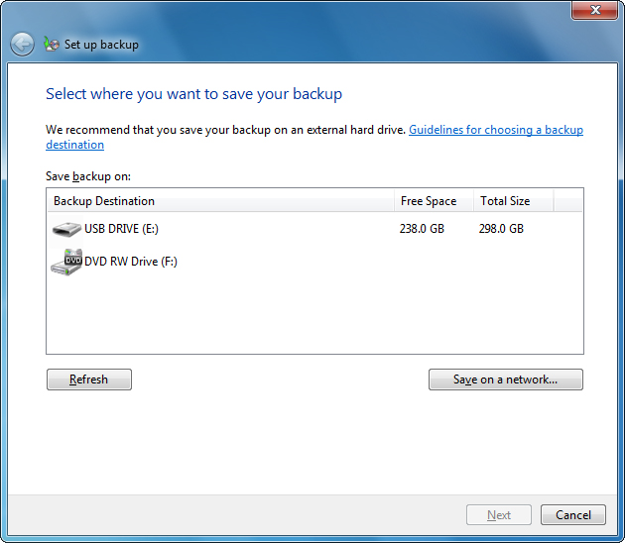
Recommend Windows 7 Professional
Ask: Do you need advanced security to protect your files?
Automatic Backup
Recover data easily with automatic backup to your home or business network.

Slide 18
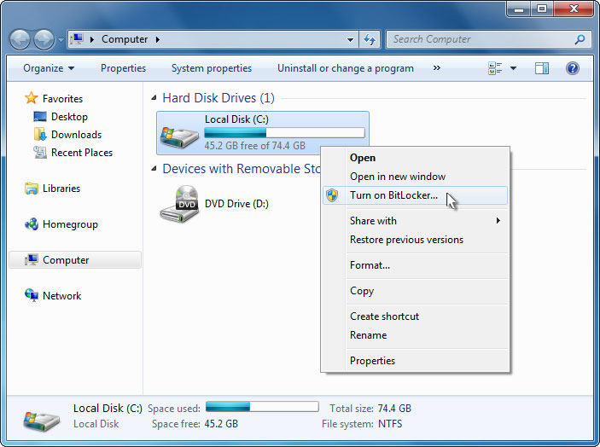
Recommend Windows 7 Professional
Ask: Do you need advanced security to protect your files?
Encrypting File System
Protect valuable information before sending to another location.

Slide 19
Recommend Windows 7 Professional
Do you want the best compatibility to use your programs and applications?
XP Mode - Run many Windows XP productivity
applications in Windows XP mode.
Notes:
Ask your customers if they want the best compatibility to use their programs and applications.
Tell your customers they can use Windows XP programs and applications when they are working on a Windows 7 machine.
Don’t forget to tell your customers they must download Windows XP Mode (which runs on Windows 7 Professional or Ultimate) and virtualization technology such as Windows Virtual PC.
Customers can download Windows XP Mode and Windows Virtual PC free-of-charge from www.windows.com/business when available.

Slide 20
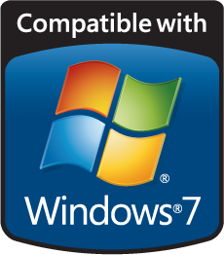
Don’t Forget to Tell your Customers About
Windows Live™
Windows Logo Program
Notes:
Tell your customers about additional resources: Windows Live and the Windows Logo Program

Slide 21
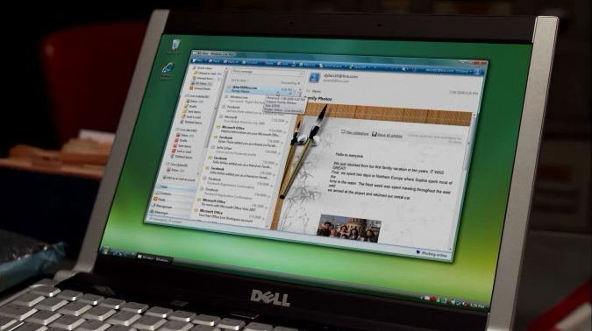
It’s FREE!
Windows Live Essentials
Windows Live Services
Windows Live Mobile
Hotmail
Messenger
SkyDrive
Photos
People
Windows Live: Life online
Notes:
More and more people are spending a lot of time, and doing a lot of things, online. So we've put Windows on the web to make it easier and more familiar to stay in touch and in sync. Instant messaging, networking, email, blogging, browsing—with Windows Live it's more connected, more convenient, and more fun.
Email. IM. Blog. And more.
Windows Live™ makes it easy to keep up with all your favorite people - all in one place.
Welcome back!
Sign in to Windows Live If you have a Hotmail, Messenger, or Xbox LIVE account, you already have a Windows Live ID.
New to Windows Live?
Sign up
Mail
- Faster, easier, and more reliable than ever before. Go to Hotmail Messenger
- Stay in touch, instantly—simply chat, or share photos, play games, and more. Get Messenger SkyDrive
- Free, password-protected online storage. Go to SkyDrive Photos
- Share your favorite shots with friends, and comment on their photos, too. Go to photos People
- Add people to your network and stay in touch more easily. Go to people On your PC or mobile device
- More for your PC or mobile device - Get free programs for your PC. Use Windows Live on your mobile device, too.

Slide 22
System Requirements
Windows 7 System Requirements
1GHz or faster 32-bit (x86) or 64-bit (x64) processor
1GB RAM (32-bit) / 2GB RAM (64-bit)
16BG available disk space (32-bit) / 20GB (64-bit)
DirectX® 9 graphics processor with WDDM 1.0 or higher driver
Plus, Additional Requirements to use Certain Features

Slide 23
Thank You

